Slide 1
Synthesis
Artix-7
Vivado 2017.1 Version

Slide 2
Objectives
After completing this module, you will be able to:
Elaborate a design and perform analysis
Make basic timing constraints with the Constraints viewer
Use the check_timing report to verify constraint coverage of your design
Build useful design reports that will help you avoid the most common design mistakes and assure design success
Use the clock_interaction report to verify constraint coverage on datapaths between clock domains

Slide 3
Outline
Elaboration
Synthesis
Basic Timing Constraints
Synthesis Reports
Summary

Slide 4
Elaboration
Elaboration is the RTL optimization to an FPGA technology
Vivado IDE allows designers to import and manage RTL sources
Verilog, System Verilog, VHDL, NGC, or testbenches
Create and modify sources with the RTL Editor
Cross-selection between all the views
Sources view
Hierarchy view: Display the modules in the design by hierarchy
Libraries view: Display sources by category

Slide 5

Elaboration and Analysis
In a RTL based design, elaboration is the first step
Click on Open Elaborated Design under RTL Analysis to
Compile the RTL source files
Load the RTL netlist for interactive analysis
You can check RTL structure, syntax, and logic definitions
Analysis and reporting capabilities include:
RTL compilation validation and syntax checking
Netlist and schematic exploration
Design rule checks
Early I/O pin planning using an RTL port list
Ability to select an object in one view and cross probe to the object in other views, including instantiations and logic definitions within the RTL source files

Slide 6
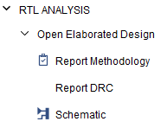
Analysis of an Elaborated Design
Three options available after opening an Elaborated Design
Report DRC
Runs DRC on the design
Report Noise
Checks the SSO on the design based on a XDC file
Schematic
Opens the schematic

Slide 7
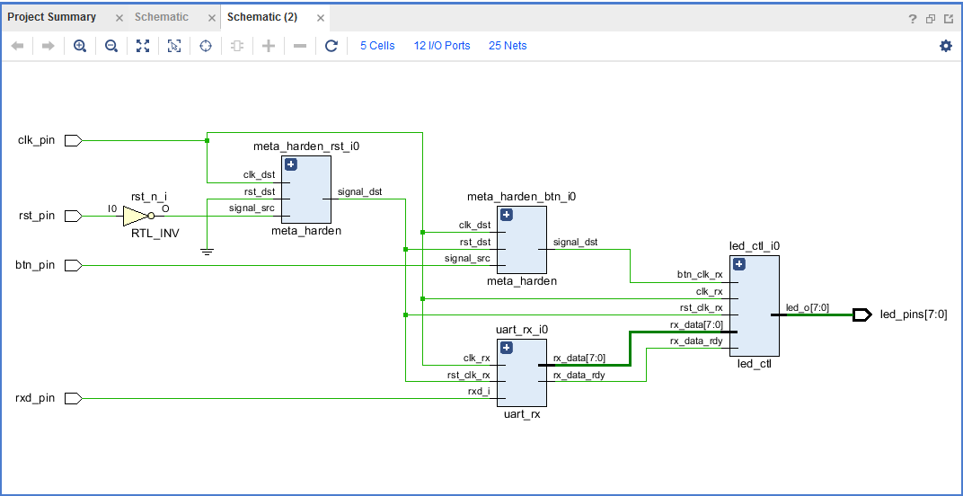
Schematic View of an Elaborated Design
When Schematic is clicked under the Elaborated Design, the schematic is opened showing the hierarchical blocks
Note that no I/O buffers are inferred at this stage
Each block opens up to reveal underlying logic and sub-modules in the hierarchy
Closest representation to the actual coded design

Slide 8
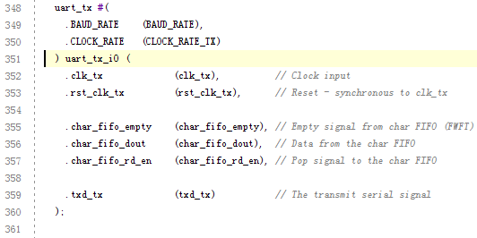
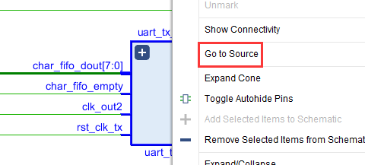
Cross Probing
Select an object in the schematic, right-click, and select Go To Source to view where the object is defined in the source file

Slide 9
Outline
Elaboration
Synthesis
Basic Timing Constraints
Synthesis Reports
Summary

Slide 10
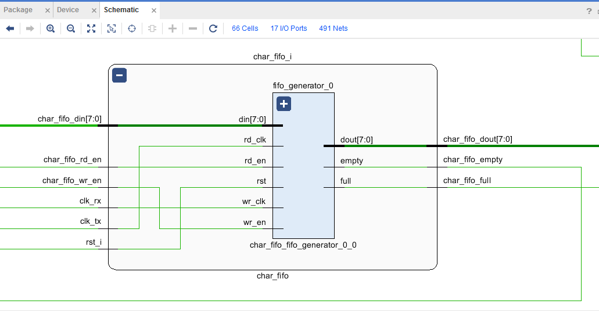
Synthesis: Logic Optimization and Mapping to Device Primitives
Synthesis of an RTL design
Optimizes the gate-level design
Maps the netlist to Xilinx primitives
Sometimes called technology mapping
The figure shows a generic FIFO behavioral component mapped to the dedicated FIFO hardware in a 7-Series FPGA
Notes:
Getting behavioral logic to map to specific primitives may require specific HDL coding techniques or synthesis-specific primitives. Hopefully generic inference is sufficient, but it will depend on the architecture resource and the synthesis tool

Slide 11
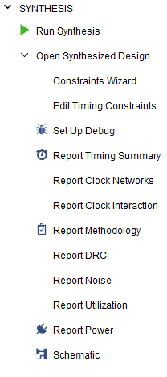
Vivado IDE Synthesis
Applicable only for RTL (HDL) design flows
EDIF is black boxed and linked after synthesis
Synthesis tool uses XDC constraints to drive synthesis optimization
XDC file must exist
Timing constraints considerations
Design must first be synthesized without timing constraints for constraints editor usage
Constraints Wizard is available after synthesis to define rudimentary timing constraints
Synthesis settings provide access to additional options
Note the changes in the Flow Navigator when the synthesized design has been opened
Set Up Debug allows for integration of debug feature

Slide 12

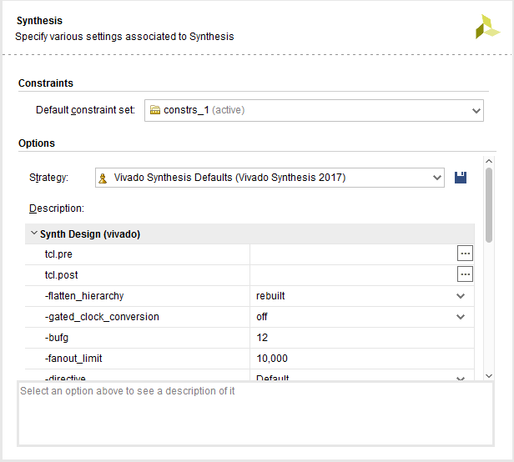
Vivado IDE Synthesis Settings
Synthesis Settings brings up Project Settings dialog box
Central location for all project settings
Select the Default Constraint Set as the active constraint set. Two types of the design constraints
Physical constraints define pin placement, and absolute, or relative, placement of cells such as block RAMs, LUTs, Flip-Flops, and device configuration settings.
Timing constraints, written in industry standard SDC, define the frequency requirements for the design. Without timing constraints, the Vivado Design Suite optimizes the design solely for wire length and placement congestion.
Notes:
Note that with improvements in elaboration, more improvements in synthesis can now be found. All synthesis options can be found under the Synthesis Settings options in the Vivado IDE GUI.

Slide 13
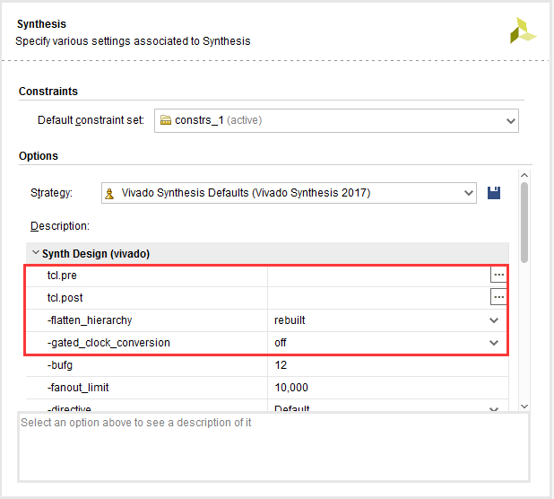
Vivado IDE Synthesis Settings
The tcl.pre and tcl.post options are hooks for Tcl files that run immediately before and after synthesis
flatten_hierarchy: Determines how synthesis controls hierarchy
none: Do not flatten the hierarchy.
Maintains the exact same hierarchy as the original RTL
full: Fully flatten the hierarchy leaving only the top level
rebuilt: Flatten the hierarchy, perform synthesis, and then rebuild the hierarchy based on the original RTL
Allows the QoR benefit of cross-boundary optimizations, with a final hierarchy that is similar to the RTL for ease of analysis
gated_clock_conversion: Turns on and off the synthesis tools ability to convert clock_logic with enables
Notes:
Note that with improvements in elaboration, more improvements in synthesis can now be found. All synthesis options can be found under the Synthesis Settings options in the Vivado IDE GUI.
design_opt = logic trimming (used to be in Map).
synth_opt = logic optimization (fanout control, hierarchy opt, logic optimization, retiming, register balancing).
ower_opt = power optimization switches.

Slide 14
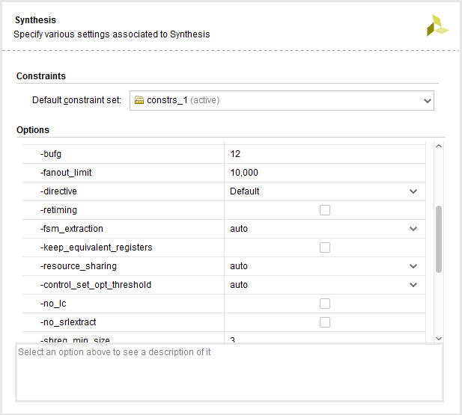
Vivado IDE Synthesis Settings
bufg: Controls how many BUFGs the tool infers in the design
This option is used when other BUFGs in netlists are not visible to the synthesis process
fsm_extraction: Encode the state machine in a specific encoding type: one_hot, sequential, johnson, gray, or auto
keep_equivalent_registers: Prevents registers with the same input logic from being merged
resource_sharing: Sets the sharing of arithmetic operators between different signals
The values are auto, on and off
Notes:
fsm_extraction: Controls how synthesis extracts and maps finite state machines. By default this option is set to off, and the state machine is synthesized as logic. Or you can choose from the following options to encode the state machine in a specific encoding type: one_hot, sequential, johnson, gray, or auto
Note that with improvements in elaboration, more improvements in synthesis can now be found. All synthesis options can be found under the Synthesis Settings options in the Vivado IDE GUI.
design_opt = logic trimming (used to be in Map).
synth_opt = logic optimization (fanout control, hierarchy opt, logic optimization, retiming, register balancing).
ower_opt = power optimization switches.

Slide 15
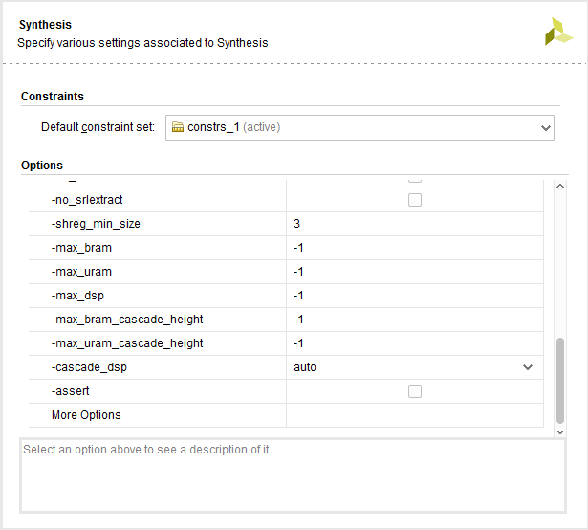
Vivado IDE Synthesis Settings
control_set_opt_threshold: Sets the threshold for clock enable optimization to the lower number of control sets
no_lc: When checked, this option turns off LUT combining
shreg_min_size: Is the threshold for inference of SRLs
This sets the number of sequential elements that would result in the inference of an SRL for fixed delay chains (static SRL)
max_bram: Limits the number of BRAM allowed in the design.
-1 default lets the tool pick as many BRAM as it can, limited by number of BRAMs in device
max_dsp: Similar in concept to max_bram, except this applies to DSPs.
To see explanation of each option, click on the name of each option to highlight it.
Notes:
control_set_opt_threshold: Sets the threshold for clock enable optimization to the lower number of control sets. The default is 1.
The given value is the number of fanouts necessary for the tool to move the control sets into the D logic of a register. If the fanout is higher than the value, the tool attempts to have that signal drive the control_set_pin on that register.

Slide 16
Synthesis RTL Attributes Supported

Slide 17
Synthesis RTL Attributes Supported, cont’d…

Slide 18
Attributes Example in RTL
No support for timing constraints embedded in RTL
Example of KEEP attribute
VHDL
signal sig1 : std_logic;
attribute KEEP : string; attribute KEEP of sig1 : signal is "true";
sig1 <= in1 and in2;
out1 <= sig1 and in3;
Verilog
(* KEEP = "true" *) wire sig1;
assign sig1 = in1 & in2;
assign out1 = sig1 & in3; // without the attribute sig1 will be optimized away if it not // being used anywhere else in the model

Slide 19
Attributes Example in RTL
Attributes do not work with Verilog 2001 module syntax
Does Not Work
module top ((* buffer_type = "none" *) input sys_clock,
input sys_reset,
(* buffer_type = "none" *) input serDataIn,
Works
module top ( sys_clock,
sys_reset,
serDataIn,
…
);
(* buffer_type = "none" *) input sys_clock;
input sys_reset;
(* buffer_type = "none" *) input serDataIn;

Slide 20
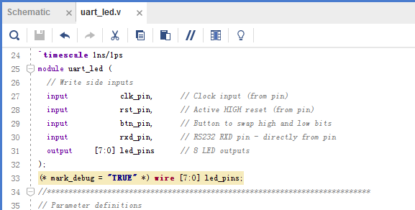
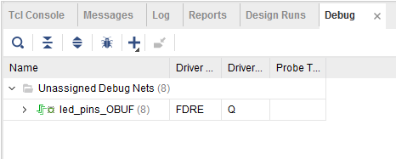
Mark_Debug RTL Attribute
Apply attribute in HDL
MARK_DEBUG support with Vivado synthesis
Tag signals in HDL
Corresponding nets preserved in netlist (DONT_TOUCH behavior)
Tagged nets appear in the logic analyzer Unassigned nets view
XDC and elaborated design netlist support available
You can also mark nets after synthesis
After Synthesis
Notes:
MARK_DEBUG is an attribute designated for tagging signals for debug and it is now supported in Vivado IDE design flows. MARK_DEBUG can be applied in multiple ways depending on needs and design flows.
MARK_DEBUG attributes can be applied in HDL files and synthesized design netlists. Support for placement of MARK_DEBUG attributes in both XDC and elaborated design netlists is available.

Slide 21
Outline
Elaboration
Synthesis
Basic Timing Constraints
Synthesis Reports
Summary

Slide 22
Basic Timing Constraints
There are three basic timing constraints applicable to a sequential machine
Period
Paths between synchronous elements clocked by the reference clock net
Synchronous elements include flip-flops, latches, synchronous RAM, and DSP slices
Use create_clock to create the constraint
Input Delay
Paths between input pin and synchronous elements
Use set_input_delay to create the constraint
Output delay
Paths between synchronous elements and output pin
Use set_output_delay to create the constraint
More about this in the module on Xilinx Design Constraints

Slide 23
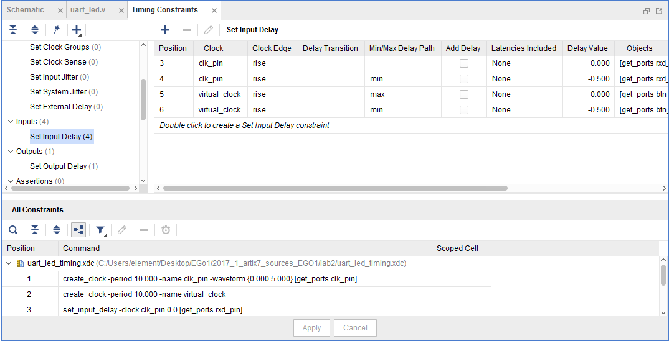
Constraints Viewer
Constraints Viewer allows you to see/edit the timing constraints contents of the XDC file
All timing constraints are supported with the GUI
Right-clicking the constraint in the Create window allows you to modify/delete an existing constraint
Select a different constraint by clicking it in the All Constraints window
To create a different constraint, select the type from the GUI
After constraint entry is completed, constraints must be "saved" to have them stored in the XDC
Changes will be written into the specified Target XDC only

Slide 24
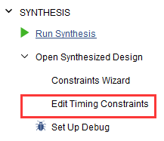
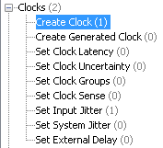
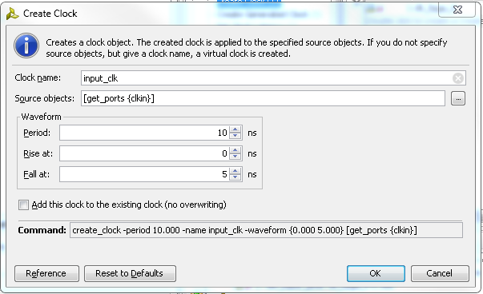
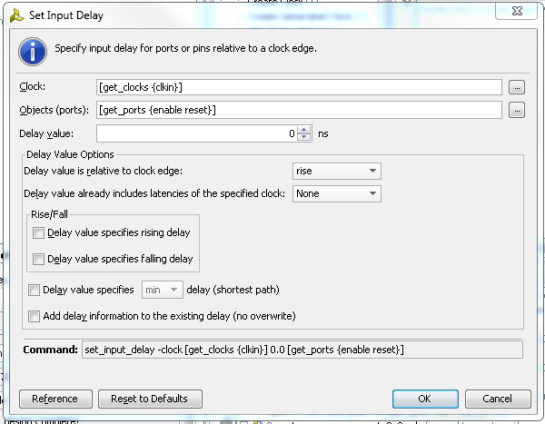
Creating Basic Timing Constraints in Vivado IDE
Run Synthesis
Open the synthesized design
Invoke constraints editor
Notes:
This only works after synthesis. Launch the timing constraints menu by (1) clicking on Edit Timing Constraints, (2) double click on Create Clock. Optionally (but importantly) set the Input Delay by double clicking on the input delay option.

Slide 25
Creating Basic Timing Constraints using Tcl
Period constraint using create_clock
create_clock –period 10 [get_ports clk_pin]
create_clock –period 10 –waveform {0.000 5.000} –name clk [get_ports clk_pin]
set_input_delay
The input delay external to FPGA
set_input_delay –clock clk_pin 2.000 [all_inputs]
set_input_delay –clock clk_pin 3.000 [get_ports in1]
set_input_delay –clock clk_pin 2 [get_ports l_msn* ]
set_output_delay
The output delay external to FPGA
set_output_delay –clock clk_pin -2 [all_output]
set_output_delay –clock [get_clocks clk_pin] -2 [get_ports out1]
Notes:
You need to first create the Period constraint to define a clock and a period (waveform is optional, see second line of constraints in example above).
After that, you can define input/output delays based on the defined period constraints.

Slide 26
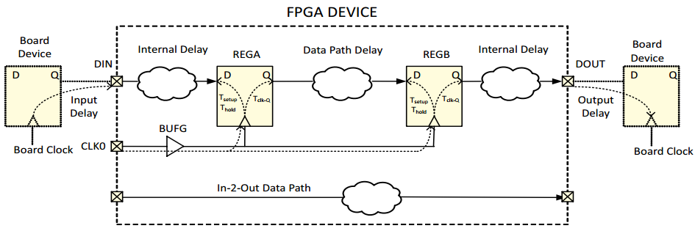
Timing Paths Example

Slide 27
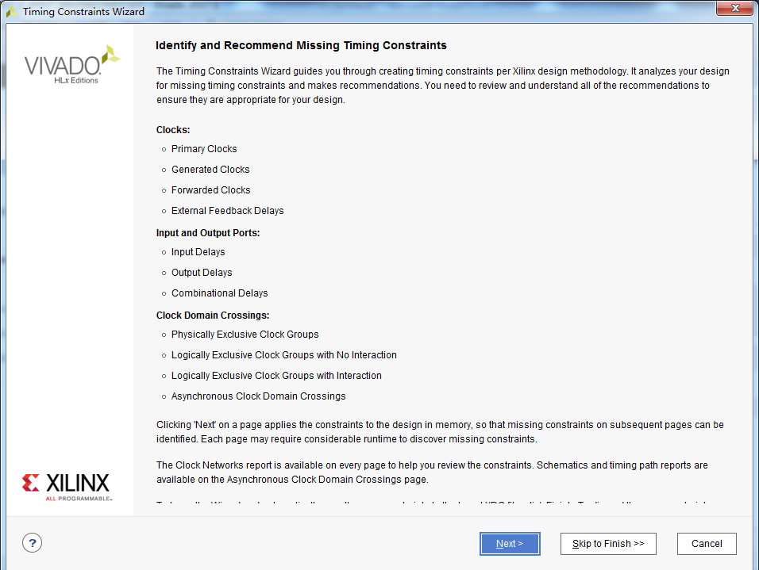
Constraints Wizard
Allows Vivado to suggest timing constraints missing from the design
Recommended flow for an initially unconstrained design
User can ignore the recommended constraints
Option to deselect constraints at every stage of the wizard
Opens the Timing Constraints Editor with recommended constraints
User needs to consciously add the constraints to the target XDC file
A great alternative to using the Timing Constraints Editor in Vivado
User can still use the editor to add constraints
Notes:
You need to first create the Period constraint to define a clock and a period (waveform is optional, see second line of constraints in example above).
After that, you can define input/output delays based on the defined period constraints.

Slide 28
Outline
Elaboration
Synthesis
Basic Timing Constraints
Synthesis Reports
Summary

Slide 29
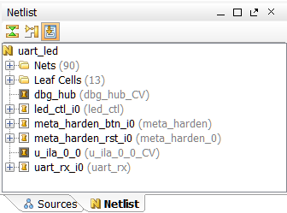
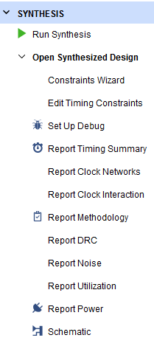
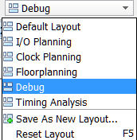
After Synthesis
In the Synthesized Design view:
Sources tab does not change
RTL Netlist tab (Elaborated Design) changes to Netlist (Synthesized Design)
However, the Flow Navigator now includes:
Constraints Wizard, Edit Timing Constraints, Set Up Debug, Report Timing Summary, Report Clock Networks, Report Clock Interaction, Report DRC, Report Noise, Report Utilization, Report Power, Schematic
Views can selected by purpose
All timing information is only an estimate (until implementation has completed)
Setup debug tool

Slide 30
Synthesized Design
Accessed through the Flow Navigator by selecting Open Synthesized Design
Representation of the design after synthesis
Interconnected netlist of hierarchical and BELs
Instances of modules/entities
BELs
LUTs, flip-flops, carry chain elements, wide MUXes
Block RAMs, DSP cells
Clocking elements (BUFG, BUFR, MMCM, …)
I/O elements (IBUF, OBUF, I/O flip-flops)
Object names are the same as names in the elaborated netlist when possible

Slide 31
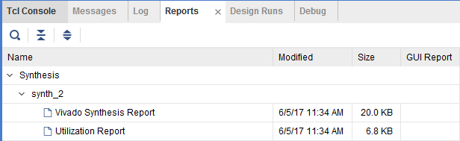
Synthesis Reports
While the Flow Navigator points to the most important reports, the Reports tab contains several other useful reports
Vivado Synthesis Report shows
HDL files synthesized, synthesis progress, timing constraints read, and RTL primitives from the RTL design
Timing optimization goals, technology mapping, removed pins/ports, and final cell usage (technology-mapped cell usage)
Utilization Report shows
Technology-mapped cell usage in an easy-to-read tabular format

Slide 32
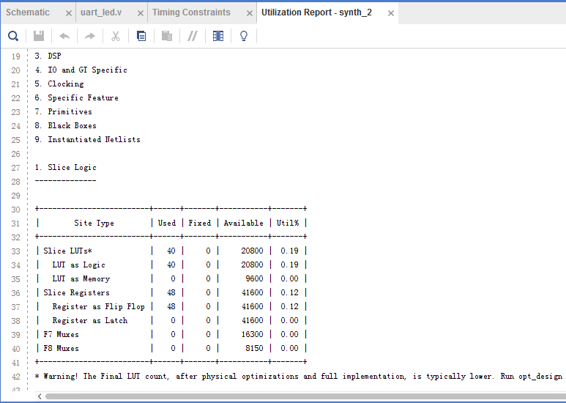
Synthesis Utilization Report
Reports slice logic, memory, DSP slice, IO, clocking, and other resources used by the design

Slide 33
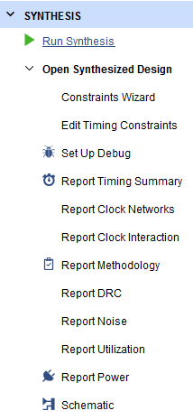
Commands Available After Synthesis
Flow Navigator is optimized to provide quick access to the options most frequently used after synthesis
Constraints Wizard: Already mentioned
Edit Timing Constraints: Launch the timing constraints tab
Set Up Debug: Launch the view for marking nets for debug
Report Timing Summary: Generate a default timing report
Report Clock Networks: Generates a clock tree for the design
Report Clock Interaction: Verifies constraint coverage on paths between clock domains
Report DRC: Performs design rule check on the entire design
Report Noise: Performs an SSO analysis of output and bidirectional pins in the design
Report Utilization: Generates a graphical version of the Utilization Report
Report Power: Detailed power analysis reports
Schematic: Opens the Schematic viewer

Slide 34
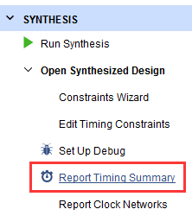
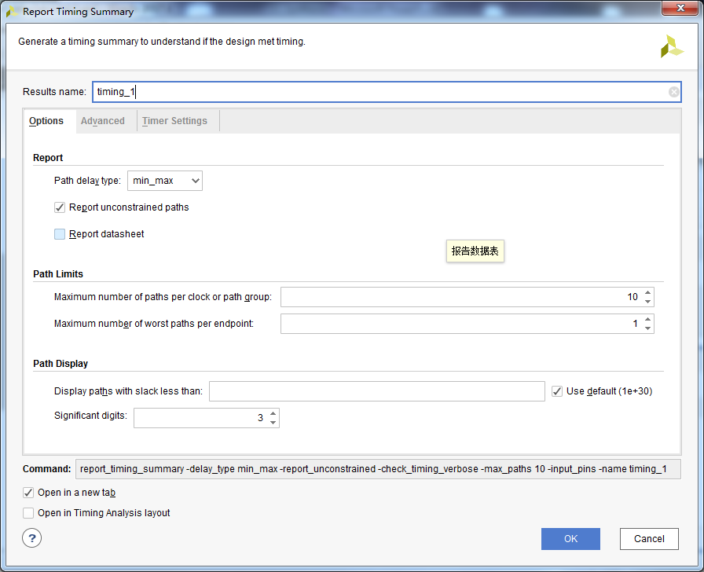
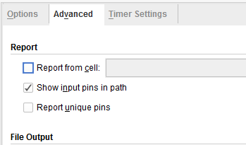
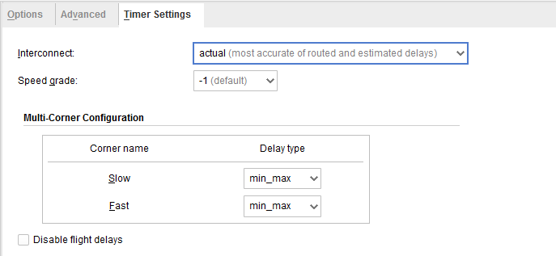
Report Timing Summary
Vivado IDE
Options tab
Maximum number of paths
Advanced tab
Write to a file
Timer Settings
Interconnect delay can be ignored
Flight delays can be disabled
Tcl command: report_timing_summary
report_timing_summary -delay_type max -report_unconstrained -check_timing_verbose -max_paths 10 -input_pins -name timing_1

Slide 35
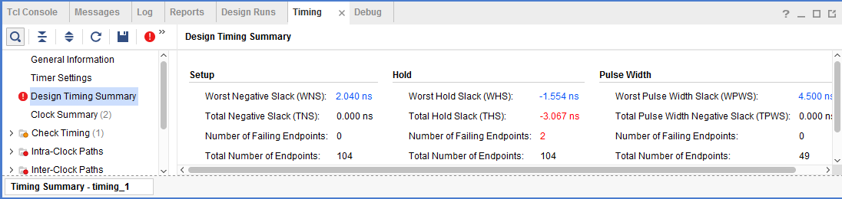
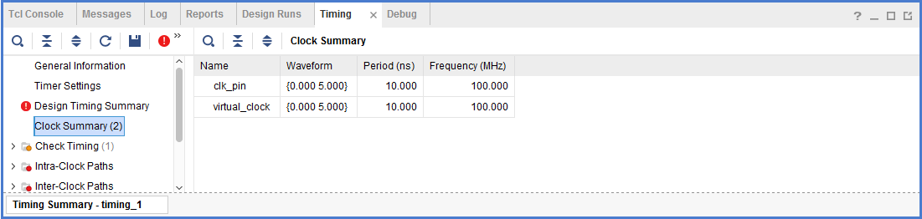
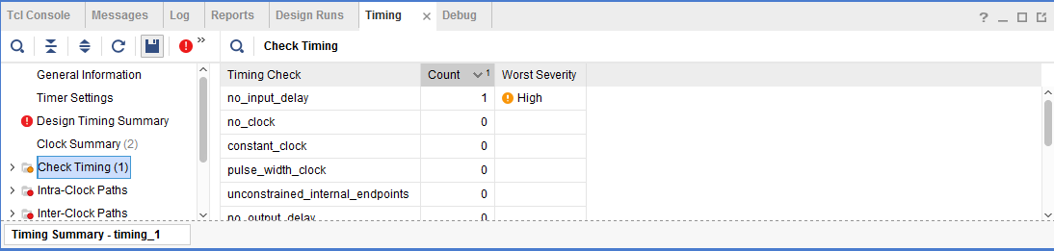
Report Timing Summary
Design Timing Summary
WNS, TNS, total number of endpoints are of interest
Clock Summary
Primary and derived clocks
Check Timing
Number of unconstrained internal endpoints

Slide 36
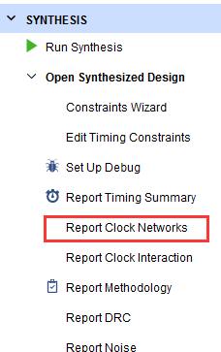
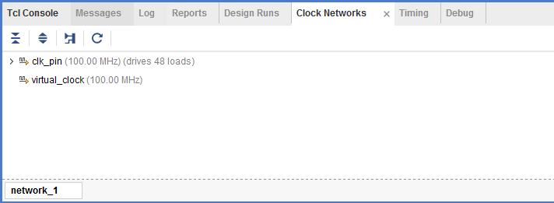
Report Clock Networks
To generate a report on the clock networks in a design, use the tcl command
report_clock_networks
Creates a tree view of all the logical clock trees found in the design, annotated with existing and missing clock definitions on the roots of these trees
Vivado IDE

Slide 37
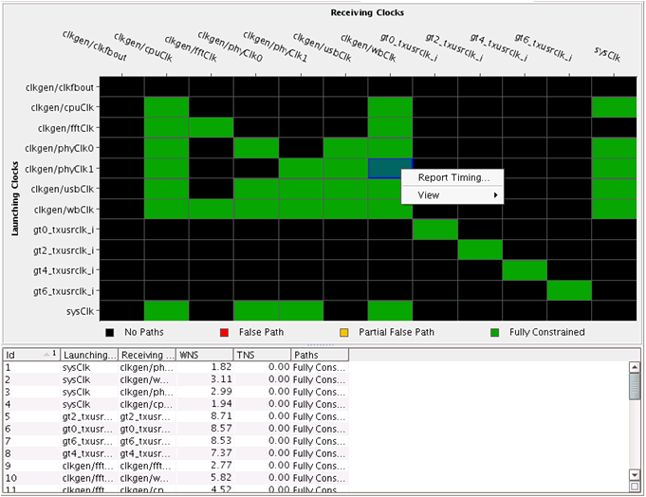
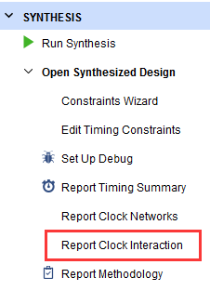
Report Clock Interaction
Use Tcl command
report_clock_interaction -significant_digits 3 -name timing_1
Reports paths on inter-clock domain paths and unclocked registers
Uses an inter-clock path matrix to show clock relationships and group paths
Tells if timing is asynchronous and if paths are constrained (green)
Uses the worst-slack value for each clock grouping

Slide 38
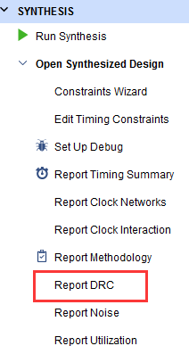
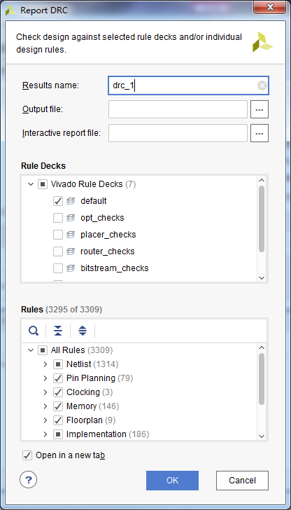
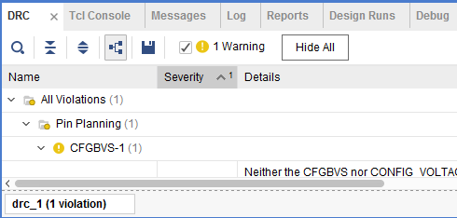
Report DRC
Use Tcl command
report_drc -name drc_1
DRCs performed early in the design flow allow for correction before a full implementation
Objects listed in violations are cross-selectable with HDL sources
Can select which DRCs to run, or run all
This check is more thorough than the I/O DRC checks that occur during pin planning
Any problems will open a DRC window at the bottom of the GUI
Run implementation for the final sign-off DRC
Vivado IDE

Slide 39
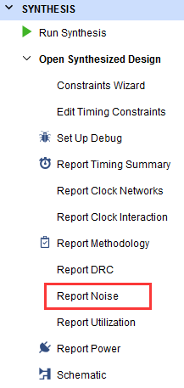
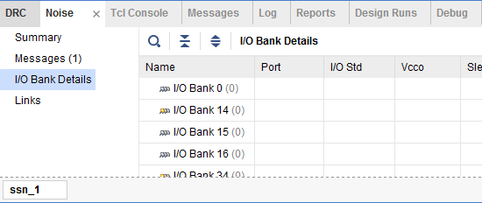
Report Noise
Use Tcl command
report_ssn -name ssn_1
Performs a SSN analysis of the planned I/O layout
This report is looking to gauge the number of pins, I/O standard, and drive strength on a bank-by-bank basis
Banks that exceed what is recommended will be flagged in the Summary tab
SSN analysis can only be done on output and bidirectional ports
Vivado IDE

Slide 40
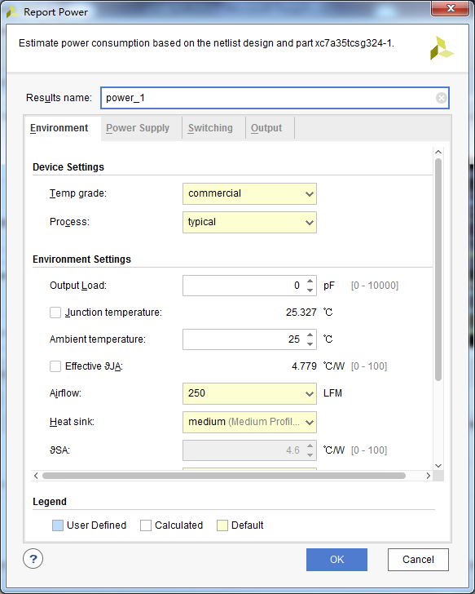
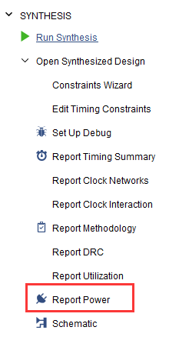
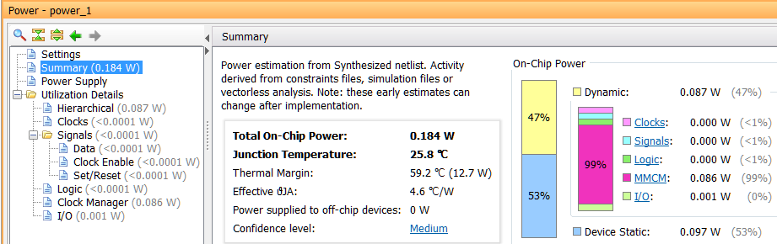
Report Power
Use Tcl command
report_power -results {power_1}
Accurate power and thermal analysis
Power estimates at every stage after synthesis
Perform what-if analysis by varying switching activity
Extensive debug capabilities through cross-probing
Exports data to XPE

Slide 41
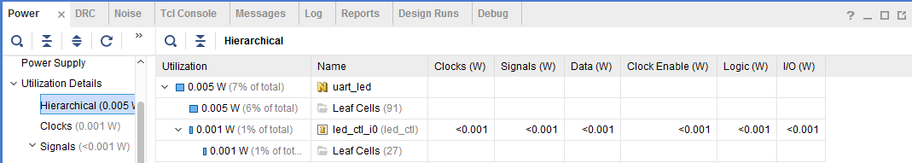
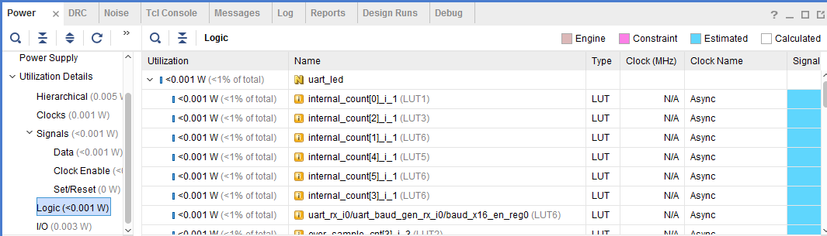
Power Utilization Details
Select different resource types to see more details

Slide 42
Outline
Elaboration
Synthesis
Basic Timing Constraints
Synthesis Reports
Summary

Slide 43
Summary
Elaborated design allows early drc checks, noise analysis, and cross-probing between the source file and the generated hierarchical design
Synthesis performs logic optimization and technology mapping to Xilinx primitives
Vivado IDE supports VHDL, Verilog, and SystemVerilog
Vivado IDE supports the use of Xilinx Design Constraint (XDC) syntax, which is used to drive synthesis design optimization
check_timing report is used to verify that a design has been sufficiently constrained by the designer
Vivado IDE includes numerous reporting mechanisms for the designer to improve performance, avoid common design mistakes, and get the most out of the FPGA

