Slide 1
Implementation and STA
Artix-7
Vivado 2017.1 Version
Notes:
Implementation takes a netlist and maps it into the physical array of a Xilinx device.

Slide 2
Objectives
After completing this module, you will be able to:
Implement a design to completion
Generate useful implementation reports
Describe static timing analysis and static timing paths
Describe setup and hold checks
Understand the relationship between clocks and setup and hold checks
Generate a custom timing report to perform basic static timing analysis
Use the timing summary report to verify your timing constraints were met
Generate a bitstream and verify the functionality in hardware

Slide 3
Outline
Implementation
Reports
Basic Static Timing Analysis
Bitstream Generation and Verification in Hardware
Summary

Slide 4
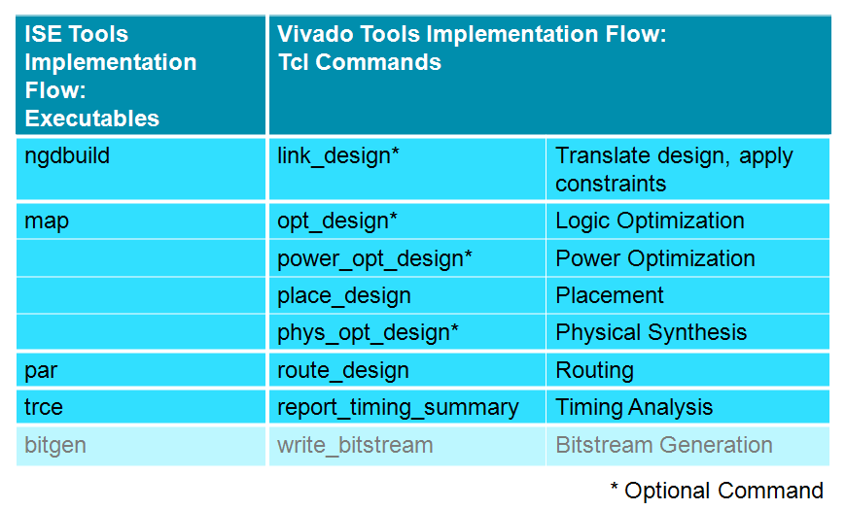
Implementation: ISE vs. Vivado
Notes:
This table highlights the differences between implementation commands/operations in Vivado and ISE.
As we can see, Vivado breaks the implementation flow down into more operations than ISE.

Slide 5
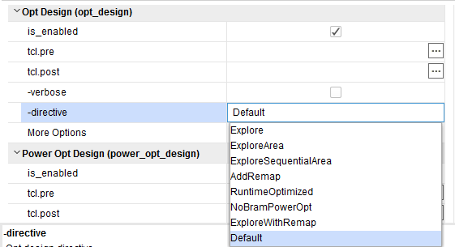
opt_design: Logic Optimization
Ensures optimal netlist for placement
Further logic optimization on fully-assembled netlist built from synthesized RTL, IP blocks
Performs logic trimming on incoming netlist
Constant propagation – remove unnecessary static logic
LUT equation remapping
Optional in non-project batch flow (but recommended)
Example: needed to trim unused bank cells in MIG IP (phaser/iodelay/….)
Automatically enabled in the project-based flow
Notes:
Because this is the first view of the assembled design (RTL and IP blocks), the design can usually be further optimized. The opt_design command is the next step and performs logic trimming, removing cells with no loads, propagating constant inputs, and combining LUTs for example LUTs in series that can be combined into fewer LUTs.
Constant propagation: Propagates constant values through logic which results in:
Obsolete logic – example: a logic AND with a logic 0 input
Reduced logic – example: a 3-input OR with a logic 1 input reduced to a 2-input OR
Redundant logic – example: a 2-input OR with a logic 1 input is reduced to a wire
Remap: Combines multiple LUTs into a single LUT to reduce the depth of the logic.

Slide 6
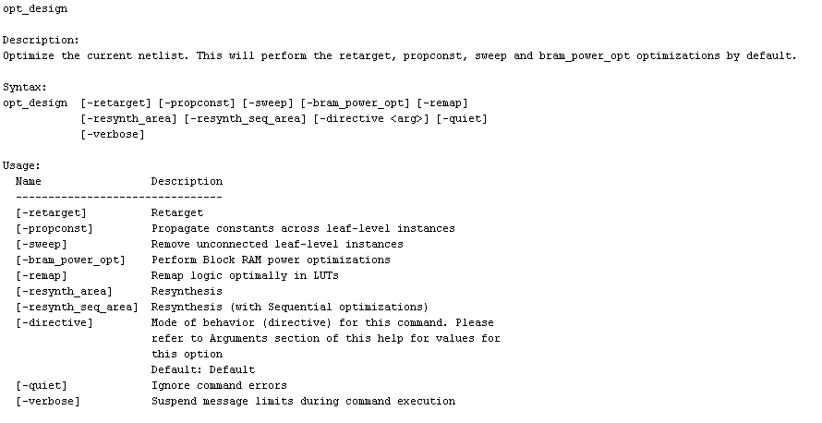
opt_design Options
Non-project batch flow
Can specify which optimizations to perform from a script
Notes:
Optimizes a design netlist for the target part. Optimization can provide improvements to synthesized netlists from third-party tools, or for netlists that may not have been optimized during synthesis.
Run this command prior to implementation to optimize the design and simplify the netlist before placing and routing the design.
The opt_design command performs the following optimizations by default:
* Retarget
* Constant Propagation
* Sweep
* Block RAM Power optimizations

Slide 7
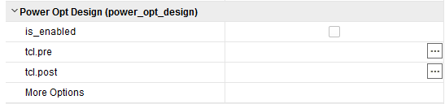
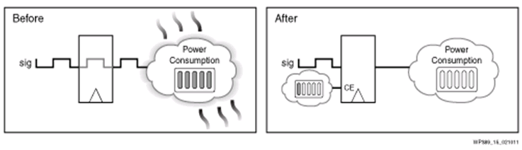
power_opt: Power Optimization
Power optimization includes a fine-grained clock gating solution that can reduce dynamic power by up to 30%
Intelligent clock gating optimizations are automatically performed on the entire design and will generate no changes to the existing logic or clocks
Algorithm performs analysis on all portions of the design
Legacy and third-party IP blocks

Slide 8
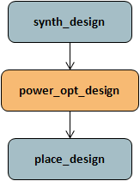
Power Optimization Commands
Automatic power reduction
Automatically turns off unused portions of the design
Does not require deep system level knowledge
Vivado IDE provides optimization control at global and object level
Global command for optimizing the design: power_opt_design
Local level control through SDC command: set_power_opt
Instance level: Include/exclude instances for power opt
Clock domain: Optimize instances clocked by the specified clock
Cell-type level: Block RAM, registers, SRL

Slide 9
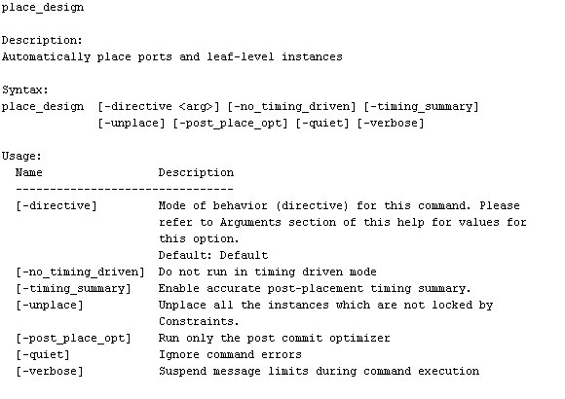
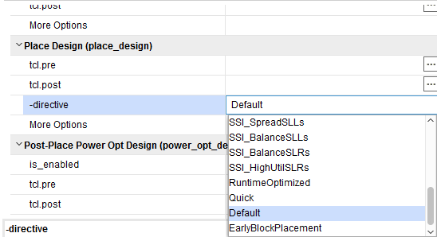
place_design: placer
Project-based flow
Included in implementation stage
Non-project batch flow
place_design
Can use an input XDEF as a starting point for placement

Slide 10
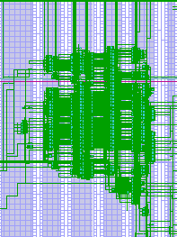
Placement
Phases of a complete placement
Pre-placement DRC
Check for unroutable connections, valid physical constraints, overutilization
Placement
I/O and clock placement
Macro and primitive placement
Timing-driven and wire length-driven
Congestion-aware
Detailed placement
Refine locations of small "shapes," flip-flops, LUTs
Commit to location sites – pack into slices
Post-commit optimizations
Notes:
The next step after logic optimization is placement. These are the major phases of a full placement. For global placement, the placer builds shapes ahead of time.
Placement is not clock skew aware. Skew is included with timing, but it does not target the skew as being too large and optimize placement to minimize clock skew. But it does include skew with the timing information used during placement.
The tools spend a lot more time trying to meet a hold violation because design will not run if there is a hold violation.

Slide 11
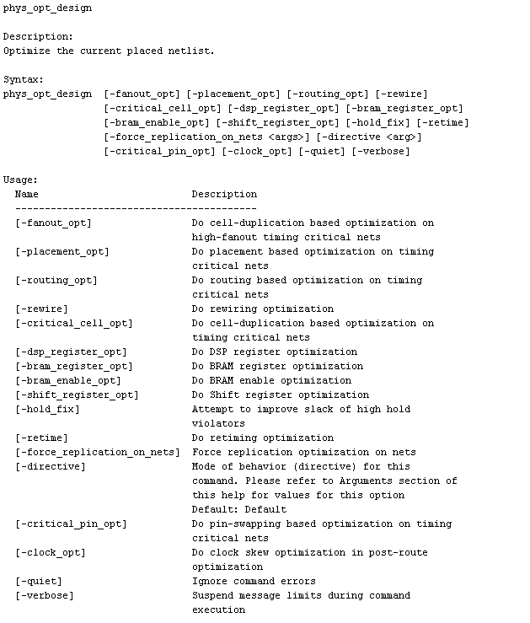
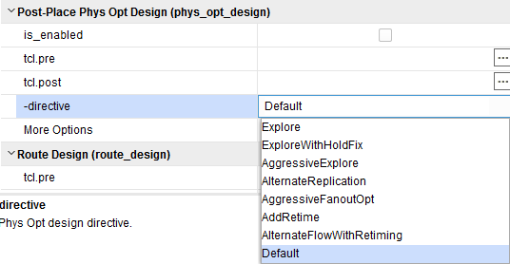
phys_opt_design: Physical Synthesis
Post-placement timing-driven optimization
Replicates and places drivers of high fanout nets with negative slack
Replication only performed if it improves timing
Slack must be within critical range
Approximately 10% of worst negative slack (WNS)
Available in all flows and can be de-activated in the GUI
phys_opt_design
Run between place_design and route_design

Slide 12
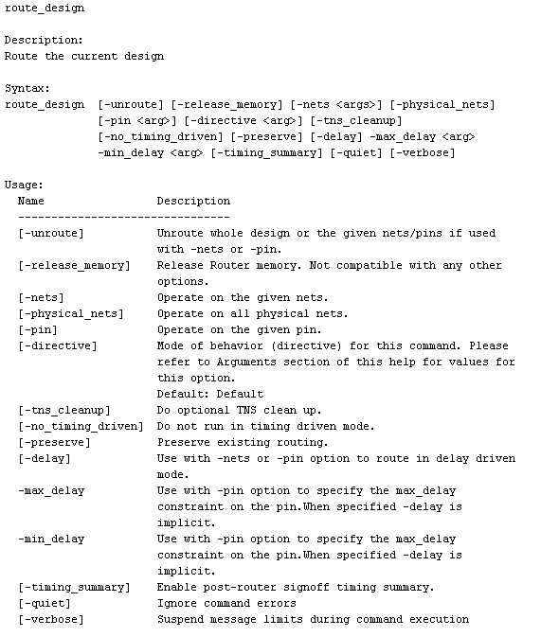
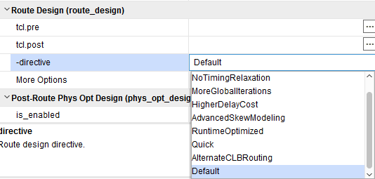
route_design: Router
Project-based flow
Included in implementation stage
Non-project batch flow
route_design
Router reporting
report_route_status command
Check route status of individual nets
Fully routed: lists routing resources
Failed routes

Slide 13
Router
Phases of a complete route
Special net and clock routing
Timing-driven routing
Prioritized by setup/hold path criticality
Swap LUT inputs pin to improve critical paths
Fix reasonable hold time violations
Two modes
Normal (default): Router starts with a placed design and attempts to route all nets
Re-Entrant (non-project batch only): Router can route/unroute as well as lock/unlock specific nets
Notes:
The router can start with either a placed, unrouted design or a routed design with some or all nets routed. The router then allows any amount of incremental routing changes. This mode is used to control routing of a subset of nets.

Slide 14
Outline
Implementation
Reports
Basic Static Timing Analysis
Bitstream Generation and Verification in Hardware
Summary

Slide 15
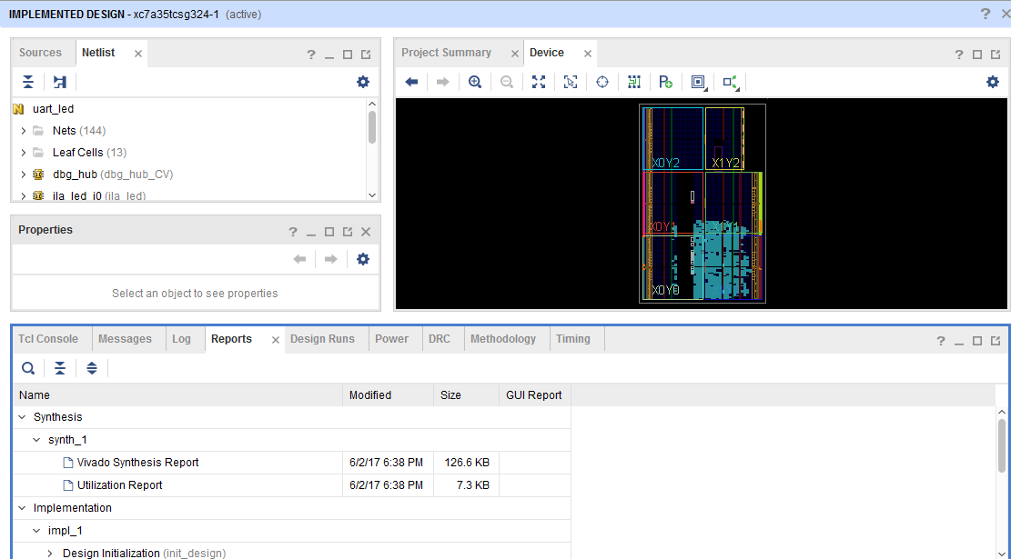
After Implementation
Sources and Netlist tabs do not change
As each resources is selected, it will show the exact placement of the resource on the die
Timing results have to be generated with the Report Timing Summary
As each path is selected, the placement of the logic and its connections is shown in the Device view
This is the cross-probing feature that helps with static timing analysis

Slide 16
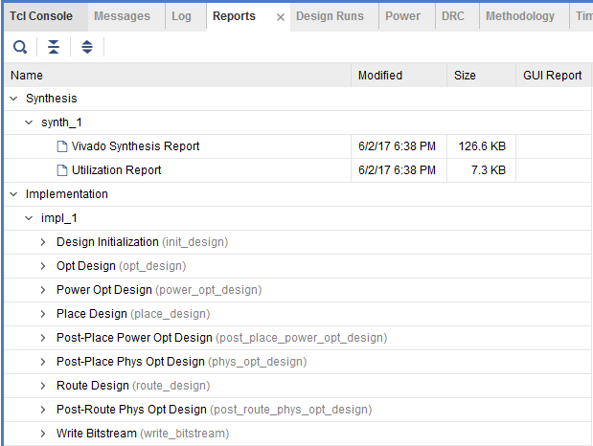
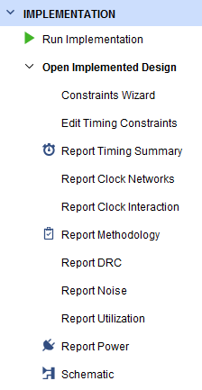
Implementation Reports
While the Flow Navigator points to the most important reports, the Reports tab contains several other useful reports
Post Optimization DRC Report: Lists the I/O DRC checks that were completed
Post Power Optimization DRC Report: Lists the power DRC checks that were completed
Place and Route Log: Describes the implementation process and any issues it encountered
IO Report: Lists the final pinout for your design
Clock Utilization Report: Describes the clock resources used and the clock utilization resource on a region-by-region basis
Utilization Report: Describes the amount of FPGA resources used in a text format
Control Sets Report: describes how your control signals were grouped

Slide 17
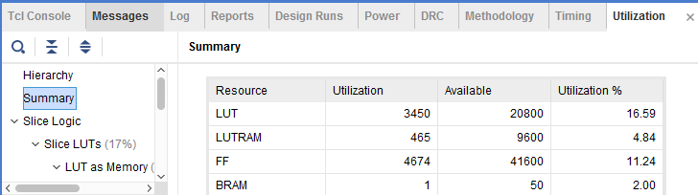
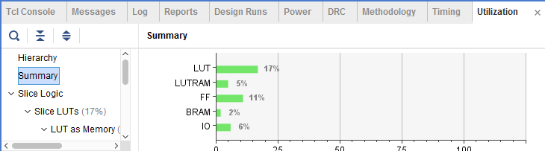
Utilization Reports
Double-click in the Reports tab to view in text form
Click on Report Utilization under Implementation Result in the Flow Navigator pane to view in chart/table format

Slide 18
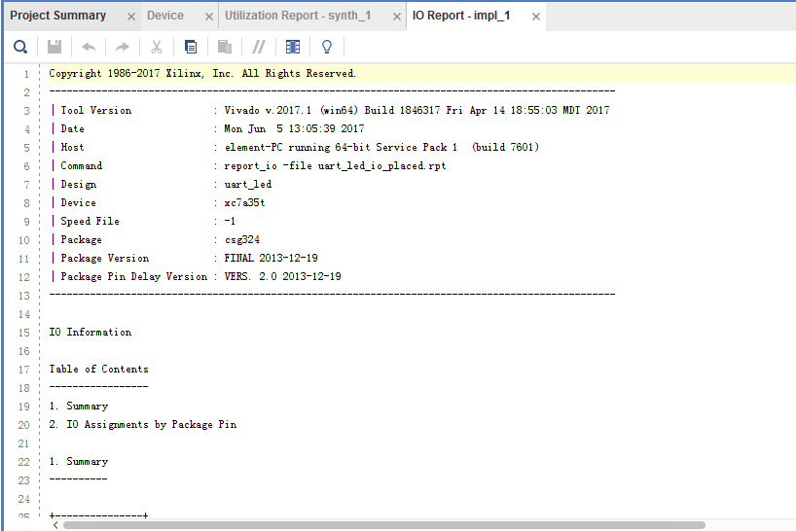
I/O Report
This report provides a table that lists every signal, its attributes, and its final location
It is always important to double-check pin assignments before implementing because the tools can move any pin that is unassigned

Slide 19
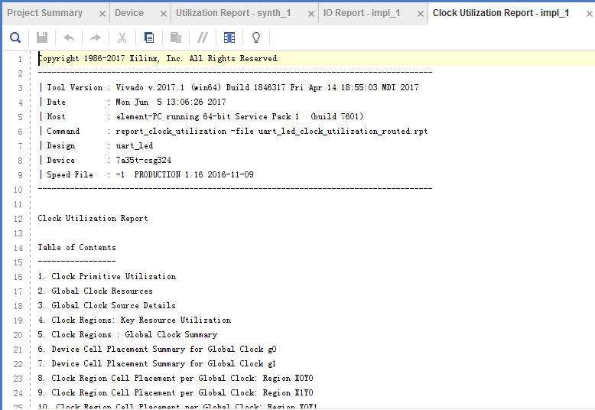
Clock Utilization Report
This report describes the clocking resources used in the design
BUFG, BUFH, BUFHCE, MMCM, and a clock region analysis

Slide 20
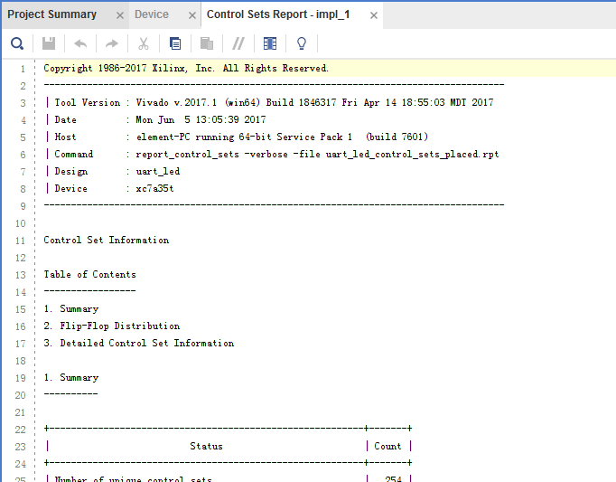
Control Sets Report
This report describes the number of unique control sets in the design (ideally this will be as small as possible)
Number of control sets describes how control signals were grouped
This determines the ability of the tools to reach high device utilization
Number of controls signals in the design is determined by the designer's inference of sets, resets, and clock enable signals
Number of control signals can be reduced if the designer attempts to share controls signals throughout the design as much as possible
Notes:
Control signals include clocks, clock enables, set, and reset signals. How the tools group them into slices and CLBs will dictate the density (efficiency) of the design in the FPGA.
Xilinx recommends using synchronous sets/resets whenever possible and that designers reduce the number of control signals in their design to improve device utilization.

Slide 21
power_opt: Report
report_power_opt command details the gating performed on the design by the power_opt program
Can be run before power optimization to create a report detailing all the user-gated logic in the design for a before and after picture of your design

Slide 22
Outline
Implementation
Reports
Basic Static Timing Analysis
Bitstream Generation and Verification in Hardware
Summary

Slide 23
Static Timing Analysis (STA)
A design is an interconnected set of cells and nets
The functionality of a design is determined by the RTL design sources
The functionality can be verified by a simulation tool
The performance of a device is determined by the delays of the cells that comprise the design
This is verified by static timing analysis
In STA the functionality of the components of the design are not important
Only the performance of the components
Cells need only be classified as combinatorial or sequential

Slide 24
Component Delays
Each component takes time to perform its function
A LUT has propagation delay from its inputs to its outputs
A net has propagation delay from the driver to the receiver(s)
A flip-flop requires stable data for a required time around its sample point
These delays are dependent on a several factors
Some are determined by the composition of the FPGA and the implementation of the design
The physical characteristics of the element (how it is constructed)
The location of the object (where it is placed with respect to other objects)
Some are determined by environmental factors (PVT)
The process variation of the device
The voltage applied to the cells
The temperature of the cells

Slide 25
Delays
Component and net delays are provided by Xilinx, and are extracted by careful characterization of production devices
Timing is extracted over the allowed operating range of the device
Process is within a specific range
Different ranges are used for different speed grades (-1, -2, -3)
Voltage is between the minimum and maximum allowed for the device
Different speed grades may allow different voltages (i.e. -1L)
Temperature is between the maximum and minimum specified
Commercial and industrial parts allow different temperature ranges
These characterized delays may be extracted at various process corners
Fastest PVT, slowest PVT
The characterized delays at the appropriate corner are used by the tools during STA

Slide 26
Why Do We Need STA?
Many of the processes in FPGA implementation are timing driven
Synthesis for circuit construction
Placer for optimal cell locations
Router for choosing routing elements
Tools must have constraints to determine the desired performance goals
STA is used during the processes, and afterwards for generating reports
Ultimately, STA determines if a design will provide the desired performance

Slide 27
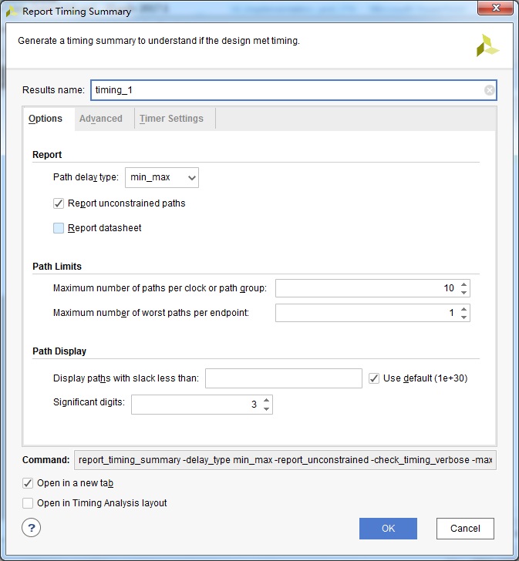
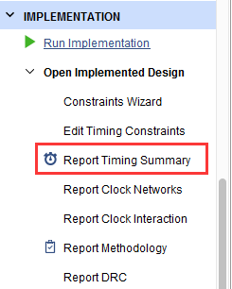
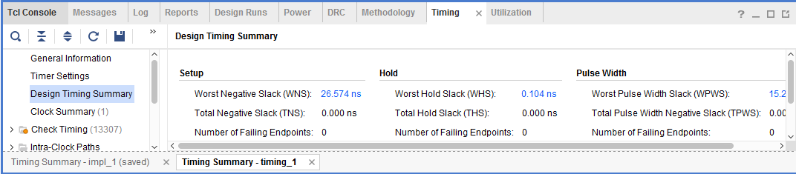
report_timing_summary: Timing Report Summary
Timing reports with true timing information can be generated from the Flow Navigator after implementation has been completed

Slide 28
Timing Summary
Summary reports Setup, Hold, and Pulse Width related results
Setup
Worst Negative Slack (WNS): The worst slack of all the timing paths for max delay analysis. It can be positive or negative; positive means no violation
Total Negative Slack (TNS): The sum of all WNS violations, when considering only the worst violation of each timing path endpoint- 0ns when all timing constraints are met, Negative when there are some violations
Number of Failing Endpoints: The total number of endpoints with a violation (WNS<0ns)
Hold
Worst Hold Slack (WHS): Corresponds to the worst slack of all the timing paths for min delay analysis. It can be positive or negative
Pulse Width
Worst Pulse Width Slack (WPWS): Corresponds to the worst slack of all the timing checks listed above when using both min and max delays

Slide 29
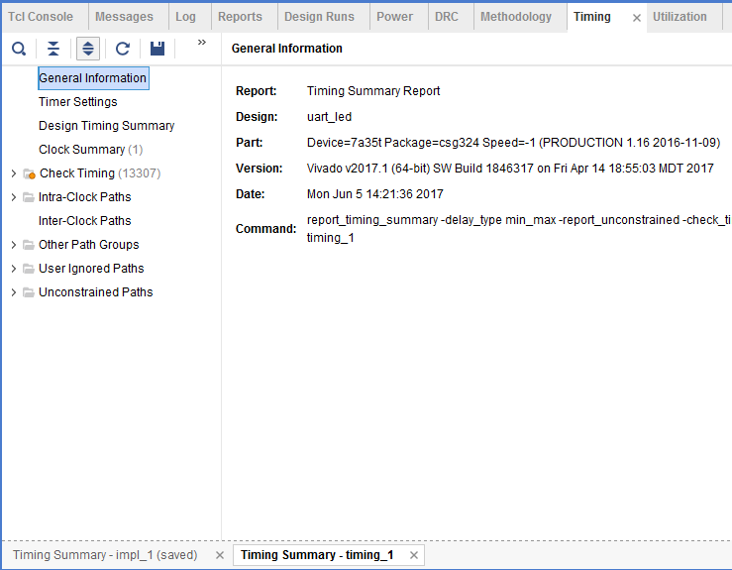
The Timing Summary Table
The Timing Summary table shows
General Information provides design name, device, package, speed grades etc.
Timer Settings provides timing analysis engine settings
Design Timing Summary provides a summary of all the timing reports
Clock Summary includes information similar to that produced by report_clocks
Check Timing includes information about missing timing constraints or paths with constraints issues that need to be reviewed
Intra-Clock Paths includes summary of the worst slack and total violations of the timing paths with the same source and destination clocks
Inter-Clock Paths includes summary of the worst slack and total violations of timing paths with different source and destination clocks
Other Path Groups displays paths not covered above, including user-defined path groups
User Ignored Paths are paths that are ignored during timing analysis
Unconstrained Paths contain paths that were not covered by the XDC constraints
Violations are displayed in red

Slide 30
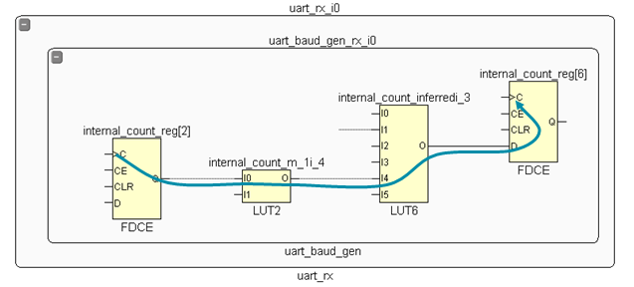
Static Timing Paths
A static timing path is a path that
Starts at a clocked element
Propagates through any number of combinatorial elements and the nets that interconnect them
Ends at a clocked element
Clocked elements include flip-flops, block RAMs, DSP cells, …
Combinatorial elements include LUTs, wide MUXes, carry chains, …

Slide 31
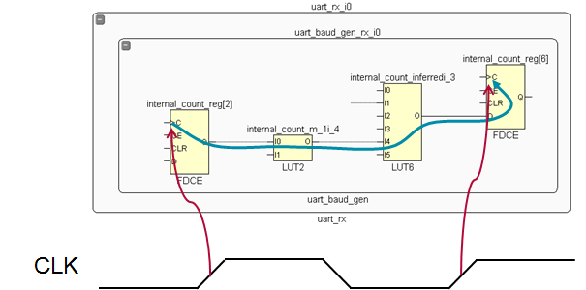
Setup Check
Checks that a change in a clocked element has time to propagate to other clocked elements before the next clock event
That is, from the rising edge of the clock to the next rising edge of the clock
Checked for all static timing paths

Slide 32
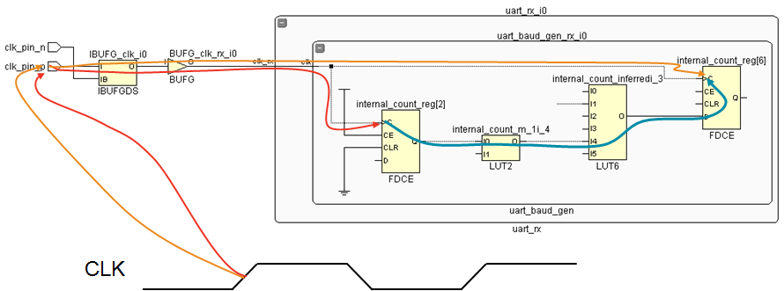
Hold Check
Checks that a change in a clocked element caused by a clock event does not propagate to a destination clocked element before the same clock event arrives at the destination element
Usually from the rising edge of the clock to the same edge of the clock
Checked for all static timing paths
The shortest delay is used for Source Clock and Data Path Delay, and the longest delay is used for Destination Clock Delay

Slide 33
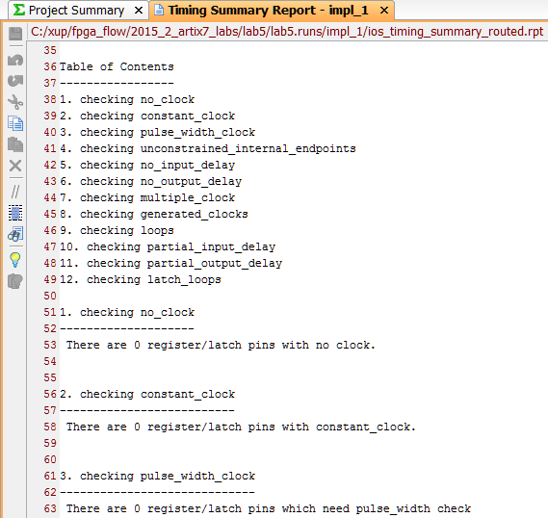
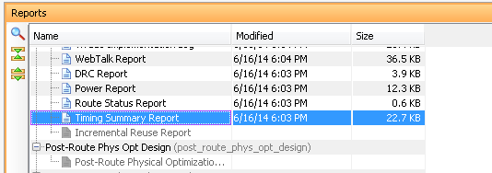
report_timing_summary: TRCE Like Report
report_timing_summary command produces a comprehensive TRCE-like timing report
This report contains these sections
Timer Settings
check_timing report
Design Timing Summary
Clock Definitions
Intra Clock table
Inter Clock table
Path Group table

Slide 34
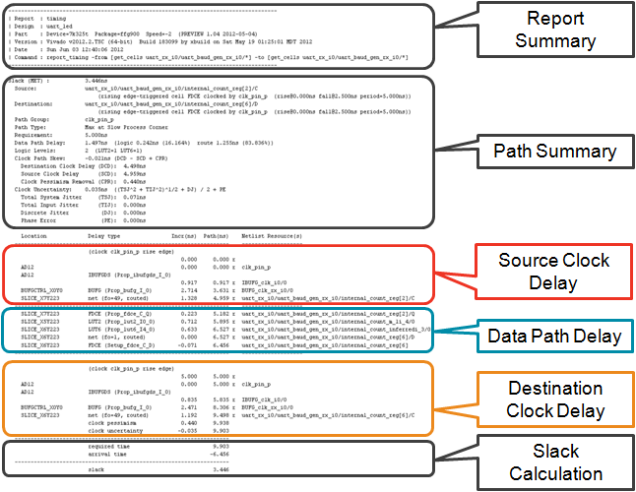
Anatomy of Timing Report

Slide 35
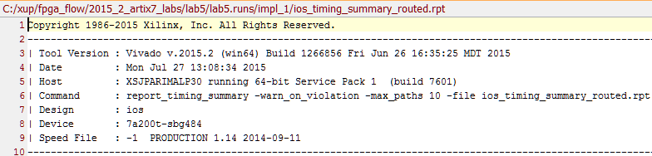
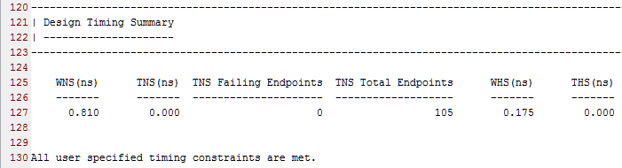
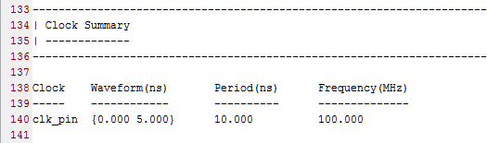
Report Sections
Report summary
Design timing summary
Clock summary

Slide 36
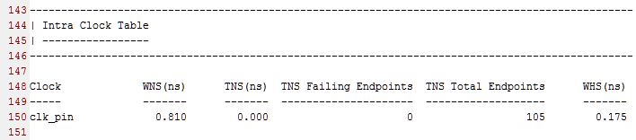
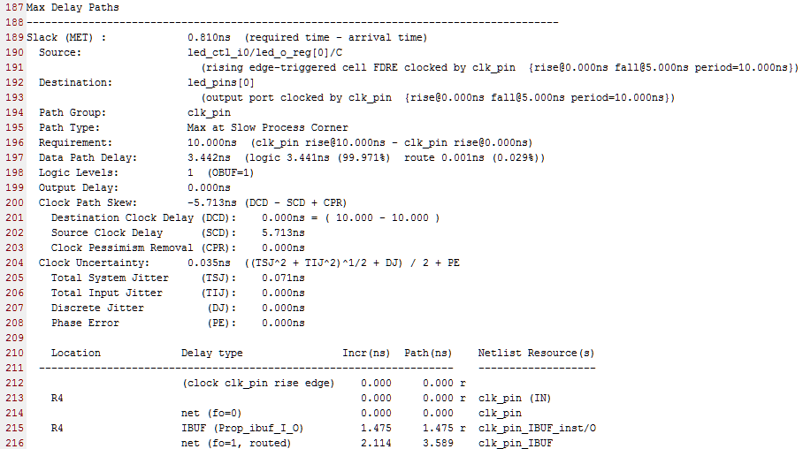
Report Sections
Intra clock table
Maximum delay path

Slide 37
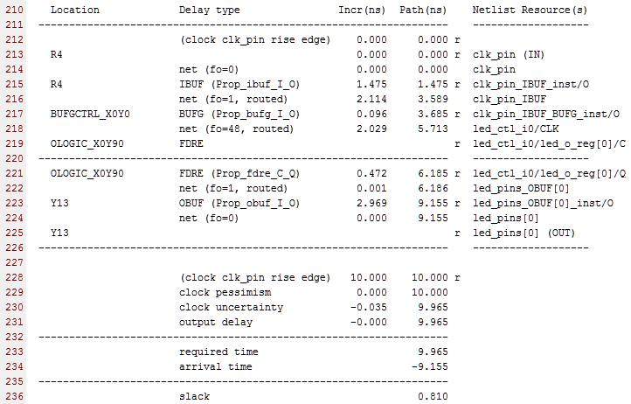
Report Sections
Delay path

Slide 38
Outline
Implementation
Reports
Basic Static Timing Analysis
Bitstream Generation and Verification in Hardware
Summary

Slide 39

Bitstream Generation
Generates bitstream for the device chosen for the current project
Runs on an implemented design
Uses the pull model to regenerate implemented design if design is out of date
Project-based flow
IDE: Generate bitstream
Tcl: launch_runs impl_1 -to_step write_bitstream

Slide 40
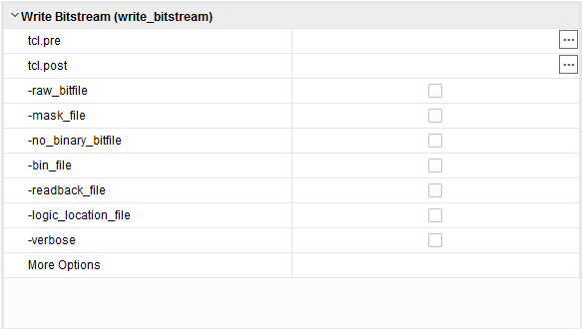
Bitstream Generation Settings
By default binary bitstream format is used
-raw_bitfile: Causes write_bitstream to write a raw bit file (.rbt) containing the same information in ASCII format
-mask_file: Generates a mask file that masks out dynamic bits in the device fabric
-no_binary_bitfile: Do not write the binary bitstream file (.bit)
Use this command to generate the ASCII bitstream or mask file, or to generate a bitstream report, without generating the binary bitstream file
-bin_file: Creates a binary file (.bin) containing only device programming data, without the header information
-logic_location_file: Generates a (.ll) file that contains the location of LUTs, BRAM, flip-flops, latches, I/O block inputs and outputs

Slide 41
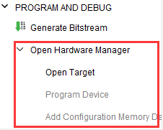
Hardware Manager
The steps to connect to hardware and programing the target FPGA device
Open a hardware manager
Uses Target Communication Framework (TCF) Agent, hw_server
Open a hardware target that is managed by a hardware server running on a host computer
Associate the bitstream data programming file with the appropriate FPGA device
Program or download the programming file into the hardware device
Opens the hardware analyzer view for debugging

Slide 42
Outline
Implementation
Reports
Basic Static Timing Analysis
Bitstream Generation and Verification in Hardware
Summary

Slide 43
Summary
Implementation is made up of the programs link, opt_design, power_opt, place_design, phys_opt_design, and route_design
There are several implementation reports available to help designers better manage their FPGA designs
Static timing paths start at clocked elements and end at clocked elements
Static timing paths are analyzed for setup and hold violations at both fastest and slowest process corners
Setup and hold checks include the analysis of the clock propagation paths
report_timing_summary is used as post-implementation sign-off
report_timing is used for interactive and detailed timing analysis after synthesis or implementation

