Slide 1
IP Integrator and IP Catalog
Artix-7
Vivado 2017.1 Version

Slide 2
Objectives
After completing this module, you will be able to:
Achieve greater design productivity using Vivado IP Integrator
Rapidly create and reuse subsystem level IP with Vivado and IP Integrator
Describe the IP Packager features
Differentiate between the free and evaluation base IP available in IP Catalog
Use the Clocking Wizard to configure and add clocking resources to the design

Slide 3
Outline
IP Integrator
IP Packager
IP Catalog
Clocking Wizard
Summary

Slide 4
Challenges of Designing with Complex IP
Modern IP contains multiple complex interfaces
Many signals, complex port mappings in RTL
Connectivity in overall design not apparent
Modern IP is highly parameterizable
Designer must maintain consistency between interconnected IP blocks
Designer must understand interactions between blocks
Subsystems containing multiple IP blocks are often difficult to capture and reuse
How to best capture IP for reuse
To help designers be more productive when integrating IP, Xilinx introduced the IP Integrator in the Vivado Design Suite

Slide 5

What is IP Integrator?
A hierarchical IP integration tool for processor based and non-processor based systems
A graphical and scriptable IP configuration and connection environment
Integrated Design Environment
IP Packager
IP Integrator
IP Repository
IP Usage
Extensible IP Catalog
IP Management and Delivery

Slide 6
Benefits of Vivado IP Integrator
Interface Level Connectivity
Connect complex interfaces between IP in a single step
Users can create custom interface definitions
Integration and Reuse of IP
Rapid creation of complex IP by packaging the contents of a diagram
Automatic Generation of HDL
Instantiates all IP in a diagram and makes all the interconnections
Take advantage of IP metadata
Propagate correct parameters to connected IP
Recognition of unique data types
Processor based system support
Integrated Design Environment
IP Packager
IP Integrator
IP Repository
IP Usage
Extensible IP Catalog
IP Management and Delivery

Slide 7
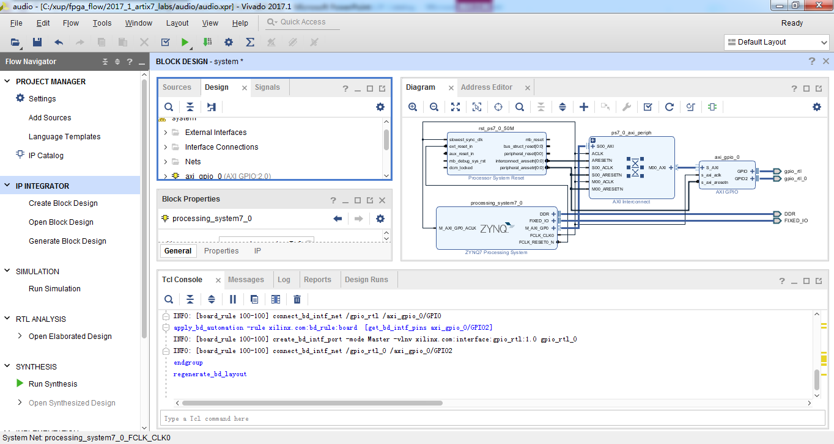
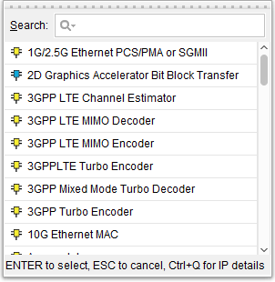
Vivado IP Integrator User Interface
Hierarchy Support
System Hierarchy View
Interface Connections with Live DRCs
TCL Console
Extensible IP Repository
Notes:
Many of the advanced feature of IP Integrator are highlighted here. Beginning in the upper left, all of the IP sources and resulting HDL generated from a diagram are shown in the Vivado sources window. IP Integrator does not generate separate project files, so integration issues are nonexistent.
When making connections between blocks, DRC are run real time. These DRCs show the designer the valid connection possibilities, and do not allow improper connections.
IP Integrator supports arbitrary levels of hierarchy. It is very easy to place a related group of IPs into a new level of hierarchy, and equally easy to break the hierarchy if needed.
A simple right click on a diagram opens the searchable IP Catalog, allowing any IP to be quickly added to a diagram.
Finally, every graphical action has a corresponding Tcl command that is run. The Tcl console updates for each action. A special Tcl command is available that will generate a complete script that can be used to recreate any diagram, including parameter settings on IP.

Slide 8
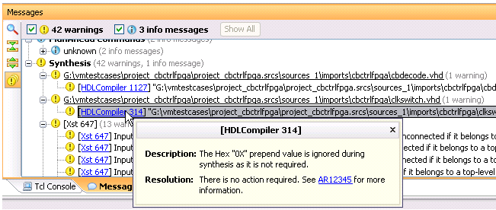
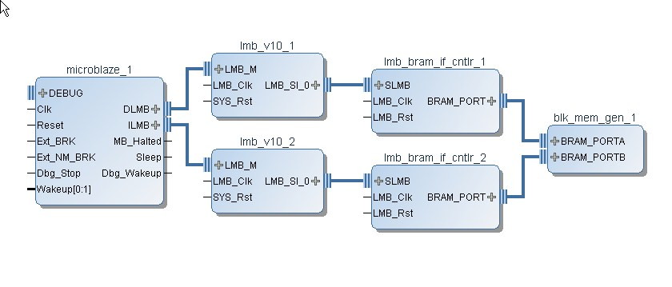
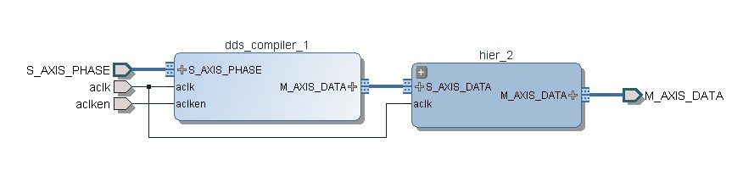
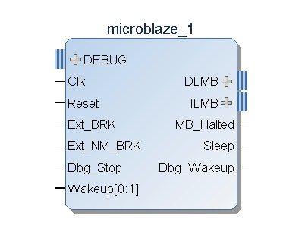
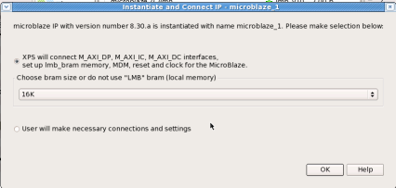

Intelligent IP Integration: Correct by Construction Design
Real-time DRCs
Auto Connection
Apply solution 1
Parameter Propagation
Parameter Resolution
IP0
IP1
IP2
IP0
IP1
AXIS Width Converter
IP2
User specifies width=64
Default width=32
Is updated to
propagated value
Input width=64
after propagation
User specifies
width=64
IP2 only supports
width=32
Notes:
The real time DRCs that run will alert the designer to errors that may exist in a diagram. DRCs can be run at any time to provide feedback. In some cases, IP Integrator can alert the user to a problem and provide an automated means to correct the problem.
Some IP is almost always connected to other IP in a standard way. In this case, IP can contain automation rules that will handle adding and connecting the other IP. An example of this is MicroBlaze. If a MicroBlaze is in a design, there is almost always local BRAM memory, a reset block, possible a DDR memory controller, and common peripherals. When the MicroBlaze is added to a diagram, the user is alerted to the fact that automation rules exist for MicroBlaze. If the user chooses to run the rules, a dialog will open prompting the user to answer some questions, and then IP Integrator will add and connect the other IP.
Parameter propagation is one of the most power features available in IP Integrator. IP can be packaged with specific propagation and design rules, and IP Integrator will run these rules as the diagram is created. For example, IP0 is added to a diagram, and by default, has a 64 bit wide data bus. IP1 is then added and connected, as is IP2. In this case, IP2 has a default databus width of 32 bits. When the parameter propagation rules are run, the user is alerted to the fact that IP2 has a different bus width. Assuming that the data bus width of IP2 can be changed through a change of parameter, IP Integrator can automatically update IP2. This is a simple example, but demonstrates the power of parameter propagation. The types of errors that can be corrected by parameter propagation are often errors not found until simulation.
If an IP does not support changing of a certain parameter, IP Integrator can sometimes resolve the incompatibility using parameter resolution. For example, different bus widths can be fixed by the automatic addition of a bus width converter. Active signal levels can be resolved by auto insertion of inverters.

Slide 9
Outline
IP Integrator
IP Packager
IP Catalog
Clocking Wizard
Summary

Slide 10
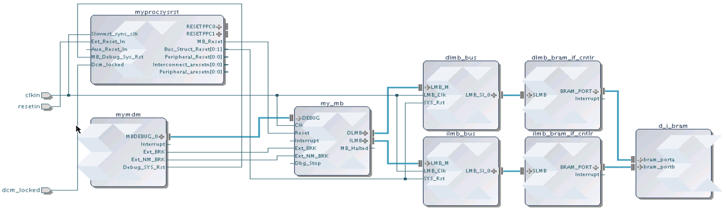
Reusing Your IP
IP from many sources can be packaged and made available in Vivado
All IP available in the Vivado IP Catalog can be used to create IP Integrator designs
Any IP Integrator diagram can be quickly packaged as a single complex IP
Standardized IP-XACT representation
Vivado IP Integrator
IP Catalog
Source (C, RTL, IP, etc)
Simulation Models
IP Packager
Xilinx IP
Documentation
Example Designs
3rd Party IP
Test Bench
User IP
Notes:
Vivado supports reuse of IP is by providing users a means to capture their individual IP or IP subsystems and package that IP, and then make the IP available to other users through the Vivado IP catalog. This approach also benefits third party IP providers, who now have a standard way of providing their IP for both evaluation and purchase, and that IP will be visible through the IP Catalog.
Packaging an IP Integrator diagram takes one Tcl command, or several mouse clicks.

Slide 11
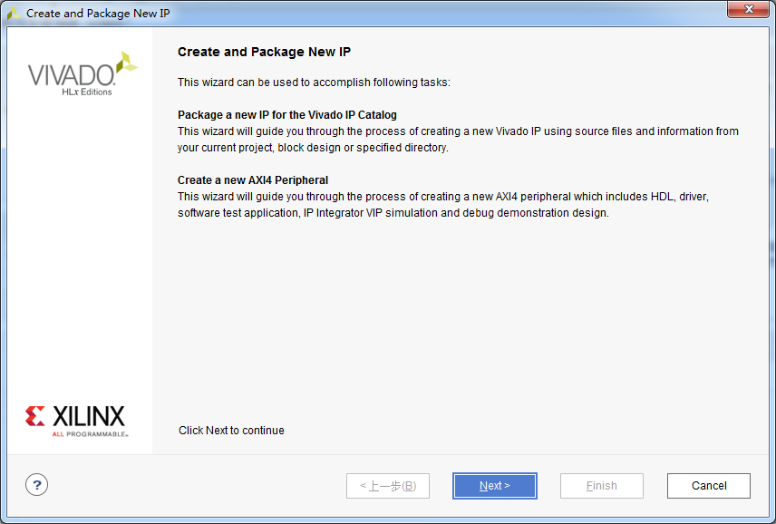
Capture Your IP Using the Vivado IP Packager
Wizard-based flow
Automates generation of IP-XACT IPs
Many pieces of meta-data automatically inferred
Users can add additional meta-data
Notes:
Vivado IP Packager is a powerful wizard built into Vivado that guides the user through the necessary steps of packaging IP. Xilinx uses an industry standard method of capturing IP sources, metadata, constraints, and documentation – that method is commonly called IP –XACT. Users can package HDL source or netlists, and once packaged, add them to repositories that can be visible to other designers.

Slide 12
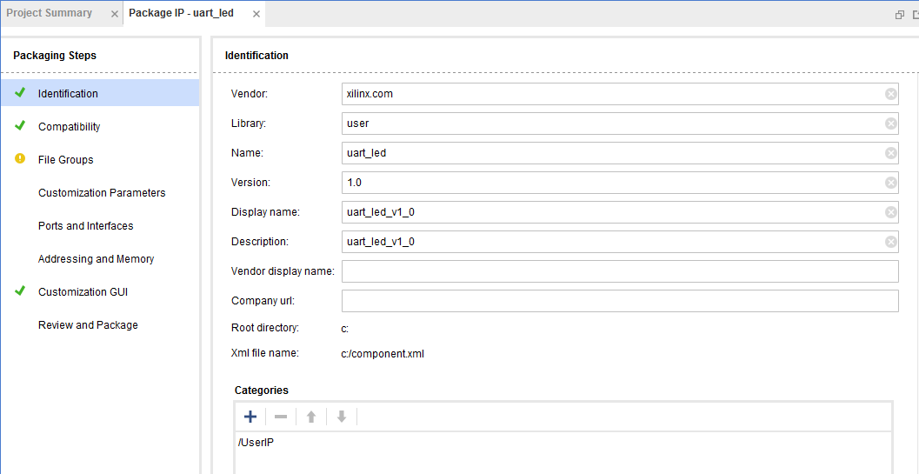
Customizing IP for Reuse in IP Packager
Select
Options
Add, Edit or change defaults
Notes:
The packager handles all the IP-XACT specific file creation, manages IP versions, recognizes interfaces, and creates customized configuration dialogs, as well as more advanced functionality.

Slide 13
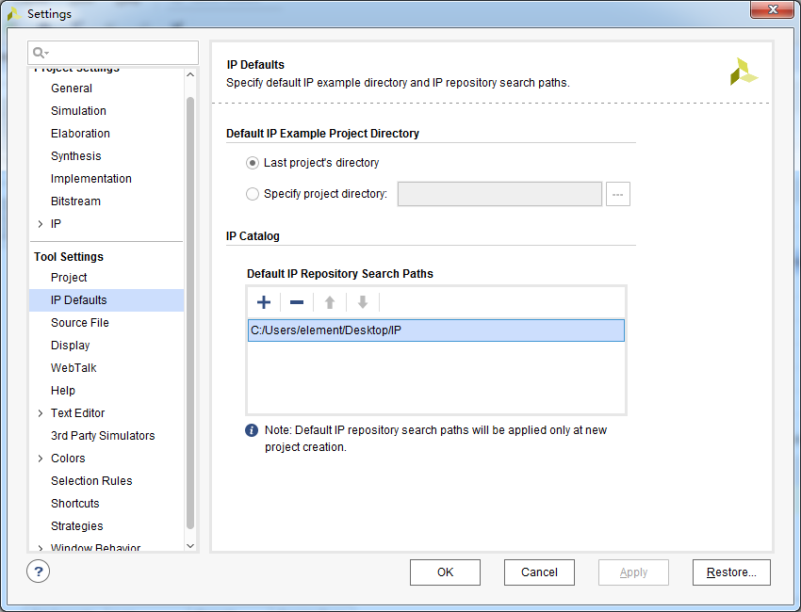
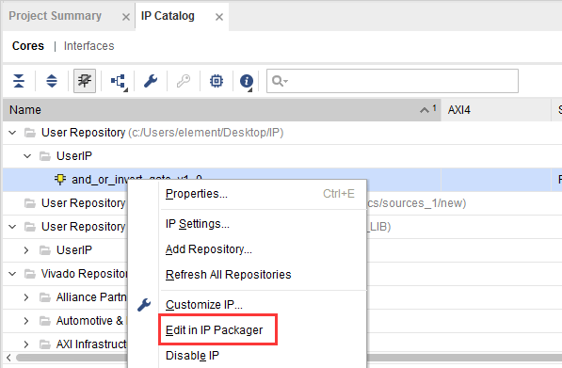
Using and Reusing Packaged IP
The Vivado IP Catalog can be extended by adding additional IP Repositories. Third party IP, your custom IP, and Xilinx provided IP are displayed in the identical manner

Slide 14
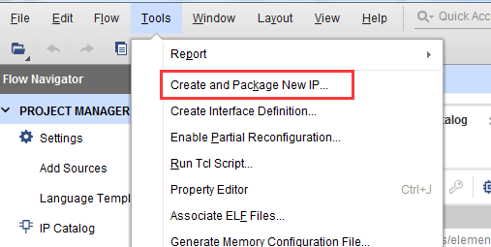

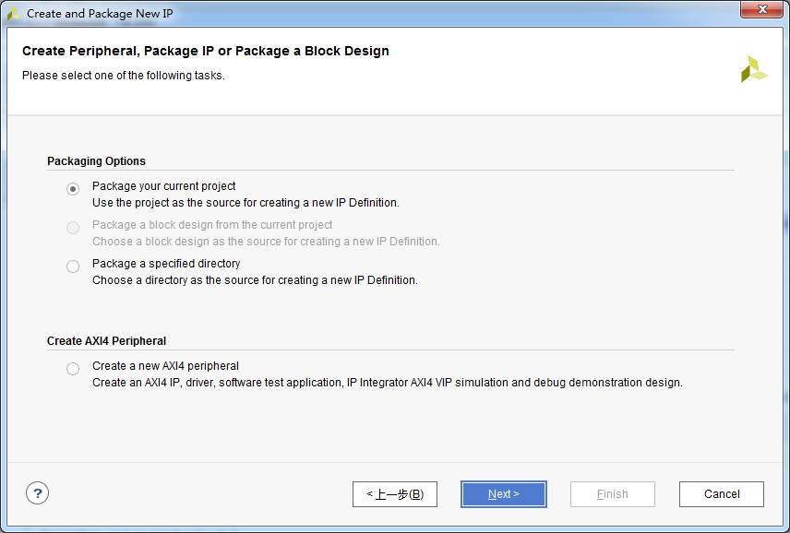
IP Packager
The IP Packager allows a core to be packaged and included in the IP Catalog, or for distribution
Complete set of files include
Source code, Constraints, Test Benches (simulation files), documentation
IP Packager can be run from Vivado on the current project, or on a specified directory

Slide 15
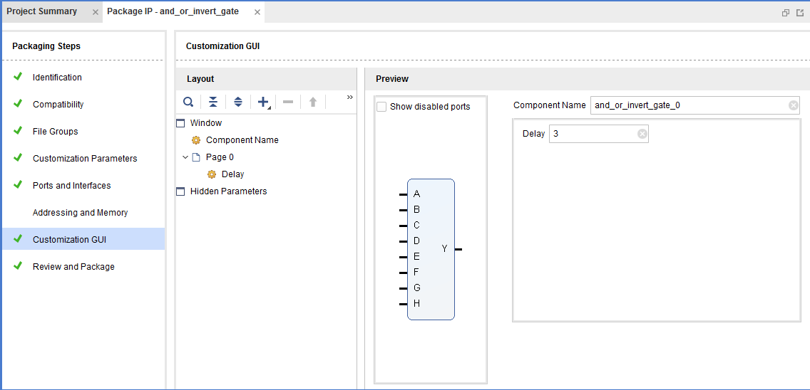
IP Packager
Automatically analyse project/files to determine parameters
Initial Summary
Identifies
Files
Parameters
Ports
Interfaces
Creates GUI Layout for IPI

Slide 16
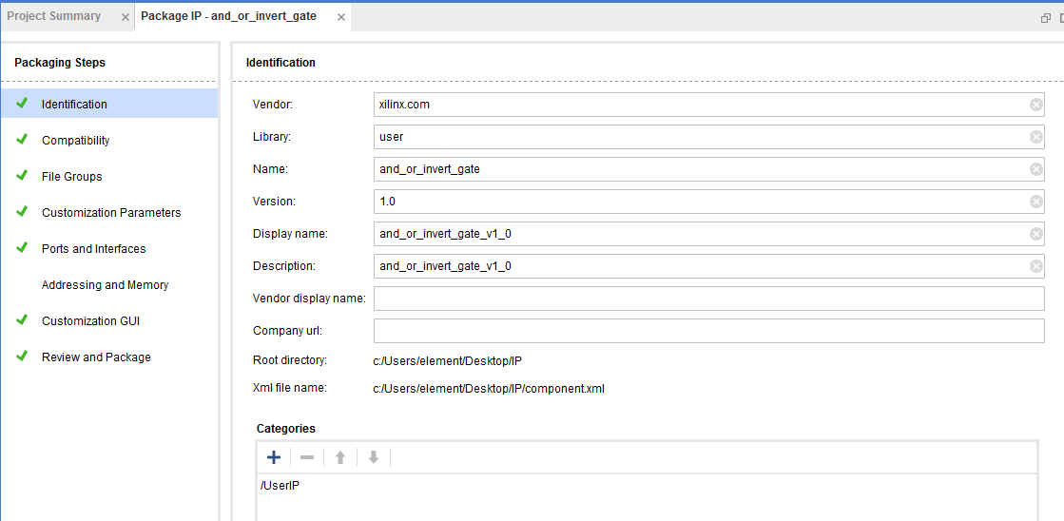
IP Packager
Modify configuration
Properties
Compatibility
Files
Custom parameters
Ports
Interfaces
Address and Memory
IP and security

Slide 17
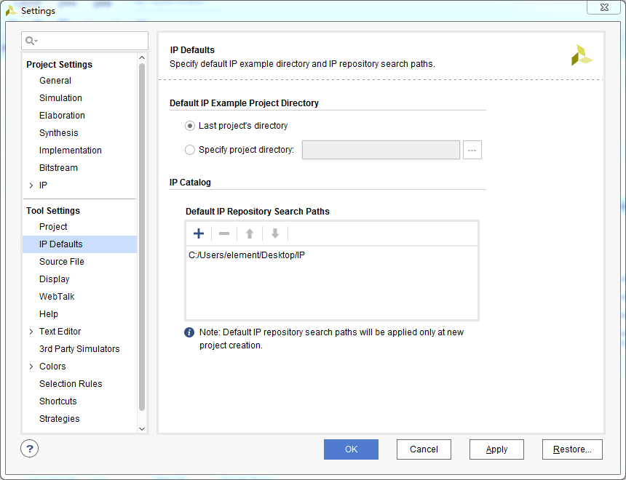
IP Repository
Creates component.xml file for the IP
Specify the directory in the repository
Displays IP in the repository

Slide 18
Outline
IP Integrator
IP Packager
IP Catalog
Clocking Wizard
Summary

Slide 19
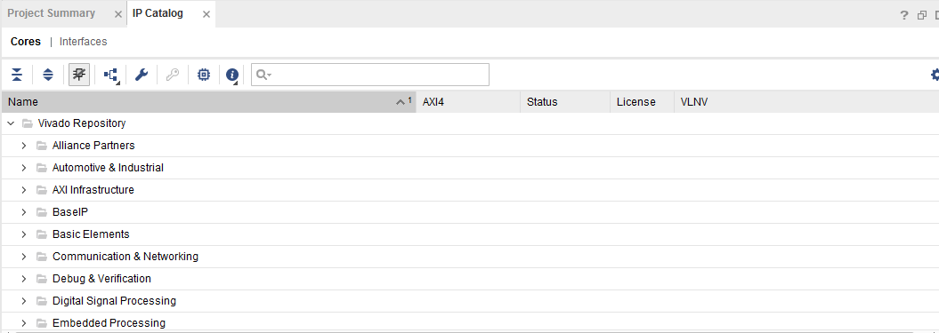
IP Catalog
The IP Catalog contain a collection of IP that can be used to assemble a system
Supported by IPI
Facilitates quick system construction
Each IP block has its own configuration parameters
Most of the IP are free, some require licenses
Stored as source code in the install directory
Always synthesized with the latest tools
Some proprietary source code is encrypted

Slide 20
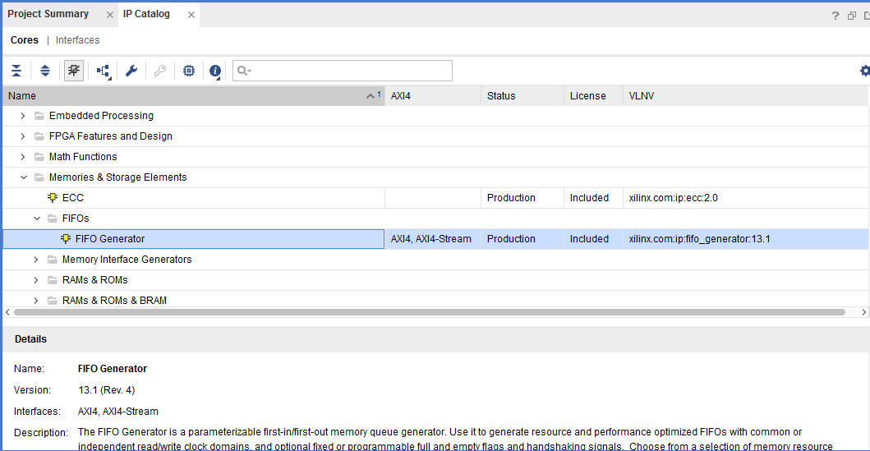
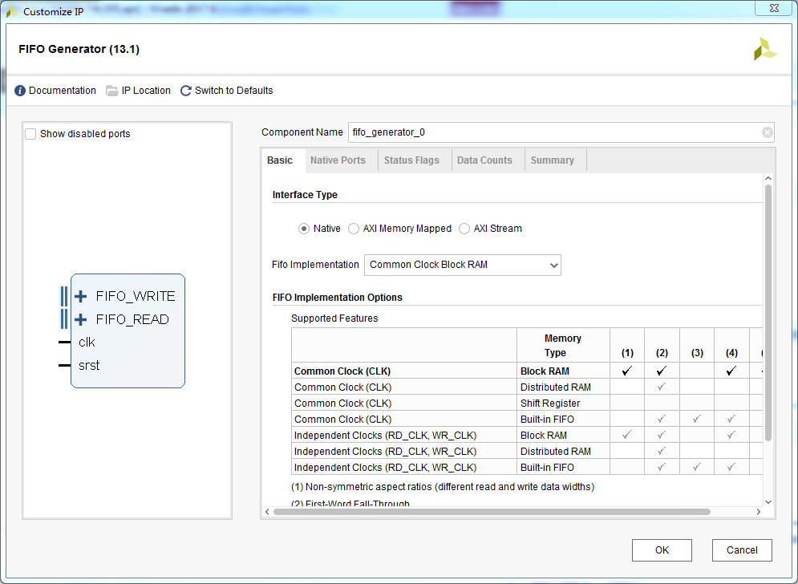
Vivado IP Catalog
Integrated IP Support
Instant access to IP customization
Vivado IP GUI look and feel
Support for Vivado synthesis and implementation
Selectable IP output products
Full Tcl support
Notes:
Vivado has a unified IP catalog – all IP available in one place. The catalog can be extended through use of additional repositories. IP can be selected in the catalog and customization GUIs launched. IP is then added directly to a Vivado project, or in the case of IP Integrator, added to the diagram. The user can select simulation or implementation files. IP can be accessed and customized entirely from the Tcl console as well.

Slide 21
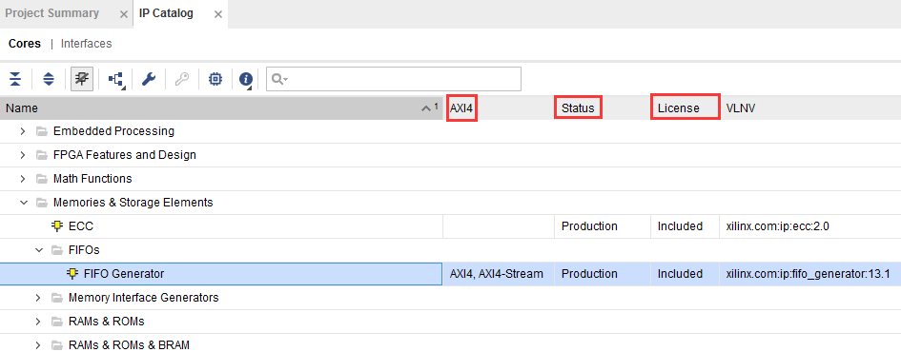
Peripheral and Non-Peripheral Type IP
Many IP in the catalog are peripheral type
Peripheral type are indicated by AXI4, AXI4-Stream
Non-peripheral IP listing do not have entry in the AXI4 column
Status column indicates if the IP is of production or pre-production category
License column indicates if the IP is free (Included) or costs money (Purchase)

Slide 22
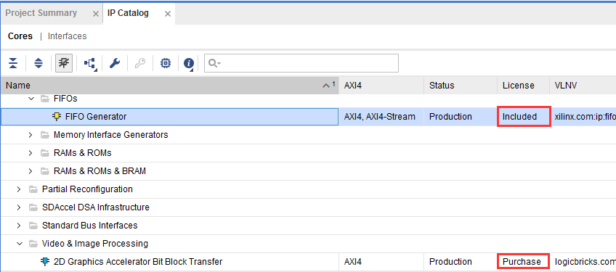
IP Peripherals Included as Source (Free)
Bus and bridge controllers
Debug cores
DMA and Timers
Inter-processor communication
External peripheral controller Memory and memory controller
High-speed and low-speed communication peripherals
Other cores

Slide 23
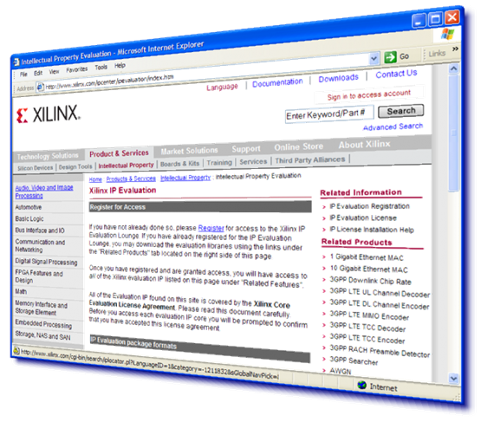
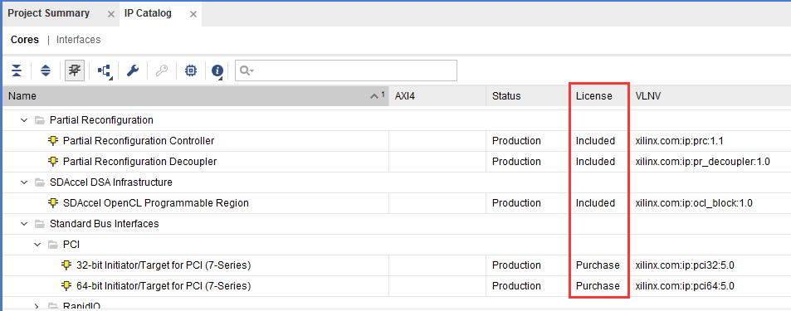
IP Cores Included as Evaluation
AXI CAN controller
AXI USB2 device
Video IP
Telecoms/ Wireless IP
Xilinx developed, delivered, and supported
Evaluation IP installs with a 90-day evaluation license

Slide 24
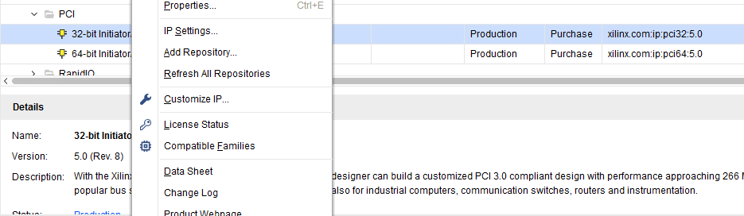
IP Cores
Right click to customize
Determine compatibility
Product Guide (datasheet) > Document Navigator
Change Log
Product Webpage
Answer record
Export complete IP Catalog to excel

Slide 25
Outline
IP Integrator
IP Packager
IP Catalog
Clocking Wizard
Summary

Slide 26
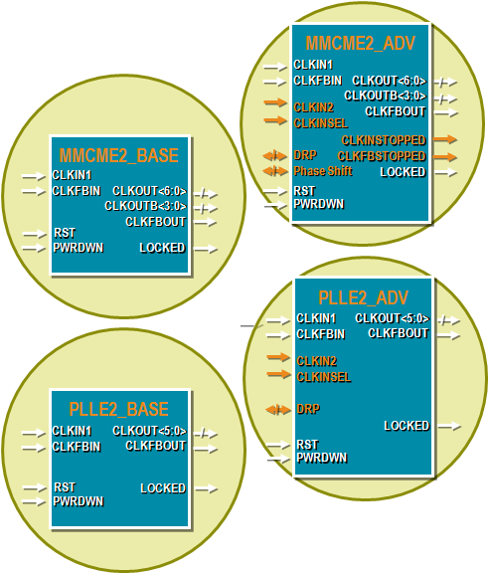
Clocking Resources: MMCM and PLL
Up to 24 CMTs per device
One MMCM and one PLL per CMT
Two software primitives (instantiation)
*_BASE has only the basic ports
*_ADV provides access to all ports
PLL is primarily intended for use with the I/O phaser for high-speed memory controllers
The MMCM is the primary clock resource for user clocks

Slide 27
Inference
Clock networks are represented by nets in your RTL design
The mapping of an RTL net to a clock network is managed by using the appropriate clock buffer to generate that net
Certain resources can be inferred
A primary input net (with or without an IBUF instantiated) will be mapped to a global clock if it drives the clock inputs of clocked resources
The BUFG will be inferred
BUFH drivers will be inferred whenever a global clock (driven by a BUFG) is required in a clock region
BUFHs for each region required will be inferred
BUFIO, BUFR, and BUFMR cannot be inferred
Instantiating these buffers tells the tools that you want to use the corresponding clock networks
PLLs and MMCMs cannot be inferred

Slide 28
Instantiation
All clocking resources can be directly instantiated in your RTL code
Simulation models exist for all resources
Refer to the Library Guide for HDL Designs
Use the Language Templates ( ) tab
PLLs and MMCMs have many inputs and outputs, as well as many attributes
Optimal dividers for obtaining the desired characteristics may be hard to derive
The Clocking Wizard via the IP Catalog
Only *_ADV available

Slide 29
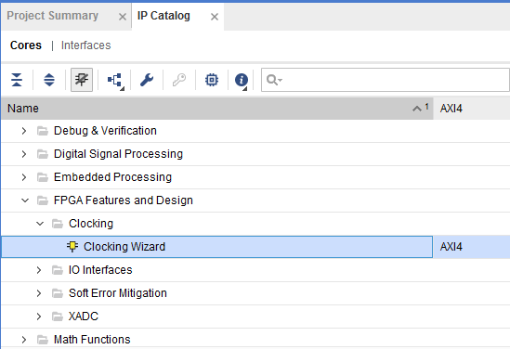
Invoking Clocking Wizard
Click on the IP Catalog
Expand FPGA Features and Design > Clocking
Double-click on Clocking Wizard
The Clocking Wizard walks you through the generation of complete clocking subsystems

Slide 30
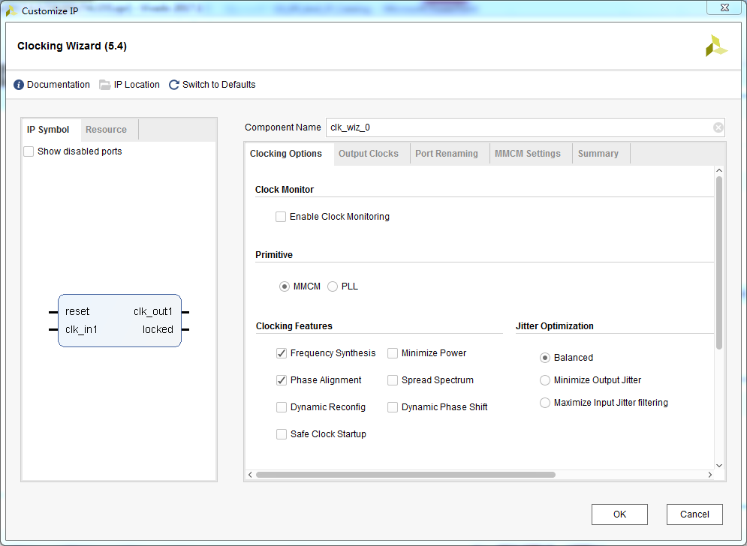
The Clocking Wizard: Clocking Options
Select Primitives to be used
MMCME2_ADV
PLLE2_ADV
Specify the primary input frequency and source type
Optionally, select and specify secondary input clock
Select clocking features
Frequency synthesis
Phase alignment
Dynamic phase shift
…

Slide 31
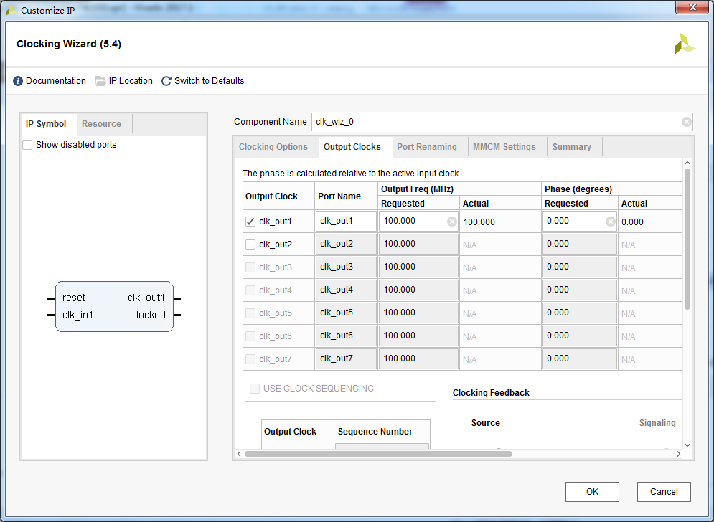
The Clocking Wizard: Output Clocks
Select the desired number of output clocks
Set the desired output frequencies
Select optional ports

Slide 32
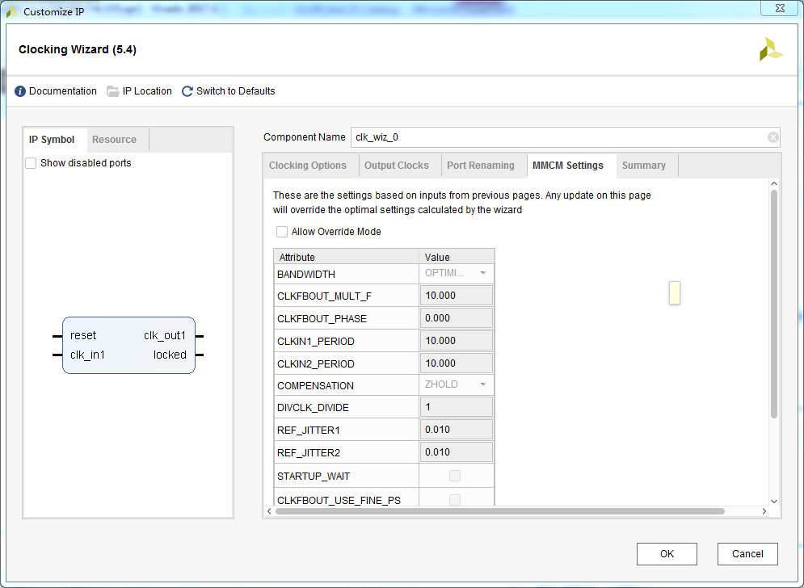
The Clocking Wizard: MMCM Settings
Allows overriding of wizard settings
Sets the phase, period, jitter…

Slide 33
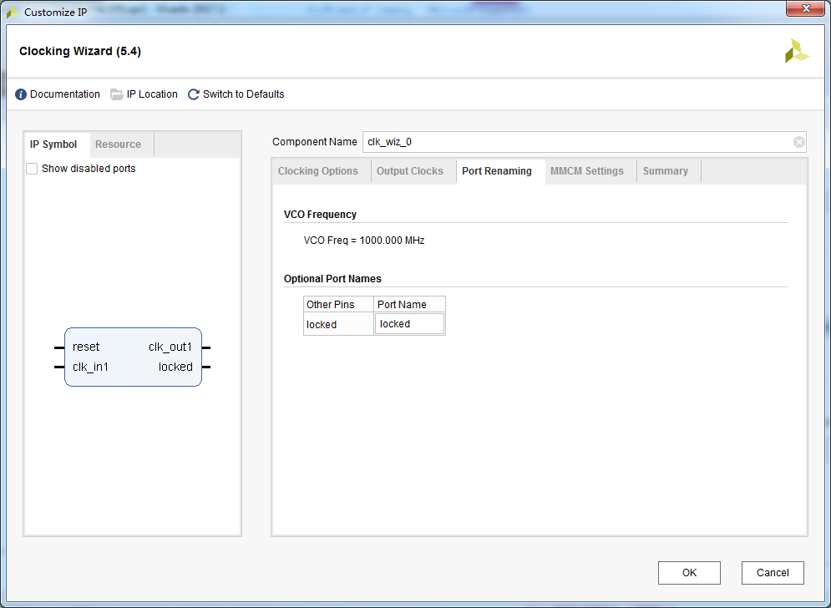
The Clocking Wizard: Port Renaming
Change input/output port names
Change optional port names

Slide 34
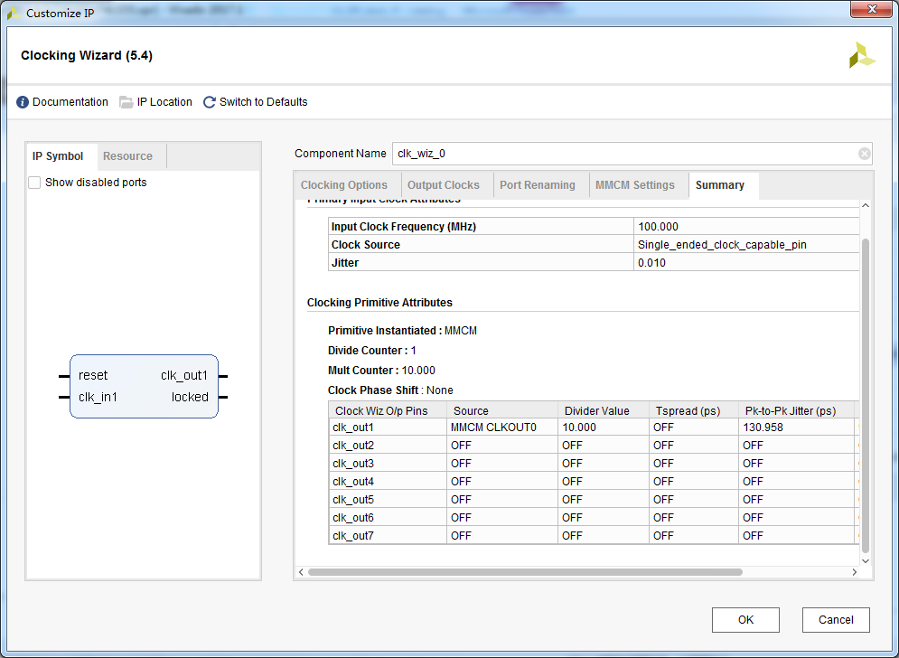

The Clocking Wizard: Summary
Shows the input, output frequencies
Other attributes depending on the selections made
The Resource tab on the left provides summary of type and number of resources used

Slide 35
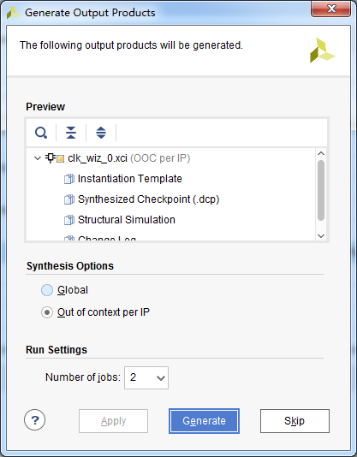
Generating Output Products
Generate Instantiation Template
Synthesis model
Simulation model
Implementation related files
Examples on how to use the product
Optionally, synthesized design checkpoint so it can be used in the implementation without re-synthesizing in the project

Slide 36
Outline
IP Integrator
IP Packager
IP Catalog
Clocking Wizard
Summary

Slide 37
Summary
Vivado is an IP Centric design environment, allowing multiple ways to add/manage IP
Automatic RTL generation
Rapid assembly, packaging, and reuse of IP subsystems
Processor based system design support
Vivado IP Integrator provides unique time to market advantages when designing with complex IP
The IP Packagers provides flexibility of IP reuse and repackaging
The IP Catalog provides access to extensive IP resources
Simple IP to highly complex IP
Grouped according to functionality
The Clocking Wizard enables the configuration of complex clocking resources

