Slide 1
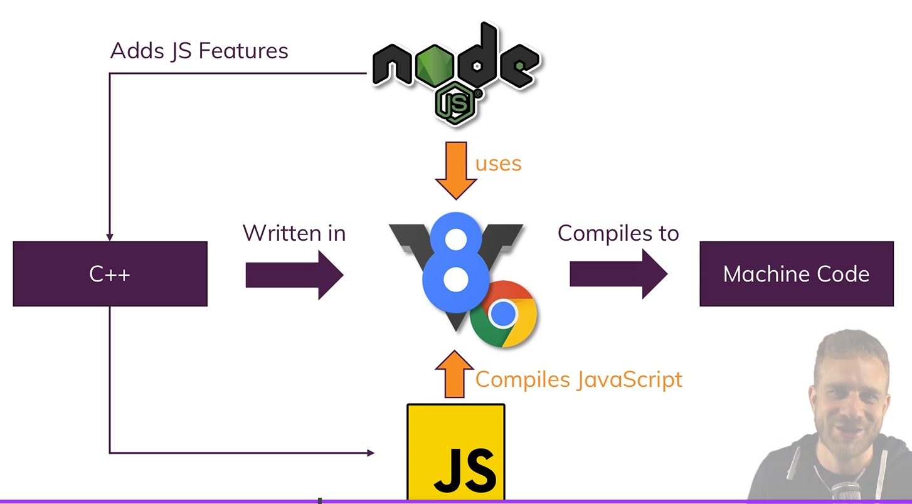
2.What is node.js?
瀏覽器使用V8(C++編寫)引擎，將JavaScript 編譯成機器語言
Node.js 則是將 V8(vanilla v8)拆出來使用，讓使用者在本地端就可編譯 JS

Slide 2
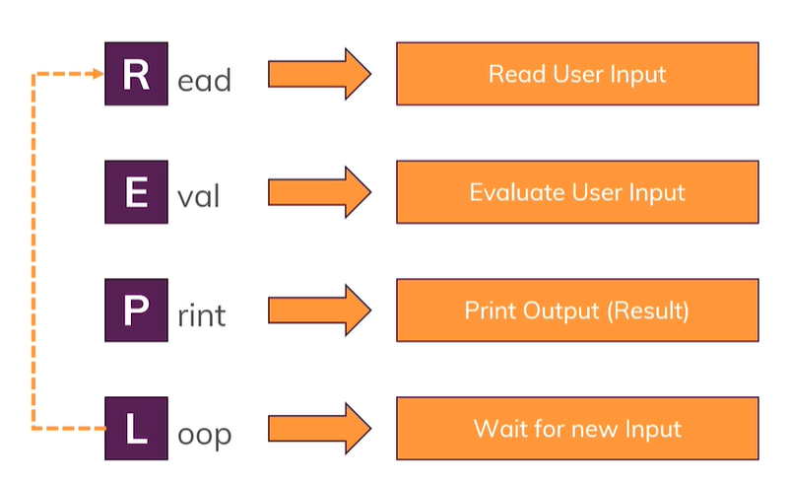
The REPL

Slide 3
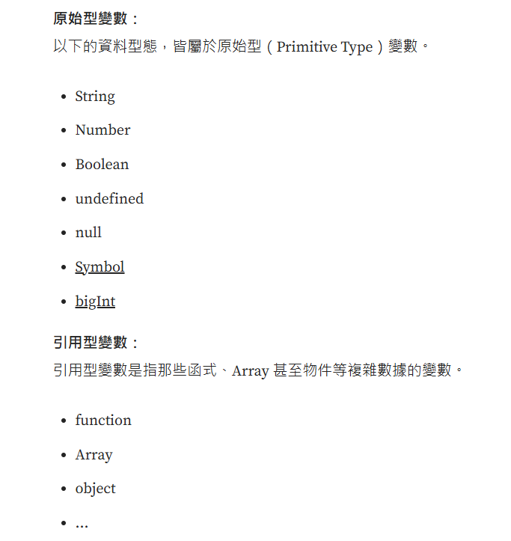
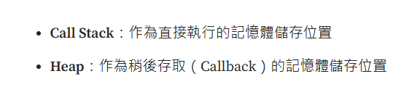
原始型（Primitive Type）和引用型（Reference Type）
let x=5; x=7 一開始5記憶體位置(Call Stack位置)可能為C001，在變為7時是先指定到新的記憶體位置C002後，若原先5(C001)都沒用到後，直接釋放此記憶體空間，而不是直接修改(C001)上的值
let obj = {name: Chris}; obj={} 一開始{name: Chris}記憶體位置(Call Stack位置 => Heap位置 )可能為C001 => H001，在變為{}時是指定到新的位置H002，但還是記憶體位置還是指向 C001，也就是 C001 => H002
參考

Slide 4
Node.js Program Lifecycle
Node app.js
Start Script
Parse Code, Register
Variables & Functions
Keeps on running as long as there are event listeners registered
The Node Application
Event Loop
process exit

Slide 5
4.Npm tips
npm install XXX –save(-dev) = npm I XXX -D ：可決定安裝的第三方是否要在生產環境中啟用

Slide 6
2.What is node.js?
瀏覽器使用V8(C++編寫)引擎，將JavaScript 編譯成機器語言

Slide 7
2.What is node.js?
瀏覽器使用V8(C++編寫)引擎，將JavaScript 編譯成機器語言

Slide 8
Join our Online Learning Community
Great to have you on board as a student!
This course also comes with free access to our “Academind Community” on Discord: https://academind.com/community/
There, you can find like-minded people, discuss issues, help each other, share progress, successes and ideas and simply have a good time!
---
I believe that you learn the most if you don't learn alone but find learning partners and other people with similar interests. Our community is a great place for this - it's the perfect complimentary resource for this course.
>>> Joining it is of course free and 100% optional! :-)
We'd love to welcome you on board of the community!

Slide 9
Course Setup
For following along with this course, you can use VS Code - a free, extensible IDE that works on all operating systems.
A popular alternative are the IDEs offered by Jetbrains. They offer a variety of IDEs for different programming languages and projects. For web development, Webstorm is a popular choice.
As a student of this course, you can get one Jetbrains IDE for free for six months!
All you need to do, is select it and enter the following coupon code on the checkout page: ACADEMIND_JETBRAINS.
You find detailed instructions regarding the coupon code usage on this page.
Please note: Using Jetbrains IDEs is optional (you could use VS Code). If you do go for the Jetbrains deal, you'll need to enter your email address during the checkout process.

Slide 10
Using the Attached Source Code
Throughout this course, we'll write a lot of code.
To give you the possibility of comparing your code to mine (to find + fix potential errors in your code), you'll find multiple code snapshots per module attached to different lectures in this course.
The last lecture of each module always contains all snapshots for the module, ordered chronologically.
You can view the code and compare it to yours or replace (parts of) your code with it temporarily (to narrow down the issue).
How do you use the attached code?
BEFORE we started using npm, you simply run the main .js file via node - just as we do it in the videos. Or you simply look into the code files to view + compare the code.
AFTER we started using npm, you need to run npm install inside of the extracted code attachment before you can run npm start to run the server.

