Slide 1
PROGRESS UPDATE 2
Drunky: Robot Bartender
🍹· 🥃 ·🍸
An automated bartender system built on two SO-101 arms, imitation learning, and color and label based perception.
COURSE
TEAM
TECHIN 517 — Robotics Final Project
Tony Chen · Rushav Dash · Joyce Zhou
INSTITUTION
DATE
University of Washington Global Innovation Exchange
May 2026

Slide 2
WHERE WE LEFT OFF
Previous progress
Previously completed
Recently completed
Alcohol Bottle Detection and Classification
Rosetta integration
Collected 100+ images of shooter bottles and fine-tuned YOLO. Localize bottles on the shelf and get pose coordinates
Deployed the ACT policy through the Rosetta pipeline for ROS 2-based inference
ACT grab policy v1
ACT grab policy v2
Imitation learning pipeline validated: teleoperation, data collection, ACT training, and autonomous inference
Policy scoped down to bottle grabbing only; trained on 66 right-arm episodes and 32 left-arm episodes
Dual-arm ROS 2 stack
Classical pose sequence
Synchronized control of both SO-101 arms over a shared topic graph
Pre-recorded poses for pouring, tossing bottle, and pushing the drink forward
Environment set-up
Docker environment configured with ROS 2 Humble, LeRobot, and RealSense support
DRUNKY · PROGRESS UPDATE 2
02

Slide 3
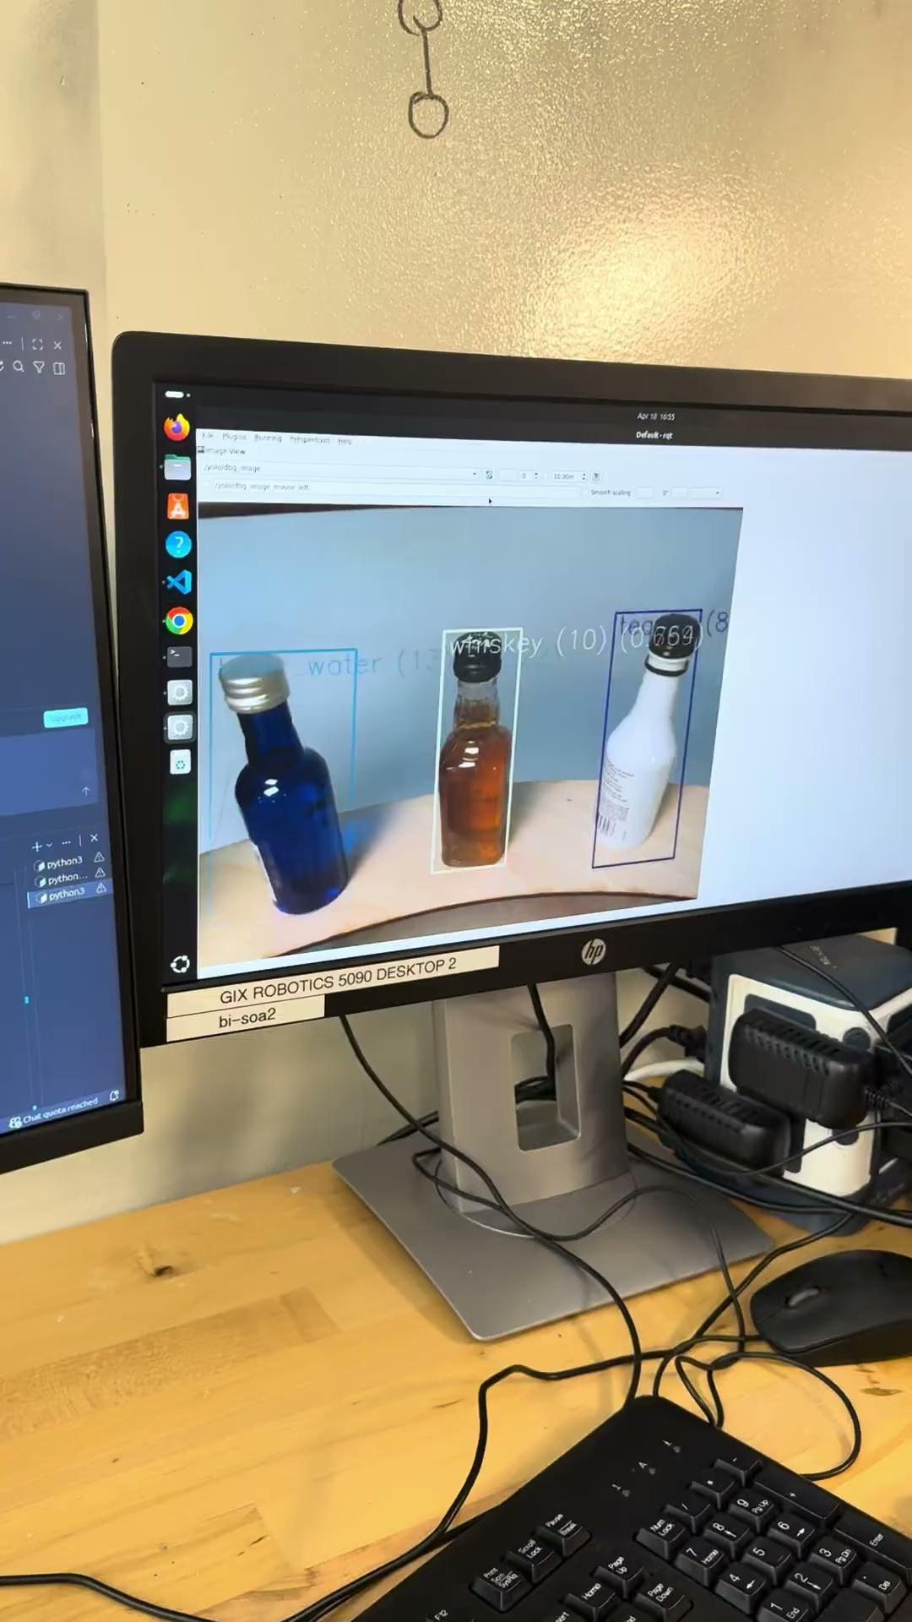
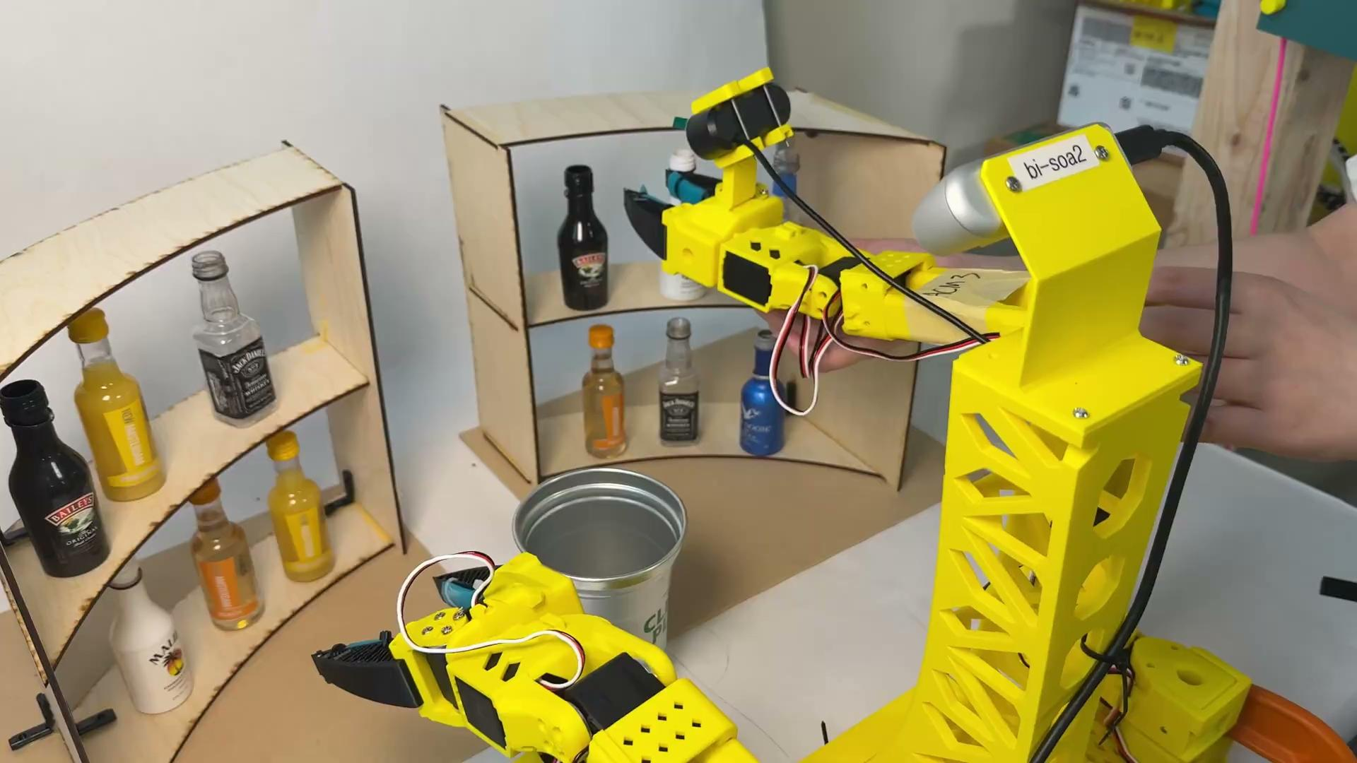
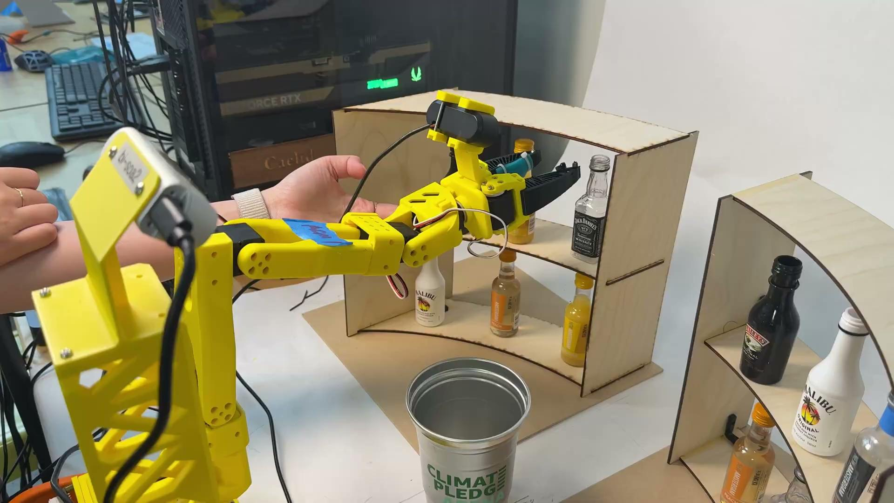

DEMO REEL
System in action
Image
CLIP_02.MP4 · 1920×1080
CLIP_03.MP4 · 1920×1080
Grab + pour policy (right arm)
Grab policy (left arm)
CLIP_04.MP4 · 1920×1080
CLIP_05.MP4 · 1920×1080
Bottle detection
Tose/dispose
Serving
DRUNKY · PROGRESS UPDATE 2
03

Slide 4
SINCE THE LAST UPDATE
Perception & Policy
Team contributions
Tony Chen
Collaborative
Rushav Dash
Joyce Zhou
Data & Rosetta
Data & Forward Kinematics
DRUNKY · PROGRESS UPDATE 2
04

Slide 5
PLAN VS. REALITY
Evaluation
Evaluation plan
Results so far (right arm grab)
Pour accuracy
Yes or No
Grabbing success rate average
88.33%
End-to-end task success rate
> 70%
Grabbing success rate (top-left)
10/10
Drink type detection
> 90%
Grabbing success rate (top-middle)
10/10
Full cycle time (grab → pour → toss→ serve)
< 180 s
Grabbing success rate (top-right)
8/10
Additional side plan
Grabbing success rate (bottom-left)
9/10
Recovery from a single slip / mis-grasp
retry once
Grabbing success rate (bottom-middle)
9/10
Stir drink before serving
Grabbing success rate (bottom-right)
7/10
DRUNKY · PROGRESS UPDATE 2
05

Slide 6
TOWARD FINAL PRESENTATION
Remaining work & final goal
WEEK 7+8
End-to-end integration
Connect all pose sequences with the LeRobot grab policy through Rosetta and begin full pipeline test runs.
WEEK 9
Evaluation spring
Run 10-trial evaluation sets per drink; measure pour accuracy, cycle time, and success rate against targets.
WEEK 10
Final deliverables
Clean up the repo, document the system, and prepare the final presentation and live demo.
FINAL GOAL
Reliably detect, grab, pour, and toss a single drink — closed-loop, with no human intervention — in under 180 seconds , on at least 7 out of 10 consecutive trials.
DRUNKY · PROGRESS UPDATE 2
06

Slide 7
Thank you.
Questions?
Drunky: Robot Bartender
UNIVERSITY OF WASHINGTON GLOBAL INNOVATION EXCHANGE · TECHIN 517
TONY CHEN · RUSHAV DASH · JOYCE ZHOU

