Slide 1



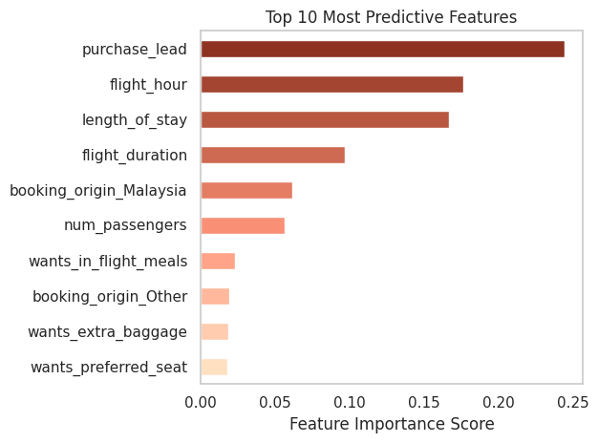



Slide 4
Booking Completion Machine Learning
What influences customer buying behavior?
Analyzed 50,000 customer records to identify the patterns contributing to the 15% successful holiday booking conversions. With a goal of training a predictive model, our data was prepared for the development and evaluation of a machine learning that can provide a predictive utility to the team.
85% Incomplete Holidays
15% Complete Holidays
Top Sale Conversion Rates Per Group
Top Predictive Contributing Factors
Model Performance
89% Accuracy Predicting No Sale Conversion (Precision & Recall)
38% Accuracy Predicting Sale Conversion (Precision & Recall)
225% Prediction Improvement (Sale Recall)
Reasonable performance given low conversion rate (Sale F1-Score: 0.37)
75% Successful identification of a favorable client (ROC AUC)
Round Trips
3X Highest
Internet
Sales
15%
Malaysia
Origin
34%
PENTPE
Route
43%
See Notes for final recommendation
GitHub: Johnny Diaz
Notes:
Final Recommendation: Focus on the successful factors regarding your customers that seek a small number of passengers, shorter purchase leads, and most importantly RoundTrips and bookings from Southeast Asia. These offer a sales conversion rate at up to 6x the global average

