Slide 1
week 1{
welcome();
}
code1Fall_2018

Slide 2
void agenda{
sayHello();
syllabusReview();
whyWeCode();
variables();
pseudocode();
theProcessingIDE();
homeworkAndClassGithub();
}

Slide 3
void sayHello(){
println(“HELLO!”);
}

Slide 4
void syllabusReview(){
read(syllabus);
}

Slide 5
void whyWeCode(){
}

Slide 6

Notes:
Processing is not a joke. With it, you can make things like this! Neat! But we’re not there yet.

Slide 7
void variables(){
int myInt; // stores an integer (eg. 1)
float myFloat; // stores a number with a decimal point (eg. 9.31)
string myString; // stores text (eg. “Code 1 2017”)
boolean myBoolean; // true/false (don’t worry you’ll understand this later)
}

Slide 8
void pseudocode(){
//pseudocoding is a tool we use to map out //what components we need in our code
// before we build them
//think of it like making an outline before //writing your paper
}

Slide 9
Peanut Butter & Jelly Sandwich
2 slices of bread Peanut Butter Jelly
Spread peanut butter on one slice of bread
Spread jelly on the other slice of bread
Put the pieces of bread together
Notes:
Recipes are often used as an example of code for humans: preheat an oven then mix specific quantities of sugar, flour, water, and eggs in a bowl then put that mixture in a container in the oven for 30 minutes and you might ought to wind up with cookies.
See how it took the process of ‘making a cookie’ and identified all the things and the actions we ought to take on those things?

Slide 10
Recipe Breakdown
Variables: breadSlice1 breadSlice2 peanutButter jelly
Functions: spreadOnBread() putBreadTogether()
Notes:
When we think about how to break this down further, we can think of the ‘things’ as variables and the tasks as ‘functions’.
That covers the best case scenario, where everything works and goes as planned. That’s the *should*. Note that there are many other possibilities. What happens if the oven is broken? If the eggs are spoiled? If there is not enough sugar? And so on. When programming, you also have to cover these situations or your program likely will not work in practice.

Slide 11
Pseudocode 1
// spread peanutButter on breadSlice1
// spread jelly on breadSlice2
// put bread slices together
Notes:
About thinking through the steps need to do

Slide 12
PseudoCode example 2
main() { spreadOnBread(peanutButter, breadSlice1)
spreadOnBread(jelly, breadSlice2)
putBreadTogether()
}
Notes:
More you code the more your pseudo code will resemble code syntax

Slide 13
void yourPseudocode(){
//partner up and write your own pseudocode
//briefly present to the class
}

Slide 14
void theProcessingIDE(){
//finally we can open processing
}

Slide 15
Your Homework:
Create your own github account
Homework assignment is on our class github
Paste a gist link to you homework to our class github page

Slide 16
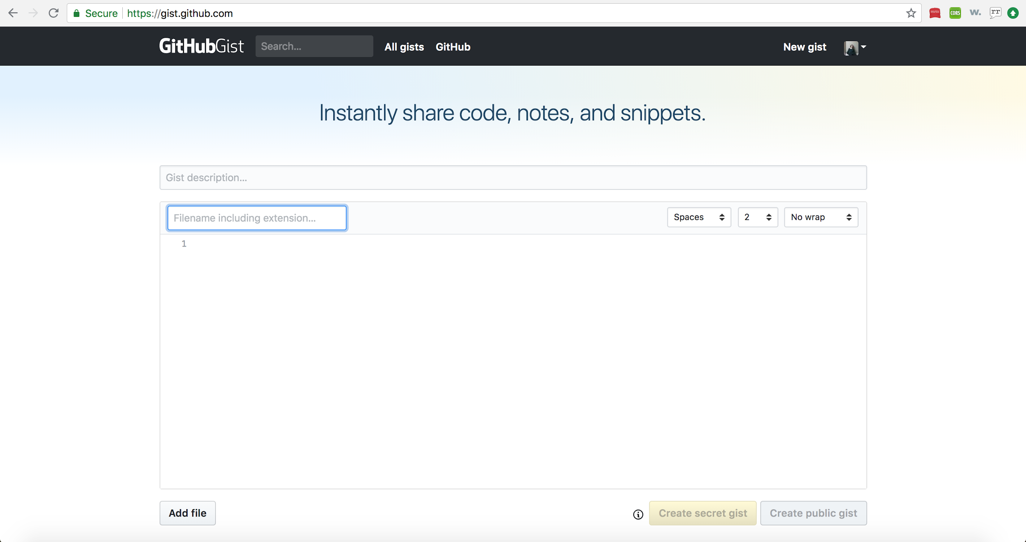
Go to gist.gihub.com and add your processing file;
Make sure to select public gist!

Slide 17
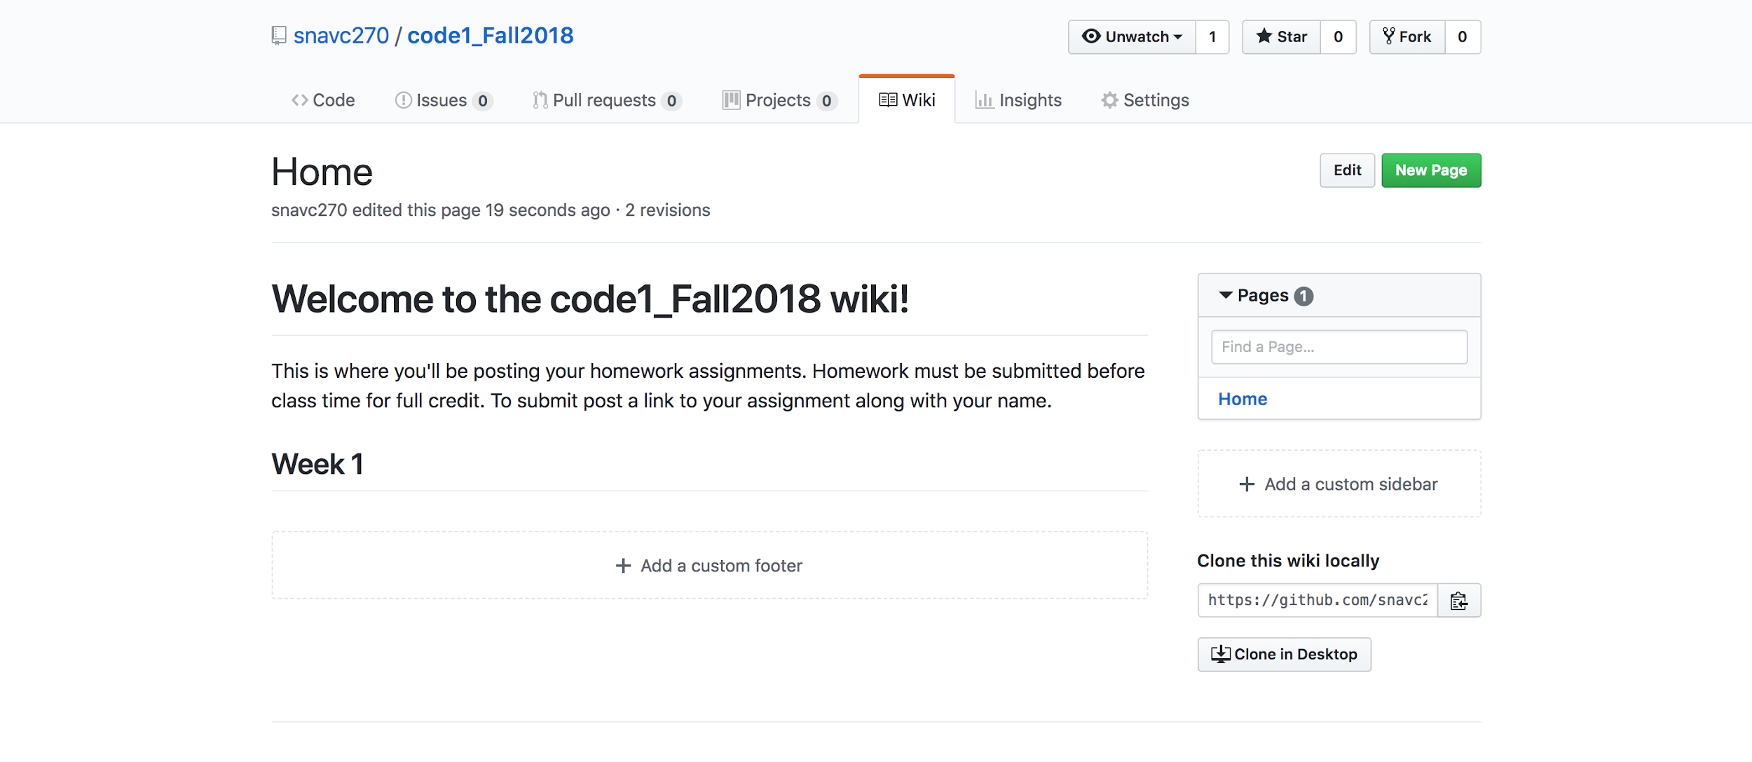
Click on the Wiki tab of our class github

Slide 18
Click Edit

Slide 19
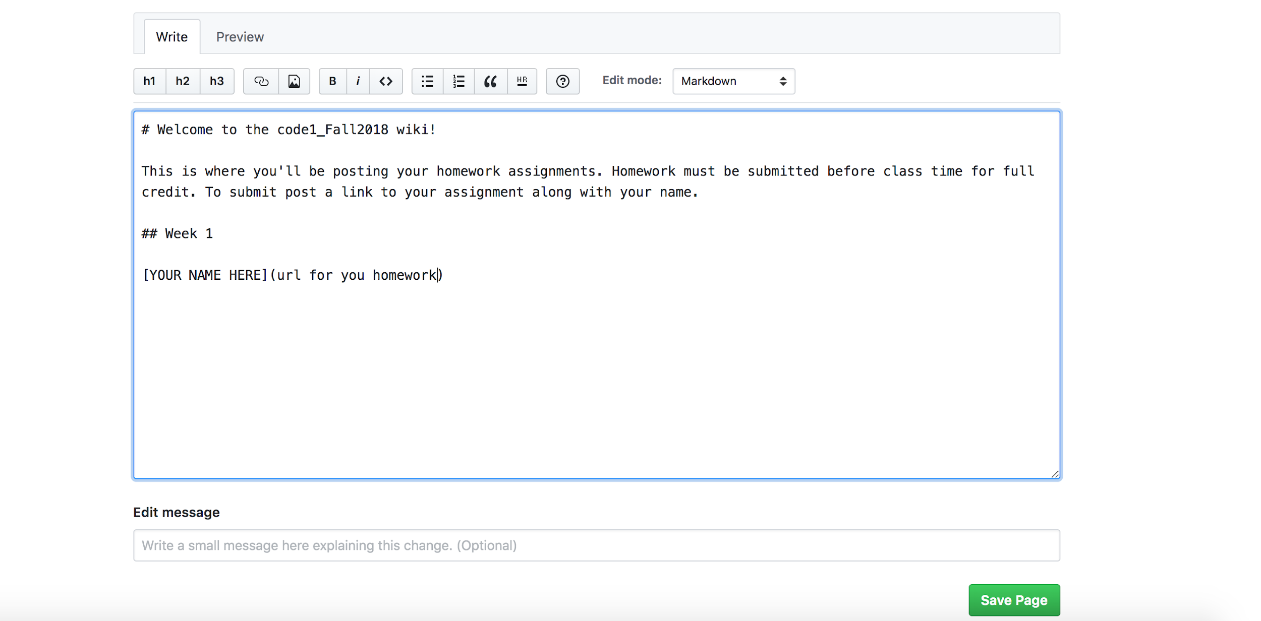
Paste a link to your gist under week1

Slide 20


