Slide 1
week 2{
manipulatingTheCoordinatePlane();
}
code1Fall_2018

Slide 2
void agenda{
reviewHW();
transformations();
mouseX_mouseY();
inClassExercise();
input();
}

Slide 3
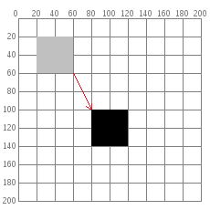
what we we’ve been doing

Slide 4
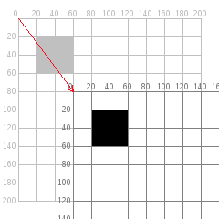
what we’re gonna do !!!

Slide 5
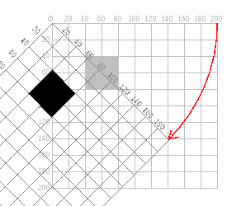
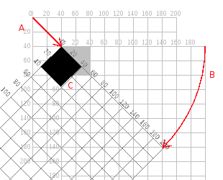
wrong.
right!

Slide 6
wrong.
right!

Slide 7
pushMatrix();
popMatrix();
translate();
scale();
rotate();
=
=
=
=
=
Stores the coordinate system
Resets the coordinate system
Moves the coordinate system
Changes the size of the coordinate system
Rotates the coordinate system
Transformations cheat sheet

Slide 8
Rotate an object in your scene based on your mousePosition data
In class exercise

Slide 9
mouseX and mouseY =
tracks the x and y coordinates of the mouse on the canvas

Slide 10
keypressed vs keyPressed()
Two things look similar, but are very different in usage!
int value = 0; void draw() { fill(value); rect(25, 25, 50, 50); } void keyPressed() { if (value == 0) { value = 255; } else { value = 0; } }
void draw() { if (keyPressed == true) { fill(0); } else { fill(255); } rect(25, 25, 50, 50); }
Notes:
What do each of these guys do?

Slide 11
‘key’
This is how we let processing know what key we want to trigger the input
if(keypressed){
if(key == ‘b’) || (key == ‘B’){
//do something!
}
}
Notes:
void draw() {
if (keyPressed) {
if (key == 'b' || key == 'B') {
fill(0);
}
}else {
fill(255);
}
rect(25, 25, 50, 50);
}

Slide 12
‘keyCode’
This is how we tell processing to detect special keys like the arrow keys
color fillVal = color(126);
void draw() {
fill(fillVal);
rect(25, 25, 50, 50);
}
void keyPressed() {
if (key == CODED) {
if (keyCode == UP) {
fillVal += 10;
} else if (keyCode == DOWN) {
fillVal -= 10;
}
} else {
fillVal = 126;
}
}

Slide 13
keyReleased()
int value = 0;
void draw() {
fill(value);
rect(25, 25, 50, 50);
}
void keyReleased() {
if (value == 0) {
value = 255;
} else {
value = 0;
}
}
Notes:
Jk we know

Slide 14
mouseButton & mousePressed
Work just like key and keyPressed for keyboard input
mouseButton = a variable that gets changed to LEFT, CENTER, or RIGHT whenever the mouse is clicked
mousePressed = a BOOLEAN that is true/false depending if the mouse was pressed
Notes:
void setup() {
size(500, 500);
background(255);
}
void draw() {
if (mousePressed && (mouseButton == LEFT)) {
fill(mouseX);
ellipse(mouseX, mouseY, random(50), random(50));
} else if (mousePressed && mouseButton == RIGHT) {
clear();
background(255);
}
}

Slide 15
mousePressed vs mousePressed()
void draw() {
if (mousePressed) {
fill(0);
} else {
fill(126);
}
rect(25, 25, 50, 50);
}

Slide 16
mousePressed vs mousePressed()
void draw() { rect(25, 25, 50, 50); } void mousePressed() { if (mouseButton == LEFT) { fill(0); } else if (mouseButton == RIGHT) { fill(255); } else { fill(126); } }
Notes:
Building examples which require mouse/kb input (buttons/etc)

Slide 17
Homework
Read Chapter 2 of Form & Code
Insert transformations & input into your scene from last week (more information on our class github)
Notes:
Building examples which require mouse/kb input (buttons/etc)

