Slide 1
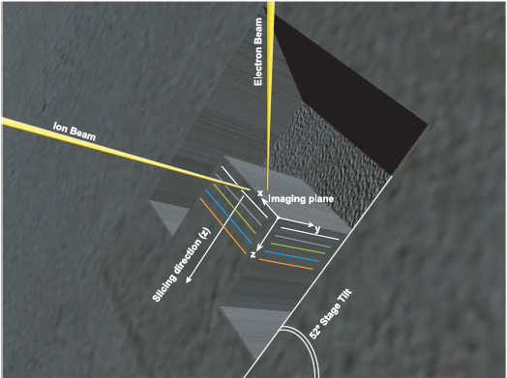
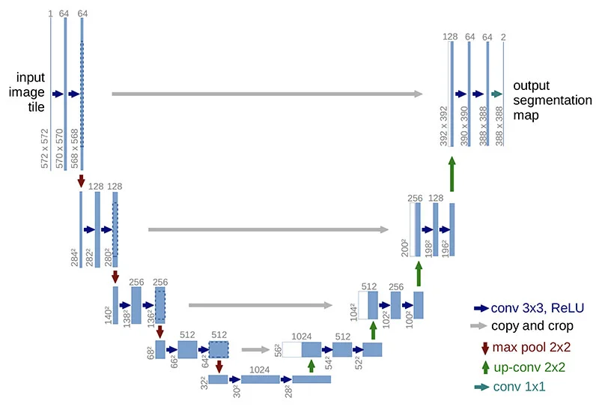
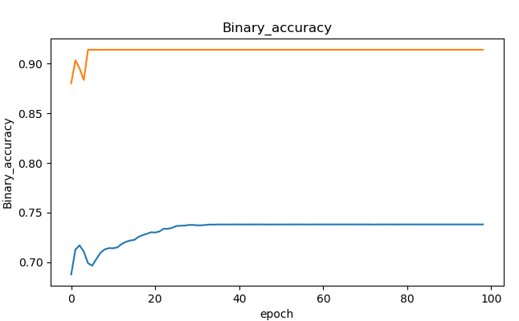
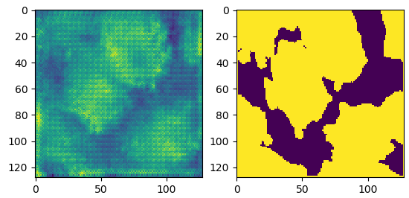
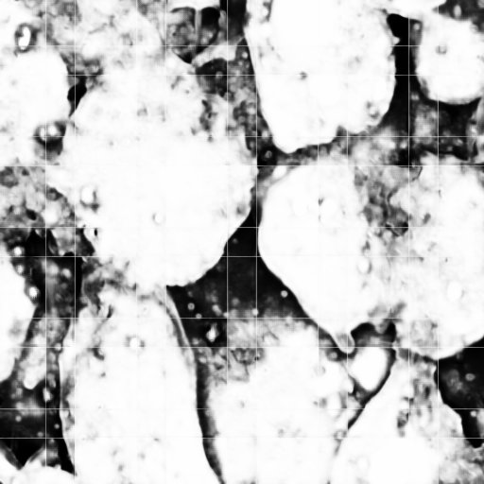

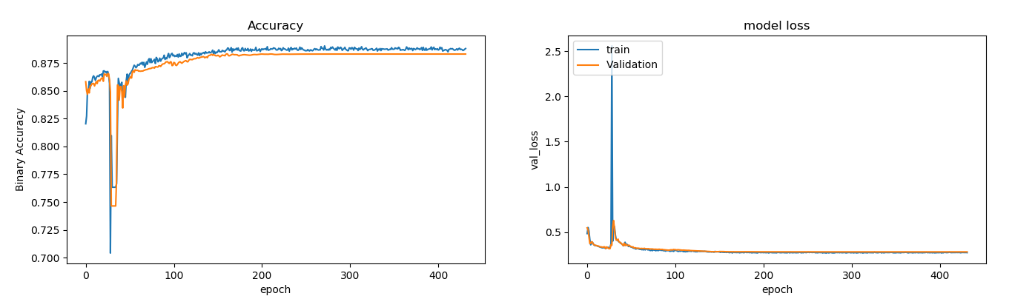
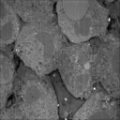
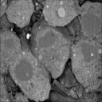
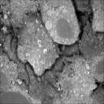
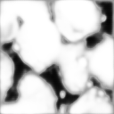
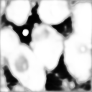
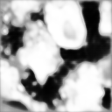
Semantic Segmentation for Biological Specimen under FIB-SEM
Abstract
In the context of embryo developmental biology, growing interests have been addressed on the extracellular space (ECS) activities, which often include molecular diffusion and transportation. Hence, a high-resolution 3D spatial map reflecting the ESC and cell organizations is required. Embedding-free focused-ion beam scanning electron microscopy (FIB-SEM) is believed to be the best imaging tools to achieve such goal, but the data analysis part is challenging in that the image quality is compromised for imaging speed. Here I proposed a working pipeline that combines with the deep learning algorithms for semantic segmentation of the FIB-SEM data.
Jun Zhong^{1,2}
¹MechanoBiology Institute, Singapore, National University of Singapore
²Center for BioImaging Sciences, Dept. of Biological Sciences, National University of Singapore
Introduction
Focused-ion beam scanning electron microscopy (FIB-SEM) has demonstrated its capability in imaging 3D volume of biological tissues. In such case, it often comes with resin-embedding during sample preparation to protect the sample from high energy beam, and also enhance contrast by blocking signals from deep layers other than the surface, thereby generating high quality image data. However, the sample preparation procedure is still time-consuming which often takes about 100 hours (Bushby et al., 2011; Xu et al., 2017), and is the rate-limiting step in many studies. To further improve the application of FIB-SEM, we propose an embedding-free protocol, which could save up to 60% of the sample preparation time. However, the data quality was compromised in both image contrast and background noise, and the conventional imaging analysis approach failed for this type of data.
Over the past decades, deep learning neural networks have demonstrated the capability in processing complex task in image classification and semantic segmentation in biomedical data. Therefore, it has the potential to address the challenge in our case.
Fig. 1. FIB-SEM scheme and raw data
Strategy 2
Fig. 2. U-Net Scheme and training strategies
A
B
Limited annotations: manual annotation of 80 slices out of 650. (1536×1024×650)
Strategy 1: training a 2D U-net with the 60 resized training and label images. (Input size = 128×128)
Strategy 2: training a 3D U-net with only 1 resized annotated volume. (Input size = 128×128×64)
Strategy 3: training a 3D U-net with subvolumes of annotated images. (Input size = 128×128×64)
Strategy 1
Figure 1. A) Working scheme of FIB-SEM, electron beam is for collecting signal, and ion beam is to mill and slice the sample surface. B) Zebrafish embryos being imaged at different depth. Total number of image slices is ~ 650 per data set.
Strategy 2
Strategy 3
…
Fig. 3. 3D U-net performs better in FIB-SEM 3D volume
A
Learning curve
Prediction
Ground Truth
Fig. 4. Reconstruction from subvolumes provide more details
2D U-net
Summary
Embedding-free FIB-SEM provides an efficient data acquisition approach of EM images of 3D biological specimen.
Deep learning neural network helps process the FIB-SEM data for quantitative analysis.
3D U-net performs well in limited training sample and annotations.
Fourier Space Filter
B
3D U-net
References
Çiçek, Ö., Abdulkadir, A., Lienkamp, S.S., Brox, T., and Ronneberger, O. (2016). 3D U-Net: Learning Dense Volumetric Segmentation from Sparse Annotation. In Medical Image Computing and Computer-Assisted Intervention – MICCAI 2016, S. Ourselin, L. Joskowicz, M.R. Sabuncu, G. Unal, and W. Wells, eds. (Cham: Springer International Publishing), pp. 424–432.
Nicholson, C., and Hrabětová, S. (2017). Brain Extracellular Space: The Final Frontier of Neuroscience. Biophys. J. 113, 2133–2142
Xu, C.S., Hayworth, K.J., Lu, Z., Grob, P., Hassan, A.M., García-Cerdán, J.G., Niyogi, K.K., Nogales, E., Weinberg, R.J., and Hess, H.F. (2017). Enhanced FIB-SEM systems for large-volume 3D imaging. ELife 6, e25916.
Ronneberger, O., Fischer, P., and Brox, T. (2015). U-Net: Convolutional Networks for Biomedical Image Segmentation. In Medical Image Computing and Computer-Assisted Intervention – MICCAI 2015, N. Navab, J. Hornegger, W.M. Wells, and A.F. Frangi, eds. (Cham: Springer International Publishing), pp. 234–241.
C
Training from subvolumes by 3D U-net has equivalent performance
Subvolumes provide more details such as small particles, etc.
Artifacts can be removed from Fourier space
Original
Prediction
Figure 3. A) Learning curve and prediction of 2D U-net, clear over-fitting pattern. B) Learning curve of 3D U-net, consistent behavior for both training and validation set. C) Prediction of 3D U-net at different layers

