Slide 1

Ways to increase SAT Participation

Slide 2
Why the need to improve SAT Participation?
SAT fees are cheaper than ACT fees.
More cost efficient to take SAT than ACT.
More accessible for people in the lower income group.
SAT getting more and more recognized compared to ACT (Number of SAT takers overtook ACT takers as of 2018, ACT has held the throne since 2012)

Slide 3
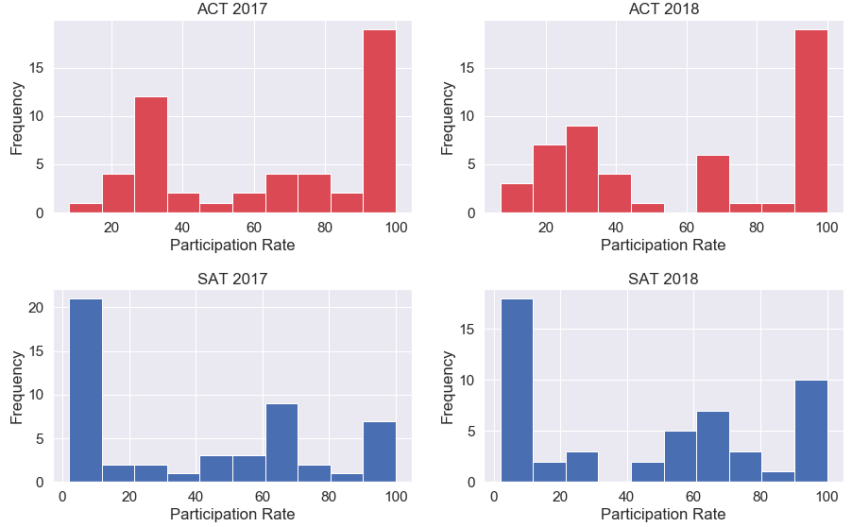
Why?
Skewness: -0.19 | Skewness: -0.02
The trend observed between the participation rates is participants are shifting from ACT to SAT.
Skewness: 0.34 | Skewness: 0.13

Slide 4
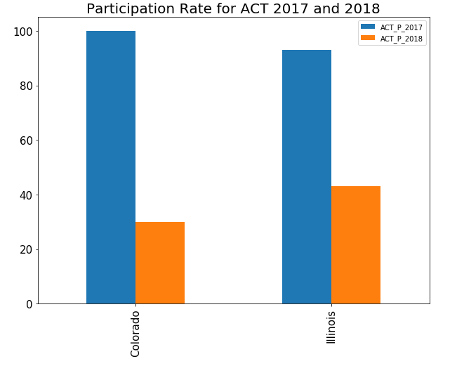
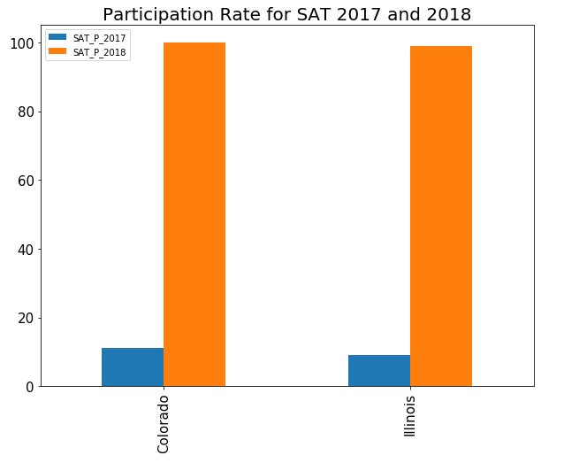
Observations
Government policy - Made compulsory for students to take the SAT to qualify for college.

Slide 5
Ways to improve SAT participation in Oklahoma
SATs to be made exit exam for high school.
Compulsory
Subsidized by school
Held on a school day
Implement compulsory PSAT one year before SAT

Slide 6
Additional Data needed
Collect PSAT data
Compare PSAT 2017 data to SAT 2018 data

