Slide 1

Rate Hikes or not?

Slide 2
Problem Statement
The ability of market participants to predict the FF rate is important to modern analyses of monetary policy in that other interest rates are believed to be linked to the FF rate by the market expectation of monetary policy actions that directly affect the FF rate.
Develop a machine learning model to predict if the Fed will increase or decrease the interest rate.

Slide 3
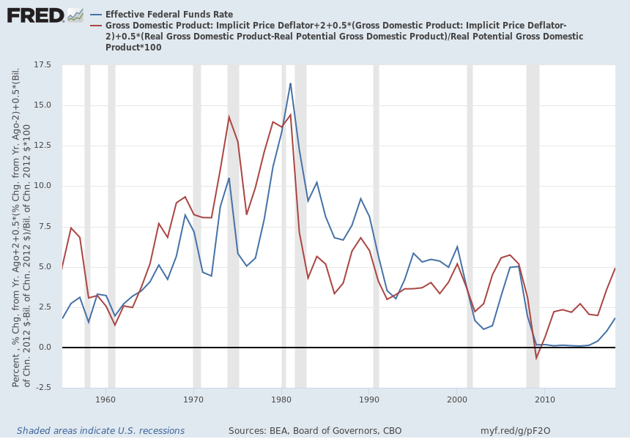
Taylor Rule
Guides how central banks should alter interest rates due to changes in the economy.
Adjust and set prudent rates for the short-term stabilization of the economy while maintaining long-term growth.
Recommends that interest rates should raise when inflation is high or when employment levels are high.

Slide 4
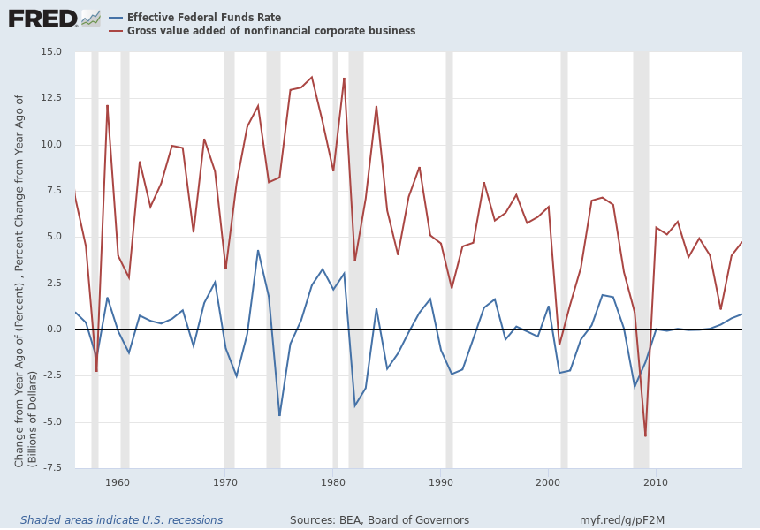
Gross Value Added of Nonfinancial Corporate Business

Slide 5
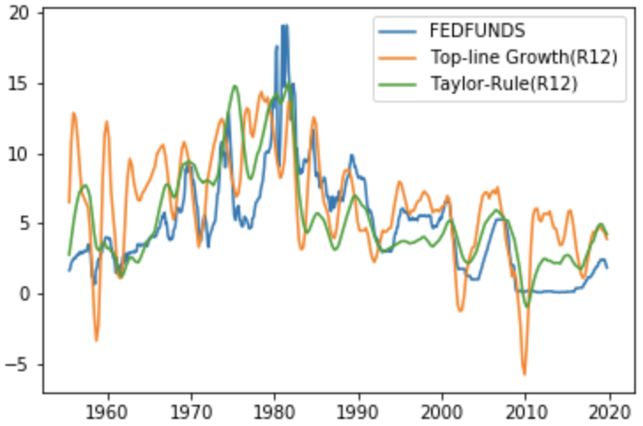
12 Months Rolling Average

Slide 6
Model Selection and Accuracy
Model | Training Accuracy | Validation Accuracy
Logistic Regression | 0.673 | 0.634
Support Vector Machine | 0.681 | 0.619
Random Forest | 0.683 | 0.627
Model | Test Accuracy
Logistic Regression | 0.693

Slide 7

Conclusions
When interest rate is already at 0, the model might inaccurately classify that the fed will decrease interest rate in times of low inflation/employment levels.

