Slide 1
System Level Programming Software College of SCU
Instructor: Shu, Li

Slide 2
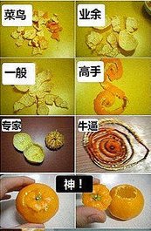
How to Peel an Orange?

Slide 3
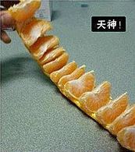
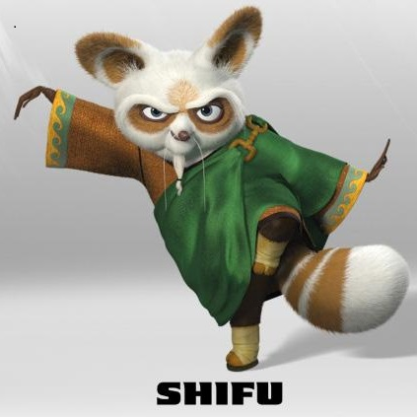

How to Peel an Orange?

Slide 4
System Level Programming Software College of SCU
Instructor: Shu, Li
week01.0

Slide 5
Unit 0. About this course
0.1 Introduction of this course
0.2 Reference
0.3 Some suggestions

Slide 6
0.1 Introduction of this course(1/11)
Prerequisites:
Computer Architecture, Operating System, C , X86 assembly language;

Slide 7
0.1 Introduction of this course(2/11)
Objective：
Provides students with a programmer-level view of computer system
1) learn computer system
2) learn some advanced programming topics of C
Writing High Level，Thinking Low Level
Consider the following questions ……
Question 1
Question 2

Slide 8
Q1: Any differences in behavior ? (3/11)
// A.1
#define ARRAY_SIZE 10
#include <stdio.h>
void main() {
int array[ARRAY_SIZE];
int i =1;
while (i <= ARRAY_SIZE) {
array[i] = i - 1;
i = i + 1;
}
printf("completed!\n");
}
// A.2
#define ARRAY_SIZE 10
#include <stdio.h>
void main() {
int i =1;
int array[ARRAY_SIZE];
while (i <= ARRAY_SIZE) {
array[i] = i - 1;
i = i + 1;
}
printf("completed!\n");
}

Slide 9
Q2: Any differences in Performance ? (4/11)
//B.1
for(i=0;i<n;i++)
for(j=0;j<n;j++)
{
sum=0.0;
for(k=0;k<n;k++)
sum += A[i][k]*B[k][j];
C[i][j] = sum;
}
//B.2
for(k=0;k<n;k++)
for(i=0;i<n;i++)
{
r=A[i][k];
for(j=0;j<n;j++)
C[i][j] += r*B[k][j];
}

Slide 10
0.1 Introduction of this course(5/11)
PART | Content | week | textbook
1 | Introduction | 1 | Chapter 1
2 | Representation of Data/code | 2~6 | Chapter 2&3
3 | Memory Related Issues | 7~9 | Chapter 3&10
4 | Performance & Optimization | 10~11 | Chapter 9&5
5 | MH & Cache | 12~13 | Chapter 6
6 | Linker & Loader | 14 | Chapter 7
7 | Process & Thread | 15 | Chapter 8&13

Slide 11
0.1 Introduction of this course(6/11)
Syllabus
1. The Wonder of Program Execution
2. Representation of Data
3. Representation of Code
4. Structured Data Representation
5. Function Call and Return：stack frame
6. Memory Layout and Allocation
7. Memory related bugs
8. Garbage collection
9. Performance Measurement
10. Optimizing Program Performance
11. Memory Operation and Performance
12. Cache and Cache-Aware Programming
13. Linking and Linker
14. Exception and Process/Thread

Slide 12
0.1 Introduction of this course(7/11)
Labs:
Lab 1：Using VC++ 6.0 IDE
Lab 2：Data Lab
Lab 3：Representation of Code
Lab 4：Structured Data Representation
Lab 5：Function Call and Return
Lab 6：Buffer Overflow
Lab 7: Binary Bomb
Lab 8：Memory related bugs
Lab 9：Garbage Collector
Lab 10：Performance Measurement
Lab 11：Optimizing Analysis
Lab 12：Memory Technologies and Memory Hierarchy
Lab 13：Cache and Cache-Aware Programming
Lab 14：Linking and Linker
Lab 15：Concurrent Programming

Slide 13
0.1 Introduction of this course(8/11)
Tools & Environment:
OS: Windows
Code::Blocks
https://www.codeblocks.org
VC++ IDE
https://support.microsoft.com/en-us/topic/the-latest-supported-visual-c-downloads-2647da03-1eea-4433-9aff-95f26a218cc0、
https://www.youtube.com/watch?v=2U3zZLP6jmA
Microsoft Visual C++ 6.0 Standard Edition.rar
https://www.youtube.com/watch?v=GPv8coYl3cE
VS98.rar

Slide 14
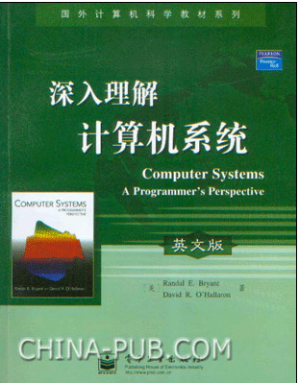
0.1 Introduction of this course(9/11)
Text Book
A book: CSAPP

Slide 15
0.1 Introduction of this course(10/11)
Each weeks : (3 periods) lecture + practice
Practice：C/C++
Multiple Choice Quiz
Lab practice
Recitation

Slide 16
0.1 Introduction of this course(11/11)
Grade:
60%
Multiple Choice Quiz
Practice/Lab
Recitation
Attendence
40% final exam (close book)

Slide 17
Unit 0. About this course
0.1 Introduction of this course
0.2 Reference
0.3 Some suggestions

Slide 18


0.2 Reference(1/4)
Write Great Code volume 1 & 2

Slide 19
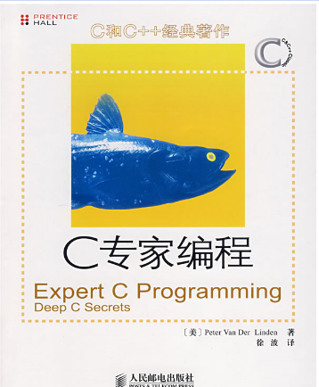
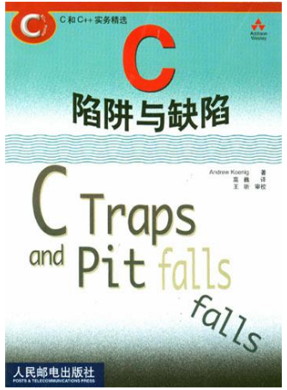

0.2 Reference(2/4)
C books

Slide 20

0.2 Reference(3/4)
Linker and Loader books

Slide 21
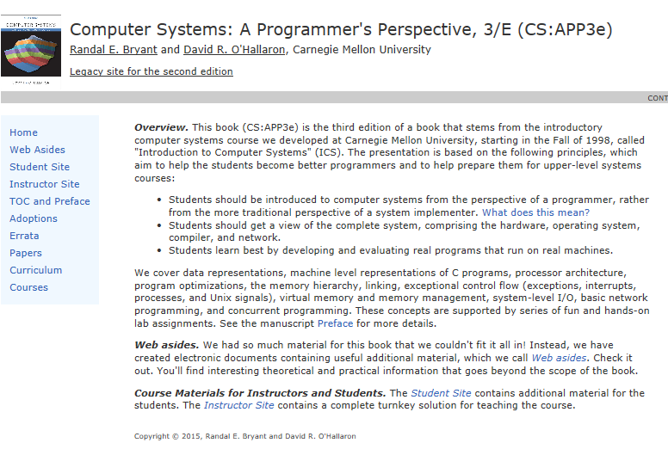
0.2 Reference(4/4)
http://csapp.cs.cmu.edu/

Slide 22
Unit 0. About this course
0.1 Introduction of this course
0.2 Reference
0.3 Some suggestions

Slide 23
0.3 Some suggestions(1/1)
1. Learning by doing
2. Having the courage to ask questions and discuss with your classmates
Failure reasons
A late start
Not focused
Not familiar with C program

