Slide 1
System Level Programming Software College of SCU
Week04

Slide 2
Unit 4. Structured Data Representation
4.0 Review
4.1 Pointers
4.2 Array
4.3 String
4.4 Structure and Union
4.5 Alignment

Slide 3
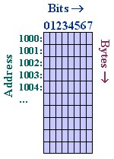
4.0 Review (1/6）
Memory Address
All data is stored in memory.
Memory is a sequence of bytes that is numbered, starting with 0x. That number is the address.
Think of memory as a single one-dimensional array
In general, neither the name nor the type of the variables survive this translation done by compiler. (important)

Slide 4
4.0 Review (2/6）
//Addresses.cpp
#include <stdio.h>
char globalchar1;
char globalchar2 = 'g';
int globalint1;
int globalint2 = 9;
char globalchar3;
int main (int argc, char * argv[ ])
{
char localchar1;
char localchar2 = 'l';;
int localint1;
int localint2 = 1;
char localchar3;
printf("Globals: '%c'(%d) '%c'(%d) %d %d '%c'(%d)\n",
globalchar1, globalchar1, globalchar2, globalchar2, globalint1, globalint2,
globalchar3, globalchar3);
printf("Locals: '%c'(%d) '%c'(%d) %d %d '%c'(%d)\n",
localchar1, localchar1,
localchar2, localchar2,
localint1, localint2,
localchar3, localchar3);
return 0;
}
Are variables allocated consecutive on memory?

Slide 5
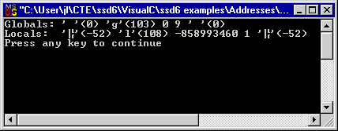
4.0 Review (3/6）
Why the Output:
It would appear
the uninitialized global variables seem to be somehow initialized to zero
but that the same is not true of local variables.
The 2’s complement of -52 is 0XCC.

Slide 6
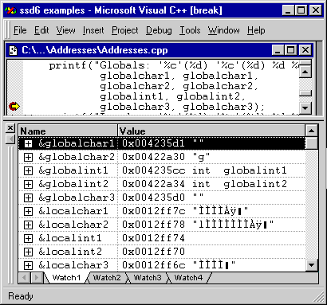
4.0 Review (4/6）
Pay attention to the addresses

Slide 7
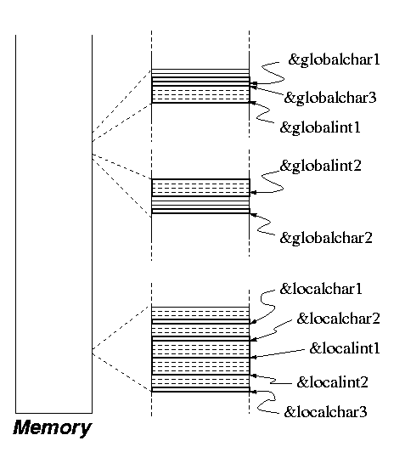
4.0 Review (5/6）
Global vs. Local Variables
all the local variables are clustered together.
of the global variables,
those that are initialized when declared are in one cluster,
those that are not initialized are in another.
uninitialized
High
initialized
Low
201001V1.1

Slide 8
4.0 Review (6/6）
We can notice that ints take 4 bytes and that chars take only one.
Because each byte of memory is independently addressable, one int will "use up" 4 addresses, whereas a char only needs one.
The compiler may choose to pack data less densely than it might.
You can see this in the figure, where it is obvious that out of some 4-byte blocks, only one of the bytes is used.

Slide 9
Unit 4. Structured Data Representation
4.0 Review
4.1 Pointers
4.2 Array
4.3 String
4.4 Structure and Union
4.5 Alignment

Slide 10
4.1 Pointers (1/18)
C gives the programmers the freedom to do just about anything.
Using pointer
It subverts the clean abstractions programming languages usually provide.

Slide 11
4.1 Pointers (2/18)
Definition:
Pointer variable (pointer): variable that holds an address
Declaration:
int* intptr;
Read as: “intptr can hold the address of an int”
Spacing in definition does not matter:
int * intptr;
int* intptr;

Slide 12
4.1 Pointers (3/18)
Pointers occupy 4 bytes on a 32-bit platform.
Key point：declaration vs. dereference
int *prt = NULL;
*prt = 5

Slide 13
4.1 Pointers (4/18)
Pointer arithmetic operation
Unary Operator ‘& ‘
The address-of operator (&) takes the address of its operand.
Unary Indirection Operators ‘*’
dereferences a pointer
Through ‘&’ and ‘*’ operators, a C programmer can make two variable names refer to the same location in memory.
An assignment to one of the variables will change the value of the other (important)

Slide 14
4.1 Pointers (5/18)
0xFFFFFFFF
Assignment:
char* p;
char c = ‘a’:
p = &c;
0x00
0x12
p
0xff
0x0012ff44
0x40
The statement
will indirectly rewrite the value of variable c from ‘a’ to ‘w’.
*
*p = ‘w’;
0x0012ff40
‘a’
0x00000000
Address
Data
Memory

Slide 15
4.1 Pointers (6/18)
We will verify the memory allocation of variables in “watch” window of VC IDE using the following file.
//Pointers.c
#include <stdio.h>
main (int argc, char * argv[])
{
char a = 'a';
char * ptr = &a;
while (1);
}

Slide 16
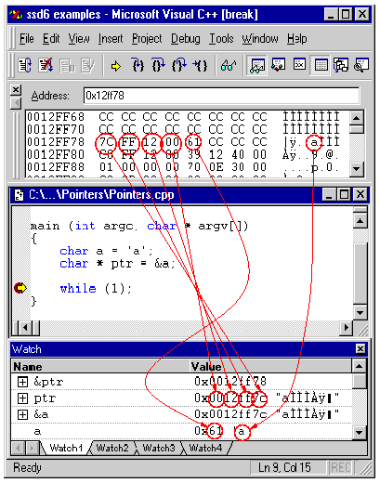
4.1 Pointers (7/18)
Address | Content
00 12 ff 78 | 0x7C
00 12 ff 79 | 0xFF
00 12 ff 7a | 0x12
00 12 ff 7b | 0x00
00 12 ff 7c | 0x61
00 12 ff 7d | 0xCC
00 12 ff 7e | 0xCC
00 12 ff 7f | 0xCC

Slide 17
4.1 Pointers (8/18)
“Read an integer as if it were a character“, is this possible at all?
The answer is: Yes
Reason: The real machine has no notion of integers or characters, it only knows about bits and bytes.
Conclusion: you should already realize that a character can be read as an integer, and vice versa, because they are both represented with raw bits in the hardware.

Slide 18
4.1 Pointers (9/18)
What if the data at 0x0012ff40 is actually allocated as the result of a declaration like int Variable?
int i =0x8041;
char* p;
p = (char *) &i;
What is the value of *p?

Slide 19
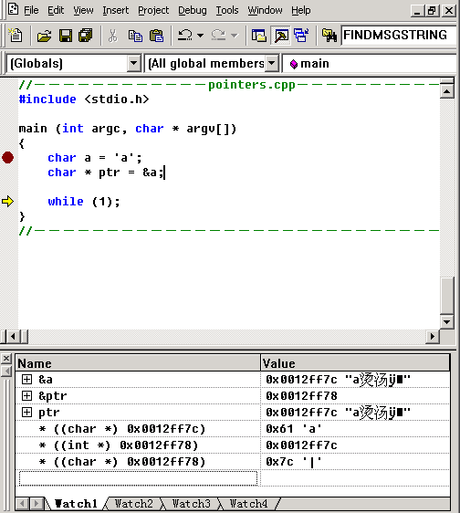
4.1 Pointers (10/18)
* ((char *) 0x0012ff7c)
gets a
* ((int *) 0x0012ff78)
gets address of a
* ((char*) 0x0012ff78)
gets the lowest byte of address of a

Slide 20
4.1 Pointers (11/18)
Encoding
It dictates which bit sequence represents which integer, and which bit sequence represents which character.
In other word, Encoding specifies the mapping of values to bit patterns, but it also specifies how many bits a particular type requires.
It depends on the computer and the encodings we use .
The compiler does this job and takes care of these details for us.

Slide 21
4.1 Pointers (12/18)
Pointer Arithmetic
Integers can be added to or subtracted from pointers using the operators +, -, +=, -=, ++and --
One pointer can be subtracted from another by using the subtraction operator –
But the meaning of adding or subtracting here is different from normal arithmetic. For example, by adding n, we get a value in memory location n elements away.

Slide 22
4.1 Pointers (13/18)
int start = (int)(*(((char *) &dummy)));
int stride = (int)(*(((char *) &dummy) + 1));
0x12ff77 | 0x01
0x12ff76 | 0x02
0x12ff75 | 0x03
0x12ff74 | 0x04
int dummy

Slide 23
4.1 Pointers (14/18)
int key1,key2;
process_keys12(&key1, &key2);
void process_keys12 (int * pkey1, int * pkey2)
{
*((int *) (pkey1 + *pkey1)) = *pkey2;
}
0
0
0
3
... | ...
key1 | 0
 | 0
 | 0
 | 2
key2 | 0
 | 0
 | 0
 | 3
pkey1=0x0012ff74
pkey2=0x0012ff70

Slide 24
4.1 Pointers (15/18)
Advantages
You can do almost anything with them
Pointers allow you to implement sharing without copying i.e. pass by reference vs. pass by copying
Pointers allow us to use dynamic memory allocation
Disadvantages
You can do almost anything with them.
You must manage all the memory

Slide 25
4.1 Pointer (16/18)
Function Pointer
An Example
void (*foo)(int);
To declare a pointer to function, we code it as if it were a prototype definition, with the function pointer in parentheses.
Explanation
In this example, foo is a pointer to a function taking one argument, an integer, and returning void.

Slide 26
4.1 Pointer (17/18)
Initializing Function Pointers
To initialize a function pointer, you must give it the address of a function in your program.
#include <stdio.h>
void my_int_func(int x) {
printf( "%d\n", x );
}
int main() {
void (*foo)(int);//declare function pointer
/* the ampersand(&) is actually optional */
foo = &my_int_func;
return 0;
}

Slide 27
4.1 Pointer (18/18)
Using a Function Pointer
#include <stdio.h>
void my_int_func(int x) {
printf( "%d\n", x );
}
int main() {
void (*foo)(int);
foo = &my_int_func;
/*call my_int_func (note that you do not need to write (*foo)(2) ) */
foo( 2 );
/* but if you want to, you may */
(*foo)( 2 );
return 0;
}

Slide 28
Unit 4. Structured Data Representation
4.0 Review
4.1 Pointers
4.2 Array
4.3 String
4.4 Structure and Union
4.5 Alignment

Slide 29
4.2 Arrays(1/10)
Array definition and Memory allocation
A sequence of elements of some uniform type.
The compiler arranges array elements adjacent to one another in memory in increasing order

Slide 30
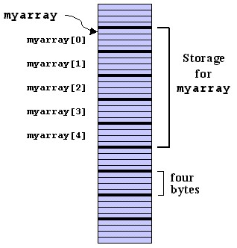
4.2 Arrays(2/10)
Examples：
int myarray[5]
low
high

Slide 31
4.2 Arrays(3/10)
Array VS Pointer：
myarray + N = &(myarray[N])
myarray[N] = *(myarray + N)
Pointer’s Bound check : none

Slide 32
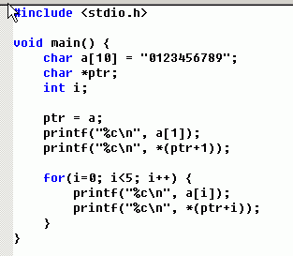
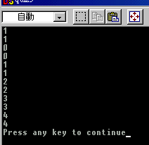
4.2 Arrays(5/10)

Slide 33
4.2 Arrays(6/10)
intArray + 7
charArray + 7
7*4=28 bytes
7 bytes
intArray
charArray
char charArray[10]
int intArray[10]

Slide 34
4.2 Arrays(7/10)
Arrays of Multi-Byte Types
int intArray[10]
0
0
0
0
intArray[2] = 3
0
3
0
intArray[1] = 2
0
0
2
0
0
intArray[0] = 1
0
intArray = 0x00123456
1
*(int *)((char *)intArray + 7);

Slide 35
4.2 Arrays(8/10)
2-Dimensional Array
E.g. long a[2][3];
This declares an array with 2 elements, each of which is an array of 3 elements, so it looks like this in memory:
a[n][m] == (a[n])[m] == *((a[n]) + m) == *(*(a + n*3) + m)
In this example, 3 is the number of elements in a single row of the two-dimensional array.
a[0][0]
a[0][1]
a[0][2]
a[1][0]
a[1][1]
a[1][2]

Slide 36
4.2 Arrays(9/10)
for (int i = 0; i < 3; i++)
for (int j = 0; j < 4; j++)
*(md + i*4 + j) = 0;//compiler error：left operand must be l-value
i=0,j= 0, *md =0;
for (int i = 0; i < 3; i++)
for (int j = 0; j < 4; j++)
*(*(md+ i*4) + j) = 0;//right

Slide 37
4.2 Arrays(10/10)
Expression of 2-D Array
for (int i = 0; i < 3; i++)
for (int j = 0; j < 4; j++)
md[i][j] = 0;
for (int i = 0; i < 3; i++)
for (int j = 0; j < 4; j++)
*((int*)(md) + i*4 + j) = 0;

Slide 38
Unit 4. Structured Data Representation
4.0 Review
4.1 Pointers
4.2 Array
4.3 String
4.4 Structure and Union
4.5 Alignment

Slide 39
4.3 String(1/4)
In C, there is no string type.
A string is an array of chars terminated by the character `\0' (also known as the null character)
Standard string library:
char *strcat (char *dest, char *src)
char *strcpy( char *dest, char *src );
int strcmp(char *string1, char *string2 );
int strlen (char *s)
char *strchr (char *s, char c)
…

Slide 40
4.3 String(2/4)
An array of character is terminated by a null character (0x00)
char a[4] = “Hi?”;
a[0] = H;
a[1] = I;
a[2] =?;
a[3] = 0x00
Incorrect declaration:
char a[3] = “Hi?”;
as 0x00 is missing

Slide 41
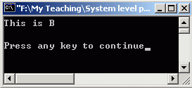
4.3 String(3/4)
// Demonstrate ArrayStorage.cpp
#include <stdio.h>
void Initialize (char * a, char * b) {
a[0] = 'T'; a[1] = 'h'; a[2] = 'i';
a[3] = 's'; a[4] = ' '; a[5] = 'i'; a[6] = 's';
a[7] = ' '; a[8] = 'A'; a[9] = '\0';
b = a;
b[8] = 'B';
}
#define ARRAY_SIZE 10
char a[ARRAY_SIZE];
char b[ARRAY_SIZE];
int main(int argc, char * argv[]) {
Initialize(a, b);
printf("%s\n%s\n", a, b);
return 0;
}

Slide 42
4.3 String(4/4)
gloabl
a | 0x00402000
b | 0x0040200C
mem segment
Initialize Local para
a | 0x00402000
b | 0x0040200c
mem segment
0x00402000

Slide 43
Unit 4. Structured Data Representation
4.0 Review
4.1 Pointers
4.2 Array
4.3 String
4.4 Structure and Union
4.5 Alignment

Slide 44
4.4 Structure and Union (1/7)
Structures(Records) store a collection of arbitrary elements that are accessed by name
Records are declared using the struct keyword in C or C++

Slide 45
4.4 Structure and Union (2/7)
Defining Structs
struct {
char a, b, c, cc;
int i;
double d;
} v1, v2;
What we have achieved: Two struct variables v1 and v2.
Elements can be accessed as follows: v1.a, v2.d, etc.
Problem:
This struct definition cannot easily be reused (say, we want to use it for v3 too, but v3 is defined later)
How to make a struct containing a pointer to itself (linked-list)?

Slide 46
4.4 Structure and Union (3/7)
Defining Structs with Tags
struct person
{
int alter;
char *name;
struct person *next;
} v1, v2;
struct person v3;
Now we can have self references
Definition can be reused

Slide 47
4.4 Structure and Union (4/7)
Defining new Types
typedef struct person_tag
{
int alter;
char *name;
struct person_tag *next;
} person_typ;
person_typ v1, v2, v3;
… and later:
v1.alter = 26;
Now we need not to specifiy “struct” all the time when defining variables.
We can also directly define types which are pointers to structs.

Slide 48
4.4 Structure and Union (5/7)
Defining new Types
struct person_tag
{
int alter;
char *name;
struct person_tag *next;
};
typedef struct person_tag Person;

Slide 49
4.4 Structure and Union (6/7)
Memory Layout of Structs
RULE 1:
The alignment of a struct is the same as the largest alignment of its elements
RULE 2:
The size of a struct is a multiple of its alignment

Slide 50
4.4 Structure and Union (7/7)
Union is a data structure which represents only one of the component in the declaration.
The memory allocated for a union variable is determined by the largest component in the union.
Compared with struct
struct S{
char c;
int i[2];
double v;
};
union U{
char c;
int i[2];
double v;
};
Type | c i v (address) | Sizeof
Struct | 0 4 12 | 20
Union | 0 0 0 | 8

Slide 51
Unit 4. Structured Data Representation
4.0 Review
4.1 Pointers
4.2 Array
4.3 String
4.4 Structure and Union
4.5 Alignment

Slide 52
4.5 Alignment(1/5)
What is Alignment ?
compilers often try to align data to word boundaries or even double-word boundaries
Padding
some inserted meaningless bytes between the end of the last data structure and the start of the next
The same to stack and heap
Why
increases the system's performance due to the way the CPU handles memory.

Slide 53
4.5 Alignment(2/5)
Implementing a game:
struct Player {
int x, y;
char symbol;
short health;
};

Slide 54
4.5 Alignment(3/5)
Investigating field offsets
#include <stdio.h>
#define OFFSET_OF(s,f) ((unsigned) ((char*)&s.f - (char*)&s))
struct Player {
int x, y;
char symbol;
short health;
};
int main(void) {
struct Player p;
printf("x offset=%u\n", OFFSET_OF(p,x));
printf("y offset=%u\n", OFFSET_OF(p,y));
printf("symbol offset=%u\n", OFFSET_OF(p,symbol));
printf("health offset=%u\n", OFFSET_OF(p,health));
return 0;
}

Slide 55
4.5 Alignment(4/5)
Why "wasting" space?
access to multiple-byte data like d is faster if the data is aligned on natural hardware boundaries
Alignment (8-byte as example)
struct itself will start on an 8-byte boundary
the structure must have a length that is a multiple of 8 bytes
Differs in debug or release version

Slide 56
4.5 Alignment(5/5)
specify struct alignment
#include <stdio.h>
#define OFFSET_OF(s,f) ((unsigned) ((char*)&s.f - (char*)&s))
#pragma pack (1) /*specified by 1 byte aligned*/
struct Player {
int x, y;
char symbol;
short health;
};
int main(void) {
struct Player p;
printf("x offset=%u\n", OFFSET_OF(p,x));
printf("y offset=%u\n", OFFSET_OF(p,y));
printf("symbol offset=%u\n", OFFSET_OF(p,symbol));
printf("health offset=%u\n", OFFSET_OF(p,health));
return 0;
}

