Slide 1
System Level Programming Software College of SCU
Week05

Slide 2
Unit 5. Function Call and Return
5.0 Introduction
5.1 Implementation of Parameter and Local Variables
5.2 Activation Record
5.3 Function Invocation Process
5.4 Procedure Example

Slide 3
5.0 Introduction(1/4)
Why use function?
To reuse a segment of code, by inputting different value, and getting back the return value

Slide 4
5.0 Introduction(2/4)
int sum (int a, int b)
{
int c;
c= a+b;
return c;
}
void main()
{
int x=100, y=200;
int s = sum (x, y);
}
sum proc far
….
….
….
ret
sum endp
….
….
….
call sum

Slide 5
5.0 Introduction(3/4)
Just like jump and branch, the “call” and “ret” instructions change the execution order by changing the value of PC
There are also data transferring when using function, such as parameters/argument, return value
Also usually there are local variables inside the function

Slide 6
5.0 Introduction(4/4)
Conclusion
parameters
local variables
return value
return address

Slide 7
Unit 5. Function Call and Return
5.0 Introduction
5.1 Implementation of Parameter and Local Variables
5.2 Activation Record
5.3 Function Invocation Process
5.4 Procedure Example

Slide 8
5.1 Implementation of Parameter and Local Variables
5.1.1 Local Variables
5.1.2 Parameter/ Argument
5.1.3 How the compiler implement them

Slide 9
5.1.1 Local Variables(1/6)
Scope of Variables
Global variable
It can be accessed by other functions.
Local variable
It is private to that function in which it is declared.

Slide 10
5.1.1 Local Variables(2/6)
Can variables have the same name?
The answer is: It Depends…
Why?
The same variable name may be mapped to different addresses by the compiler.

Slide 11
5.1.1 Local Variables(3/6)
Example Scope.c
#include <stdio.h>
int first;
int second;
void callee ( int first ) {
int second; second = 1; first = 2; printf("callee: first = %d second = %d\n", first, second);
}
int main (int argc, char *argv[]) {
first = 1;
second = 2; callee(first); printf("caller: first = %d second = %d\n", first, second);
return 0;
}

Slide 12
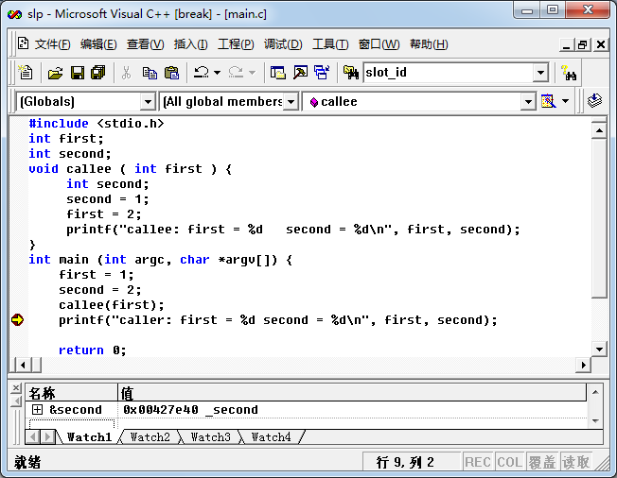
5.1.1 Local Variables(4/6)
Address of second is 0x00427e40 in main()

Slide 13
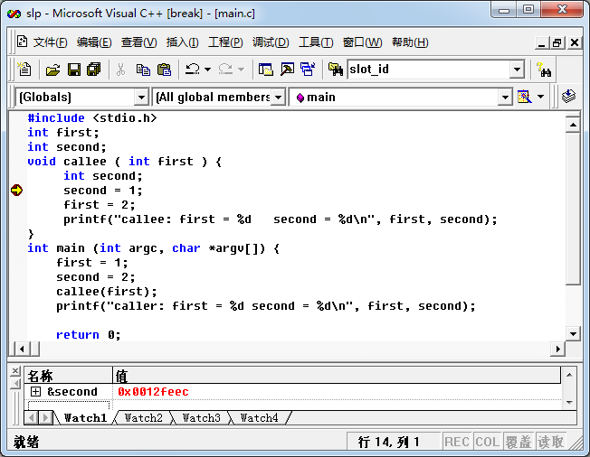
5.1.1 Local Variables(5/6)
Address of second is 0x0012feec in callee()

Slide 14
5.1.1 Local Variables(6/6)
Conclusion:
The variables occupy memory.
The compiler (and the debugger) maps the variables with same name to completely different addresses in order to achieve the illusion of scoping.

Slide 15
5.1 Implementation of Parameter and Local Variables
5.1.1 Local Variables
5.1.2 Parameter/ Argument
5.1.3 How the compiler implement them

Slide 16
5.1.2 Parameter/ Argument(1/7)
Formal Parameters & Actual Parameters
void callee ( int first ) { int second; second = 1; first = 2; printf("callee: first = %d second = %d\n", first, second);
}
first = 1
… callee(first) // pass the value of first to callee

Slide 17
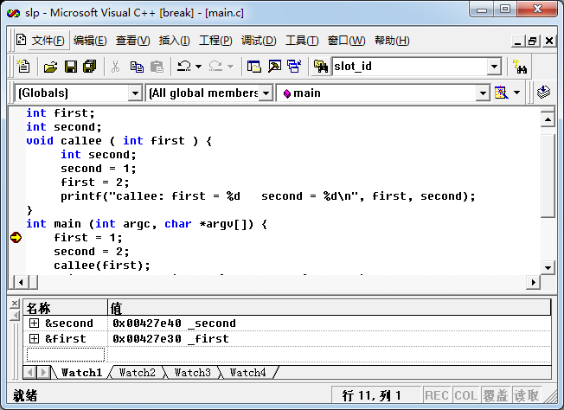
5.1.2 Parameter/ Argument(2/7)
Address of first is 0x00427e30 in main()

Slide 18
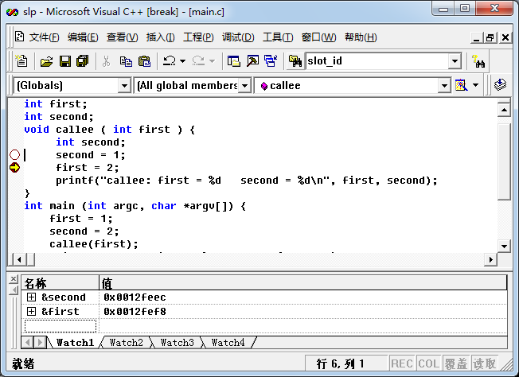
5.1.2 Parameter/ Argument(3/7)
Address of first is 0x0012fef8 in callee()

Slide 19
5.1.2 Parameter/ Argument(4/7)
Notice:
For a formal parameter (形参) to a function, the compiler assigns an address for the scope of the callee - just as if it were declared locally.
This allows the actual parameter (实参)to remain unperturbed（不被打扰的） by any assignment made to the formal parameter in the callee.

Slide 20
5.1.2 Parameter/ Argument(5/7)
Passed by value
This allows the actual parameter to remain unperturbed
Passed by reference
C has no language support for calling by reference
but it is very easy to achieve the same effect using its & and * operators.

Slide 21
5.1.2 Parameter/ Argument(6/7)
#include <stdio.h>
void callee ( int * first ) //not a variable, but an address
{
int second; second = 1;
*first = 2; printf("callee: first = %d second = %d\n", *first, second);
}
int main (int argc, char *argv[])
{
int first = 1; // &first = 0x0012ff7c
int second = 2;
callee(&first); //passed by address --- printf("caller: first = %d second = %d\n", first, second); return 0;
}
Content by address
callee: first = 2 second = 1
caller: first = 2 second = 2

Slide 22
5.1.2 Parameter/ Argument(7/7)
const casts original data to a constant for use in the function.
void doSomething(const SomeBigClass& x) {
...
}
main() {
SomeBigClass x(100);
// initialize and do whatever with x
doSomething(x);
...
}

Slide 23
5.1 Implementation of Parameter and Local Variables
5.1.1 Local Variables
5.1.2 Parameter/ Arguments
5.1.3 How the compiler implement them

Slide 24
5.1.3 How the compiler implement them(1/7)
What we have seen:
In the example above we saw that local and global variables seem to be allocated in very different address ranges,
and also that globals are near other globals, and locals near other locals.

Slide 25
5.1.3 How the compiler implement them(2/7)
10 (0x0065fda4)
9 (0x0065fd4c)
8 (0x0065fcf4)
7 (0x0065fc9c)
6 (0x0065fc44)
5 (0x0065fbec)
4 (0x0065fb94)
3 (0x0065fb3c)
2 (0x0065fae4)
1 (0x0065fa8c)
1 (0x0065fa8c)
2 (0x0065fae4)
3 (0x0065fb3c)
4 (0x0065fb94)
5 (0x0065fbec)
6 (0x0065fc44)
7 (0x0065fc9c)
8 (0x0065fcf4)
9 (0x0065fd4c)
10 (0x0065fda4)
#include <stdio.h>
#include <stdlib.h>
void callee (int n) {
if (n == 0) return;
printf("%d (0x%08x)\n", n, &n);
callee (n - 1);
printf("%d (0x%08x)\n", n, &n);
}
int main (int argc, char * argv[]) {
int n;
if (argc < 2) {
printf("USAGE: %s \n", argv[0]);
return 1;
}
n = atoi(argv[1]);
callee(n);
return 0;
}

Slide 26
5.1.3 How the compiler implement them(3/7)
Recursion
Calling itself, say
callee (n) {
if (n == 0) return;
printf(“……”);
callee(n-1);
}
It will create local variable (n) for each call

Slide 27
5.1.3 How the compiler implement them(4/7)
A Problem
The compiler would not be able to decide how many to allocate until after the program was already running.
But if the program is running, the compiler should has already finished its work!

Slide 28
5.1.3 How the compiler implement them(5/7)
Solution
Global variables can be allocated statically.
This means that the compiler can fix specific addresses for global variables before the program executes.
Compilers must allocate local variables dynamically because
functions can be called recursively, and each recursive invocation needs its own instantiation of local variables

Slide 29
5.1.3 How the compiler implement them(6/7)
Why the local variables are allocated to addresses that are very far away from the addresses that hold the global variables?
Answer:
Because the compiler does not know how many variables it will need to allocate dynamically, it reserves a lot of space for expansion.

Slide 30
5.1.3 How the compiler implement them(7/7)
Actual parameters and local variables need to be allocated memory space dynamically in stack segment.
Stack
Stack is a special region of the memory that stores temporary variables created by each function.
The stack grows and shrinks as functions push and pop local variables.
There is no need to manage the memory yourself, variables are allocated and freed automatically.

Slide 31
Unit 5. Function Call and Return
5.0 Introduction
5.1 Implementation of Parameter and Local Variables
5.2 Activation Record/Stack Frame
5.3 Function Invocation Process
5.4 Procedure Example

Slide 32
5.2 Activation Record
5.2.1 What is Activation Record/Stack Frame
5.2.2 The elements of Stack Frame

Slide 33
5.2.1 What is Activation Record(1/7)
Local variable and actual parameters：
dynamically allocated
Disadvantages：
slow down the program’s execution

Slide 34
5.2.1 What is Activation Record(2/7)
Solution
To minimize the cost of dynamic allocation，
the compiler calculates the amount of total space required for the function's locals and
allocates that space in one single chunk.

Slide 35
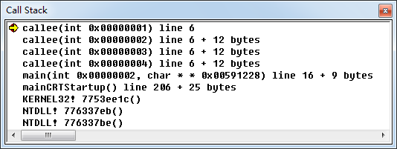
5.2.1 What is Activation Record(3/7)
Activation Record/Stack Frame：
The chunk of memory allocated for each function invocation
Activation records are organized in the stack , they are often also called stack frames.
Life cycle：function call/function return

Slide 36
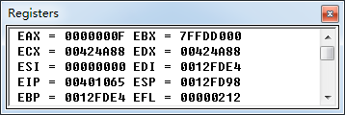
5.2.1 What is Activation Record(4/7)
Hardware Supports
ESP: Point to the top of the stack
EBP: Base pointer for the current stack frame
EIP: Hold the address of instruction to execute next

Slide 37
5.2.1 What is Activation Record(5/7)
Only the activation record at the top of the stack (or simply TOS) can be accessed.
Is this Rule OK? : YES
A function never returns before all of its active subroutines return.
We never need to access data from an activation record that is not at the top of the stack

Slide 38
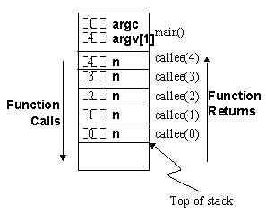
5.2.1 What is Activation Record(6/7)
In practice, most computers allocate activation record stacks (often called simply "stacks") from higher addresses to lower addresses
H
L

Slide 39
5.2.1 What is Activation Record(7/7)
The order of returns from a function is the reverse of function invocations; that is, LIFO behavior.
H
L

Slide 40
5.2 Activation Record
5.2.1 Basic of Activation Record and Stack Frame
5.2.2 The elements of Stack Frame

Slide 41
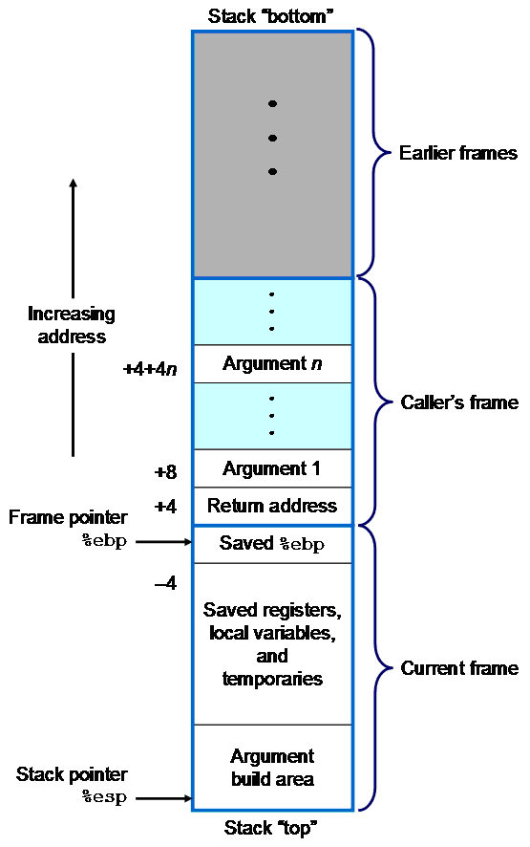

5.2.2 The Elements of Stack Frame(1/2)
Stack Frame growth

Slide 42
5.2.2 The Elements of Stack Frame(2/2)
The stack frame usually includes the following items
arguments (parameter values) passed to the routine;
return address back to the routine's caller;
caller’s ebp;
space for the local variables of the routine
saved registers

Slide 43
Unit 5. Function Call and Return
5.0 Introduction
5.1 Implementation of Parameter and Local Variables
5.2 Activation Record
5.3 Function Invocation Process
5.4 Procedure Example

Slide 44
5.3 Function Invocation Process
5.3.1 The process of call/ret
5.3.2 Caller/Callee and Stack Frame
5.3.3 Function Calling Conventions

Slide 45
5.3.1 The process of call/ret(1/4)
When a function is called, the compiler and hardware:
push parameters into the stack
push the return address into the stack
push the frame pointer into the stack
set the frame pointer equal to the stack pointer
decrement the stack pointer by as many memory addresses as are required to store the local state of the callee.

Slide 46
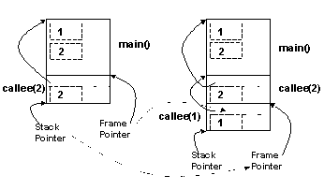
5.3.1 The process of call/ret(2/4)
Diagram - stack push (call)

Slide 47
5.3.1 The process of call/ret(3/4)
When a function returns, the compiler and hardware:
Set the stack pointer equal to the frame pointer.
Pop the value of the old frame pointer from the stack.
Set the EBP equal to the value of old frame pointer
Pop the return address, set EIP equal to the value
Pop the parameter(s)

Slide 48
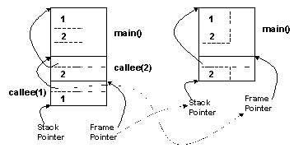
5.3.1 The process of call/ret(4/4)
Diagram - stack pop (return)

Slide 49
5.3 Function Invocation Process
5.3.1 The process of call/ret
5.3.2 Caller/Callee and Stack Frame
5.3.3 Function Calling Conventions

Slide 50
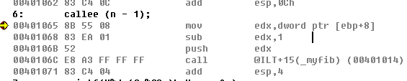
5.3.2 Caller/Callee and Stack Frame(1/11)
1. Function Call
Caller Responsibilities
Save caller-save registers (if necessary)
eax, ecx, edx
Arguments (push)
Pushed onto stack
In what order?
Arguments
Return Addr
Old ebp
Local
Variables
saved
register
Argument
Build

Slide 51
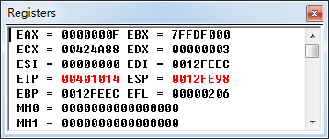
5.3.2 Caller/Callee and Stack Frame(2/11)
1. Function Call
Caller Responsibilities
Execute the call instruction
Pushes return address (that of the next instruction) onto the stack
Set EIP register
Arguments
Return Addr
Old ebp
Local
Variables
saved
register
Argument
Build

Slide 52
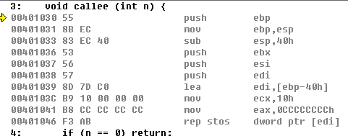
5.3.2 Caller/Callee and Stack Frame(3/11)
1. Function Call
Callee Responsibilities
Save base pointer on stack
push ebp
Arguments
Return Addr
Old ebp
Local
Variables
saved
register
Argument
Build

Slide 53
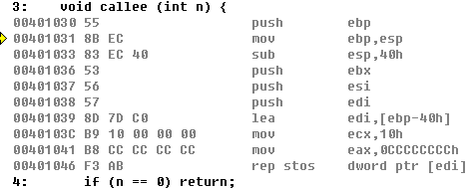
5.3.2 Caller/Callee and Stack Frame(4/11)
1. Function Call
Callee Responsibilities
Set base pointer to point to the top of the stack
mov ebp,esp
Arguments
Return Addr
Old ebp
Local
Variables
saved
register
Argument
Build

Slide 54
5.3.2 Caller/Callee and Stack Frame(5/11)
1. Function Call
Callee Responsibilities
Allocate space for local variables
Decrement the stack pointer
sub esp,40h
Arguments
Return Addr
Old ebp
Local
Variables
saved
register
Argument
Build

Slide 55
5.3.2 Caller/Callee and Stack Frame(6/11)
1. Function Call
Callee Responsibilities
Save callee-save registers
push ebx
push esi
push edi
Arguments
Return Addr
Old ebp
Local
Variables
saved
register
Argument
Build

Slide 56
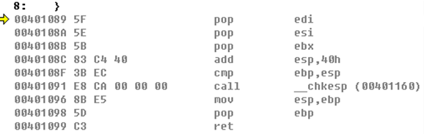
5.3.2 Caller/Callee and Stack Frame(7/11)
2. Function Call Return
Callee Responsibilities
Move return value into eax
Pop registers
Arguments
Return Addr
Old ebp
Local
Variables
Saved
Registers
Argument
Build

Slide 57
5.3.2 Caller/Callee and Stack Frame(8/11)
2. Function Call Return
Callee Responsibilities
Restore stack pointer
mov esp,ebp
Arguments
Return Addr
Old ebp
Local
Variables
Saved
Registers
Argument
Build

Slide 58
5.3.2 Caller/Callee and Stack Frame(9/11)
2. Function Call Return
Callee Responsibilities
Restore the base pointer to value for calling function
pop ebp
Arguments
Return Addr
Old ebp
Local
Variables
Saved
Registers
Argument
Build

Slide 59
5.3.2 Caller/Callee and Stack Frame(10/11)
2. Function Call Return
Callee Responsibilities
Execute the ret instruction
Pops a value from the stack
Set EIP
Arguments
Return Addr
Old ebp
Local
Variables
Saved
Registers
Argument
Build

Slide 60
5.3.2 Caller/Callee and Stack Frame(11/11)
2. Function Call Return
Caller Responsibilities
Increment the stack pointer for arguments
add esp,4
Arguments
Return Addr
Old ebp
Local
Variables
Saved
Registers
Argument
Build

Slide 61
5.3 Function Invocation Process
5.3.1 The process of call/ret
5.3.2 Caller/Callee and Stack Frame
5.3.3 Function Calling Conventions

Slide 62
5.3.3 Function Calling Conventions(1/2)
Calling conventions describe the interface of called code:
The order in which parameters are allocated
Where parameters are placed (pushed on the stack or placed in registers)
Which registers may be used by the function
How the task of setting up for and cleaning up after a function call is divided between the caller and the callee

Slide 63
5.3.3 Function Calling Conventions(2/2)
Calling Conventions Types
_cdecl
Parameters are pushed into stack by the order of “from right to left”
caller’s Responsibility to clean parameters on the stack
Default for C programming language
_stdcall (WinAPI)
Parameters are pushed into stack by the order of “from right to left”
callee’s Responsibility to clean parameters on the stack

Slide 64
Unit 5. Function Call and Return
5.0 Introduction
5.1 Implementation of Parameter and Local Variables
5.2 Activation Record
5.3 Function Invocation Process
5.4 Procedure Example

Slide 65
5.4 Procedure Example(1/4)
#include <stdio.h>
#include <stdlib.h>
int myfib(int n) {
if(n<3) { return 1; }
return myfib(n-2) + myfib(n-1);
}
int fib(int n) {
return myfib(n);
}
void main(int argc,char** argv) {
int x = atoi(argv[1]);
printf("fib(%d)=%d\n",x,fib(x));
}
0x0012ff7c | 4
0x0012ff78 | rtn_addr
0x0012ff74
0x0012ff70

Slide 66
5.4 Procedure Example(2/4)
Requirement of full up the form
Fill in the blanks the value of these memory locations so that it shows the stack when the function fib has been invoked with 4 as the argument and myfib(2) has been entered for the second time.
Objective
Test your understanding of the stack frame structure.

Slide 67
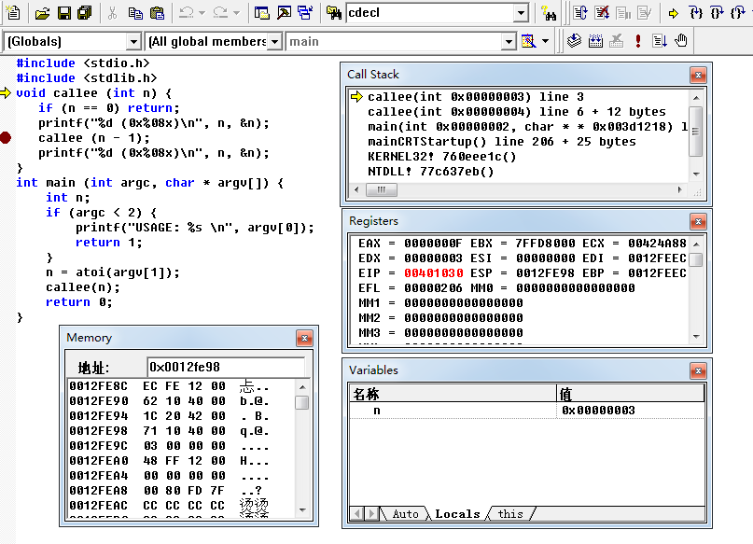
5.4 Procedure Example(3/4)
Set breakpoint

Slide 68
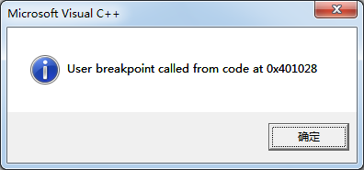
5.4 Procedure Example(4/4)
INT 3.
Breakpoint Interrupt
Defined for use by debuggers to set a breakpoint.
int main(int argc, char* argv[])
{
// manual breakpoint
__asm INT 3;
printf("Hello INT 3!\n");
return 0;
}

