Slide 1
System Level Programming Software College of SCU
week06

Slide 2
1. Decoding Lab
1.1 Review of cryptography
1.2 Problem Description
1.3 Code Analysis

Slide 3
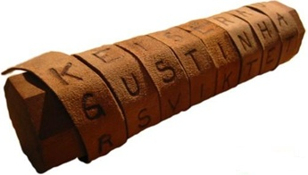

1.1 Review of cryptography(1/7)
Transposition Cipher (变位密码)
scytale
the scytale is a transpositon cipher
thesn eipcs soica spyti htrte aairl no

Slide 4
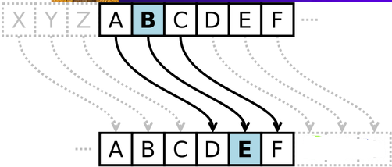

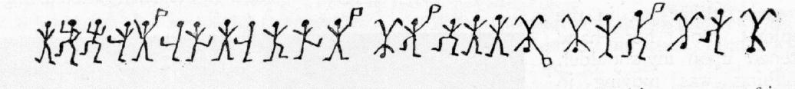
1.1 Review of cryptography(2/7)
Substitution Cipher (替换密码)
Caesar Cipher
wkhfd hvduf lskhu lvdvx evwlw xwlrq flskh u
the caesar cipher is a substituion cipher

Slide 5
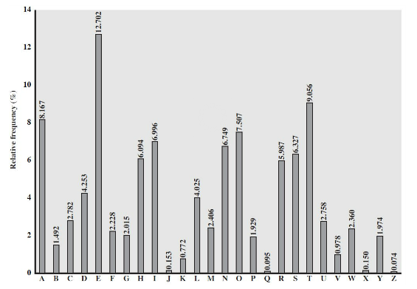
1.1 Review of cryptography(3/7)
Disadvantage of Substitution Cipher
It can be broken by frequency analysis.
English Letter Frequencies

Slide 6
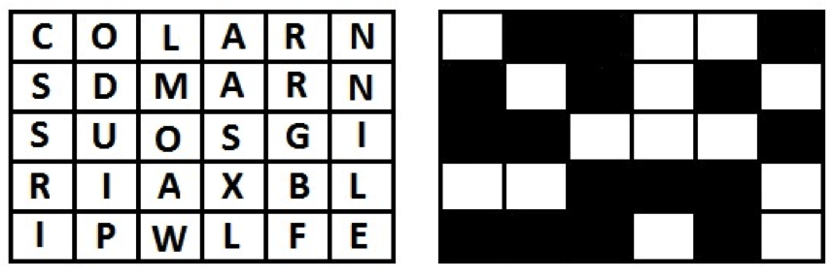
1.1 Review of cryptography(4/7)
Grille Cipher(格栅密码)
A steganographic method, where the message was hidden in a number of other letters.

Slide 7
1.1 Review of cryptography(5/7)
Principles of Modern Cryptography
Kerckhoffs' principle
The design of a system should not require secrecy

Slide 8
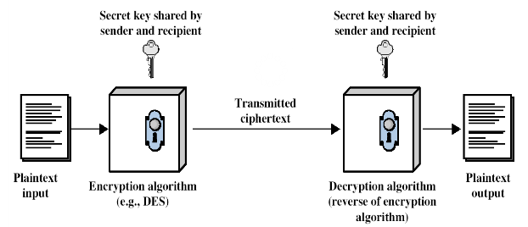
1.1 Review of cryptography(6/7)
Symmetric-key Cryptography

Slide 9
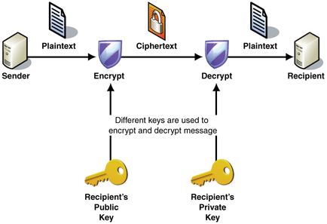
1.1 Review of cryptography(7/7)
Asymmetric-key Cryptography
Notes:
RSA公钥加密体制包含如下3个算法：KeyGen（密钥生成算法），Encrypt（加密算法）以及Decrypt（解密算法）

Slide 10
1. Decoding Lab
1.1 Review of cryptography
1.2 Problem Description
1.3 Code Analysis

Slide 11
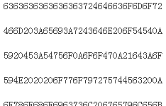
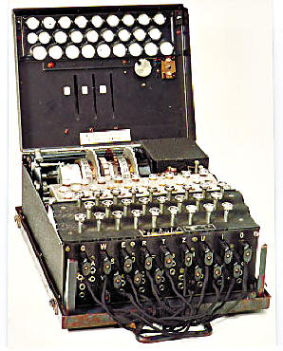
1.2 Problem Description(1/1)
???
???
Plaintext
Cipher-text
Decoder
key1? key2?
key3? key4?

Slide 12
1. Decoding Lab
1.1 Review of cryptography
1.2 Problem Description
1.3 Code Analysis

Slide 13
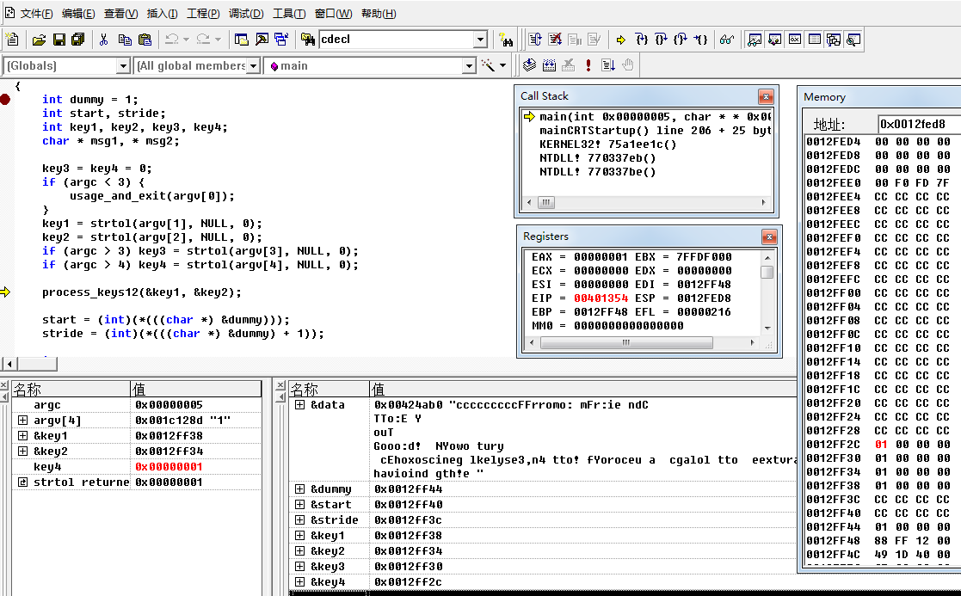
1.3 Code Analysis(1/19)

Slide 14
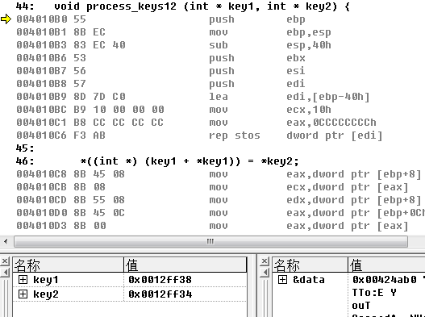
1.3 Code Analysis(2/19)
What process_keys12 does?
void process_keys12 (int * key1, int * key2) {
*((int *) (key1 + *key1)) = *key2;
}

Slide 15
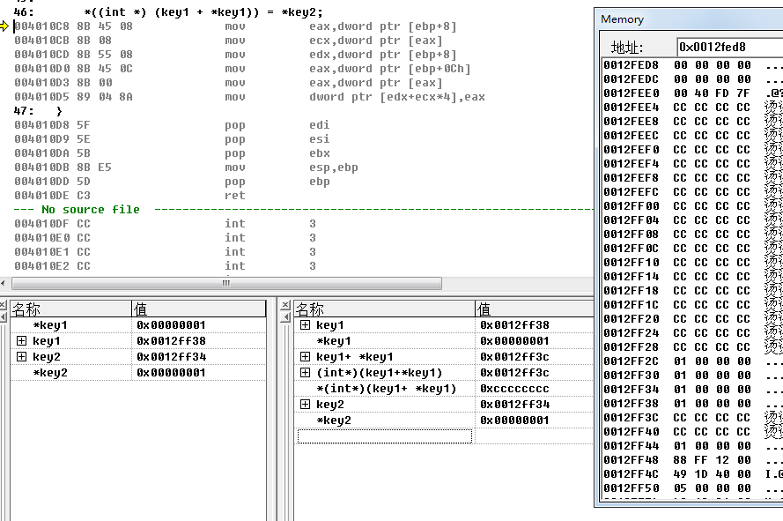
1.3 Code Analysis(3/19)
What process_keys12 does?

Slide 16
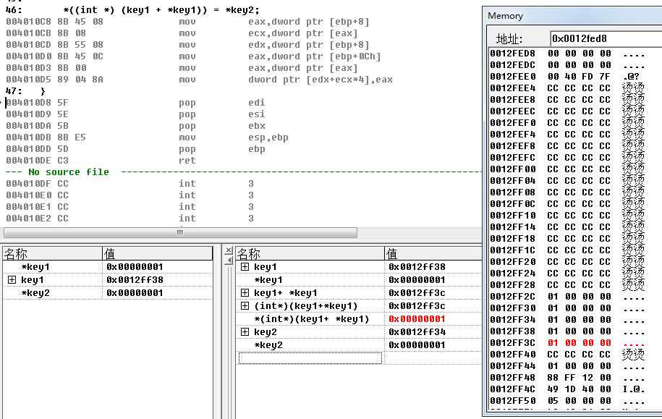
1.3 Code Analysis(4/19)
What process_keys12 does?
The function process_keys12 modifies the value of address 0012ff3c in this case by key1=1 and key2=1.

Slide 17
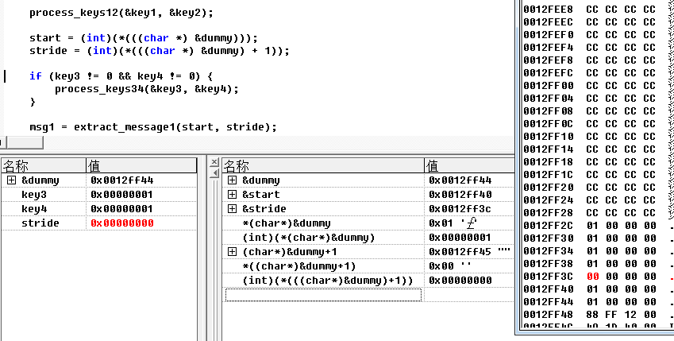
1.3 Code Analysis(5/19)
How to get the value of local variables start and stride?

Slide 18
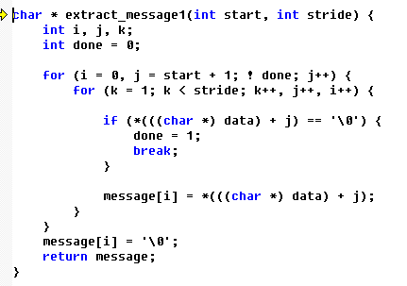
1.3 Code Analysis(6/19)
What extract_message1 does?

Slide 19
1.3 Code Analysis(7/19)
What extract_message1 does?
Extract message from data by rule.
For example: 1234567890A
start:0 and stride: 2, will produce 24680
Start:0 and stride: 3, will produce 235689A
Start:0 and stride: 4, will produce 2346780A
Start:1 and stride: 3, will produce 346790

Slide 20
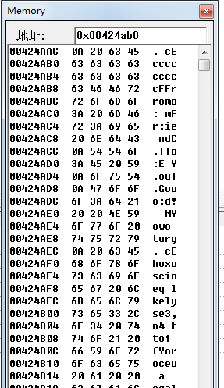
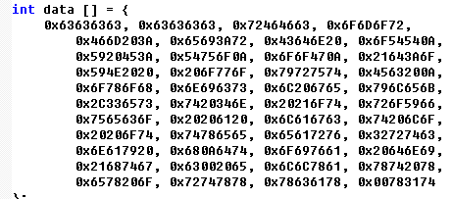
1.3 Code Analysis(8/19)
What about array data?

Slide 21
1.3 Code Analysis(9/19)
Now, guess!!
cccccccccFFrromo: mFr:ie ndC.TTo:E Y.ouT.Gooo:d! Nyowo tury. cEhoxoscineg lkelyse3,n4 tto! fYoroceu a cgalol tto eextvraectr2 yantd havioind gth!e .caxllx txo xexxtrxacxt1x.
cccccccccFFrromo: mFr:ie ndC.TTo:E Y.ouT.Gooo:d! Nyowo tury. cEhoxoscineg lkelyse3,n4 tto! fYoroceu a cgalol tto eextvraectr2 yantd havioind gth!e .caxllx txo xexxtrxacxt1x.
start=9 stride=3

Slide 22
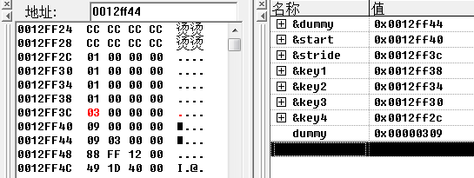
1.3 Code Analysis(10/19)
If start=9, stride=3, what is the value dummy?
start = (int)(*(((char *) &dummy)));
stride = (int)(*(((char *) &dummy) + 1));

Slide 23
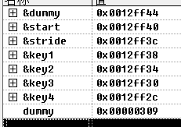
1.3 Code Analysis(11/19)
How to set the value of dummy?
The function process_keys12 is used to modify the value of dummy.
*(key1 + *key1) is the address of dummy and *key2 is the value.
key1(0x0012ff38) + ? = 0x0012ff44(address of dummy)

Slide 24
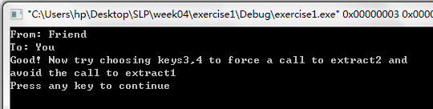
1.3 Code Analysis(12/19)
So：
key1=0x00000003
key2=0x00000309

Slide 25
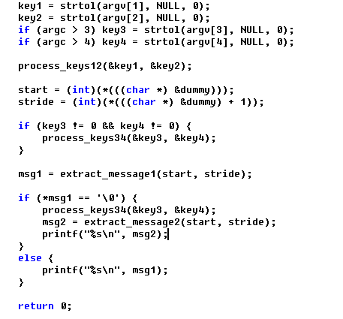
1.3 Code Analysis(13/19)
How to avoid call extact1?
Can we try to change the return address of process_key34?

Slide 26
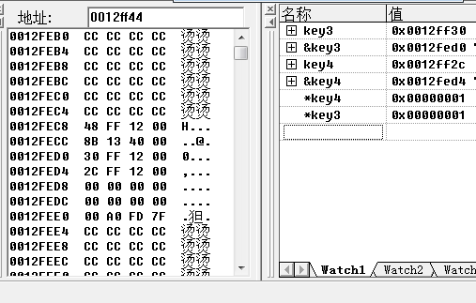
1.3 Code Analysis(14/19)
What process_keys34 does?
void process_keys34 (int * key3, int * key4) {
*(((int *)&key3) + *key3) += *key4;
}

Slide 27
1.3 Code Analysis(15/19)
When a function is called, the compiler and hardware:
push parameters into the stack
push the return address into the stack
push the frame pointer into the stack
set the frame pointer equal to the stack pointer
decrement the stack pointer by as many memory addresses as are required to store the local state of the callee.

Slide 28
1.3 Code Analysis(16/19)
What process_keys34 does?
Set the return address to something else by shift key3.
Location of key3: 0x0012FED0
Location of return address:0x0012FECC
0x0012FED0 + ? = 0x0012FECC

Slide 29
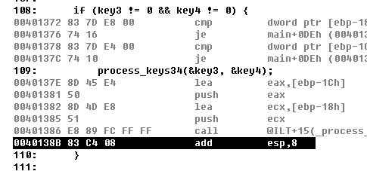
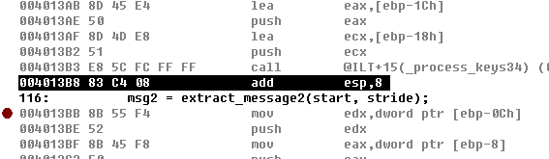
1.3 Code Analysis(17/19)
The value of the return address?

Slide 30
1.3 Code Analysis(18/19)
*(((int *)&key3) + *key3) += *key4;
The original value of return address: 0x0040138B
The return address would be: 0x004013B8
*key4 = 0x004013B8 – 0x0040138B = 0x2D
Always remember that the parameters need to pop from the calling stack.

Slide 31
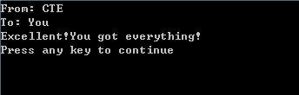
1.3 Code Analysis(19/19)
Final answer：
key1 = 3
Key2 = 777(0x00000309)
key3 = -1
Key4 = 45

Slide 32
2. Buffer Overflow Attack
2.1 Intro
2.2 Code Analysis
2.3 Problem-solving ideas
2.4 What to do about Buffer Overflow Attacks

Slide 33
2.1 Intro(1/6)
Computer Systems A Programmer’s Perspective 3.38
Students can gain first-hand experience at mounting a buffer overflow attack.
Requires a deep understanding of
machine-language programming ,
stack organization,
byte ordering,
instruction encoding.

Slide 34

2.1 Intro(2/6)
Review
while (i <= 10)
{
array[i=10] = i - 1;
i = i + 1;
}
Why array[10] is variable i?

Slide 35
2.1 Intro(3/6)
Buffer
A consecutive chunk of memory
In C, such as array and string
On stack, heap etc
Buffer Overflow
Place more than the buffer can hold, so overwrite the boundary
Buffer Overflow in C
C does not check whether an array index is out of bounds

Slide 36
2.1 Intro(4/6)
Stack Buffer Overflow in C
Parameter/Local Variables/Old EBP/Return Address are all in the Stack Frame
Stack frame
for caller
Return address
Saved old ebp
ebp
[3]
[2]
[1]
[0]
buf
Stack frame
for callee

Slide 37
2.1 Intro(5/6)
We’re letting you hijack programs by running buffer overflow attacks on them.
To understand stack discipline and stack frames

Slide 38
2.1 Intro(6/6)
Attack Activities
Each relies on a specially crafted assembly sequence to purposefully overwrite the stack
Activity 1 – Overwrites the return addresses
Activity 2 – Writes an assembly sequence onto the stack

Slide 39
2. Buffer Overflow Attack
2.1 Intro
2.2 Code Analysis
2.3 Problem-solving ideas
2.4 What to do about Buffer Overflow Attacks

Slide 40
2.2 Code Analysis(1/9)
We are expecting the output: deadbeef
int getbuf() {
char buf[16];
getxs(buf);
return 1;
}
void test() {
int val;
printf("Type Hex string:");
val = getbuf();
printf("getbuf returned 0x%x\n", val);
}

Slide 41
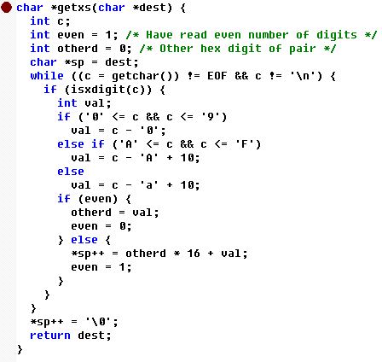
2.2 Code Analysis(2/9)

Slide 42

2.2 Code Analysis(3/9)
getxs()
similar to the library gets,
except that it reads characters encoded as pairs of hex digits.

Slide 43
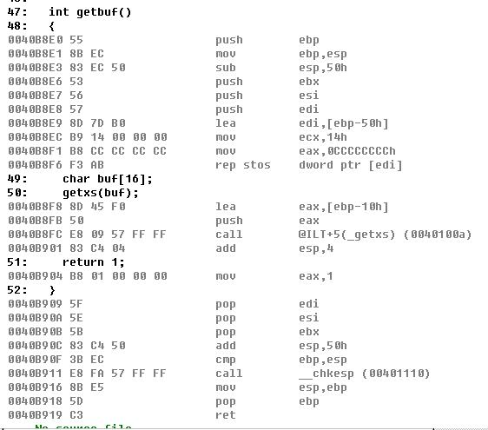
2.2 Code Analysis(4/9)
Disassembly

Slide 44
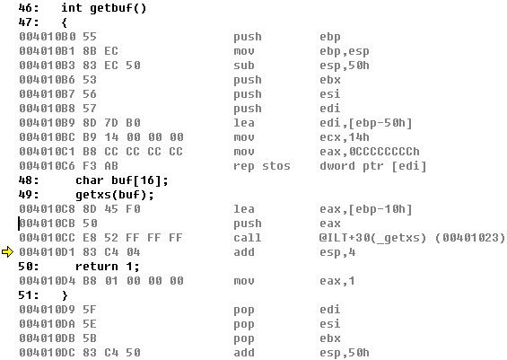
2.2 Code Analysis(5/9)
Code Analysis
004010B0 -004010B2: save caller’s ebp, create a new stack frame for getbuf() procedure.
004010B3 -004010B5: save memory space for local variable, the size is 5x16+0 = 80 bytes.
004010B5-004010C7: initialize the local variable with 0xCC

Slide 45
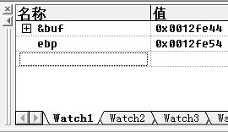
2.2 Code Analysis(6/9)
The address of buf: 0x0012fe44

Slide 46
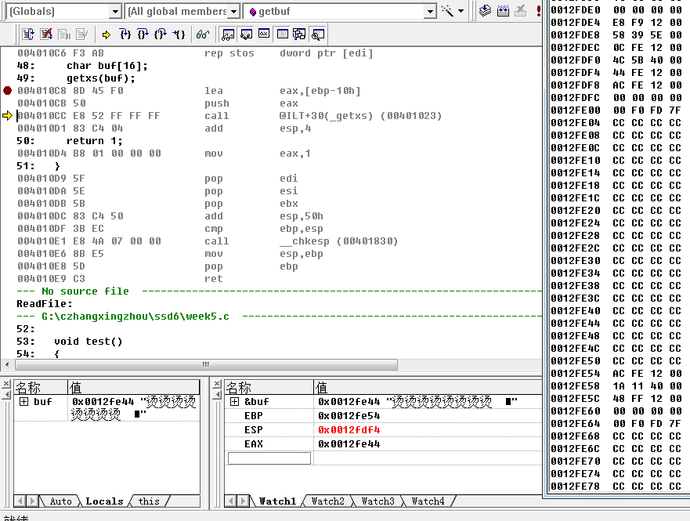
2.2 Code Analysis(7/9)
Observe:
Stack frames of getbuf() and getxs()

Slide 47
2.2 Code Analysis(8/9)
return address for getbuf() | 0x0012fe58 | 0x0040111a
old ebp of test() | 0x0012fe54 | 0x0012feac
Local variable: buf | 0x0012fe50
Local variable:buf | 0x0012fe4c
Local variable:buf | 0x0012fe48
Local variable:buf | 0x0012fe44
Local variable .. | 0x0012fe04-0012fe43 | 0xCC
Saved register | 0x0012fdf8-0012fe03
Parameters for getxs(), the address of buf | 0x0012fdf4 | 0x0012fe44
return address of getxs() | 0x0012fdf0 | 0x004010d1
old ebp of getbuf() | 0x0012fdec | 0x0012fe54
Local variable of getxs()

Slide 48
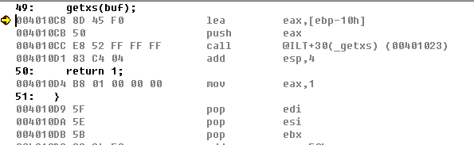
2.2 Code Analysis(9/9)
0x004010D1: pop parameter, esp increases.
0x004010D4 - D8: assign 1 to eax, eax holds the return value
0x004010D9 - E5: clear the saved registers
0x004010E6 - E8: restore the old ebp, set esp
0x004010E9: pop return address, set eip

Slide 49
2. Buffer Overflow Attack
2.1 Intro
2.2 Code Analysis
2.3 Problem-solving ideas
2.4 What to do about Buffer Overflow Attacks

Slide 50
2.3 Problem-solving ideas(1/6)
To achieve the goal, we would like to
Input more chars from keyboard to make buf overflow and try to replace the return address of getbuf(),
Then, execute some special code which could assign 0xdeadbeaf to eax.
return address for getbuf() | 0x0012fe58 | 0x0040111a
old ebp of test() | 0x0012fe54 | 0x0012feac
Local variable: buf | 0x0012fe50
Local variable:buf | 0x0012fe4c
Local variable:buf | 0x0012fe48
Local variable:buf | 0x0012fe44

Slide 51
2.3 Problem-solving ideas(2/6)
The input char array is composed of:
return address for getbuf() | 0x0012fe58 | 0x0040111a
old ebp of test() | 0x0012fe54 | 0x0012feac
Local variable: buf | 0x0012fe50
Local variable:buf | 0x0012fe4c
Local variable:buf | 0x0012fe48
Local variable:buf | 0x0012fe44
0x0012fe44
0x0012fe58
Function code
old ebp
&function code

Slide 52
2.3 Problem-solving ideas(3/6)
0x0012fe44
0x0012fe58
ac | ff | 12 | 00 | 44 | fe | 12 | 00
old ebp
&function code
return address for getbuf() | 0x0012fe58 | 0x0040111a
old ebp of test() | 0x0012fe54 | 0x0012feac
Local variable: buf | 0x0012fe50
Local variable:buf | 0x0012fe4c
Local variable:buf | 0x0012fe48
Local variable:buf | 0x0012fe44

Slide 53
2.3 Problem-solving ideas(4/6)
0x0012fe44
0x0012fe58
Function code
return address for getbuf() | 0x0012fe58 | 0x0040111a
old ebp of test() | 0x0012fe54 | 0x0012feac
Local variable: buf | 0x0012fe50
Local variable:buf | 0x0012fe4c
Local variable:buf | 0x0012fe48
Local variable:buf | 0x0012fe44
__asm {
mov eax, 0xdeadbeef
push 0x0040111a
ret
}

Slide 54
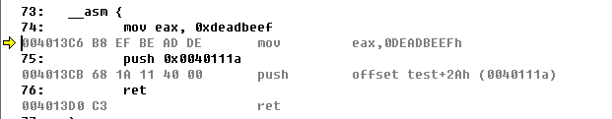
2.3 Problem-solving ideas(5/6)
__asm {
mov eax, 0xdeadbeef
push 0x0040111a
ret
}
B8 | EF | BE | AD | DE | 68 | 1A | 11 | 40 | 00 | C3 | 00 | 00 | 00 | 00 | 00
Function code
Leftover

Slide 55
2.3 Problem-solving ideas(6/6)
Final answer:
Verification:
B8 EF BE AD DE 68 1A 11 40 00 C3 00 00 00 00 00 AC FE 12 00 44 FE 12 00

Slide 56
2. Buffer Overflow Attack
2.1 Intro
2.2 Code Analysis
2.3 Problem-solving ideas
2.4 What to do about Buffer Overflow Attacks

Slide 57
2.4 What to do about Buffer Overflow Attacks(1/5)
Avoid Overflow Vulnerabilities in Code (!)
For example, use library routines that limit string lengths
fgets instead of gets
strncpy instead of strcpy
Don’t use scanf with %s conversion specification
Use fgets to read the string
Or use %ns where n is a suitable integer
/* Echo Line */ void echo() { char buf[4]; /* Way too small! */ fgets(buf, 4, stdin); puts(buf); }

Slide 58
2.4 What to do about Buffer Overflow Attacks(2/5)
Randomized stack offsets
At start of program, allocate random amount of space on stack
Shifts stack addresses for entire program
Makes it difficult for hacker to predict beginning of inserted code
E.g.: 5 executions of memory allocation code
Stack repositioned each time program executes
Stack base
Random
allocation
main
Application
Code
B?
pad
exploit
code
B?

Slide 59
2.4 What to do about Buffer Overflow Attacks(3/5)
Nonexecutable code segments
In traditional x86, can mark region of memory as either “read-only” or “writeable”
Can execute anything readable
x86-64 added explicit “execute” permission
Stack marked as non-executable
Data Execution Protection (DEP,数据执行保护技术)
Stack after call to gets()
P stack
frame
B
data written
by gets()
pad
exploit
code
Q stack frame
B
Any attempt to execute this code will fail
Notes:
操作系统最终使用数据执行保护技术来修补这个漏洞，该技术标记内存数据不可执行。 启用数据执行保护，机器将拒绝执行任何内存中user级别可写区域的代码

Slide 60
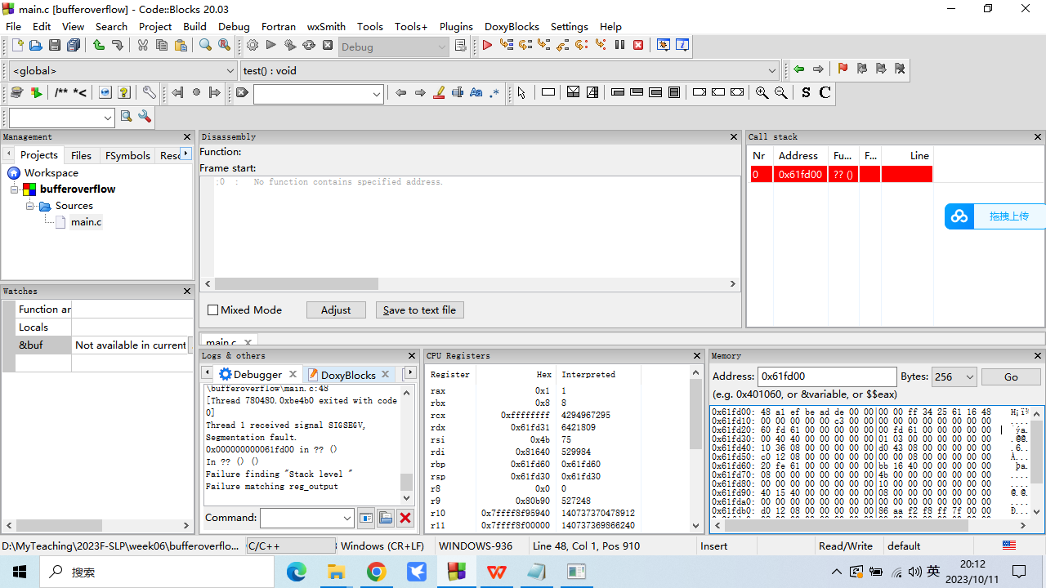
2.4 What to do about Buffer Overflow Attacks(4/5)
asm (
"mov 0xdeadbeef, %rax;\
push 0x0000000000401661;\
ret"
);

Slide 61
2.4 What to do about Buffer Overflow Attacks(5/5)
Stack Canaries
Place special value (“canary”) on stack just beyond buffer
Check for corruption before exiting function
Before call to gets
Stack Frame
for call_echo
Return Address
(8 bytes)
20 bytes unused
Canary
(8 bytes)
[3]
[2]
[1]
[0]
buf
esp
Notes:
canary的意思是金丝雀，在煤矿中，人们用金丝雀来判断是否有有害的气体。在处理栈溢出的问题上，在程序起始的时候，根据某些规则生成一个数（也可以是随机），把这个数放到函数返回地址之前，如果有溢出攻击，那么这个数也会被覆盖，发生错误。

