Slide 1
System Level Programming
Software College of SCU
Week11

Slide 2
Unit 8. Optimizing Program Performance
8.1 Introduction of Optimizing Program
8.2 The Golden Rules of Optimization
8.3 Optimizing Compilers
8.4 Example of Optimizing Program
8.5 General Optimization Techniques

Slide 3
8.1 Introduction of Optimizing Program(1/4)
This unit is about making programs run fast.
  Usually speed is not the most important concern while writing a program.
  The professional programmer is usually most concerned with making a program that is easy to write, debug, and maintain.

Slide 4
8.1 Introduction of Optimizing Program(2/4)
A correct program, even if slow, computes right answers faster than a program that is not. It is often better to use a simple but slow algorithm. Why??
  Fast programs often take much more time to develop, and they are useless until they are finished.
  Speed improvements of less than a factor of two are barely noticeable to users in an interactive setting.
  Computer technology changes so fast that improvements in speed can often be obtained simply by waiting for the next generation of hardware.

Slide 5
8.1 Introduction of Optimizing Program(3/4)
Procedure of Developing a Program
A slow but correct
Program
Modify the program
To make it faster

Slide 6
8.1 Introduction of Optimizing Program(4/4)
Optimize at multiple levels:
  Algorithm
  Data Representations
  Procedures
  Loops
  …

Slide 7
Unit 8. Optimizing Program Performance
8.1 Introduction of Optimizing Program
8.2 The Golden Rules of Optimization
8.3 Optimizing Compilers
8.4 Example of Optimizing Program
8.5 General Optimization Techniques

Slide 8
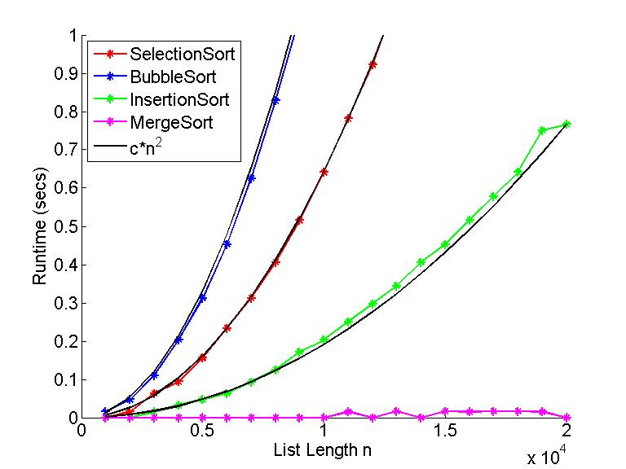
8.2 The Golden Rules of Optimization (1/5)
Good Algorithms Rule
  The best and most important way of optimizing a program is using good algorithms

Slide 9
8.2 The Golden Rules of Optimization (2/5)
Algorithm engineering focuses on the design, analysis, implementation, optimization, profiling and experimental evaluation of computer algorithms, bridging the gap between algorithm theory and practical applications of algorithms in software engineering.(Wiki)

Slide 10
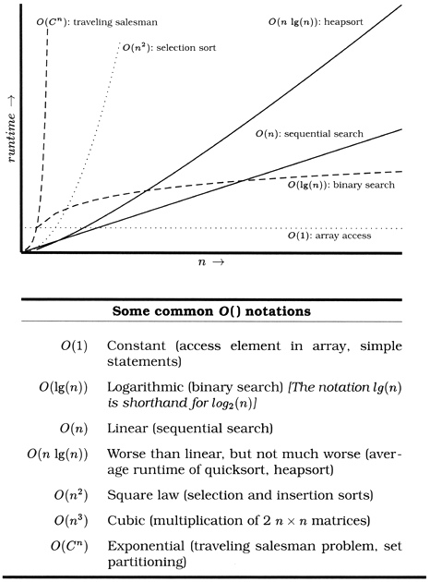
8.2 The Golden Rules of Optimization (3/5)
Asymptotic Complexity (时间复杂度)
201001V1.1

Slide 11
8.2 The Golden Rules of Optimization (4/5)
Up to programmer to select best overall algorithm
  Big-O savings are (often) more important than constant factors
  But constant factors also matter
    E.g. a linear time algorithm than runs in 100*n+100 time is slower than a cubic time algorithm than runs in n³+10 time if the problem size is small

Slide 12
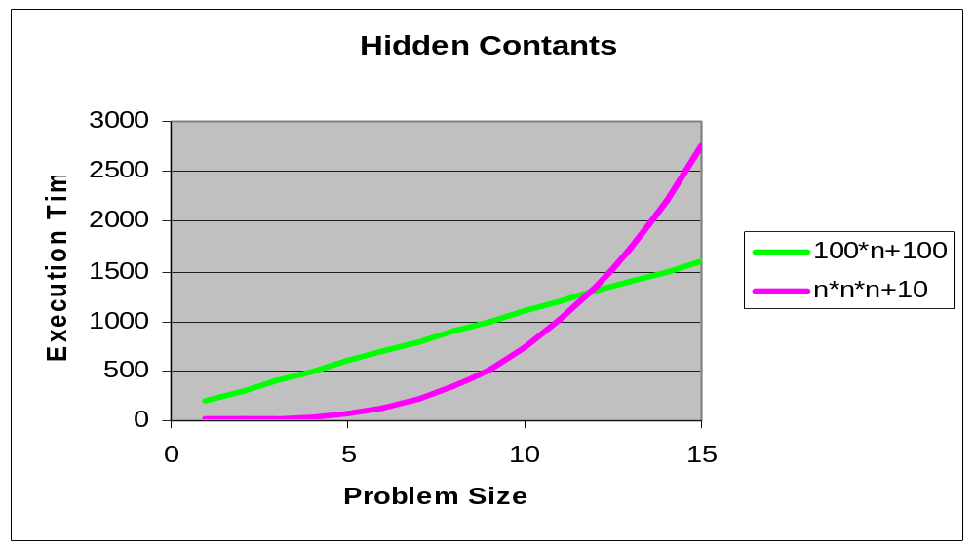
8.2 The Golden Rules of Optimization (5/5)
Asymptotic Complexity: Hidden Constants

Slide 13
Unit 8. Optimizing Program Performance
8.1 Introduction of Optimizing Program
8.2 The Golden Rules of Optimization
8.3 Optimizing Compilers
8.4 Example of Optimizing Program
8.5 General Optimization Techniques

Slide 14
8.3 Optimizing Compilers(1/6)
hello.c
Pre-
Processor
Compiler
hello.i
(text)
(text)
assembly
program
(text)
hello.s
printf.o
hello
Linker
hello.o
Assembler
(binary)
Executable object
program (binary)

Slide 15
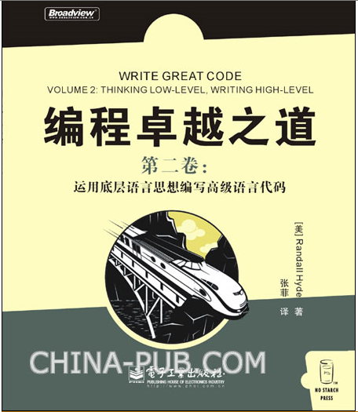
8.3 Optimizing Compilers(2/6)
Capabilities of Optimizing Compilers
  Provide efficient mapping of program to machine
    register allocation
    code selection and ordering
    eliminating minor inefficiencies
hello.c
Compiler
hello.o
(text)
(binary)

Slide 16
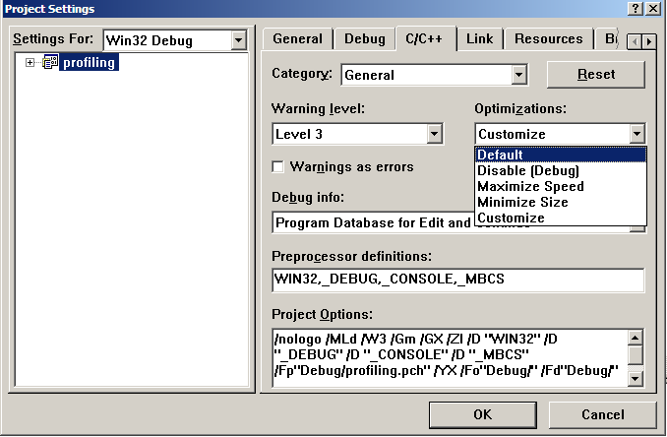
8.3 Optimizing Compilers(3/6)
201001V1.1

Slide 17
8.3 Optimizing Compilers(4/6)
Limitations of Optimizing Compilers
  Compilers have difficulty overcoming “optimization blockers(妨碍优化的因素)”
Optimization Blockers
  potential memory aliasing (存储器别名使用)
  potential procedure side-effects (函数副作用)

Slide 18
8.3 Optimizing Compilers(5/6)
Memory Aliasing
  编译器必需假设不同的指针可能会指向存储器的同一位置，造成了妨碍优化的因素。
1 void twiddle1(int *xp, int *yp)
2 {
3 *xp += *yp;
4 *xp += *yp;
5 }
6
7 void twiddle2(int *xp, int *yp)
8 {
9 *xp += 2* *yp;
10 }
Q1: Which one is more efficient?
2, 三次存储器引用，read *xp, read *yp, write *xp
Q2：Does the twiddle1 have the same behavior as twiddle2?
Q3: If xp and yp are equal, what are the results?
X=Y, twiddle1的xp增加4倍，twiddle2的xp增加3倍。
201001V1.1

Slide 19
8.3 Optimizing Compilers(6/6)
procedure side-effects
  编译器不会判断一个函数是否有副作用，它会假设最糟的情况，并保持所有的函数调用不变
1 int f(int);
2
3 int func1(x) {
4 return f(x) + f(x) + f(x) + f(x);
5 }
6
7 int func2(x) {
8 return 4*f(x);
9 }
Q1: Which one is efficient?
Q2: Do they have same result?
0+1+2+3
Q3: What are the results if the following code for f is:
1 int counter = 0;
2
3 int f(int x) {
4 return counter++;
5 }
4*0
f() will modify the global variable which causes side-effect.
201001V1.1

Slide 20
Unit 8. Optimizing Program Performance
8.1 Introduction of Optimizing Program
8.2 The Golden Rules of Optimization
8.3 Optimizing Compilers
8.4 Example of Optimizing Program
8.5 General Optimization Techniques

Slide 21
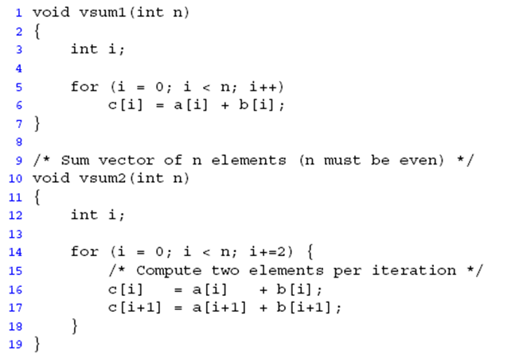
8.4 Example of Optimizing Program (1/20)
Expressing Program Performance

Slide 22
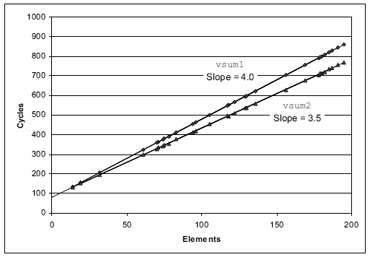
8.4 Example of Optimizing Program (2/20)
vsum1: 80 + 4.0n
vsum2: 83.5 + 3.5n
CPE(cycles per element): 每元素的周期数

Slide 23
8.4 Example of Optimizing Program (3/20)
Expressing Program Performance
  Cycles Per Element (CPE): 每元素的周期数
    给定的向量长度，程序运行的速度如何。
  unsigned __int64 get_counter(unsigned hi, unsigned lo)
  {
  __asm {
  rdtsc
  mov hi, edx;
  mov lo, eax;
  }
  return ((unsigned __int64)hi << 32) + (unsigned __int64)lo;
  }

Slide 24
8.4 Example of Optimizing Program (4/20)
In this example, we will see a program of vector
  Data structure
  Some functions of this vector
    Among them, the combine() function is the one that need to be optimized
      Combine1() : without optimization
      Combine2() : Eliminating Loop Inefficiencies
      Combine3() : Reducing Procedure Calls
      Combine4(): Eliminating Unneeded Memory References

Slide 25
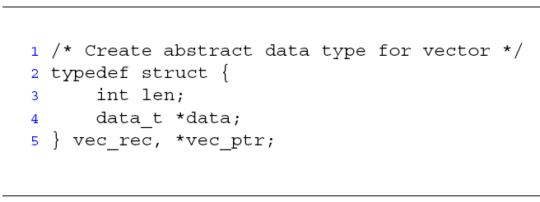
8.4 Example of Optimizing Program (5/20)
length
0
1
2
length–1
data
• • •
Read the code in the folder of “vector code of csapp 5.3”

Slide 26
8.4 Example of Optimizing Program (6/20)
Functions
  vec_ptr new_vec(int len)
    Create vector of specified length
  int get_vec_element(vec_ptr v, int index, int *dest)
    Retrieve vector element, store at *dest
    Return 0 if out of bounds, 1 if successful
  int vec_length(vec_ptr v)
    Return the length of the vector

Slide 27
8.4 Example of Optimizing Program (7/20)
/* Create vector of specified length */
vec_ptr new_vec(long int len) {
vec_ptr result = (vec_ptr) malloc(sizeof(vec_rec)); //Allocate header structure
if (!result) return NULL; /* Couldn't allocate storage */
result->len = len;
/* Allocate array */
if (len > 0) {
data_t *data = (data_t *)calloc(len, sizeof(data_t));
if (!data) {
free((void *) result);
return NULL; /* Couldn't allocate storage */
}
result->data = data;
}
else
result->data = NULL;
return result;
}

Slide 28
8.4 Example of Optimizing Program (8/20)
  /* * Retrieve vector element and store at dest.
  * Return 0 (out of bounds) or 1 (successful)
  */
  int get_vec_element (vec_ptr v, long int index, data_t *dest)
  {
  if (index < 0 || index >= v->len)
  return 0;
  *dest = v->data[index];
  return 1;
  }
  /* Return length of vector */
  long int vec_length (vec_ptr v) {
  return v->len;
  }

Slide 29
8.4 Example of Optimizing Program (9/20)
Function combine1
  Compute sum of all elements of vector
  Store result at destination location
void combine1(vec_ptr v, int *dest)
{
int i;
*dest = 0;
for (i = 0; i < vec_length(v); i++) {
int val;
get_vec_element(v, i, &val);
*dest += val;
}
}
CPE(每元素的周期数): 31.25

Slide 30
8.4 Example of Optimizing Program (10/20)
Move call to vec_length out of inner loop
  Value does not change from one iteration to next
  vec_length requires only constant time, but significant overhead
  Code motion/代码移动
void combine2(vec_ptr v, int *dest)
{
int i;
int length = vec_length(v);
*dest = 0;
for (i = 0; i < length; i++) {
int val;
get_vec_element(v, i, &val);
*dest += val;
}}
CPE: 20.66

Slide 31
8.4 Example of Optimizing Program (11/20)
Code Motion Example #2
  Procedure to Convert String to Lower Case
  strlen()所用的时间与字符串s长度n成正比. 对于n次迭代，lower1的整体运行时间是字符串长度的二次项;
void lower1(char *s)
{
int i;
for (i = 0; i < strlen(s); i++)
if (s[i] >= 'A' && s[i] <= 'Z')
s[i] -= ('A' - 'a');
}

Slide 32
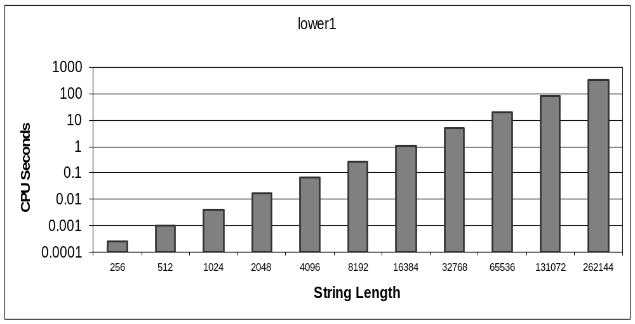
8.4 Example of Optimizing Program (12/20)
Time quadruples(四倍) when double string length

Slide 33
8.4 Example of Optimizing Program (13/20)
Move call to strlen outside of loop
  Since result does not change from one iteration to another
Form of code motion
void lower2(char *s)
{
int i;
int len = strlen(s);
for (i = 0; i < len; i++)
if (s[i] >= 'A' && s[i] <= 'Z')
s[i] -= ('A' - 'a');
}

Slide 34
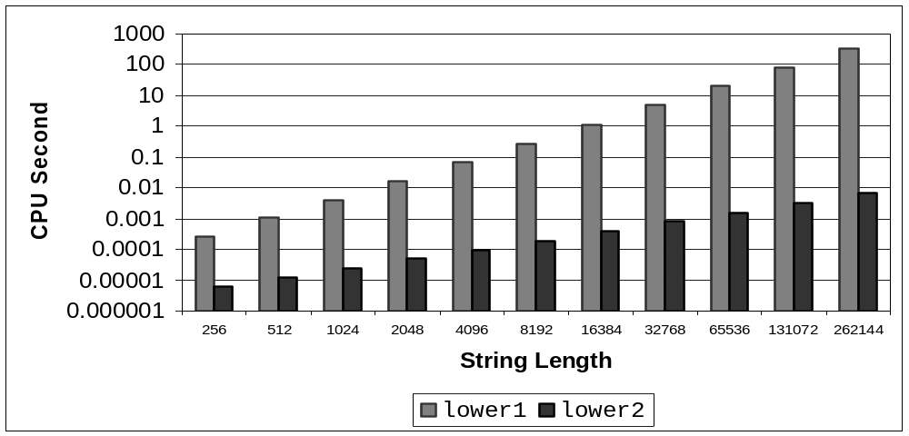
8.4 Example of Optimizing Program (14/20)
Time doubles when double string length
Linear performance

Slide 35
8.4 Example of Optimizing Program (15/20)
Optimization: Reduction in Procedure Call
  Procedure calls are expensive!
void combine2 (vec_ptr v, int *dest)
{
int i;
int length = vec_length(v);
*dest = 0;
for (i = 0; i < length; i++) {
int val;
get_vec_element(v, i, &val);
*dest += val;
}
}

Slide 36
8.4 Example of Optimizing Program (16/20)
Improvement : Avoid procedure call to retrieve each vector element
  Get pointer to start of array before loop
  Within loop just do pointer reference
  Shortcoming: Not as clean in terms of data abstraction
    Trade off

Slide 37
8.4 Example of Optimizing Program (17/20)
  int* get_vec_start(vec_ptr v)
  {
  return v->data;
  }
  void combine3 (vec_ptr v, int *dest)
  {
  int i;
  int length = vec_length(v);
  int *data = get_vec_start(v);
  *dest = 0;
  for (i = 0; i < length; i++)
  *dest += data[i];
  }
CPE: 6.00

Slide 38
8.4 Example of Optimizing Program (18/20)
Overview *dest += data[i];
*dest += data[i];
00401159 8B 55 0C mov edx,dword ptr [ebp+0Ch] // edx = dest
0040115C 8B 02 mov eax,dword ptr [edx] // eax = [edx]=[dest]
0040115E 8B 4D FC mov ecx,dword ptr [ebp-4] // ecx = i
00401161 8B 55 F4 mov edx,dword ptr [ebp-0Ch] // edx = data
00401164 03 04 8A add eax,dword ptr [edx+ecx*4] // eax = eax + data[i]
00401167 8B 4D 0C mov ecx,dword ptr [ebp+0Ch] // ecx = dest
0040116A 89 01 mov dword ptr [ecx],eax // [ecx] = [dest] = eax

Slide 39
8.4 Example of Optimizing Program (19/20)
Optimization: Eliminate Unneeded Memory References
  Don’t need to store in destination until end
  Local variable sum held in register
  Avoids 1 memory read, 1 memory write per loop cycle
  Memory references are expensive!
void combine4 ( vec_ptr v, int *dest )
{
  int i;
  int length = vec_length(v);
  int *data = get_vec_start(v);
  int sum = 0;
  for (i = 0; i < length; i++)
  sum += data[i];
  *dest = sum;
}
CPE: 2.00

Slide 40
8.4 Example of Optimizing Program (20/20)
Assembly Code after Optimization
004011D7 8B 4D FC mov ecx,dword ptr [ebp-4] // ecx = i
004011DA 8B 55 F4 mov edx,dword ptr [ebp-0Ch] // edx = data
004011DD 8B 45 F0 mov eax,dword ptr [ebp-10h] // eax = sum
004011E0 03 04 8A add eax,dword ptr [edx+ecx*4] // eax = eax +data[i]
004011E3 89 45 F0 mov dword ptr [ebp-10h],eax // sum = eax

Slide 41
Unit 8. Optimizing Program Performance
8.1 Introduction of Optimizing Program
8.2 The Golden Rules of Optimization
8.3 Optimizing Compilers
8.4 Example of Optimizing Program
8.5 General Optimization Techniques

Slide 42
8.5 General Optimization Techniques (1/2)
From Reference:
  How To Optimize C/C++ Source - Performance Programming, Based by Sachin Garg

Slide 43
8.5 General Optimization Techniques (2/2)
The Clicking Optimizations
Faster Mathematics
Faster Loops
Avoiding Expression Repetitions
Using Assembly
Using register
Integers
Pointer Dereferencing
Avoiding Temporary Variables
String Comparisons
Pre vs. Post Increment/Decrement
Call by Value vs. Call by Reference
Don't Reallocate, But Reuse
Use switch() instead of if...else...
Early loop breaking
Other Suggestions

Slide 44
The Clicking Optimizations
You won't have to write or modify any code to get these gains, only mouse clicks are required.
Some compilers can generate code for common tasks saving you a lot of effort.
  In Borland's Turbo C++ 3.0 and MS VC++, you can choose to optimize EXE either for speed or for size.
  Remove the debugging information from the EXEs saving a lot of space and making it more difficult to reverse engineer your program.
  Use a profiler to track down execution time
This tip can be applied to any language you are using for development.

Slide 45
The Clicking Optimizations
201001V1.1

Slide 46
Faster Mathematics
Simplifying Expressions
  Replace costly operation with simpler one
  Example:
    a*b + a*c =
    b/a + c/a
Faster Calculation Techniques
  Shift instead of multiply or divide
    x << y is same as x * 2^{y}
    x >> y is same as x / 2^{y}
    16*x -->
a*(b+c);
= (1/a)*(b+c)
= (b+c)/a
x << 4

Slide 47
Faster Loops
Loop Unrolling(循环展开)
It is because the code has to check and increment the value of i.
Example:
for(i=0; i<3; i++) {
something(i);
}
is less efficient than
something(0);
something(1);
something(2);

Slide 48
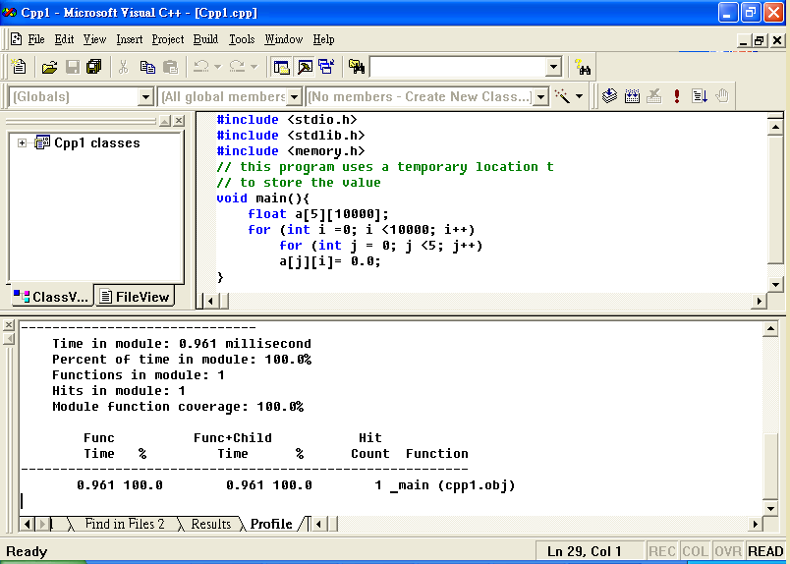
Example – Two “for loop” (0.961ms)

Slide 49
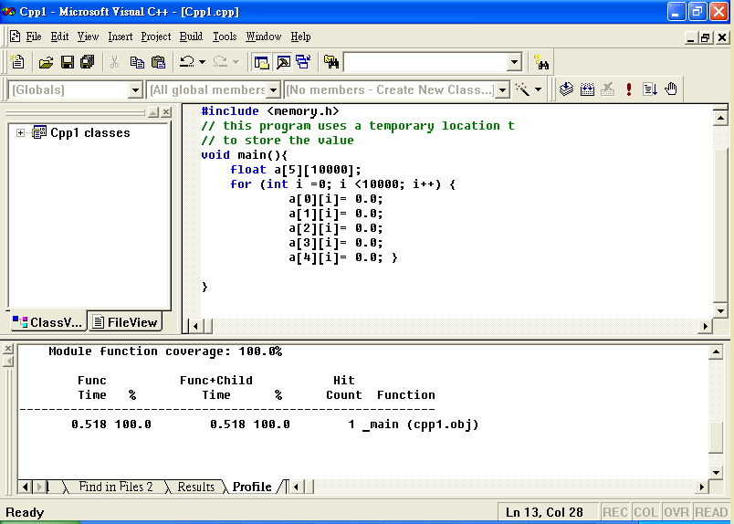
Example – One “for loop” (0.518ms)

Slide 50
Loop Fusion
Not use two loops where one is enough:
for(i=0; i<100; i++)
{
stuff();
}
for(i=0; i<100; i++)
{
morestuff();
}
for(i=0; i<100; i++) {
stuff();
morestuff();
}

Slide 51
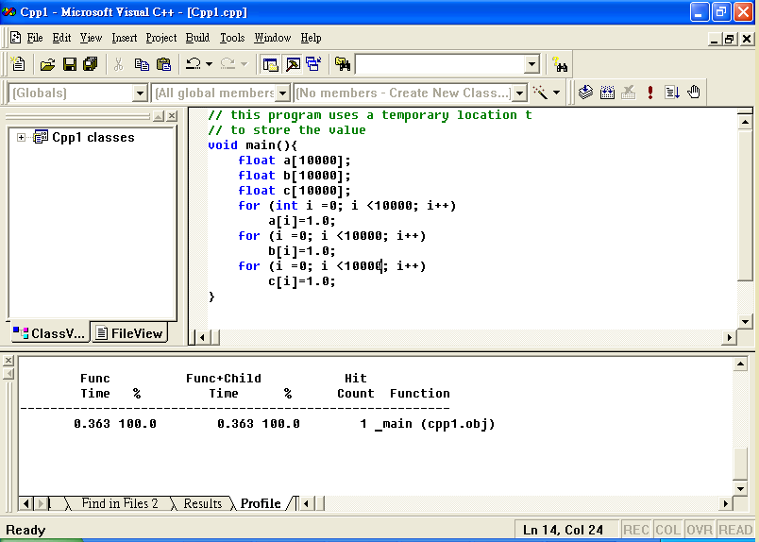
Example – Three loops (0.363ms)

Slide 52
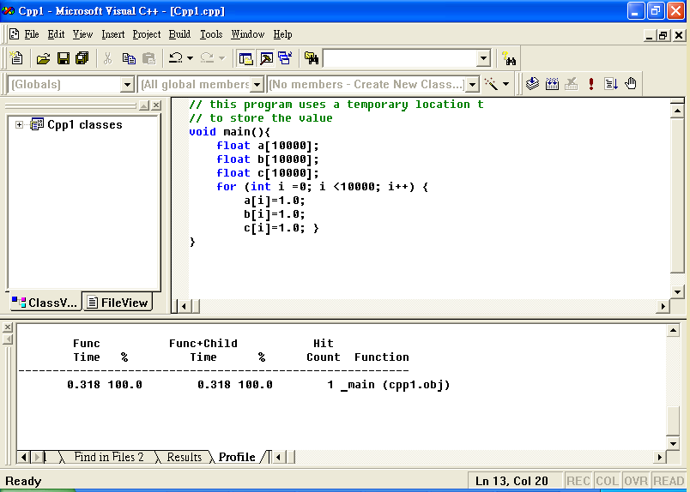
Example – One loop (0.31ms)

Slide 53
Avoiding Expression Repetitions
Common Subexpression Elimination（消除公用子表达式）
If ( (dataStructPointer->ExpensiveFunctionCall()) < 10 ) {
//some code here
}
else if ( (dataStructPointer->ExpensiveFunctionCal()) > 30 ) {
// some code here
}
int temp = dataStructPointer>ExpensiveFunctionCall() ;
if(temp < 10) {
// some code here
}
else if(temp > 30) {
// some code here
}

Slide 54
Pointer Dereferencing
This saves a lot of time wasted in pointer dereferencing, the speed gains are a lot more than what you can imagine.
for( int i = 0; i < BigNum; i++ ) {
Inventory -> StuffToSell -> LowProfitStuff -> Count[i] = Value;
}
unsigned int *InventoryCount =
Inventory -> StyffToSell -> LowProfitStuff -> Count;
for( int i = 0; i < BigNum; i++ ) {
InventoryCount[i] = Value;
}

Slide 55
Using Assembly
void main() { int a, b, c,d; a=-11; b=3; c=a/b; d=a%b; }
5: c=a/b;
00401036 8B 45 FC mov eax,dword ptr [ebp-4]
00401039 99 cdq
0040103A F7 7D F8 idiv eax,dword ptr [ebp-8]
0040103D 89 45 F4 mov dword ptr [ebp-0Ch],eax
6: d=a%b;
00401040 8B 45 FC mov eax,dword ptr [ebp-4]
00401043 99 cdq
00401044 F7 7D F8 idiv eax,dword ptr [ebp-8]
00401047 89 55 F0 mov dword ptr [ebp-10h],edx

Slide 56
Using register
Use the "register" declaration whenever you can, eg.
  register float val;
  register double dval;
  register int ival;
In for loops, it is usually most appropriate to register the loop variables.
Registering the loop variable of inner most loop.
for ( int i = 0; i < 10; i++) {
for ( int j = 0; j < 10; j++) {
for ( register int k; k<10; k++) {
// Function body
}
}
}

Slide 57
Integers
Use unsigned int instead of int if you know the value will never be negative.
  unsigned int a;
Integer arithmetic is faster than floating-point operation

Slide 58
Avoiding Temporary Variables
Second way is faster as here the compiler won't have to create any temporary objects.
But it seriously effects the code readability.
a += a1;
a += a2;
a += a3;
a = a + a1 + a2 + a3;

Slide 59
String Comparisons
The usual way is to compare each element and break out of the loop as soon as a different element is found.
First check if lengths match
  this usually gets 90% of inequalities
Checksum solution
  check if their checksums match
  check every char of the strings only if their checksums are equal.

Slide 60
String Comparisons
  unsigned char checksum = 0;
  char str[20];
  int len;
  len = strlen(str);
  //Get any string in str and the value of len.
  //str may contain any string - text or binary
  for(int i = 0; i < len; i++) {
  checksum += str[i];
  }

Slide 61
Strings
Microsoft Foundation Class (MFC) CString class allocates dynamic memory.
String manipulation is expensive in general whether it is formatting text as in printf, reading ASCII text and converting to numbers, or performing string comparisons

Slide 62
Pre vs. Post Increment/Decrement
Prefer pre-increment and -decrement to postfix operators.
Postfix operators (i++) copy the existing value to a temporary object, increment the internal value, and then return the temporary.
Prefix operators (++i) increment the value and return a reference to it.

Slide 63
Call by Value vs. Call by Reference
Passing arguments to a function by value
  e.g. void f(Type x)
  cheap for built-in types
  but potentially expensive for class types
Passing by address
  e.g. void f(Type* x)
  is light-weight
  but changes the way the function is called, and exposes the passed object to modification by the called function.
Passing by reference-to-const (常引用)
  e.g. void f (const double & x)
  combines the safety of passing by value with the efficiency of passing by address.

Slide 64
Deal with malloc()
malloc (or new in C++) is expensive.
A common solution is to use static or local variables to avoid allocating memory on the heap.
Another solution is to keep a list of objects that need to be allocated often. Then, allocation is just a matter of removing an object from the list, and freeing simply inserts the object on the list
Better not to use malloc()

Slide 65
Don't Reallocate, But Reuse
Memory allocation/deallocation takes a lot of time, it is better to reuse already allocated chunks of memory rather than deallocate them and then allocating new memory.
Also, if you are allocating memory repeatedly for "small" objects, it is better to first allocate a large memory chunk and manage you small objects inside it.

Slide 66
malloc() in printf
printf causes malloc to be called in the usual implementation.
  This can add an unexpected cost.
  Better not to use printf()
Use puts()

Slide 67
Use switch() instead of if...else...
For large decisions involving if…else if...else..., it may be faster to use a switch:
switch( val ) {
case 1: dostuff1(); break;
case 2: dostuff2(); break;
case 3: dostuff3(); break;
}
if( val == 1)
dostuff1();
else if (val == 2)
dostuff2();
else if (val == 3)
dostuff3();

Slide 68
Early loop breaking
found = FALSE;
for(i=0;i<10000;i++) {
if( list[i] == -99 ) {
found = TRUE;
}
}
if( found )
printf("Yes, there is a -99. \n");
found = FALSE;
for(i=0; i<10000; i++) {
if( list[i] == -99 ) {
found = TRUE;
break;
}
}
if( found )
printf("Yes, there is a -99. \n");

Slide 69
Suggestion (1)
Declare anything within a file (external to functions) as static, unless it is intended to be global.
Don't use recursion. Recursion can be very elegant and neat, but creates many more function calls which can become a large overhead.
Avoid the sqrt() square root function in loops - calculating square roots is very CPU intensive.

Slide 70
Suggestion (2)
Single precision maths may be faster than double precision - there is often a compiler switch for this. (float is better than double unless you really want it.)
Floating point multiplication is often faster than division - use val * 0.5 instead of val / 2.0.
Addition is quicker than multiplication - use val + val + val instead of val * 3

Slide 71
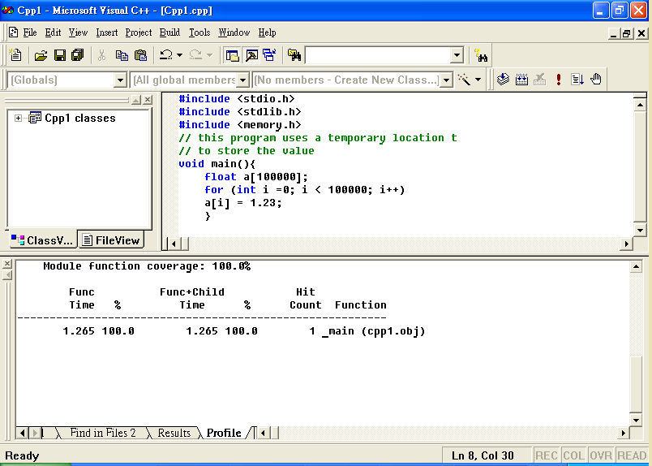
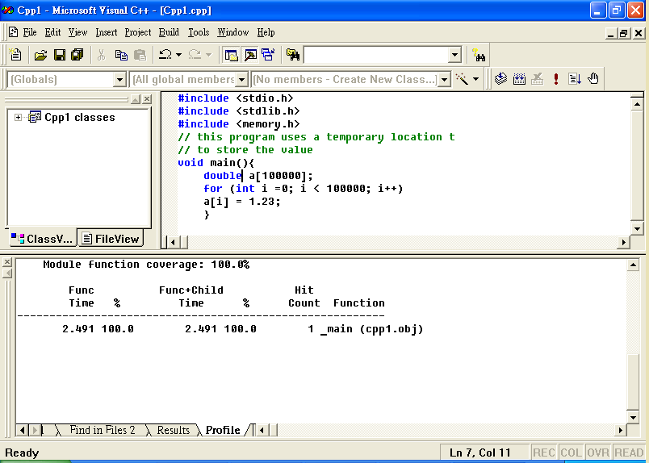
Example - float (4 bytes) and double (8 bytes)
2.49
1.26

Slide 72
Suggestion (3)
Use #defined macros instead of commonly used tiny functions
  Replacing it with a macro to perform the same job will remove the overhead of all those function calls, and allow the compiler to be more aggressive in it's optimization.
Binary/unformatted file access is faster than formatted access
  as the machine does not have to convert between human-readable ASCII and machine-readable binary.
  If you don't actually need to read the data in a file yourself, consider making it a binary file.

