Slide 1
System Level Programming Software College of SCU
week12

Slide 2
Unit 9. Memory Operation and Performance
9.1 Memory Technology
9.2 Memory Hierarchies
9.3 Locality

Slide 3
Unit 9.1. Memory Technology
9.1.1 Random-Access Memory (RAM)
9.1.2 Read only Memory (ROM)
9.1.3 Disk Storage
9.1.4 SSD/Flash
9.1.5 Storage Technology Trends

Slide 4
9.1.1 Random-Access Memory (RAM)(1/2)
Random-Access Memory (RAM)
Random Access(存取的速度与存储单元的位置无关)
Volatile (易失性)
Random-Access Memory (RAM)
Static RAM (SRAM)
Each cell stores bit with a six-transistor circuit.
Faster and more expensive than DRAM.
Dynamic RAM (DRAM)
Each cell stores bit with a capacitor and transistor.
Value must be refreshed every 10-100 ms.
Sensitive to disturbances.

Slide 5
9.1.1 Random-Access Memory (RAM)(2/2)
Random-Access Memory (RAM)
Static RAM (SRAM)
Dynamic RAM (DRAM)
Tran. Access
per bit time Persist? Sensitive? Cost Applications
SRAM 6 1X Yes No 100x cache memories
DRAM 1 10X No Yes 1X Main memories,
frame buffers

Slide 6
Unit 9.1. Memory Technology
9.1.1 Random-Access Memory (RAM)
9.1.2 Read only Memory (ROM)
9.1.3 Disk Storage
9.1.4 SSD/Flash
9.1.5 Storage Technology Trends

Slide 7
9.1.2 Read only Memory (ROM)(1/2)
Read only Memory (ROM)
Read only
Nonvolatile (非易失性)
Read only Memory (ROM)
PROM（Programmable ROM，可编程ROM）
EPROM（Erasable Programmable ROM，可擦除可编程ROM）
EEPROM(Electrically Erasable Programmable ROM，电可擦除可编程ROM）

Slide 8
9.1.2 Read only Memory (ROM)(2/2)
Firmware
Program stored in a ROM
Boot time code, such as BIOS (basic input/ouput system
graphics card
disk controller

Slide 9
Unit 9.1. Memory Technology
9.1.1 Random-Access Memory (RAM)
9.1.2 Read only Memory (ROM)
9.1.3 Disk Storage
9.1.4 SSD/Flash
9.1.5 Storage Technology Trends

Slide 10
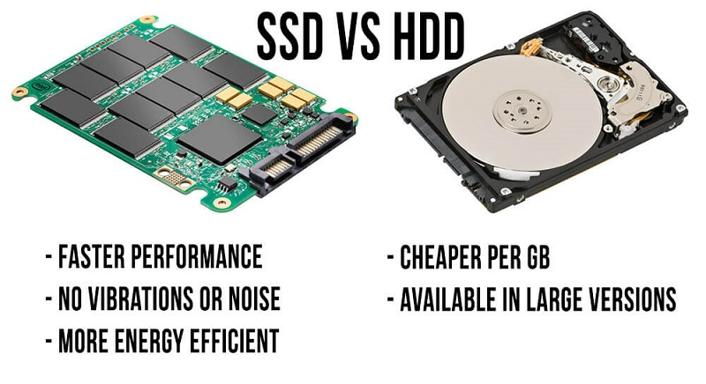
9.1.3 Disk Storage(1/8)
Disk
Hard Disk
HDD
SSD
Hold enormous amounts of data
Created by IBM first
Wildly used

Slide 11
9.1.3 Disk Storage(2/8)
HDD
Disks consist of platters/盘片, each with two surfaces/面.
Each surface consists of concentric rings called tracks/磁道.
Each track consists of sectors扇区 separated by gaps.
tracks
surface
track k
gaps
spindle
sectors

Slide 12
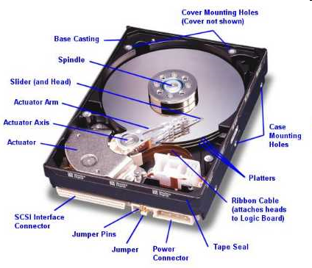
9.1.3 Disk Storage(3/8)
Inside static
cylinder k
surface 0
platter 0
surface 1
surface 2
platter 1
surface 3
surface 4
platter 2
surface 5
spindle

Slide 13
9.1.3 Disk Storage(4/8)
Capacity: maximum number of bits that can be stored.
Vendors express capacity in units of Trillionbyte (TB,万亿字节 /太字节), where 1 TB ==1024GB
Capacity is determined by these technology factors:
Recording density (bits/in): number of bits that can be squeezed into a 1 inch segment of a track.
Track density (tracks/in): number of tracks that can be squeezed into a 1 inch radial segment.
Areal density (bits/in²): product of recording and track density.
Capacity = (# bytes/sector) x (avg. # sectors/track) x
(# tracks/surface) x (# surfaces/platter) x
(# platters/disk)

Slide 14
9.1.3 Disk Storage(5/8)
Example:
512 bytes/sector
300 sectors/track (on average)
20,000 tracks/surface
2 surfaces/platter
5 platters/disk
Capacity = 512 x 300 x 20000 x 2 x 5
= 30,720,000,000
= 30.72 GB

Slide 15
9.1.3 Disk Storage(6/8)
Average time to access some target sector approximated by :
Taccess = Tavg seek + Tavg rotation + Tavg transfer
寻道/ Seek time (Tavg seek)
Time to position heads over cylinder containing target sector.
Typical Tavg seek = 9 ms
旋转/ Rotational latency (Tavg rotation)
Time waiting for first bit of target sector to pass under r/w head.
Tavg rotation = 1/2 x 1/RPMs x 60 sec/1 min
传送/ Transfer time (Tavg transfer)
Time to read the bits in the target sector.
Tavg transfer = 1/RPM x 1/(avg # sectors/track) x 60 secs/1 min.

Slide 16
9.1.3 Disk Storage(7/8)
Example:
Given:
Rotational rate = 7,200 RPM
Average seek time = 9 ms.
Avg # sectors/track = 400.
Derived:
Tavg rotation = 1/2 x (60 secs/7200 RPM) x 1000ms/sec = 4 ms.
Tavg transfer = 60/7200 RPM x 1/400 secs/track x 1000 ms/sec = 0.02 ms
Taccess = 9 ms + 4 ms + 0.02 ms

Slide 17
9.1.3 Disk Storage(8/8)
CPU Access Disk
By Bus and I/O ports
By using
DMA(Direct Memory Access 直接存储器访问) and interrupt

Slide 18
Unit 9.1. Memory Technology
9.1.1 Random-Access Memory (RAM)
9.1.2 Read only Memory (ROM)
9.1.3 Disk Storage
9.1.4 SSD/Flash
9.1.5 Storage Technology Trends

Slide 19
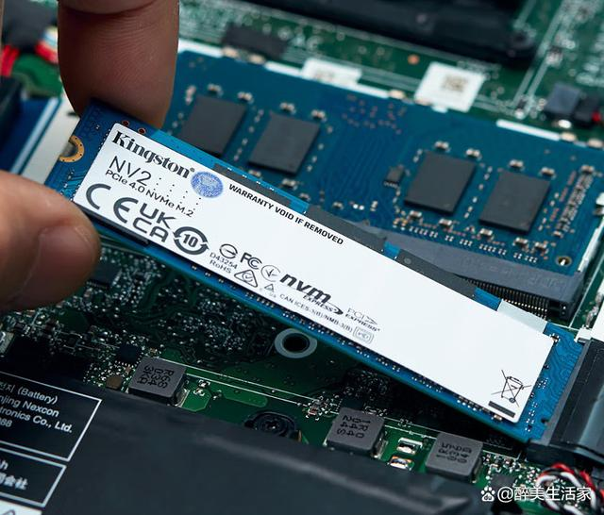
9.1.4 SSD/Flash(1/4)
Solid state drives or SSDs (Solid State Drive)
microchips with flash memories interconnected with each other.
include an integrated processor to perform operations related to the reading and writing of data.
no moving mechanical components

Slide 20
9.1.4 SSD/Flash(2/4)
Notes:
固态硬盘采用闪存芯片作为存储介质，具有快速的数据读写速度和响应时间短的特点。在启动操作系统、加载应用程序和文件传输等方面，固态硬盘明显更快，能够显著提高计算机的整体性能和响应速度。

Slide 21
9.1.4 SSD/Flash(3/4)

Slide 22
9.1.4 SSD/Flash(4/4)
 | SSD | HDD
CAPACITY | In general between 256 GB and 4 TB | between 1 and 10 TB
CONSUMPTION | Lower consumption | Greater consumption
COST | Fairly more expensive | Much cheaper
NOISE | More silent because there are no moving parts | Something noisier for having moving parts
VIBRATIONS | Does not vibrate because there are no moving parts | The rotation of your discs can cause slight vibrations
FRAGMENTATION | Does not have | It can occur
DURABILITY | Your cells can be rewritten a limited number of times | With mechanical parts that can be damaged by movements
SO BOOT TIME | 7 seconds | 16 seconds
DATA TRANSFER | between 200 and 550 MB / s | between 50 and 150 MB / s
AFFECTED BY MAGNETISM | Do not | Magnetism can eliminate data
Notes:
固态硬盘和机械硬盘并不是彼此对立的选择，而是可以相互搭配使用的。许多用户选择将操作系统和常用程序安装在固态硬盘上，以获得更好的性能和响应速度，同时将大容量文件存储在机械硬盘上，以平衡性能和存储需求。

Slide 23
Unit 9.1. Memory Technology
9.1.1 Random-Access Memory (RAM)
9.1.2 Read only Memory (ROM)
9.1.3 Disk Storage
9.1.4 SSD/Flash
9.1.5 Storage Technology Trends

Slide 24

9.1.5 Storage Technology Trends(1/8)

Slide 25
9.1.5 Storage Technology Trends(2/8)
Trends
不同的存储技术的性和价按照不同的速率变化着
DRAM和磁盘访问时间滞后于CPU的clock cycle

Slide 26

9.1.5 Storage Technology Trends(3/8)
Cloud Storage
What is cloud storage
Who provided the cloud storage
Advantages of cloud storing
Disadvantages of cloud storing

Slide 27
9.1.5 Storage Technology Trends(4/8)
What is cloud storage?
Cloud storage is a model of computer data storage in which the digital data is stored in logical pools, said to be on "the cloud". -wiki
Online file storage centers or cloud provider allow you to safely upload your files to the internet.
The data is maintained, managed and backed up remotely over a network.

Slide 28
9.1.5 Storage Technology Trends(5/8)
Who provided the cloud storage?
There are various providers of cloud storage
Examples:
Apple iCloud
Amazon AWS (https://aws.amazon.com/cn/)
阿里云 / Alibaba Cloud (https://www.aliyun.com)
Microsoft Azure / OneDrive
Google Drive
华为云 / Huawei Cloud/ ECS (Elastic Cloud Server)
腾讯云 / Tencent Cloud

Slide 29
9.1.5 Storage Technology Trends(6/8)
Ref: https://www.cnblogs.com/fastone/p/11434758.html

Slide 30
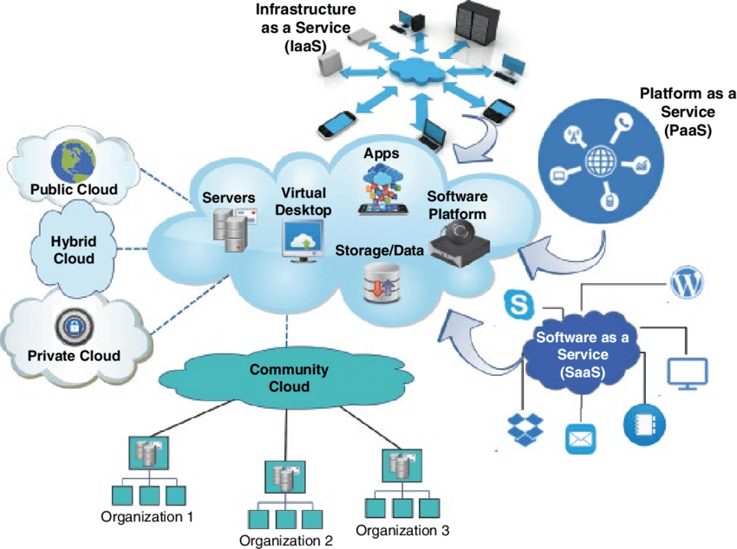
9.1.5 Storage Technology Trends(7/8)
Cloud-architecture

Slide 31
9.1.5 Storage Technology Trends(8/8)
Advantages of cloud storing
Universal document access
Easier group collaboration
Security
Cost-efficient
Scalable
Disaster recovery
Disadvantages of cloud storing
Vulnerability to attacks
Internet connectivity

Slide 32
Unit 9. Memory Operation and Performance
9.1 Memory Technology
9.2 Memory Hierarchies
9.3 Locality

Slide 33
9.2. Memory Hierarchies(1/8)
The design constraints of a computer’s memory
How much : Capacity : larger
How fast : Speed : faster/ as fast as CPU
How expensive : Price : cheaper

Slide 34
9.2. Memory Hierarchies(2/8)
(Speed , Price, Capacity)的不可兼得性/矛盾:
Faster access time, greater cost per bit
Greater capacity, smaller cost per bit
Greater capacity, slower access speed
What can we do?
Trade off？
To use them all in the right way: Memory Hierarchy

Slide 35
9.2. Memory Hierarchies(3/8)
Smaller,
faster,
and
costlier
(per byte)
storage
devices
L0:
registers
CPU registers hold words retrieved from L1 cache.
L1:
on-chip L1
cache (SRAM)
L1 cache holds cache lines retrieved from the L2 cache memory.
L2:
off-chip L2
cache (SRAM)
L2 cache holds cache lines retrieved from main memory.
L3:
main memory
(DRAM)
Larger,
slower,
and
cheaper
(per byte)
storage
devices
L4:
local secondary storage
(local disks)
Access frequency
L5:
remote secondary storage
(distributed file systems, Web servers)

Slide 36
9.2. Memory Hierarchies(4/8)
Why do memory hierarchies work?
Programs tend to access the data at level k more often than they access the data at level k+1.
Thus, the storage at level k+1 can be slower, and thus larger and cheaper per bit.
Fundamental idea of a memory hierarchy:
For each k, the faster, smaller device at level k serves as a cache for the larger, slower device at level k+1.
level k+1 serves as a backup for level k

Slide 37
9.2. Memory Hierarchies(5/8)
Smaller, faster, more expensive
device at level k caches a
subset of the blocks from level k+1
4
10
Level k:
8
9
14
3
Data is copied between
levels in block-sized transfer units
10
4
0
1
2
3
4
Larger, slower, cheaper storage
device at level k+1 is partitioned
into blocks.
Level k+1:
4
5
6
7
8
9
10
10
11
12
13
14
15

Slide 38
9.2. Memory Hierarchies(6/8)
Program needs object d, which is stored in some block b.
Cache hit
Program finds b in the cache at level k. E.g., block 14.
Cache miss
b is not at level k, so level k cache must fetch it from level k+1. E.g., block 12.
If level k cache is full, then some current block must be replaced (evicted). Which one is the “victim”?
Placement policy: where can the new block go? E.g., b mod 4
Replacement policy: which block should be evicted? E.g., LRU
Request
12
14
Request
14
12
0
1
2
3
Level
k:
4*
9
14
12
14
3
4*
12
Request
12
4*
0
1
2
3
Level
k+1:
4
5
6
7
4*
8
9
10
11
12
13
14
15
12

Slide 39
9.2. Memory Hierarchies(7/8)
Types of cache misses:
Cold (compulsary) miss
Cold misses occur because the cache is empty.
Capacity miss
Occurs when the set of active cache blocks (working set) is larger than the cache.
Conflict miss
Most caches limit blocks at level k+1 to a small subset (sometimes a singleton) of the block positions at level k.
E.g. Block i at level k+1 must be placed in block (i mod 4) at level k+1.
Conflict misses occur when the level k cache is large enough, but multiple data objects all map to the same level k block.
E.g. Referencing blocks 0, 8, 0, 8, 0, 8, ... would miss every time.

Slide 40
9.2. Memory Hierarchies(8/8)
Policy, related to transfer between two levels
Block size?
Each level’s size?
Hit or miss?
Fetch
Placement
Replacement
Write back to low level

Slide 41
Unit 9. Memory Operation and Performance
9.1 Memory Technology
9.2 Memory Hierarchies
9.3 Locality

Slide 42
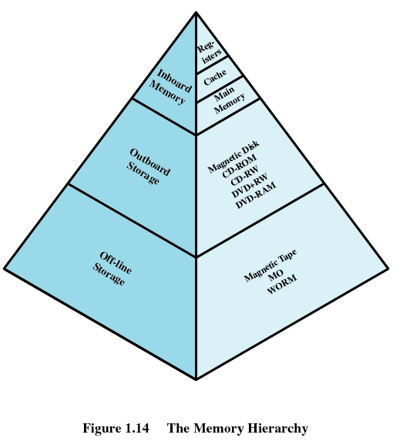
9.3. Locality(1/13)
The existence of transfer block between levels cost time, so the goal would be
to have the data already in fast memory by the time the CPU actually requests it
So that, the CPU would never have to wait for slow memory
Can the goal be fulfilled?

Slide 43
9.3. Locality(2/13)
Locality/principle of locality：
Programs tend to reference data items
that are near other recently referenced data items,
or that were recently referenced.
Locality is a attribute of program
programs with good locality run faster than programs with poor locality.
So the goal be fulfilled in some degree

Slide 44
9.3. Locality(3/13)
Locality types
时间/ temporal：tend to access the same set of data items over and over again, or they
空间/spatial：tend to access sets of nearby data items.

Slide 45
9.3. Locality(4/13)
If we can load them and keep in cache memory, it will be faster.
sum = 0;
for (i = 0; i < MAX; i++)
sum += array[i];
Let's look at a simple code fragment

Slide 46
9.3. Locality(5/13)
let's assume
that MAX is equal to 2.
that the instructions that implement the fragment start at address FRAG,
that sum and i are both local variables at addresses STACKPTR + X and STACKPTR + X + 4 respectively,
that array is a global variable at address ARRAY.

Slide 47
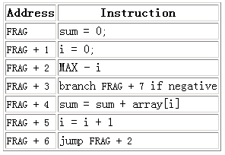
9.3. Locality(6/13)

Slide 48
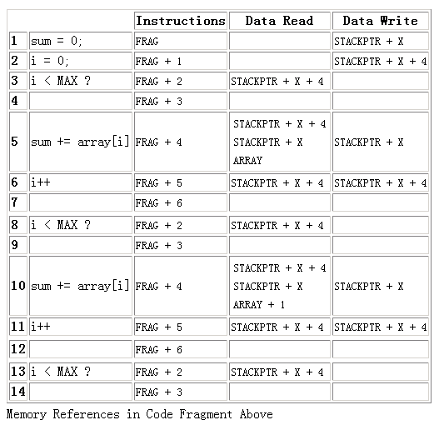
9.3. Locality(7/13)
201001V1.1

Slide 49
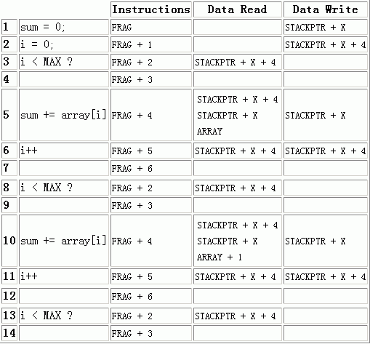
9.3. Locality(8/13)
The fetch of FRAG predicts the fetches of all addresses between FRAG and FRAG + 6. This is an example of spatial locality.

Slide 50
9.3. Locality(9/13)
The fetch of FRAG + 4 in line 5 predicts the fetch in line 10. Similarly the instruction fetches in lines 3, 4, 6, and 7 predict other fetches. This is an example of temporal locality.

Slide 51
9.3. Locality(10/13)
The references to both STACKPTR + X and STACKPTR + X + 4 predict further repeated references to each—and example of temporal locality.

Slide 52
9.3. Locality(11/13)
The reference to ARRAY predicts later reference to ARRAY + 1
— and example of spatial locality.

Slide 53
9.3. Locality(12/13)
The references to STACKPTR + X predict that STACKPTR + X + 4 is also referenced—an example of spatial locality.

Slide 54
9.3. Locality(13/13)
Summary
Programs that repeatedly reference the same variables enjoy good temporal locality.
For programs with stride-k reference patterns
the smaller the stride the better the spatial locality.
Loops have good temporal and spatial locality with respect to instruction fetches
The smaller the loop body and the greater the number of loop iterations, the better the locality.

