Slide 1
System Level Programming
Software College of SCU
Week13

Slide 2
Unit 10. Cache and Cache-Aware Programming
10.0 Introduction
10.1 Cache Design Parameters
10.2 Cache Memory
10.3 A Diversity of Caches
10.4 Cache-Aware Programming

Slide 3
10.0. Introduction(1/3)
Smaller,
faster,
and
costlier
(per byte)
storage
devices
L0:
CPU registers hold words retrieved from L1 cache.
registers
L1:
on-chip L1
cache (SRAM)
L1 cache holds cache lines retrieved from the L2 cache memory.
L2:
off-chip L2
cache (SRAM)
L2 cache holds cache lines retrieved from main memory.
L3:
main memory
(DRAM)
Larger,
slower,
and
cheaper
(per byte)
storage
devices
L4:
local secondary storage
(local disks)
L5:
remote secondary storage
(distributed file systems, Web servers)

Slide 4
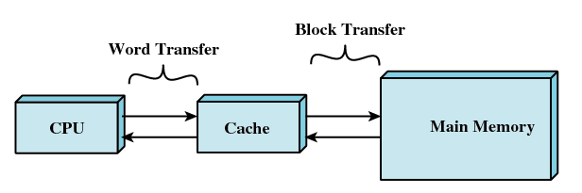
10.0. Introduction(2/3)
What Cache means?
  Broad sense：between level k and level k＋1
    Such as in Web Client/Service system
  Narrow sense：the levels of the memory hierarchy that stand between the CPU registers and the main memory (DRAM).

Slide 5
10.0. Introduction(3/3)
Cache memories are small, fast SRAM-based memories managed automatically in hardware.
  Hold frequently accessed blocks of main memory
CPU looks first for data in L1, then in L2, then in main memory.
CPU chip
register file
ALU
L1
cache
cache bus
system bus
memory bus
main
memory
L2 cache
bus interface
I/O
bridge

Slide 6
Unit 10. Cache and Cache-Aware Programming
10.0 Introduction
10.1 Cache Design Parameters
10.2 Cache Memory
10.3 A Diversity of Caches
10.4 Cache-Aware Programming

Slide 7
10.1 Cache Design Parameters(1/12)
Fetch Policy
Placement Policy
Replacement Policy
Update Policy
Size

Slide 8
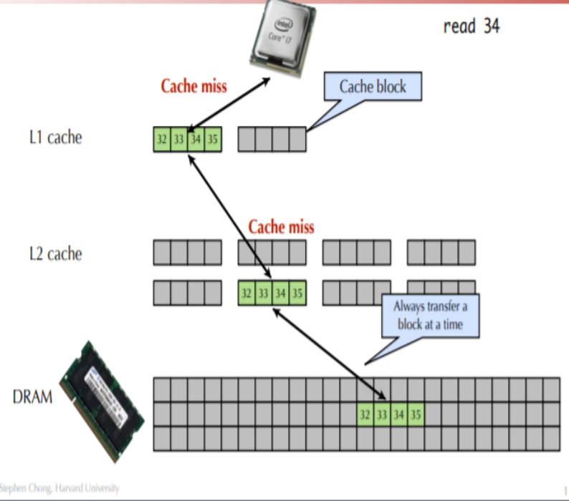
10.1 Cache Design Parameters(2/12)
Fetch Policy
  When the cache misses (means CPU does not find the data in the cache), the data must be found in the next level of the memory hierarchy.
  The "chunks" in which all transfers to and from the cache are called cache lines. Although it need to load 4 bytes (integers), it will fill up the 32 bytes in the cache line.
  Cache lines are typically in the order of 16 or 32 bytes long
disk (block) -> main memory (page) -> cache (line)

Slide 9
10.1 Cache Design Parameters(3/12)
Assume that a cache consists of 128 lines each of 32 bytes:
line 0
32 bytes
line 1
32 bytes
..................
line 126
32 bytes
line 127
32 bytes
When it loads the first byte into the line, it will load the remaining at the same time.

Slide 10
10.1 Cache Design Parameters(4/12)
Effect after cache miss
  When the cache misses an address X, it fetches addresses [X,X+32) into the cache, hoping that the program will get around to requesting the rest (that is, X+1 through X+31).
  The risk is that the program will not request the rest and the space consumed by it could have been better used to cache other values.

Slide 11
10.1 Cache Design Parameters(5/12)
struct point_color {
int c; int m; int y; int k;
};
struct point_color square[16][16];
int i, j;
for(i = 0; i < 16; i++) {
for(j = 0; j < 16; j++) {
square[i][j].c = 0;
square[i][j].m = 0;
square[i][j].y = 1;
square[i][j].k = 0;
}
}
What is the total number of writes?
What is the total number of writes that miss in the cache?
What is the miss rate?

Slide 12
10.1 Cache Design Parameters(6/12)
struct point_color {
int c; int m; int y; int k;
};
struct point_color square[16][16];
int i, j;
for(i = 0; i < 16; i++) {
for(j = 0; j < 16; j++) {
square[i][j].c = 0;
square[i][j].m = 0;
square[i][j].y = 1;
square[i][j].k = 0;
}
}
What is the total number of writes?
16*16*4 =1024 (WRITES)
square[0][0].c = 0
write

Slide 13
10.1 Cache Design Parameters(7/12)
struct point_color {
int c; int m; int y; int k;
};
struct point_color square[16][16];
int i, j;
for(i = 0; i < 16; i++) {
for(j = 0; j < 16; j++) {
square[i][j].c = 0;
square[i][j].m = 0;
square[i][j].y = 1;
square[i][j].k = 0;
}
}
What is the total number of writes that miss in the cache?
Cache Miss =16*8 =128
Miss Rate = (16*8) / (16*16*4) = 1/8 = 0.125
S[0][0].c | S[0][0].m | S[0][0].y | S[0][0].k | S[0][1].c | S[0][1].m | S[0][1].y | S[0][1].k
Cache Line

Slide 14
10.1 Cache Design Parameters(8/12)
Placement Policy -- Where can a block be placed in a cache?
  Direct mapped (直接映射): Each block has only one place it can appear in the cache.
  Set associative (组相联): A block can be placed in a restricted set of places. (2-way, 4-way, 8-way, etc.)
  Fully associative (全相联): A block can be placed anywhere in the cache.

Slide 15
10.1 Cache Design Parameters(9/12)
Replacement Policy -- When cache is full, which line is moved out. The block that is evicted is referred to as a victim block.
  Random: victim block is randomly selected.
  Least Frequently Used (LFU最不常使用): replaces the block which has been accessed the least number of times.
  Least Recently Used (LRU最近最少使用): The block replaced is the one that has been unused for the longest time.

Slide 16
10.1 Cache Design Parameters(10/12)
Write/Update Policy
  What happens on write hits?
    Write through (直写): The information is written to both the block in the cache and to the block in the lower-level memory.
    Write back (写回): The information is written only to the block in the cache.
      add ‘dirty’ bit to each line indicating that memory needs to be updated when block is replaced

Slide 17
10.1 Cache Design Parameters(11/12)
Write/Update Policy
  What happens on write misses (Cache写失效)?
    Write allocate(写分配法): The block is loaded on a write miss, followed by the write-hit actions above.
    No-write allocate(非写分配法): The block is modified in the lower level and not loaded into the cache.

Slide 18
10.1 Cache Design Parameters(12/12)
Write/Update Policy
  Write-back caches generally use write allocate and write-through caches often use no-write allocate.

Slide 19
Unit 10. Cache and Cache-Aware Programming
10.0 Introduction
10.1 Cache Design Parameters
10.2 Cache Memory
10.3 A Diversity of Caches
10.4 Cache-Aware Programming

Slide 20
10.2 Cache Memory
10.2.1 Cache Memories General Organization
10.2.2 Direct Mapped Cache
10.2.3 Set Associative Cache
10.2.4 Fully Associative Cache

Slide 21
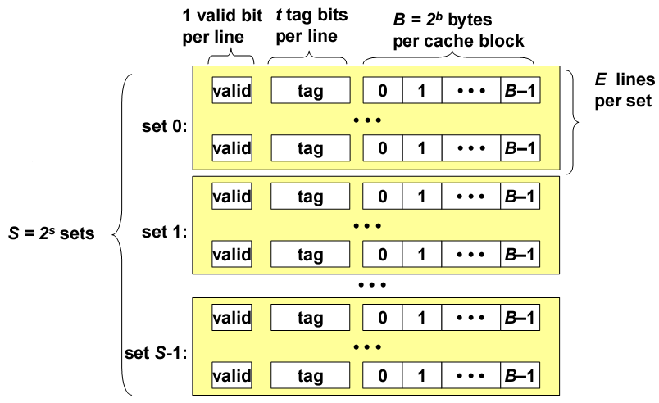
10.2.1 Cache Memories General Organization(1/2)
Cache is an array of sets.
Each set contains one or more lines.
Each line holds a block of data.

Slide 22
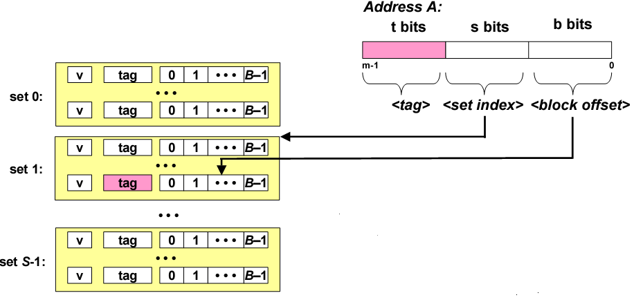
10.2.1 Cache Memories General Organization(2/2)
（set selection）组选择 + ( line matching)行匹配+( byte selection)字提取
Addressing Cache
1.Locate the set based on <set index>
2.Locate the line in the set based on <tag>
3.Check that the line is valid
4.Locate the data in the line based on <block offset>

Slide 23
10.2 Cache Memory
10.2.1 Cache Memories General Organization
10.2.2 Direct Mapped Cache
10.2.3 Set Associative Cache
10.2.4 Fully Associative Cache

Slide 24
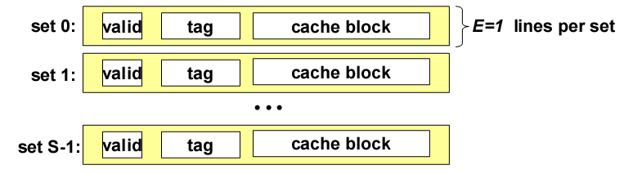
10.2.2 Direct Mapped Cache(1/6)
Organization
  Simplest kind of cache
  Each set has exactly one cache line.

Slide 25
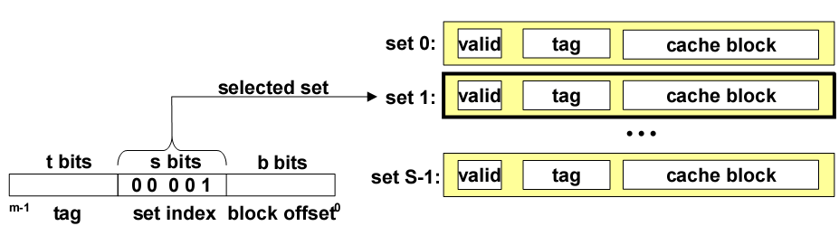
10.2.2 Direct Mapped Cache(2/6)
Addressing Direct Mapped Cache
  Set selection: Use the set index bits to determine the set of interest.

Slide 26
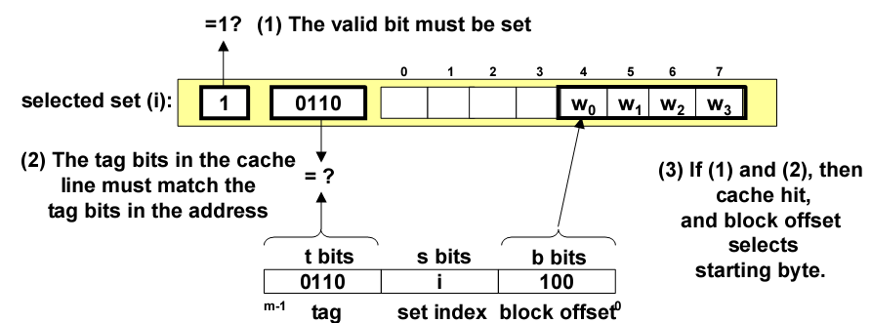
10.2.2 Direct Mapped Cache(3/6)
Addressing Direct Mapped Cache
  Line matching: Find a valid line in the selected set with a matching tag
  Byte selection: extract the byte that we want

Slide 27
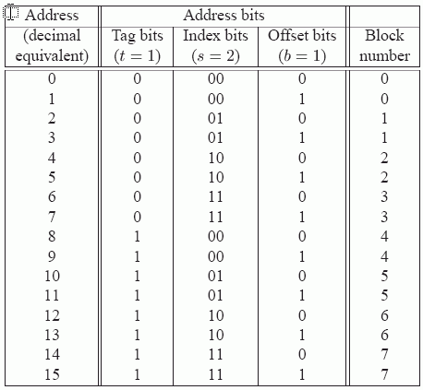
10.2.2 Direct Mapped Cache(4/6)
The Cache set size: S = 2^{s} = 4
The size of the cache line: B = 2 ^{b} = 2 byte
4-bit address

Slide 28
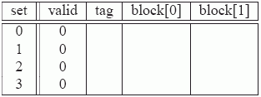
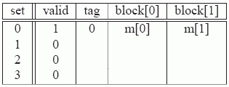
10.2.2 Direct Mapped Cache(5/6)
Simulate the Cache in action:
Initially, the cache is empty (i.e., each valid bit is 0).
Read word at address 0. Since the valid bit for set 0 is zero, this is a cache miss.
Read word at address 1. This is a cache hit. The cache immediately returns m[1] from block[1] of the cache line. The state of the cache does not change.

Slide 29
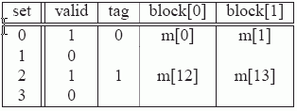
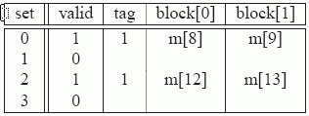
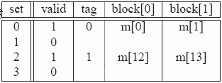
10.2.2 Direct Mapped Cache(6/6)
Read word at address 13. Since the cache line in set 2 is not valid, this is a cache miss. The cache loads block 6 into set 2 and returns m[13] from block[1] of the new cache line.
Read word at address 8. This is a miss. The cache line in set 0 is indeed valid, but the tags do not match. The cache loads block 4 into set 0 (replacing the line that was there from the read of address 0)
Read word at address 0. This is another miss, due to the unfortunate fact that we just replaced block 0 during the previous reference to address 8.

Slide 30
10.2 Cache Memory
10.2.1 Cache Memories General Organization
10.2.2 Direct Mapped Cache
10.2.3 Set Associative Cache
10.2.4 Fully Associative Cache

Slide 31
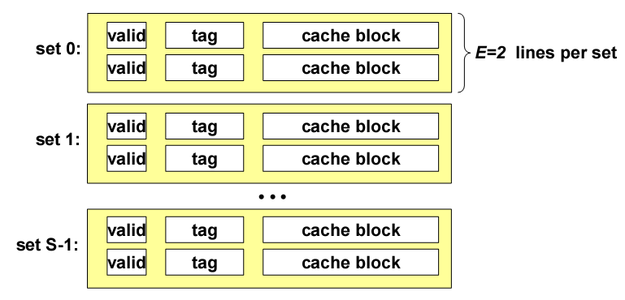
10.2.3 Set Associative Cache(1/5)
Organization
  Characterized by more than one line per set

Slide 32
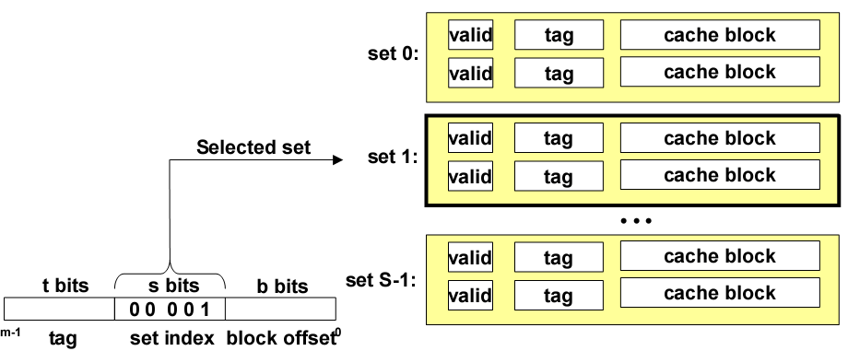
10.2.3 Set Associative Cache(2/5)
Set selection: identical to direct-mapped cache

Slide 33
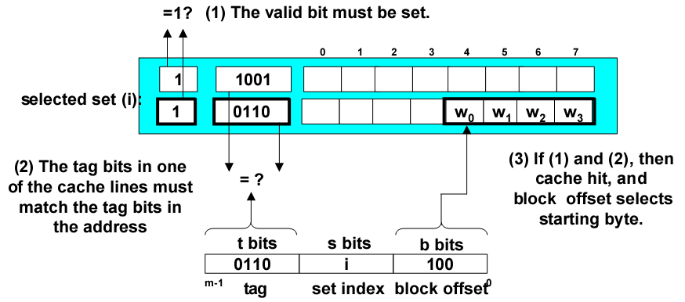
10.2.3 Set Associative Cache(3/5)
Line matching and word selection
  Must compare the tag in each valid line in the selected set.

Slide 34
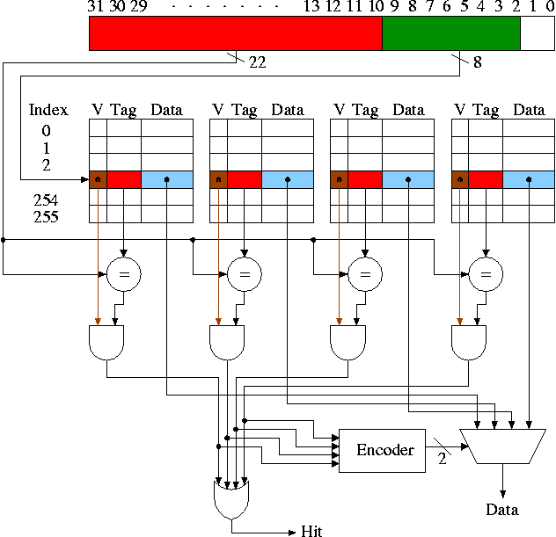
10.2.3 Set Associative Cache(4/5)
4-Way Set Associative Cache
1. How big is the cache?
Ans: 256 * 4 * 4B = 4KB
201001V1.1

Slide 35
10.2.3 Set Associative Cache(5/5)
2. How many bits are in the cache?
Ans: (1+22+32)*4*256
= 55Kb
多路选通 multiplexer

Slide 36
10.2 Cache Memory
10.2.1 Cache Memories General Organization
10.2.2 Direct Mapped Cache
10.2.3 Set Associative Cache
10.2.4 Fully Associative Cache

Slide 37
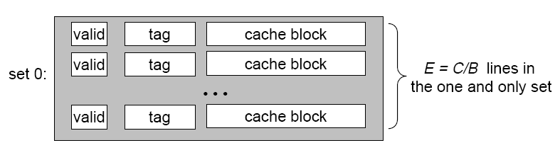
10.2.4 Fully Associative Cache (1/4)
Organization
  set index: non-existent

Slide 38
10.2.4 Fully Associative Cache (2/4)
Selection: No need
  The entire cache is one set, so by default set 0 is always selected
Valid
Tag
Cache block
Set 0:
Valid
Tag
Cache block
• • •
t bits
b bits
Valid
Tag
Cache block
m-1
Tag
Block offset
0

Slide 39
10.2.4 Fully Associative Cache (3/4)
Line matching and word selection
=1 ?
(1) The valid bit must be set
0
1
2
3
4
5
6
7
1
1001
0
0110
Entire cache
1
0110
w₀
w₁
w₂
w₃
0
1110
(3) If (1) and (2), then cache hit, and block
offset selects
starting byte
(2) The tag bits in one of the cache lines must match the tag bits in the address
= ?
t bits
b bits
0110
100
m-1
Tag
Block offset
0

Slide 40
10.2.4 Fully Associative Cache (4/4)
Compare tags in parallel
31
4
0
Cache Tag (27 bits long)
Block Offset
Ex: 0x01
Cache Tag
Valid Bit
Cache Data
=
Byte 31
:
Byte 1
Byte 0
=
Byte 63
:
Byte 33
Byte 32
=
=
:
:
:
=

Slide 41
Unit 10. Cache and Cache-Aware Programming
10.0 Introduction
10.1 Cache Design Parameters
10.2 Cache Memory
10.3 A Diversity of Caches
10.4 Cache-Aware Programming

Slide 42
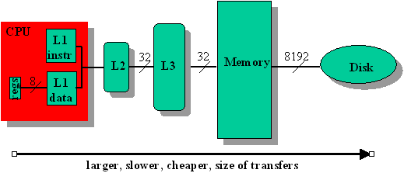
10.3 A Diversity of Caches(1/13)
Multiple Levels of Caches (L1, L2, or L3 cache, L1 is faster than L2 and L2 is faster than L3. L1 is more expensive than L2..)

Slide 43
10.3 A Diversity of Caches(2/13)
Show the benefit of cache memory of different levels
/* Assumes n is a power of two */
void merge_sort (int * data, int n) {
int half = n >> 1;
if (n == 1) return;
merge_sort(data, half);
merge_sort(data + half, half);
merge(data, data + half, half);
}

Slide 44
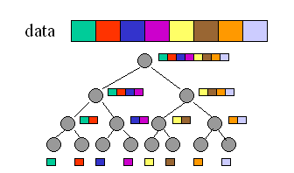
10.3 A Diversity of Caches(3/13)
Graph of Merge Sort

Slide 45
10.3 A Diversity of Caches(4/13)
Assumption
  The caches are fully associative.
  LRU is used for replacement (近期最少使用法).
  The execution time is given in terms of the access times in nanoseconds (ns) for the L1 cache (T1), L2 cache (T2), L3 cache (T3), and main memory (Tm).

Slide 46
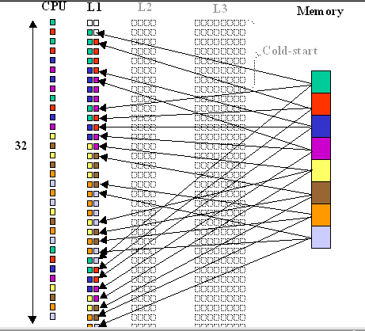

10.3 A Diversity of Caches(5/13)
Merge Sort in L1 only
Look at the total time

Slide 47
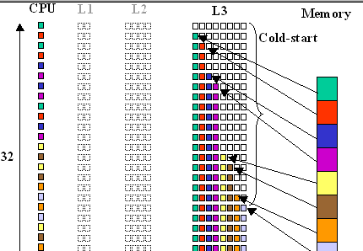

10.3 A Diversity of Caches(6/13)
Merge Sort in L3 only
Look at the total time
201001V1.1

Slide 48
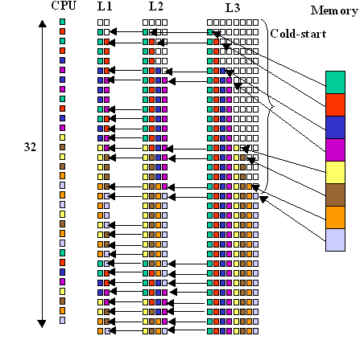
10.3 A Diversity of Caches(7/13)
Merge Sort in Three Levels of Cache
Look at the total time
201001V1.1

Slide 49
10.3 A Diversity of Caches(8/13)
Compare the result
Assume T1 = 2 ns, T2 = 4 ns, T3 = 6 ns, Tm = 60 ns
for the one small L1 cache case
  Execution Time = (32-24)*T1 + 24* Tm = 1456 ns
for the one large L3 cache case
  Execution Time = (32-8)*T3 + 8*Tm = 624 ns
for the three-cache case
  Execution Time = (32-24)*T1 + (24-16)*T2 + (16-8)*T3 + 8*Tm = 574 ns

Slide 50
10.3 A Diversity of Caches(9/13)
The cache has been warmed up by repeated memory accesses and occurs in steady state
Sometimes the data size fits completely in the cache.
  This results in very fast programs
  Because once the cache is "warmed up," the execution never has to interact with the slow main memory.
  Note that adding a little more data can wreak havoc on the performance of one such program.
Programs that exhibit extremely poor locality of reference may thus execute more slowly on a multilevel cache architecture

Slide 51
10.3 A Diversity of Caches(10/13)
Instruction and Data Caches (separate data and instruction in the cache).

Slide 52
10.3 A Diversity of Caches(11/13)
On-Chip Caches (only one level cache, L1)

Slide 53
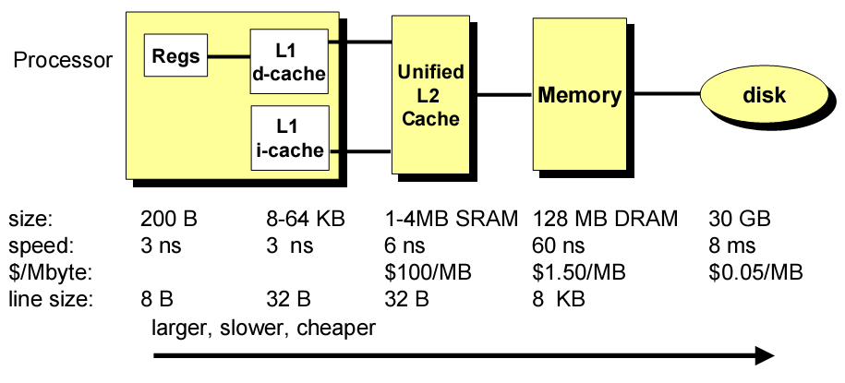
10.3 A Diversity of Caches(12/13)
Common Cache Hierarchy

Slide 54
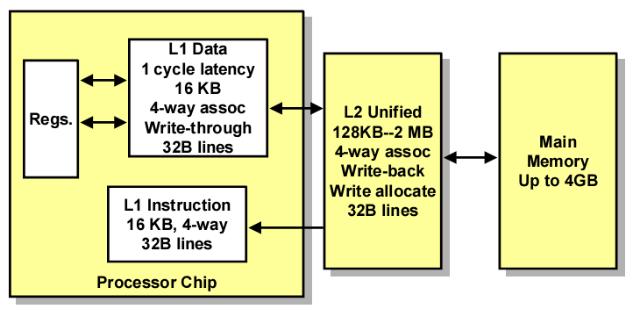
10.3 A Diversity of Caches(13/13)
Pentium Cache Hierarchy

Slide 55
Unit 10. Cache and Cache-Aware Programming
10.0 Introduction
10.1 Cache Design Parameters
10.2 Cache Memory
10.3 A Diversity of Caches
10.4 Cache-Aware Programming

Slide 56
10.4 Cache-Aware Programming
The goal of such cache-aware programming is to increase the locality of a program's memory references, either spatially or temporally.
A program's locality might be insufficient for some or all of the caches.
  each case is different

Slide 57
10.4 Cache-Aware Programming
10.4.1 case 1: Thrashing
10.4.2 case 2: Instruction Cache Overflow
10.4.3 case 3: Cache Collisions
10.4.4 case 4: Insufficient Spatial Locality
10.4.5 case 5: Insufficient Temporal Locality

Slide 58
10.4.1 case 1: Thrashing(1/2)
This is a collision that happens repeatedly, causing thrashing: a condition in which data is transferred back and forth with no benefit.
In this case, CPU is very busy but the response is very slow. It is because almost of the CPU’s time is spending in swapping in/out.

Slide 59
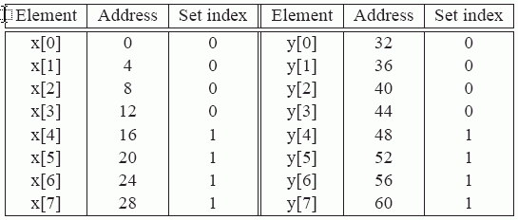
10.4.1 case 1: Thrashing(2/2)
float sum(float x[8], float y[8]) {
float sum = 0.0;
int i;
for (i = 0; i < 8; i++)
sum += x[i] * y[i];
return sum; }

Slide 60
10.4 Cache-Aware Programming
10.4.1 case 1: Thrashing
10.4.2 case 2: Instruction Cache Overflow
10.4.3 case 3: Cache Collisions
10.4.4 case 4: Insufficient Spatial Locality
10.4.5 case 5: Insufficient Temporal Locality

Slide 61
10.4.2 case 2: Instruction Cache Overflow(1/2)
There is a possibility that the instructions for the body of the for loop will overflow the capacity of the L1 instruction cache,
  and that therefore, in each iteration of the loop, each instruction will have to be fetched from main memory, again and again.
for (i = 0; i < MAX; i++) {
<Complicated operation on A[i]>
<Complicated operation on B[i]>
<Complicated operation on C[i]>
}

Slide 62
10.4.2 case 2: Instruction Cache Overflow(2/2)
optimize: loop fission(分裂)
  commonly done with very large data sets
for (i = 0; i < MAX; i++) {
<Complicated operation on A[i]>
}
for (i = 0; i < MAX; i++) {
<Complicated operation on B[i]>
}
for (i = 0; i < MAX; i++) {
<Complicated operation on C[i]>
}

Slide 63
10.4 Cache-Aware Programming
10.4.1 case 1: Thrashing
10.4.2 case 2: Instruction Cache Overflow
10.4.3 case 3: Cache Collisions
10.4.4 case 4: Insufficient Spatial Locality
10.4.5 case 5: Insufficient Temporal Locality

Slide 64
10.4.3 case 3：Cache Collisions(1/3)
A cache collision occurs when a cache line is evicted even though the cache is not full
  It is possible that the compiler may allocate a, b, and c to memory addresses that map to the same cache set.
  In this case, the assignment c[i] = a[i] + b[i] will cause three cache misses in every iteration of the loop, because the cache will be constantly evicting the cache line that the CPU requires next.
int a[N];
<other stuff...>
int b[N];
<other stuff...>
int c[N];
for (i = 0; i < N; i++) {
c[i] = a[i] + b[i];
}

Slide 65
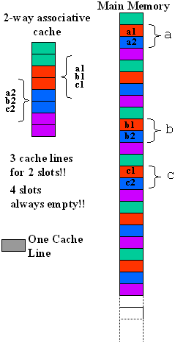
10.4.3 case 3：Cache Collisions(2/3)
int a[N];
<other stuff...>
int b[N];
<other stuff...>
int c[N];
for (i = 0; i < N; i++) {
c[i] = a[i] + b[i];
}

Slide 66
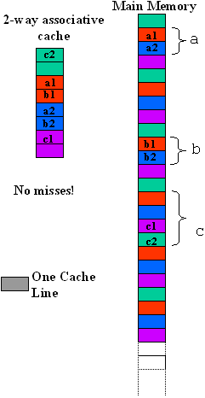
10.4.3 case 3：Cache Collisions(3/3)
#define CACHELINESIZE <Cache line size of system>
#define COFFSET ((2 * CACHELINESIZE) / sizeof(int))
int a[N];
<other stuff...>
int b[N];
<other stuff...>
int c[N + COFFSET];
for (i = 0; i < N; i++) {
c[i + COFFSET] = a[i] + b[i];
}

Slide 67
10.4 Cache-Aware Programming
10.4.1 case 1: Thrashing
10.4.2 case 2: Instruction Cache Overflow
10.4.3 case 3: Cache Collisions
10.4.4 case 4: Insufficient Spatial Locality
10.4.5 case 5: Insufficient Temporal Locality

Slide 68
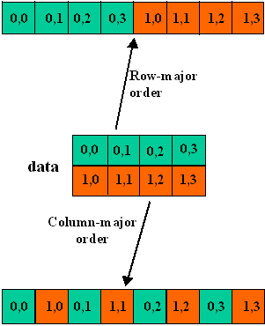
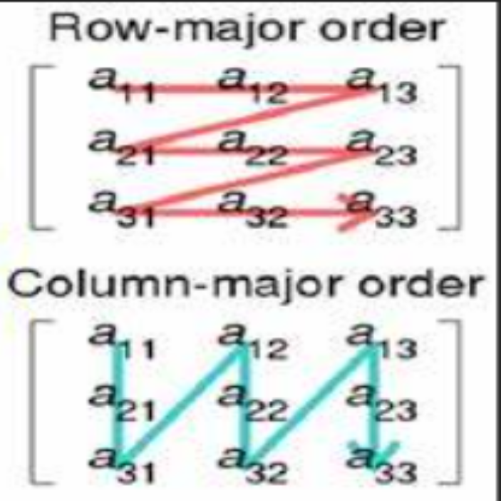
10.4.4 case 4：Insufficient Spatial Locality(1/3)
Row-major order and Column-major order
C arrays allocated in row-major order
  each row in contiguous memory locations

Slide 69
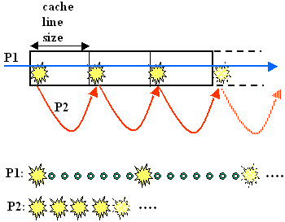
10.4.4 case 4：Insufficient Spatial Locality(2/3)
int I
int sum=0;
int data[ARRAY_SIZE]
for (i = 0; i < ARRAY_SIZE; i += stride)
sum += data[i];

Slide 70
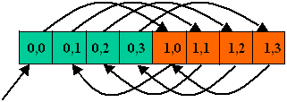

10.4.4 case 4：Insufficient Spatial Locality(3/3)
Swapping the order of the for loops results in a much more cache-friendly execution, with at most one cache miss per cache line.
int data[M][N];
for (i = 0; i < M; j++) {
for (j = 0 ; j < N; i++) {
sum += data[ j] [ i ];
}
}
int data[M][N];
for (i = 0; i < M; j++) {
for (j = 0 ; j < N; i++) {
sum += data[ i ] [ j ];
}
}

Slide 71
10.4 Cache-Aware Programming
10.4.1 case 1: Thrashing
10.4.2 case 2: Instruction Cache Overflow
10.4.3 case 3: Cache Collisions
10.4.4 case 4: Insufficient Spatial Locality
10.4.5 case 5: Insufficient Temporal Locality

Slide 72


10.4.5 case 5: Insufficient Temporal Locality(1/3)
Can we avoid the cache miss by exchange the i, j?
  Insufficient Temporal Locality
Can we do anything to improve the performance?
int original[M][N];
int transposed[N][M];
for (i = 0; i < M; i++) {
for (j = 0; j < N; j++) {
transposed[i][j] = original[j][i];
}
}

Slide 73
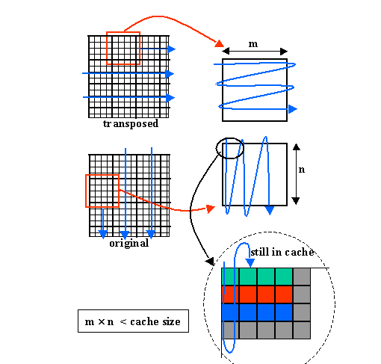
10.4.5 case 5: Insufficient Temporal Locality(2/3)
We can break up the large image into many images of the right size to improve the hit ratio.
  Loop Tiling (循环分块)

Slide 74
10.4.5 case 5: Insufficient Temporal Locality(3/3)
int original[M][N];
int transposed[N][M];
for (k = 0; k < M / m; k++) {
for (l = 0; l < N / n; k++) {
for (i = k*m; i < (k+1)*m; i++) {
for (j = l*n; j < (l+1)*n; j++) {
transposed[i][j] = original[j][i];
}
}
}
}
int original[M][N];
int transposed[N][M];
for (i = 0; i < M; i++) {
for (j = 0; j < N; j++) {
transposed[i][j] = original[j][i];
}
}

