Slide 1

K. K. Wagh Institute of Engineering and Education Research
Dept. Of Computer Engineering
Automation of a Wheelchair Mounted Robotic
Arm using Computer Vision Interface
Guided by-
Prof.
By-
Jayashree Ahire, TE- B (02)
A.Y. 2018-19 Sem II

Slide 2
I. INTRODUCTION
Largely benefits people suffering from upper body movement disorders such as Amyotrophic Lateral Sclerosis (ALS), Parkinson’s disease, Progressive Muscular Atrophy (PMA)
Enhance the manipulation capabilities for electric wheelchair users and make them feel more independent
help the electric wheelchair users to pick up objects from a table or a shelf effortlessly in a short amount of time

Slide 3
Similar Products available:
Wheelchair mounted robotic arms (WMRA) available in the market:
JACO Robot arm by Kinova Robotics
iARM by Assistive Innovations
This might be challenging to operate for users suffering from motor neuron diseases and in many cases it can consume a lot of time and effort to successfully grasp the object.
They are also very expensive usually run into thousands of dollars
Indika Pathirage et. al. implemented brain computer interface (BCI) for grasping an object by creating a visual grid to select an object from the scene image
The study showed that using BCI to select an object can consume more time and adds fatigue to the user
Hairong Jiang et. al. performed object detection using Speeded Up Robust Features (SURF) algorithm and the results were used for coarse positioning of the arm and gesture based recognition was used for fine localization
Most of the interfaces are:
semiautomatic
Use mostly touch screen, joystick and graphic display
utilize remote controlled interface such as joystick to control the arm.
require certain level of concentration and participation from the user.
Their completion times are also usually longer (around 200 to 300 seconds)

Slide 4
Goals
To develop a system that can:
Deliver the desired object to the user with minimal to no supervision
User independent
Can figure out the position of the object on its own using an object detection algorithm and can complete the task of picking up the object and returning it to the user under one minute
The coarse location of the target object is calculated by using image obtained from the vision sensor located above the arm
Fine localization is achieved by using a vision sensor near the gripper. The obtained coordinates are fed to the robotic arm using a serial communication interface to move the arm in the right direction

Slide 5
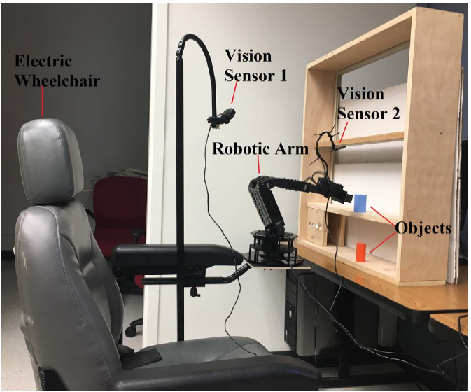
II. SYSTEM DESCRIPTION
The proposed system consists of:
a robotic arm with six degrees of freedom
an electric wheelchair
a computer system
two vision sensors

Slide 6
The robotic arm is mounted on the left arm of the wheelchair
One of the vision sensor is placed above the robotic arm which captures the video of the object placed on the shelf
The position of this vision sensor is static and the relative distance between the sensor and the base of the arm is known prior to the start of the experiment to deliver accurate results
The shelf is used to achieve the goal of accessing objects at different heights
Another vision sensor is mounted above the gripper to fine tune the position of the arm’s gripper before it can pick the object
This vision sensor is dynamic and the position varies depending on the position of the target object
A computer vision system is developed that detects multiple colored objects placed randomly on the surface within reach by the arm

Slide 7
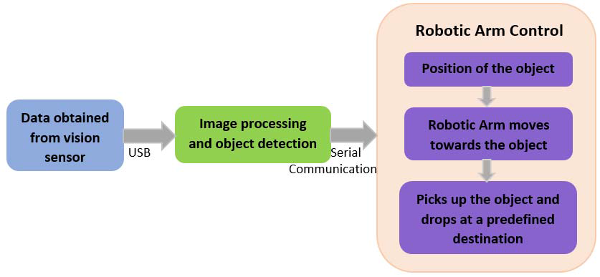
Figure 2. Block diagram of the system

Slide 8
A. Robotic Arm
A Trossen Robotics PhantomX Reactor Robot Arm
Built using an Arduino compatible advanced microcontroller called Arbotix-M robocontroller
has eight AX-12A dynamixel actuators for controlling different parts of the arm
Each servo has sensors to track its
speed
Temperature
shaft position
voltage
load.
The servo motor at the bottom is used to move the arm in the horizontal direction (left and right)
The shoulder has dual servo which moves the arm in the forward and backward direction
The elbow also has dual servo which controls the up and down movement of the arm
The wrist angle and wrist rotate have one servo each
The arm has a parallel gripper controlled by an AX-12 servo which can hold and release the object
The arm is powered by a 12V 5amp power supply and is connected to a computer system via a FTDI cable

Slide 9
A serial connection is made between the computer system and the robotic arm in order to communicate with the robotic arm
This was achieved by using PySerial, a python serial port access library
The serial connection has a baud rate of 38400
The data packet which is 17-byte long was sent serially from the computer to the Arbotix-M robocontroller to control the movement of the arm
The 17-byte data packet includes :
the header (0xFF/255)
X-axis coordinate
Y-axis coordinate
Z-axis coordinate
wrist angle
wrist rotate
gripper
delta byte
check sum
Each of the servo motor can be controlled by varying the 17-byte data sent to the arm accordingly
A short delay is introduced after every serial write command is performed to ensure the reception of the 17-byte data by the robotic arm

Slide 10
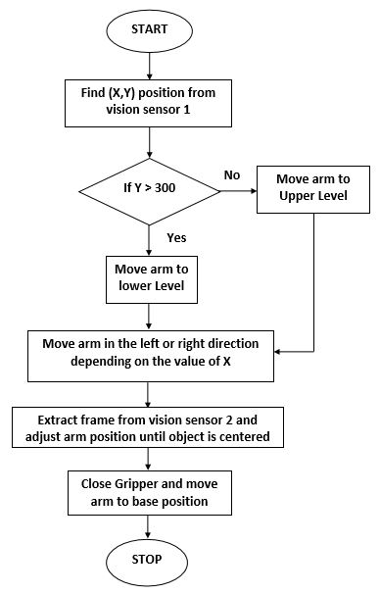
Figure 6. Flowchart for Robotic Arm Control

Slide 11
B. Vision Sensors
Uses two vision sensors (USB webcams) to perform object detection:
A logitech HD c920 webcam (vision sensor 1)
Mounted above the robotic arm facing the shelf located in front of the arm
Captures the video of the arm and the shelf in real time
Frames extracted from this video are processed and the position (x, y) of the target object is calculated
This data is used for coarse positioning of the robotic arm
A robot vga webcam (vision sensor 2):
Mounted above the gripper using a 200 mm gooseneck
The vision sensor 2 captures a close-up video of the target object
Frames from this camera are captured only after the arm is moved to the position indicated by vision sensor 1
Used to position the gripper exactly in front of the object so that the object can be picked up correctly
The resolution of the images in both the camera is 640 x 480 pixels
The webcam captures around 30 frames per second

Slide 12
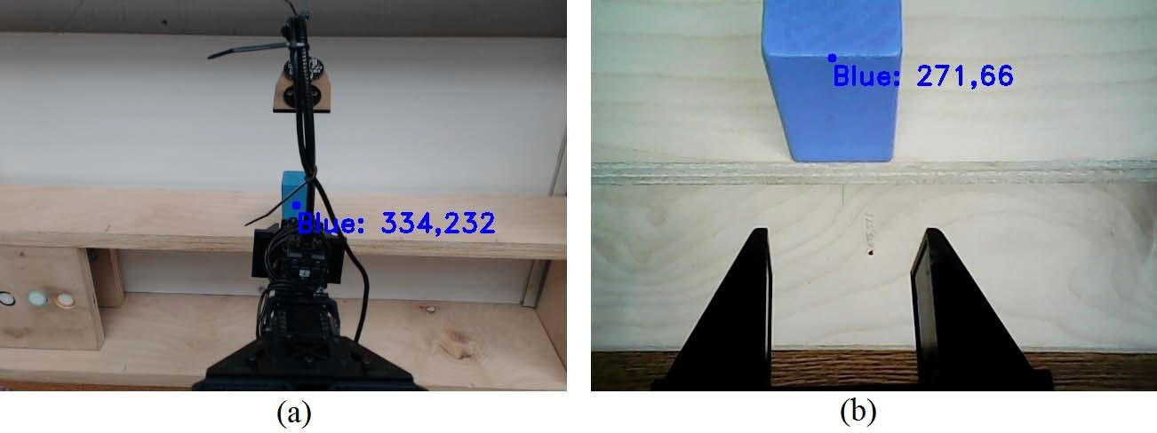
(a) Image captured by the vision sensor 1
(b) Image captured by the vision sensor 2

Slide 13
C. Computer Vision Algorithm
The robotic arm is programmed to move towards the position of a specific colored object
The color detection algorithm is written in Python using the OpenCV library
The vision sensor captures the real time video of the robotic arm and the object
The video is extracted frame by frame
each of the frame is processed through a series of steps to detect colored objects in the frame
Each frame is converted from BGR (Blue Green Red) image to HSV (Hue, Saturation and Value) image
A specific color is filtered by applying a lower and upper limit threshold to the HSV image
Different colors have different range of hue values
The experiment is performed with blue color chosen as the object of interest
The resulting image is eroded to remove the noise present in the image and dilated to fill the gaps in the image
The threshold image is scanned to check the presence of contours. In case a contour is located the position of the contour is found by calculating moments
A minimum enclosing circle is drawn around the object and the center of the circle corresponds to the X and Y coordinates of the position of the object. The color detection algorithm is extended to capture data from two vision sensors and combined with the robotic arm control code to perform the desired task. Figure 3 shows the flowchart implementation of the computer vision algorithm.

Slide 14
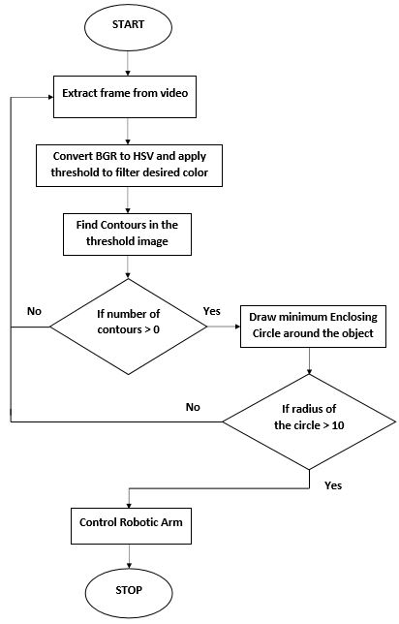
Figure 3. Flowchart for Computer Vision Algorithm

Slide 15
III. EXPERIMENT AND RESULTS
The robotic arm is operated in the Cartesian mode
Initially the two vision sensors start capturing the video in real time
A frame is extracted from the video captured by the vision sensor 1 and the X and Y position of the object is calculated using the color detection algorithm
Before proceeding with the arm control, a condition is checked to see if the position of the object is same as or very close to its previous position (X ± 5). If the condition is true, it means the object has not moved and hence the arm remains in the base position. If it is false, it indicates that the object has been moved to a different location and the arm is controlled to move towards the new location of the object
This way it eliminates the possibility of the arm to move to the same position repeatedly even if multiple frames are captured by the vision sensors
If an object is detected by the vision sensor, the arm is moved to the base position (an inverted L) and the gripper is opened
The arm is then moved up or down depending on the value of the Y coordinate with the threshold measured at 300

Slide 16
Arm Link software provided by Trossen Robotics is a simple graphic user interface (GUI) to control the InterbotiX line of robot arms
X coordinate range of the arm varies from 212 to 812 and can be controlled manually using the Arm Link software
The pixel distance in the horizontal axis varies between 0 and 640 and is measured using the color detection algorithm
The object is placed at different positions in front of the arm and multiple readings of the X distance in pixels and the corresponding X coordinate of the arm are taken and plotted in the Desmos graphing calculator
A best fit equation of a line is formulated
The factors 0.95 and 150 are calculated using trial and error method such that the line generated passes through a maximum number of points plotted
X position of the arm = (X object * 0.95) + 150 ….(Equation 1)

Slide 17
The arm is then controlled to move in the left or right direction depending on the value obtained from the equation
Now the robotic arm is moved to a position which is very close to the location of the target object
There is a possibility that the obtained location might not be the exact location of the object. Hence the vision sensor 2 is used to obtain the accurate location of the object
The X value in pixel is checked to see if it lies in the center of the frame. In the event it does not fall within the specified range
the arm is moved in small steps in the left or right direction until it reaches the center position
If the X value is already in the specified range, no command is given to the arm

Slide 18
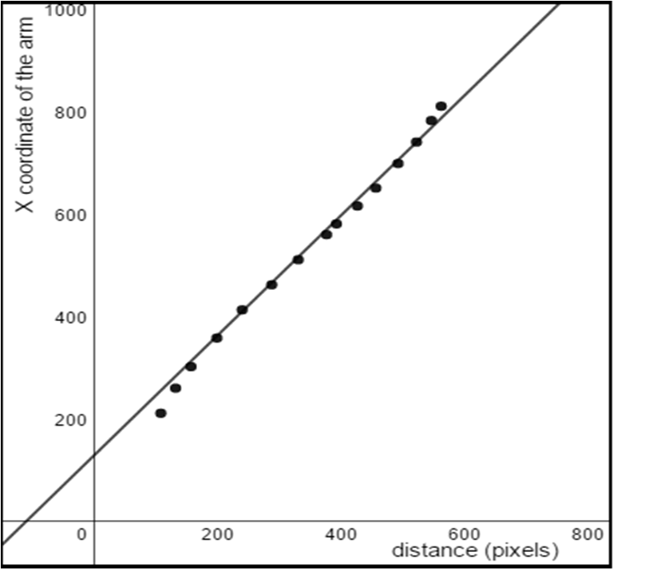
Figure 5. X distance in pixel vs X coordinate of the robotic arm

Slide 19
The object is picked up by closing the gripper and the arm then moves in front of the user to deliver the object
Out of the 24 trials performed with the objects in the upper and lower level, 20 were successful in picking up the objects correctly. This gives an accuracy of about 83.33%

Slide 20
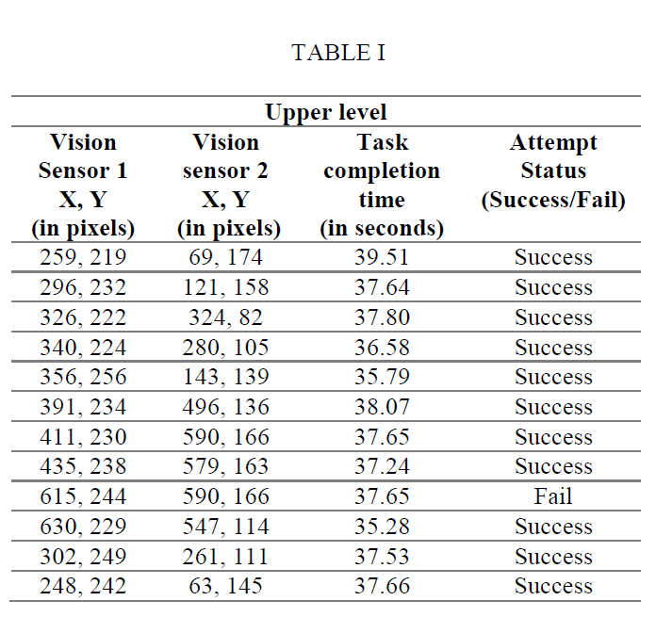
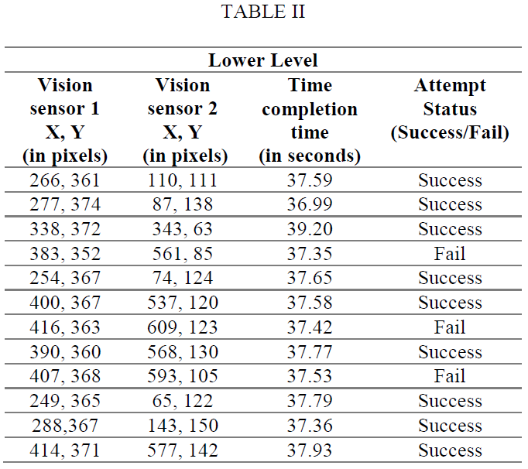

Slide 21
Figure 6. Flowchart for Robotic Arm Control

Slide 22
Most of the unsuccessful attempts occur when the target object is placed farther from the robotic arm
Accuracy is lesser for x values lesser than 200 or greater than 570. Hence the equation (1) does not hold good for extreme values
Effective solutions for reducing the number of unsuccessful attempts would be
formulating a higher order equation that can hold good for most locations of the object and
More fine tuning by repetitively moving the arm until the object is in the center of the frame.
the time taken to pick up objects from the upper and lower level are almost the same value.
This is significantly low compared to the completion times calculated when using brain computer interface or gesture based recognition
It can also be seen that attempts are more successful when the objects are placed at the upper level compared to the lower level
The reason for unsuccessful attempts on the lower level is that the light falling on the lower level is less due to the shadow cast by the shelf.
This may pose as a problem for color based object detection since the position of the detected object keeps fluctuating due to insufficient light.

Slide 23
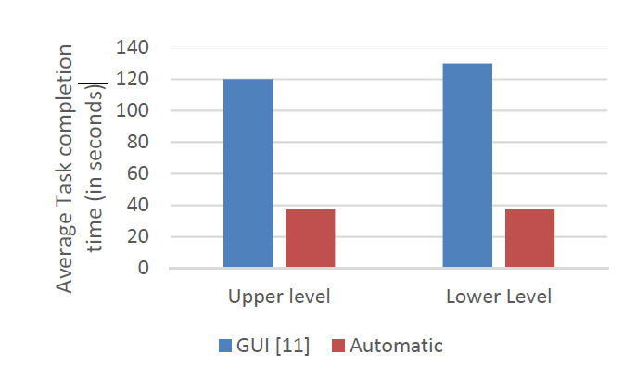
Figure 7. Comparison of task completion times using different control modes

Slide 24
the completion time for task took around 120 to 130 seconds for a skilled user.
The result shows that automating the movement of a robot arm can save a lot of time
it does not require the user to concentrate while performing the task.

Slide 25
IV. CONCLUSION
Computer vision algorithm based on color detection has been developed to automate the movement of the robotic arm
This was implemented by using two vision sensors to accurately find the location of the target object:
First sensor was used for obtaining the coarse location of the object
second one was used for fine localization
The robotic arm has the ability to pick up objects placed at different locations on the upper and lower level with a success rate of 83.33%
The main goal of performing the action of picking up the object under one minute is achieved

Slide 26
V. FUTURE WORK
Future works aimed is implementing:
The wireless protocol: Operator at one end can control the robotic arm wirelessly at the other end
Voice recognition to control a robotic arm or vision sensor over voice
And the most advanced to make it mind-controlled robotic arm by connecting to existing neurons or to electrodes implanted into the human brain to decode the signals from the brain and use them to control a robotic arm
Depth sensors can be used in addition to vision sensors to increase the performance of the robotic arm control in order to minimize the number of unsuccessful attempts
Advanced vision algorithms can be used for pose estimation and size detection to detect same object at different angles

