Slide 1

K. K. Wagh Institute of Engineering and Education Research
Dept. Of Computer Engineering
ADVANCED ROBOTIC ARM
Guided by:
Prof. S. D. Jadhav
Presented By:
Jayashree Ahire, TE- B (02)
A.Y. 2018-19 Semester II

Slide 2
I. INTRODUCTION
For people suffering from upper body movement disorders:
Amyotrophic lateral sclerosis (ALS)
Parkinson’s disease
Progressive muscular atrophy (PMA)
Other motor neuron diseases
Enhances the manipulation capabilities
More independent
Pick up objects from a table or a shelf effortlessly
Utilizes remote controlled interface

Slide 3
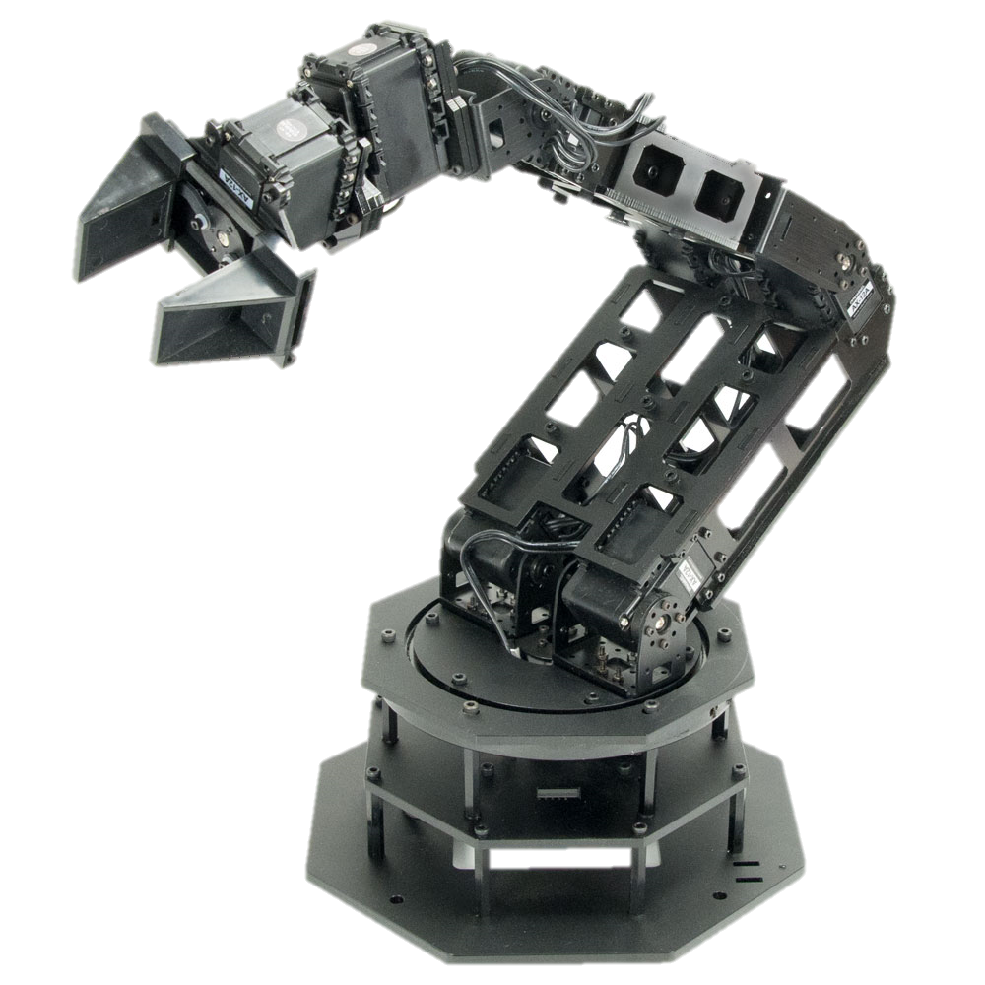
Objectives
To develop a system that can:
Deliver objects with minimal to no supervision
Be user independent
Figure out the position of the object on its own
Use an object detection algorithm
Complete the task of picking up the object and returning it to the user

Slide 4
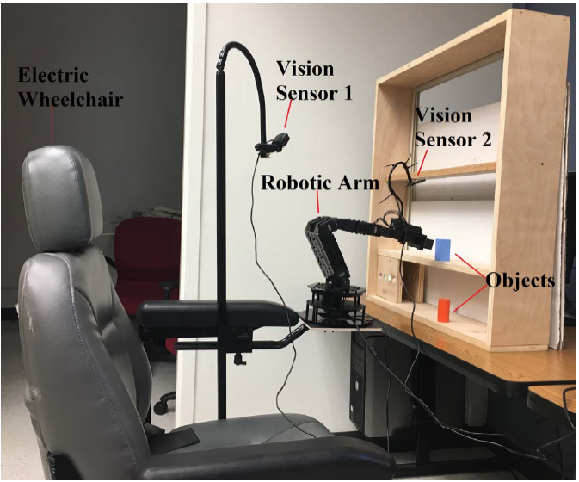
II. SYSTEM DESCRIPTION
Figure 1. Image of the robotic arm mounted on an electric wheelchair

Slide 5
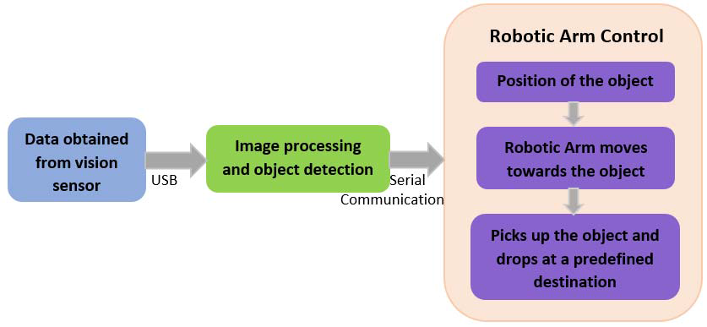
Fig 2. Block diagram of the system

Slide 6
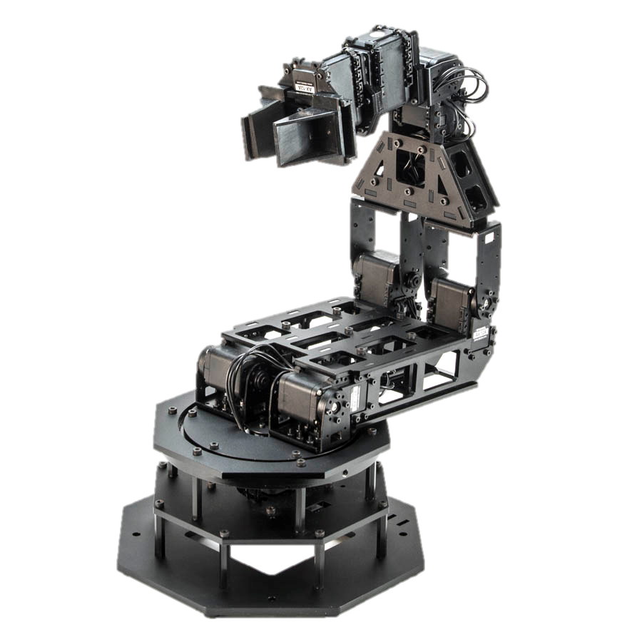
A. Robotic Arm
A Trossen robotics PhantomX reactor robot arm
Built using an Arduino compatible advanced microcontroller called Arbotix-m robocontroller
Has eight AX-12A dynamixel actuators for controlling different parts of the arm
Each servo has sensors to track its
Speed
Temperature
Shaft position
Voltage
Load

Slide 7
Robotic Arm (cont…)
Servo No | Position | Axis along Degrees of freedom
1 | Bottom | Horizontal(Left- Right)
2, 3 | Shoulder | Backward- Forward
4, 5 | Elbow | Vertical(Up- Down)
6, 7 | Wrist angle | Rotation
8 | Gripper | Hold/ Release

Slide 8
Communication of Arm and Processor
The arm is powered by a 12V 5amp power supply
Serial connection to a computer system via a FTDI cable
Uses PySerial
The serial connection has a baud rate of 38400
The data packet of length 17-byte
Each of the servo motor can be controlled by varying the 17-byte data sent to the arm
A short delay is introduced after every serial write command

Slide 9
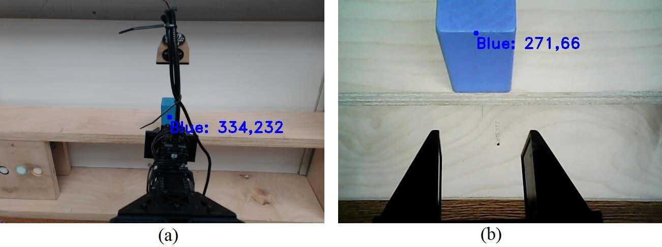
B. Vision Sensors
Vision sensor 1: Logitech HD c920 webcam
Static
Mounted facing the shelf located in front of the arm
Captures the video of the arm and the shelf in real time
Frames extracted from this video are processed
Calculates position (x, y) of the target object
This data is used for coarse positioning of the robotic arm
Fig 5:

Slide 10
B. Vision Sensors (cont…)
Vision sensor 2: robot VGA webcam
Dynamic
Follows vision sensor 1
Mounted above the gripper using a 200 mm gooseneck
Fine tunes the position of the arm’s gripper before it can pick the object
Captures a close-up video of the target object
Used to position the gripper exactly in front of the object
so that the object can be picked up correctly
Fig 6

Slide 11
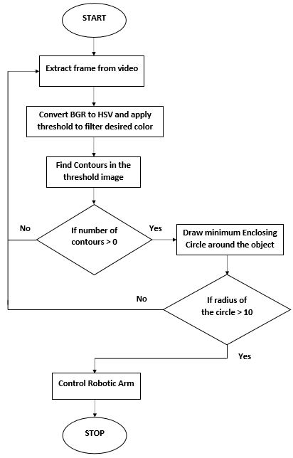
C. Computer Vision Algorithm
Programmed to move towards the position of a specific colored object
The color detection algorithm is written in python using the OpenCV library
The vision sensor captures the real time video of the robotic arm and the object

Slide 12
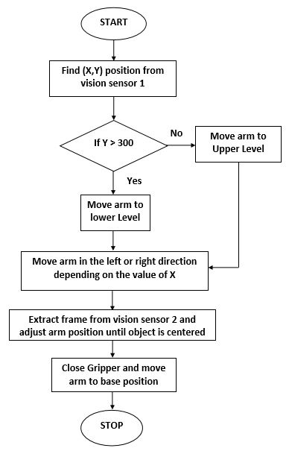
Working of Robotic Arm
Figure 3. Flowchart for robotic arm control:

Slide 13
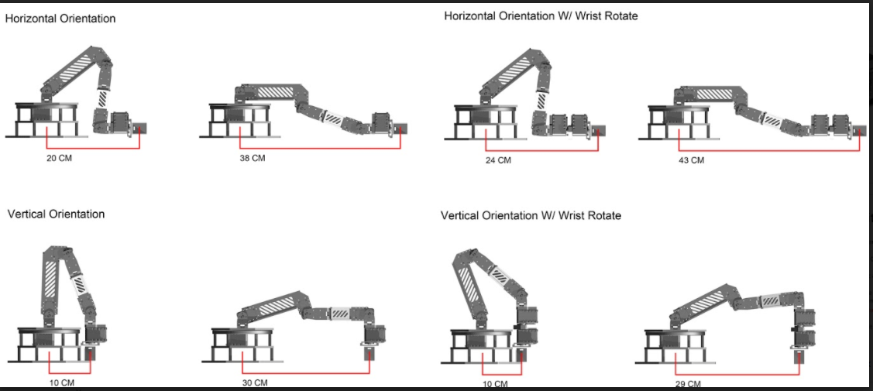
Fig 4: Range of Operation at Various Positions

Slide 14
IV. Advantages
Cost- effective
Faster
Puts less strain on user
Decreases dependency
Success rate of 83.33%
Completion of task achieved in 37.52 seconds on average

Slide 15
V. Disadvantages
Attempts are more successful when the objects are placed at the upper level compared to the lower level
Position of the detected object keeps fluctuating due to insufficient light
Working depends mostly on the amount of light percieved from the object

Slide 16
VI. CONCLUSION
Computer vision algorithm based on colour detection has been developed
Two sensors were used:
First sensor- to obtain the coarse location of the object
Second sensor- for fine localization
Ability to pick up objects placed at different locations on success rate of 83.33%
The main goal of performing the action of picking up the object under one minute is achieved

Slide 17
VII. FUTURE WORK
Future work aimed is implementing:
The wireless protocol
Voice recognition
Mind-controlled robotic arm
Depth sensors can be used in addition to vision sensors
Advanced vision algorithms

Slide 18
VIII. REFERENCES
Priyanka Karuppiah, Hem Metalia and Kiran George, \Automation of a Wheelchair Mounted Robotic Arm using Computer Vision Interface", IEEE Publication, 2018.
Camilo Perez Quintero, Oscar Ramirez, Martin Jagersand , \Assistive Vision-Based Interface for Robot Manipulation", IEEE International Conference on Robotics and Automation (ICRA), 2015.
Katherine Tsui and Holly Yanco, \Development and Evaluation of a Flexible Interface for a Wheelchair Mounted Robotic Arm", Human- Robot Interaction (HRI), 3rd ACM/IEEE International Conference, 2008.
Indika Pathirage, Karan Khokar, Elijah Klay, Redwan Alqasemi, \A Vision based P300 Brain Computer Interface for Grasping using a Wheelchair-Mounted Robotic Arm" IEEE/ASME International Conference on Advanced Intelligent Mechatronics (AIM), 2013.
Hairong Jiang , Bradley S. Duerstock , Juan P. Wachs, \A Machine Vision-Based Gestural Interface for People With Upper Extremity Physical Impairments" IEEE/ASME International Conference on Advanced Intelligent Mechatronics (AIM), 2013.

Slide 19
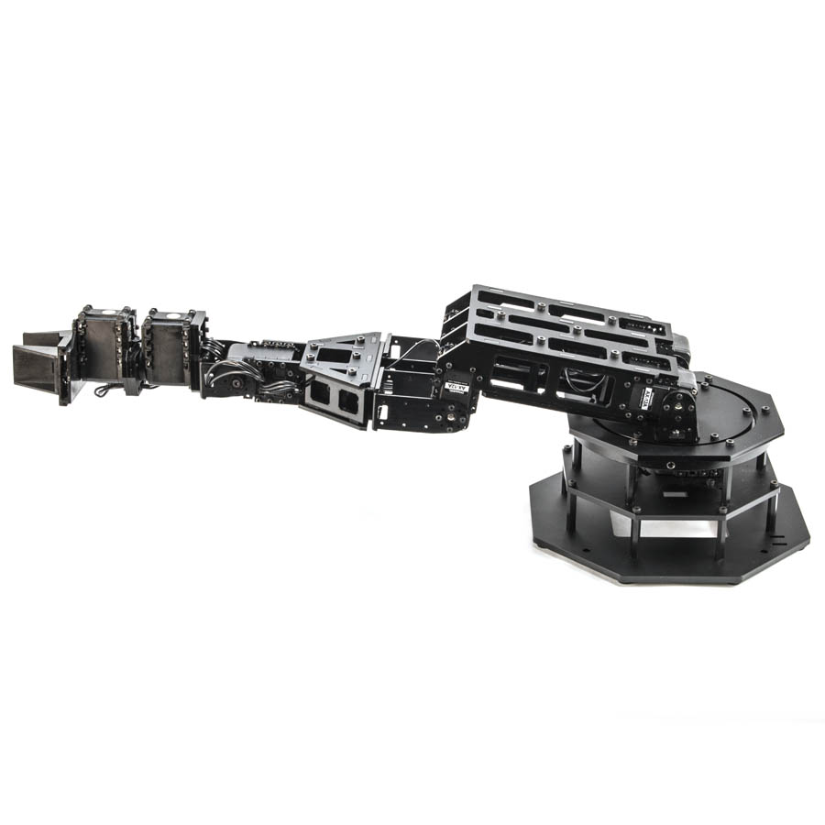
THANK YOU!
Any Questions?

