Slide 1
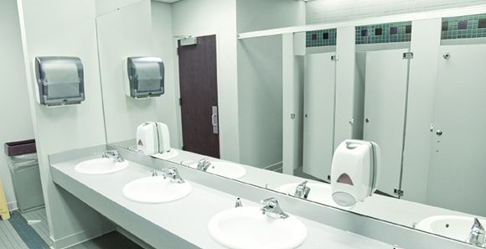
‘‘
WASHROOM HYGIENE

Slide 2

Project Team
Jayashree Ahire
Mansi Thanki
Sejal Patni
<number>

Slide 3

Table of contents
Timeline
Diagrams
Model making Process
Target audience
Hardware Specifications
Testing
Research
Software used
Conclusion
Insights
Coding
Proposed solution
Project cost
1

Slide 4
Week 1
Research and Conceptualization
Week 2
Logic and coding
Week 3
Circuit connection and testing
Week 4
Model making and testing
Timeline
Journey of the project
2

Slide 5

Target Audience
Females using public washrooms in secondary and higher secondary schools and colleges
3

Slide 6

Research
Existing solution
Research
4

Slide 7
Existing solutions
DEVELOPING SMART TOILET USING IoT
This project was made to deliver clean and hygiene toilets.
It is based on IoT and image processing concept using different sensors like smell sensor, IR(dirt) sensor, sonic sensor,RFID reader.
Automatic smart urinal flushes are based on MQTT Protocol configuration.
Smart toilets are divided into two parts-1)Automatic flusher part. 2) Server part.
AUTOMATIC FLUSHER PART(AFP)- IR(infrared sensor) can sense certain characteristics of its surroundings by either emitting and/or detecting infrared radiation. They are also capable of measuring heat being emitted by an object and detecting motion.
5

Slide 8
Existing solutions
CST SMART TOILETS - This is a company product having following features-
Sensors it has : People density counter this sensor is attached at the door of the room. The sensor contains two infrared beams that tracks the people entering and ammonia sensor to detect gas released from faeces.
Automated monitoring of usage of the toilets-Project by Sri Krishna college of Technology Coimbatore for
Swachh Bharat.
Sensors used-IR sensor, ammonia sensor for odor control, hydrogen sulphide sensor.
Faridabad smart city- Swachh Bharat by card or coin. Manual flush of auto pre-flush and auto post-flush. Panic button for any emergency.
6

Slide 9
Existing solutions
SERVER PART- The AFP detects if there is an object of the IR sensor. When the user stands in front of the urinal, an IR sensor can detect the user. If the user keeps staying in front of the sensor for 3 seconds continuously, it is considered that the user is currently using the urinal. After the urinal have been flushed AFP unit also sends a MQTT message about its usage data to the server part. The usage data will be stored into a database for a future use.
Figaro sensor a particular range is extended, then it can send the alert message to the sweeper.
7

Slide 10
Existing solutions
AUTOMATED FLUSHSYSTEM
Automated flush system consists of IR and inline sanitizer.
When user sits down to use toilets or stand in front of urinal, infrared sensor detects body heat. After user is finished IR sensor detects loss of heat and activates the flush mechanism. It releases inline sanitizer during flush which cleans the toilet used each time.
Apparatus for automatic flush-IR sensor, control circuit, electrically operated liquid dispenser and power supply.
8

Slide 11

Insights - Components
LED
LED is used to inform user
whether washroom is
functional or not.
PROXIMITY SENSOR
Used to sense the
presence of user on
the commode.
INCLINATION/ORIENTATION SENSOR
Used to detect
whether user has opened the
door or not.
SEGMENT DISPLAY
SEVEN SEGMENT
DISPLAY is used to
indicate why buzzer is on.
BUZZER
Used to alarm user if
not flushed.
WATER LEVEL SENSOR
Used to detect
whether user has
flushed or not.
9

Slide 12
Proposed solution
When the user finishes using the washroom and get up the proximity sensor detects the absence of user, if the user doesn’t flush the water level sensor remains high and when the user opens the door to leave the washroom with the above conditions satisfied the buzzer starts and the LCD displays “Please flush”.
To avoid the buzzer from starting when the washroom doesn’t have water we use an LED to warm user if there is no water in the flush tank.
10

Slide 13
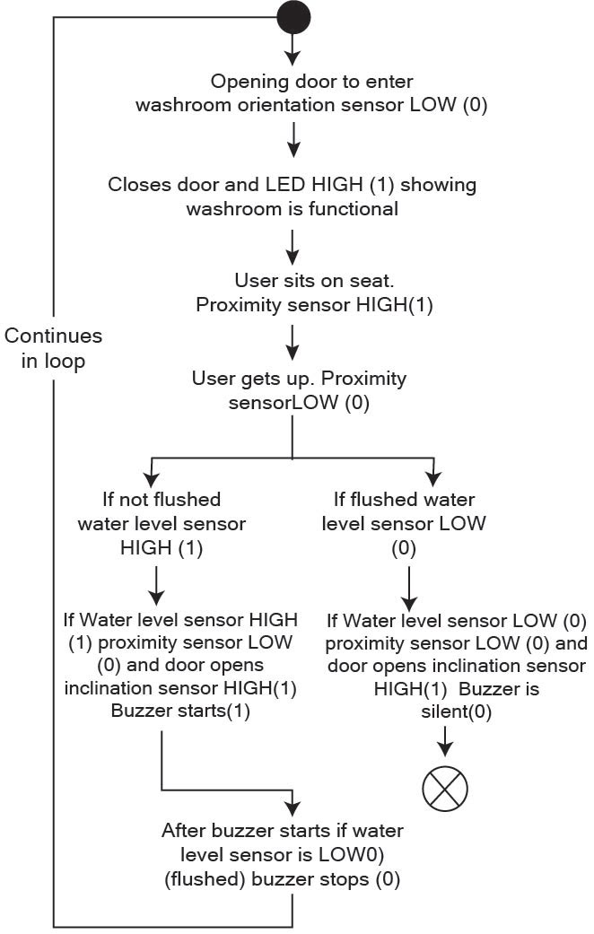
Proposed solution logical flowchart
11

Slide 14
Diagrams
12

Slide 15
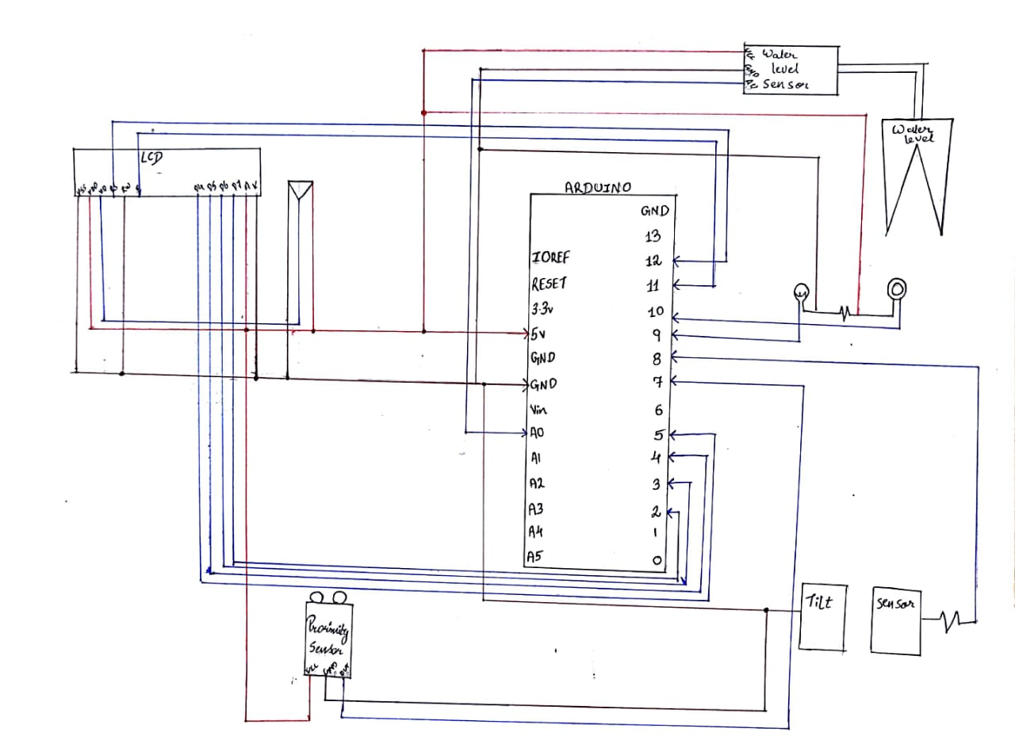
13

Slide 16
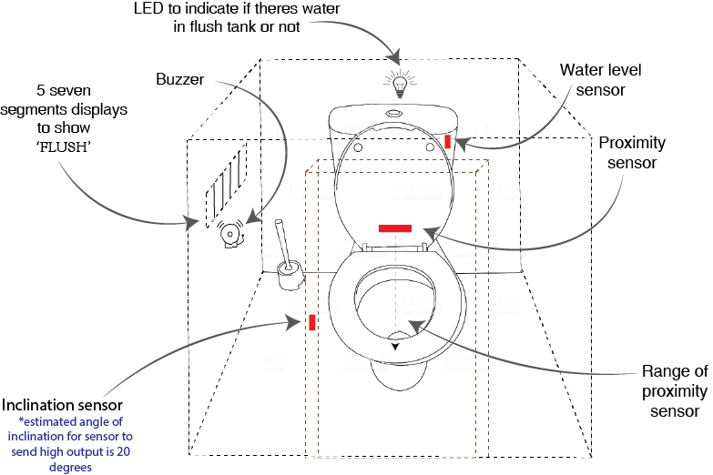
14

Slide 17
Software used
The software we used for programming this solution is Arduino IDE. We used if else conditions to correctly program all the situations needed to make this project successful
15

Slide 18
Hardware specifications
LCD
LED
IR sensor,
Water level sensor
Magnetic door switch,
Buzzer
Arduino,
PCB Board, Resistors
Jumper wires,
Potentiometer
16

Slide 19

Code
#include<LiquidCrystal.h>
int b,c,d;
const int rs = 12, en = 11, d4 = 5, d5 = 4, d6 = 3, d7 = 2;
LiquidCrystal lcd(rs, en, d4, d5, d6, d7);
void setup() {
pinMode(7,INPUT);//Proximity
pinMode(8,INPUT);//Inclination
pinMode(9,OUTPUT);//LED
Serial.begin(9600);
pinMode(10,OUTPUT);//Buzzer
lcd.begin(16, 2);
}
void loop() {
lcd.clear();
int a=analogRead(A0);
Serial.println(a);
if(a>600) {
digitalWrite(9,HIGH);
lcd.print("NON FUNCTIONAL");
}
else
17

Slide 20
Code
{
digitalWrite(9,LOW);
}
delay(1000);
b=digitalRead(7);
d=digitalRead(8);
Serial.println(a);
Serial.println(b);
Serial.println(d);
if((b==1) && (a<600) && (d==1))//Buzzer on
{
digitalWrite(10,HIGH);
lcd.print("PLEASE FLUSH");
}
else if((b==0) && (a>600) && (d==1))//Non functional+user absent
{
digitalWrite(10,LOW);
}
18

Slide 21
Code
else if((b==0) && (a>600) && (d==0))//Non-functional+user entering {
digitalWrite(10,LOW);
lcd.print("NON FUNCTIONAL");}
else if((b==0) && (a<600) && (d==1))//User preparing to leave {
digitalWrite(10,LOW);
}
else if((b==1) && (a>600) && (d==1))//Non-functional+user on commode
{
digitalWrite(10,LOW);
lcd.print("NON FUNCTIONAL");
}
else if((b==1) && (a>600) && (d==0))//Non-functional+user on commode before closing door
{
digitalWrite(10,LOW);
lcd.print("NON FUNCTIONAL");
}
else if((b==0) && (a<600) && (d==0))//Commode in use
19

Slide 22
Code
{
digitalWrite(10,LOW);
}
else if((b==1) && (a<600) && (d==0))//commode in use for tìmepass
{
digitalWrite(10,LOW);
}
else
{
digitalWrite(10,LOW);
}
delay(1000);
}
20

Slide 23
MODEL MAKING PROCESS
21

Slide 24
Materials
COMMODE & FLUSH:
Lizol bottle, foam paper, foam board, straw, Vaseline bottle.
WASHROOM CUBICAL:
Foam board, cardboard, spring.
23

Slide 25
Assembly
According to the size of the commode made the walls of the washroom cubicle. We made holes in the walls for the pipe of the flush tank and a slit of the LCD Display. We instead the pipe from the bottom of the flush tank and took it out of the wall. Below the hole of the pipe we stuck the commode to the back. After the assembly of the model we soldered and integrated the circuits with the model.
23

Slide 26
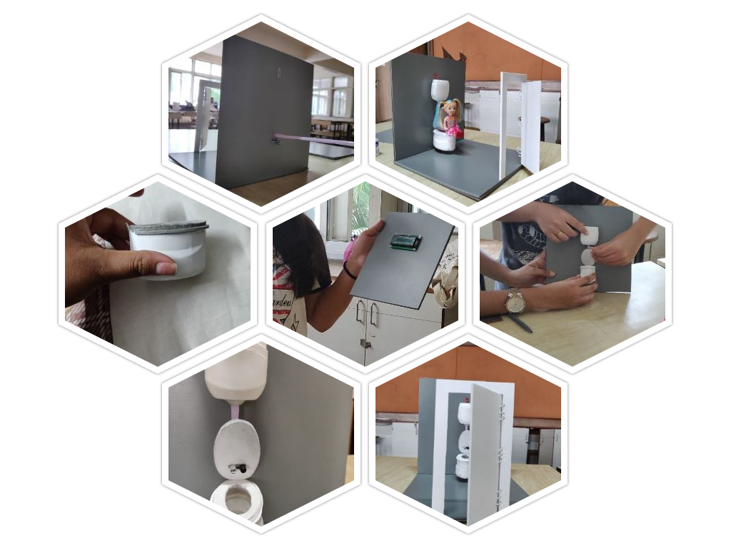
Project building
22

Slide 27
Project cost
For building this project we required Rs.1500/-
Including hardware and stationery.
23

Slide 28
Testing videos
24

Slide 29
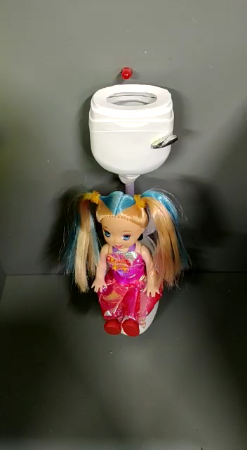
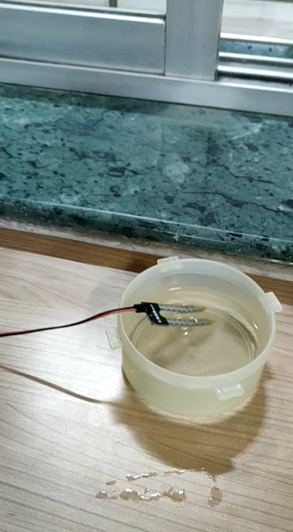

Buzzer ringing when user tries to leave without flushing and “Please Flush” is displayed on LCD
When there is no water in flush tank and user opens door the LED glows and “Non functional” appears on the LCD
25

Slide 30
Conclusion
Through our solution we intend to change the mindset of our target audience regarding hygiene. We want to make sure that through this initiative schools and colleges have better washroom hygiene.
26

Slide 31
Thank You!
30

