Slide 1
Introduction to Artificial Intelligence Logical Agents
Jianmin Li
Department of Computer Science and Technology
Tsinghua University
Spring, 2024
Notes:
3月30日，p28
枚举法：有一个组合（model）为假，即返回；否则尝试所有组合
p40. Validity is connected to inference via the Deduction Theorem. 反向，如果a为假，a->b也为真，a=>b呢？
p40. Satisfiability is connected to inference via the following. 反向，如果a为假，a与非b也为假，a=>b呢？
前向链式证明方法的完备性证明
归结规则：如果有一个字句为假，怎么办？

Slide 2
Outline
Knowledge-based agents
Logic in general - models and entailment
Propositional (Boolean) logic
Equivalence, validity, satisfiability
Inference rules and theorem proving
Notes:
Knowledge-based agents
Wumpus world
Logic in general - models and entailment
Propositional (Boolean) logic
Equivalence, validity, satisfiability
Inference rules and theorem proving

Slide 3
Knowledge based agent
Inference engine | ← | domain−independent algorithms
Knowledge base | ← | domain−specific content

Slide 4
Knowledge bases
Knowledge base
a set of sentences in a formal language
Tell
add new sentences about what the agent needs to know
Ask
query what is known or what is to be done
Inference
deriving new sentences from old
answers should follow from the KB
both Tell and Ask may involve inference
Notes:
类比数据库的增删改查
查询的答案可能不是在数据库里直接存在，需要基于知识库推理出

Slide 5
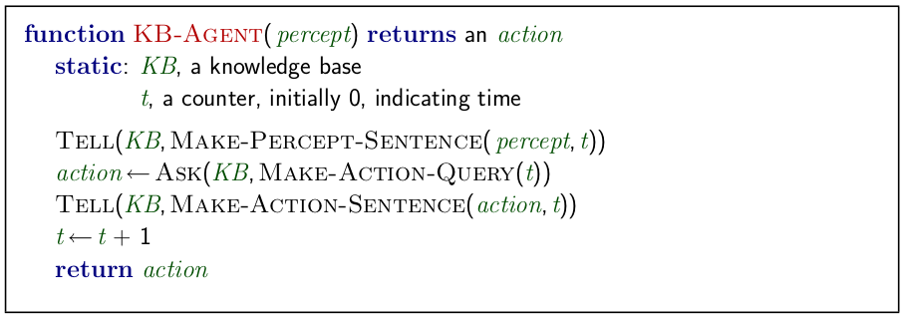
A simple knowledge-based agent

Slide 6
A simple knowledge-based agent
The agent must be able to:
Represent states, actions, etc.
Incorporate new percepts
Update internal representations of the world
Deduce hidden properties of the world
Deduce appropriate actions

Slide 7
Knowledge based Agents
Declarative approach to building an agent
TELL sentences one by one
Procedural approach
encodes desired behaviors directly as program code
Knowledge level
what they know, regardless of how implemented
Implementation level
data structures in KB and algorithms that manipulate them
Notes:
Declarative approach to building an agent (or other system)
不同的构建方法，过程性和陈述性
不同的抽象层次，知识层次和实现层次

Slide 8
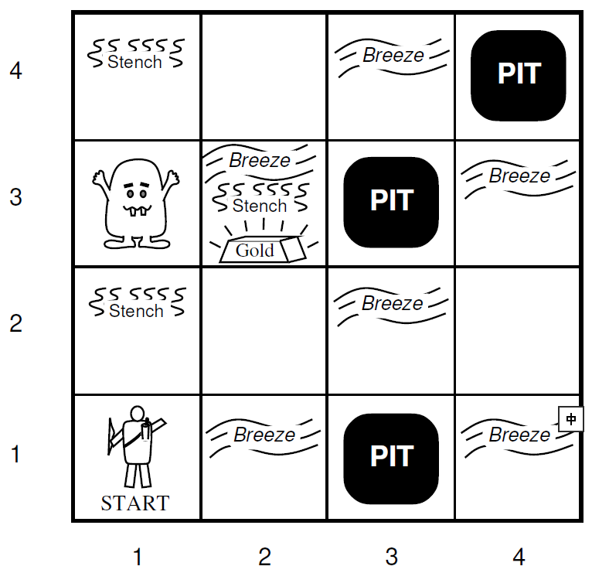
Wumpus World PEAS description
Performance measure
gold +1000, death -1000
-1 per step, -10 for using the arrow
Actuators
Left turn, Right turn, Forward, Grab, Release, Shoot
Sensors
Breeze, Glitter, Smell

Slide 9
Wumpus World PEAS description
Environment
Squares adjacent to wumpus are smelly
Squares adjacent to pit are breezy
Glitter iff gold is in the same square
Shooting kills wumpus if you are facing it
Shooting uses up the only arrow
Grabbing picks up gold if in same square
Releasing drops the gold in same square
Notes:
Squares adjacent to wumpus are smelly
Squares adjacent to pit are breezy
Glitter iff gold is in the same square
Shooting kills wumpus if you are facing it
Shooting uses up the only arrow
Grabbing picks up gold if in same square
Releasing drops the gold in same square

Slide 10
Wumpus world characterization
Observable
No - only local perception
Deterministic
Yes - outcomes exactly specified
Static
Yes - Wumpus and Pits do not move
Discrete
Yes
Single-agent
Yes - Wumpus is essentially a natural feature

Slide 11
Exploring a wumpus world
P?
OK
P
B
OK
P?
BGS
OK
OK
A
A
A
OK
S
OK
A
A
W

Slide 12
Other tight spots
Breeze in (1,2) and (2,1)
=> no safe actions
P?
B
OK
P?
P?
A
OK
B
OK
P?
A
A
Notes:
复杂的情况

Slide 13
Other tight spots
Smell in (1,1) => cannot move
Can use a strategy of coercion:
shoot straight ahead
wumpus was there => dead => safe
wumpus wasn’t there => safe
S
A
Notes:
我们可以实现安全，但是有损失，箭

Slide 14
Logic in general
Logics are formal languages for representing information
Syntax defines the sentences in the language
what is a well-formed sentence
Semantics define the “meaning” of sentences
define truth of a sentence in a world
E.g., the language of arithmetic
x +2 >= y is a sentence; x2+y > is not a sentence
x +2 >= y is true iff the number x +2 is no less than the number y
x +2 >= y is true in a world where x = 7, y = 1
x +2 >= y is false in a world where x = 0, y = 6
Notes:
前面通过逻辑推理，帮助智能体在危险的洞穴里找到合适的动作。下面我们来看看逻辑的一般概念
Logics are formal languages for representing information such that conclusions can be drawn

Slide 15
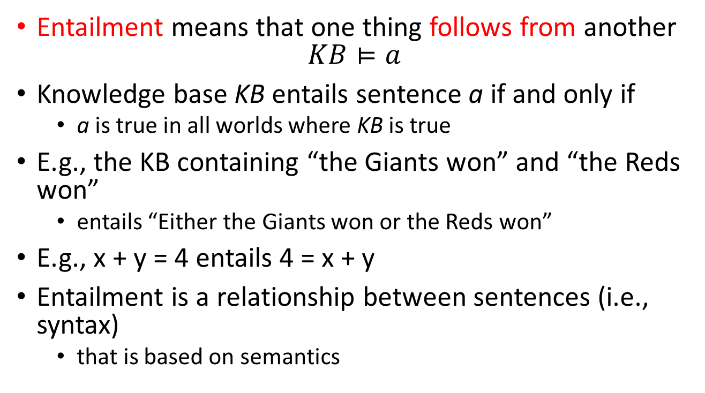
Entailment
Entailment means that one thing follows from another
$$KB⊨a$$
Knowledge base KB entails sentence a if and only if
a is true in all worlds where KB is true
E.g., the KB containing “the Giants won” and “the Reds won”
entails “Either the Giants won or the Reds won”
E.g., x + y = 4 entails 4 = x + y
Entailment is a relationship between sentences (i.e., syntax)
that is based on semantics

Slide 16
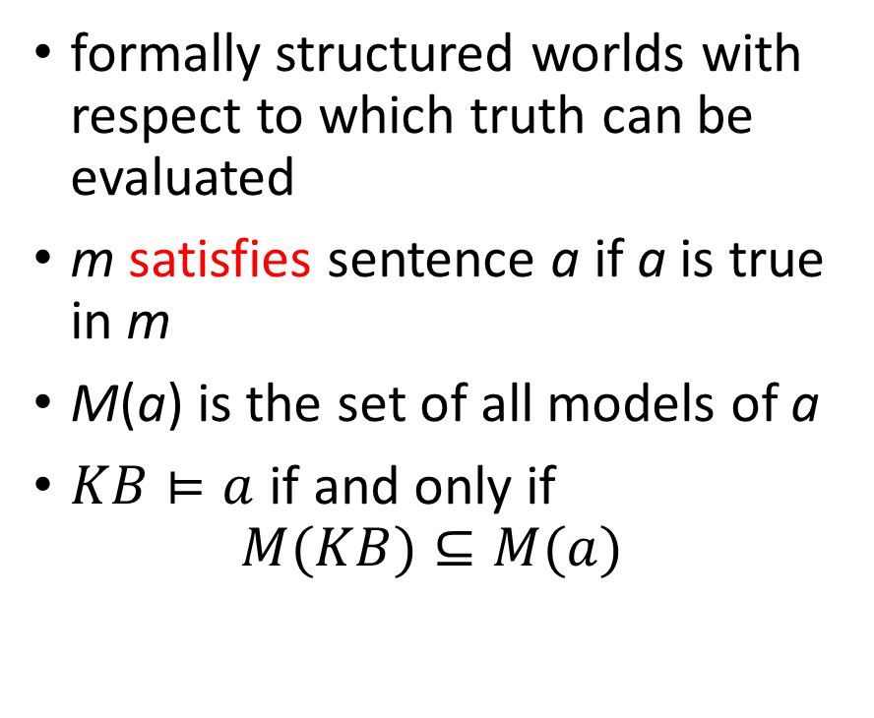
Models
formally structured worlds with respect to which truth can be evaluated
m satisfies sentence a if a is true in m
M(a) is the set of all models of a
$KB⊨a$ if and only if
$$M(KB)⊆M(a)$$
x
x
x
x
x
x
x
x
M(a)
x
x
x
x
x
x
x
x
x
x
x
x
x
x
x
x
x
x
x
x
x
xx
x
x
x
x
x
x
x
x
x
M(KB)
x
x
x
x
x
x
x
Notes:
Logicians typically think in terms of models
是可能的世界的一个数学抽象
m is a model of a sentence a if a is true in m

Slide 17
Entailment in the wumpus world
Situation after detecting nothing in [1,1]
moving right, breeze in [2,1]
Consider possible models for ?s assuming only pits
?
?
B
?
A
A

Slide 18
问题1
假设带？的房间中只可能有坑（pit），存在多少种模型？
0
1
3
8
?
?
B
?
A
A

Slide 19
Wumpus models
3 Boolean choices => 8 possible models
2
2
PIT
1
Breeze
PIT
1
Breeze
1
2
3
1
2
3
2
PIT
2
Breeze
2
PIT
1
1
Breeze
Breeze
1
2
3
1
PIT
1
2
3
1
2
3
2
PIT
1
Breeze
PIT
2
PIT
PIT
1
2
3
2
PIT
PIT
Breeze
Breeze
1
1
PIT
1
2
3
1
2
3
Notes:
proved by model checking

Slide 20
Wumpus models
KB = wumpus-world rules + observations
nothing in [1,1], breeze in [2,1]
2
2
PIT
KB
Breeze
Breeze
1
PIT
1
1
2
3
1
2
3
2
PIT
2
Breeze
2
PIT
1
1
Breeze
Breeze
1
2
3
1
PIT
1
2
3
1
2
3
2
PIT
1
Breeze
PIT
2
PIT
PIT
1
2
3
2
PIT
PIT
Breeze
Breeze
1
1
PIT
1
2
3
1
2
3
Notes:
proved by model checking

Slide 21

问题2
a₁ = “[1,2] is safe”，$KB⊨a_{1}？$
是
否
2
2
PIT
KB
Breeze
Breeze
1
PIT
1
1
2
3
1
2
3
2
PIT
2
Breeze
2
PIT
1
1
Breeze
Breeze
1
2
3
1
PIT
1
2
3
1
2
3
2
PIT
1
Breeze
PIT
2
PIT
PIT
1
2
3
2
PIT
PIT
Breeze
Breeze
1
1
PIT
1
2
3
1
2
3

Slide 22

Wumpus models
a₁ = “[1,2] is safe”
$KB⊨a_{1}$
2
2
PIT
KB
Breeze
a₁
Breeze
1
PIT
1
1
2
3
1
2
3
2
PIT
2
Breeze
2
PIT
1
1
Breeze
Breeze
1
2
3
1
PIT
1
2
3
1
2
3
2
PIT
1
Breeze
PIT
2
PIT
PIT
1
2
3
2
PIT
PIT
Breeze
Breeze
1
1
PIT
1
2
3
1
2
3
Notes:
proved by model checking

Slide 23

问题3
a₂ = “[2,2] is safe”，$KB⊨a_{2}？$
是
否
2
2
PIT
KB
Breeze
Breeze
1
PIT
1
1
2
3
1
2
3
2
PIT
2
Breeze
2
PIT
1
1
Breeze
Breeze
1
2
3
1
PIT
1
2
3
1
2
3
2
PIT
1
Breeze
PIT
2
PIT
PIT
1
2
3
2
PIT
PIT
Breeze
Breeze
1
1
PIT
1
2
3
1
2
3

Slide 24

Wumpus models
a₂ = “[2,2] is safe”
$KB⊭a_{2}$
2
2
PIT
KB
Breeze
a₂
Breeze
1
PIT
1
1
2
3
1
2
3
2
PIT
2
Breeze
2
PIT
1
1
Breeze
Breeze
1
2
3
1
PIT
1
2
3
1
2
3
2
PIT
1
Breeze
PIT
2
PIT
PIT
1
2
3
2
PIT
PIT
Breeze
Breeze
1
1
PIT
1
2
3
1
2
3
Notes:
proved by model checking

Slide 25
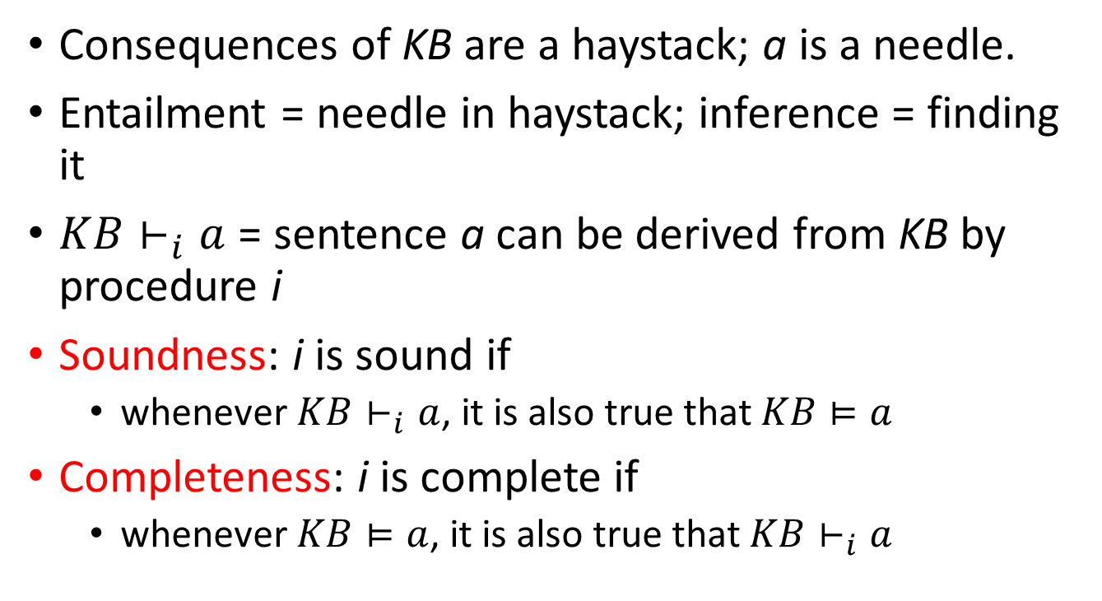
Inference
Consequences of KB are a haystack; a is a needle.
Entailment = needle in haystack; inference = finding it
$KB⊢_{i}a$ = sentence a can be derived from KB by procedure i
Soundness: i is sound if
whenever $KB⊢_{i}a$, it is also true that $KB⊨a$
Completeness: i is complete if
whenever $KB⊨a$, it is also true that $KB⊢_{i}a$
Notes:
刚才的例子不仅说明了蕴含关系，也说明了如何利用蕴含导出结论，也就是进行推理。模型检验的方法
推理方法的两个属性。可靠性，完备性。

Slide 26
Propositional logic: Syntax
Propositional logic is the simplest logic
The proposition symbols P₁, P₂, etc are atomic sentences
If S is a sentence, ¬S is a sentence (negation)
If S₁ and S₂ are sentences
S₁ ∧ S₂ is a sentence (conjunction)
S₁ ∨ S₂ is a sentence (disjunction)
S₁ ⇒ S₂ is a sentence (implication)
S₁ ⇔ S₂ is a sentence (biconditional)
Notes:
原子语句，命题符号，true, false
复合语句，逻辑连接词

Slide 27
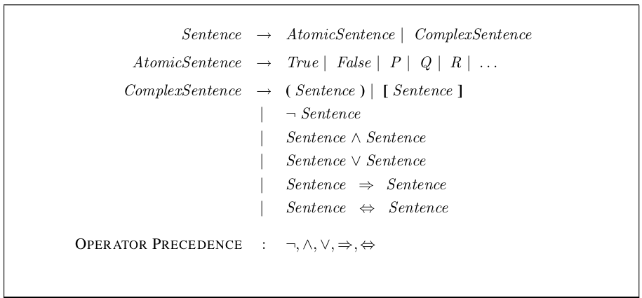
Propositional logic: Syntax

Slide 28
Propositional logic: Semantics
Each model specifies true/false for each proposition symbol
e.g.
With these symbols, 8 possible models, can be enumerated automatically
P₁₂ | P₂₂ | P₃₁
false | false | true

Slide 29
Propositional logic: Semantics
Rules for evaluating truth with respect to a model m:
¬S | is true iff | S | is false
S₁ ∧ S₂ | is true iff | S₁ | is true | and | S₂ | is true
S₁ ∨ S₂ | is true iff | S₁ | is true | or | S₂ | is true
S₁ ⇒ S₂ | is true iff | S₁ | is false | or | S₂ | is true
 | is false iff | S₁ | is true | and | S₂ | is false
S₁ ⇔ S₂ | is true iff | S₁ ⇒ S₂ | is true | and | S₁ ⇒ S₂ | is true

Slide 30
Truth tables for connectives
P | Q |  | ¬P | P∧Q | P∨Q | P⇒Q | P⇔Q
false | false |  | true | false | false | true | true
false | true |  | true | false | true | true | false
true | false |  | false | false | true | false | false
true | true |  | false | true | true | true | true

Slide 31
Truth tables for connectives
Simple recursive process evaluates an arbitrary sentence
¬P₁₂ ∧ (P₂₂ ∨ P₃₁) = true ∧ (false ∨ true)
= true ∧ true
= true
P₁₂ | P₂₂ | P₃₁
false | false | true

Slide 32
Wumpus world sentences
Let P_{ij} be true if there is a pit in [i, j].
Let B_{ij} be true if there is a breeze in [i, j].
¬ P₁₁
¬ B₁₁
B₂₁
“Pits cause breezes in adjacent squares”
“A square is breezy if and only if there is an adjacent pit”
B₁₁ ⇔ (P₁₂ ∨ P₂₁)
B₂₁ ⇔ (P₁₁ ∨ P₂₂ ∨ P₃₁)
?
?
B
?
A
A

Slide 33
Knowledge base
R₁: ¬ P₁₁
R₂: ¬ B₁₁
R₃: B₂₁
R₄: B₁₁ ⇔ (P₁₂ ∨ P₂₁)
R₅: B₂₁ ⇔ (P₁₁ ∨ P₂₂ ∨ P₃₁)
?
?
B
?
A
A

Slide 34
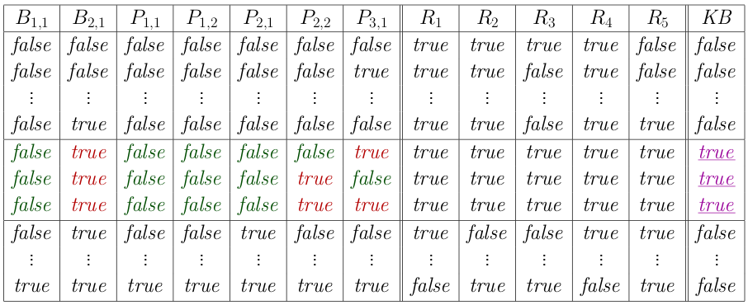
Truth tables for inference
Enumerate rows (different assignments to symbols),
if KB is true in row, check that a is too

Slide 35
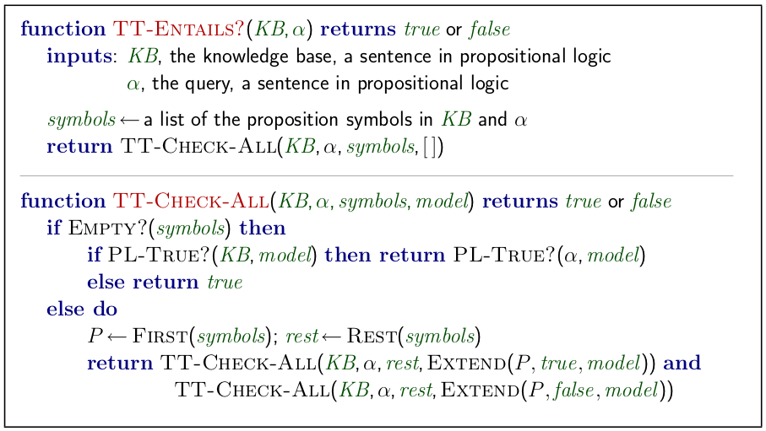
Inference by enumeration

Slide 36
Inference by enumeration
Depth-first enumeration of all models
Sound and Complete
O(2^{n}) for n symbols

Slide 37
Proof methods
Proof methods divide into (roughly) two kinds:
Model checking
truth table enumeration (always exponential in n)
improved backtracking, e.g., Davis - Putnam - Logemann - Loveland
heuristic search in model space (sound but incomplete), e.g., min-conflicts-like hill-climbing algorithms
Application of inference rules
Legitimate (sound) generation of new sentences from old
Proof = a sequence of inference rule applications
Can use inference rules as operators in a standard search alg.
Typically require translation of sentences into a normal form

Slide 38

Logical equivalence
Two sentences are logically equivalent iff true in same models:
$a≡β$ if and only if $a⊨β$ and $β⊨a$

Slide 39
Logical equivalence
α ∧ β | ≡ | β ∧ α | commutativity of ∧
α ∨ β | ≡ | β ∨ α | commutativity of ∨
(α ∧ β ) ∧ γ | ≡ | α ∧ ( β ∧ γ ) | associativity of ∧
(α ∨ β ) ∨ γ | ≡ | α ∨ ( β ∨ γ ) | associativity of ∨
¬(¬α) | ≡ | α | double-negation elimination
α ⇒ β | ≡ | ¬β ⇒ ¬α | contraposition
α ⇒ β | ≡ | ¬α ∨ β | implication elimination
α ⇔ β | ≡ | (α ⇒ β ) ∧ (β ⇒ α) | biconditional elimination
¬(α ∧ β ) | ≡ | ¬α ∨ ¬β | De Morgan
¬(α ∨ β ) | ≡ | ¬α ∧ ¬β | De Morgan
α ∧ ( β ∨ γ ) | ≡ | (α ∧ β ) ∨ (α ∧ γ ) | distributivity of ∧ over ∨
α ∨ ( β ∧ γ ) | ≡ | (α ∨ β ) ∧ (α ∨ γ ) | distributivity of ∨ over ∧

Slide 40
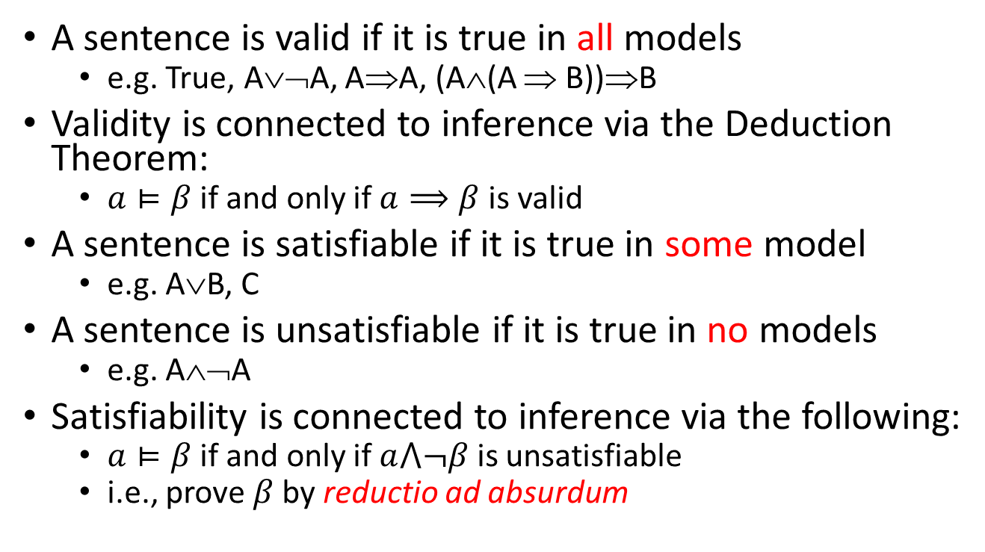
Validity and satisfiability
A sentence is valid if it is true in all models
e.g. True, A∨¬A, A⇒A, (A∧(A ⇒ B))⇒B
Validity is connected to inference via the Deduction Theorem:
$a⊨β$ if and only if $a⟹β$is valid
A sentence is satisfiable if it is true in some model
e.g. A∨B, C
A sentence is unsatisfiable if it is true in no models
e.g. A∧¬A
Satisfiability is connected to inference via the following:
$a⊨β$ if and only if $a⋀¬β$ is unsatisfiable
i.e., prove$β$ by reductio ad absurdum
Notes:
有效性，重言式

Slide 41
Forward and backward chaining
Horn Form (restricted)
KB = conjunction of Horn clauses
Horn clause
a disjunction of literals of which at most one is positive
proposition symbol; or
(conjunction of symbols) ⇒ symbol
Definite clause
a disjunction of literals of which exactly one is positive
E.g., C ∧ (B ⇒ A) ∧ (C ∧ D ⇒ B)

Slide 42
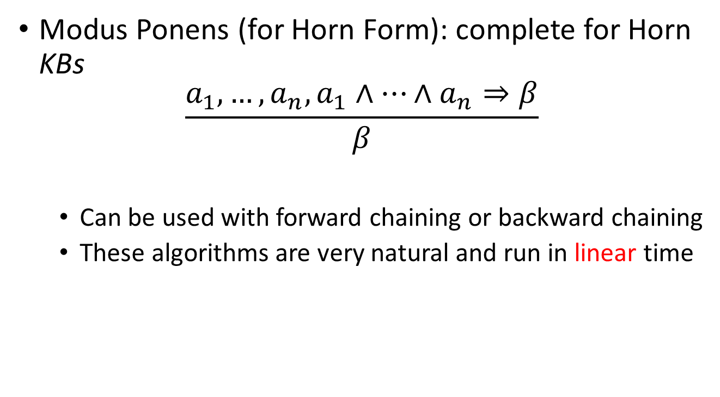
Forward and backward chaining
Modus Ponens (for Horn Form): complete for Horn KBs
$$\frac{a_{1},…,a_{n},a_{1}∧…∧a_{n}⇒β}{β}$$
Can be used with forward chaining or backward chaining
These algorithms are very natural and run in linear time
Notes:
Modus Ponens，肯定前件

Slide 43
Forward chaining
Idea
fire any rule whose premises are satisfied in the KB
add its conclusion to the KB, until query is found

Slide 44
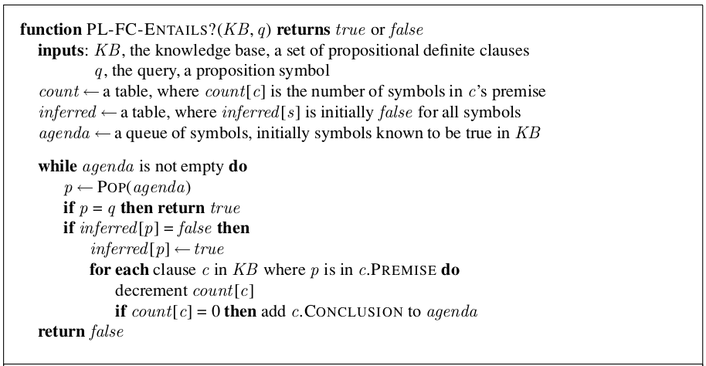
Forward chaining algorithm

Slide 45
Forward chaining example
Q
P ⇒ Q
L ∧ M ⇒ P
B ∧ L ⇒ M
A ∧ P ⇒ L
A ∧ B ⇒ L
A
B
0
1
P
1
0
2
M
0
1
2
L
2
1
0
1
2
0
A
B

Slide 46
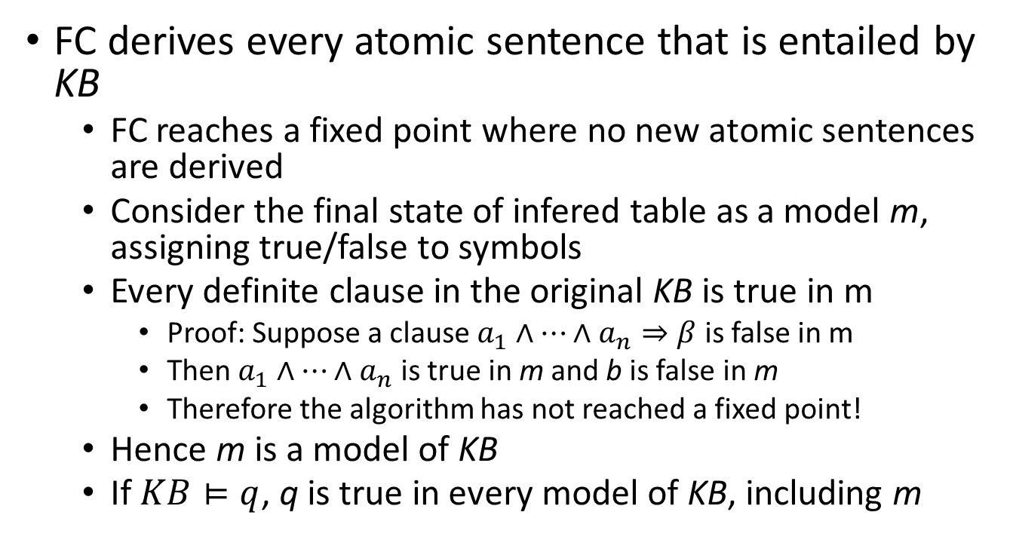
Proof of completeness
FC derives every atomic sentence that is entailed by KB
FC reaches a fixed point where no new atomic sentences are derived
Consider the final state of infered table as a model m, assigning true/false to symbols
Every definite clause in the original KB is true in m
Proof: Suppose a clause $a_{1}∧…∧a_{n}⇒β$ is false in m
Then $a_{1}∧…∧a_{n}$ is true in m and b is false in m
Therefore the algorithm has not reached a fixed point!
Hence m is a model of KB
If $KB⊨q$, q is true in every model of KB, including m

Slide 47
Backward chaining
Idea:
work backwards from the query q:
to prove q by BC,
check if q is known already, or
prove by BC all premises of some rule concluding q
Avoid loops: check if new subgoal is already on the goal stack
Notes:
Avoid repeated work: check if new subgoal
has already been proved true, or
has already failed

Slide 48
Backward chaining example
Q
P ⇒ Q
L ∧ M ⇒ P
B ∧ L ⇒ M
A ∧ P ⇒ L
A ∧ B ⇒ L
A
B
P
M
L
A
B

Slide 49
Forward vs. backward chaining
FC is data-driven
May do lots of work that is irrelevant to the goal
BC is goal-driven, appropriate for problem-solving
e.g., Where are my keys? How do I get into a PhD program?
Complexity of BC can be much less than linear in size of KB

Slide 50

Resolution
Conjunctive Normal Form (CNF—universal)
conjunction of disjunction of literals
clauses
E.g., (A∨¬B) ∧ (B∨¬C∨¬D)
Resolution inference rule (for CNF):
where l_{i} and m_{j} are complementary literals
Sound and complete for propositional logic

Slide 51

Resolution
P?
OK
P
B
OK
P?
OK
A
A
OK
S
OK
A
A
W

Slide 52
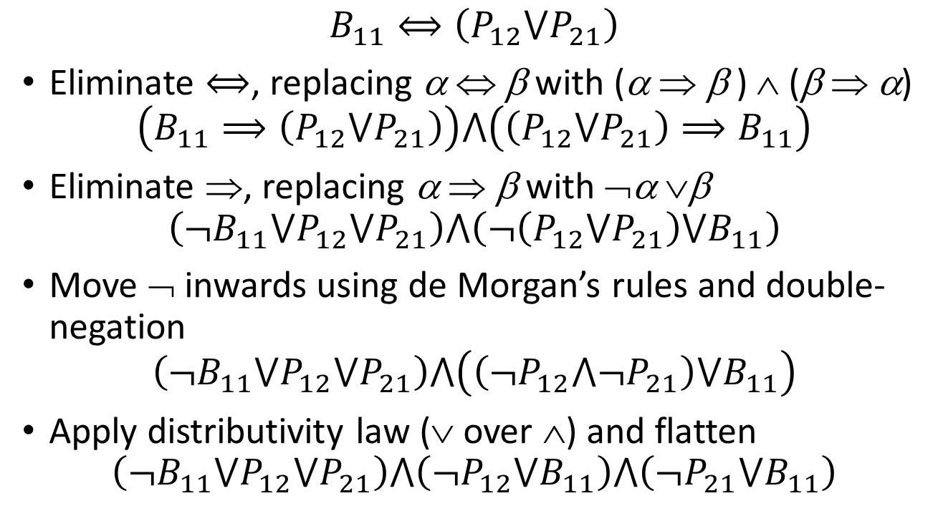
Conversion to CNF
$$B_{11}⟺\left(P_{12}⋁P_{21}\right)$$
Eliminate $⟺$, replacing α ⇔ β with (α ⇒ β ) ∧ (β ⇒ α)
$$\left(B_{11}⟹\left(P_{12}⋁P_{21}\right)\right)⋀\left(\left(P_{12}⋁P_{21}\right)⟹B_{11}\right)$$
Eliminate ⇒, replacing α ⇒ β with ¬α ∨β
$$\left({¬B}_{11}⋁P_{12}⋁P_{21}\right)⋀\left(¬\left(P_{12}⋁P_{21}\right)⋁B_{11}\right)$$
Move ¬ inwards using de Morgan’s rules and double-negation
$$\left({¬B}_{11}⋁P_{12}⋁P_{21}\right)⋀\left(\left(¬P_{12}⋀¬P_{21}\right)⋁B_{11}\right)$$
Apply distributivity law (∨ over ∧) and flatten
$$\left({¬B}_{11}⋁P_{12}⋁P_{21}\right)⋀\left(¬P_{12}⋁B_{11}\right)⋀\left(¬P_{21}⋁B_{11}\right)$$

Slide 53
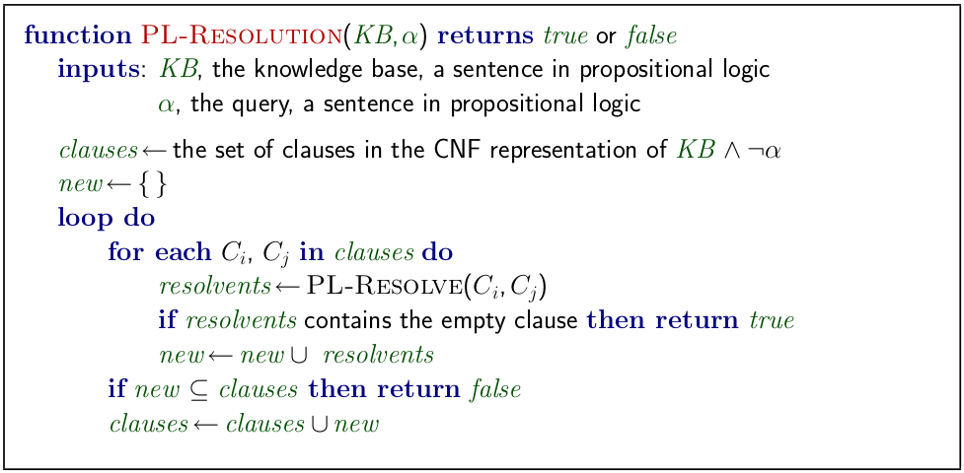
Resolution algorithm
Proof by contradiction, i.e., show KB ∧ ¬a unsatisfiable

Slide 54













Resolution example
$$KB=\left(B_{11}⇔\left(P_{12}{∨P}_{21}\right)\right)∧¬B_{11}$$
$$a=¬P_{12}$$
$$¬P_{21}⋁B_{11}$$
$${¬B}_{11}⋁P_{12}⋁P_{21}$$
$$¬P_{12}⋁B_{11}$$
$$¬B_{11}$$
$$P_{12}$$
$${¬B}_{11}⋁P_{12}⋁B_{11}$$
$${¬B}_{11}⋁P_{21}⋁B_{11}$$
$$¬P_{21}$$
$$¬P_{12}$$
$$P_{12}⋁P_{21}⋁{¬P}_{12}$$
$$P_{12}⋁P_{21}⋁¬P_{21}$$

Slide 55
Summary
Logical agents apply inference to a knowledge base
to derive new information and make decisions
Basic concepts of logic:
syntax: formal structure of sentences
semantics: truth of sentences wrt models
entailment: necessary truth of one sentence given another
inference: deriving sentences from other sentences
soundness: derivations produce only entailed sentences
completeness: derivations can produce all entailed sentences
Forward, backward chaining are linear-time, complete for Horn clauses
Resolution is complete for propositional logic
Propositional logic lacks expressive power

Slide 56
谢谢！

