Slide 1
Industrial Visit to Daikin Assembly Line & DJIME
A LEARNING EXPERIENCE FOR COLLEGE STUDENTS
Soumyadeep Das
055048
Sec K

Slide 2
Introduction to Daikin India
• DAIKIN INDIA IS A LEADING AIR CONDITIONING MANUFACTURER.
• MANUFACTURING FACILITY LOCATED IN NEEMRANA, RAJASTHAN.
• PIONEERS IN HVAC TECHNOLOGY WITH A STRONG EMPHASIS ON QUALITY AND INNOVATION.

Slide 3
Daikin Manufacturing Facility
• THE ASSEMBLY LINE FOLLOWS ADVANCED AUTOMATION FOR EFFICIENCY.
• LEAN MANUFACTURING PRINCIPLES ENSURE QUALITY CONTROL.
• STUDENTS WILL OBSERVE END-TO-END PRODUCTION OF AC UNITS.

Slide 4
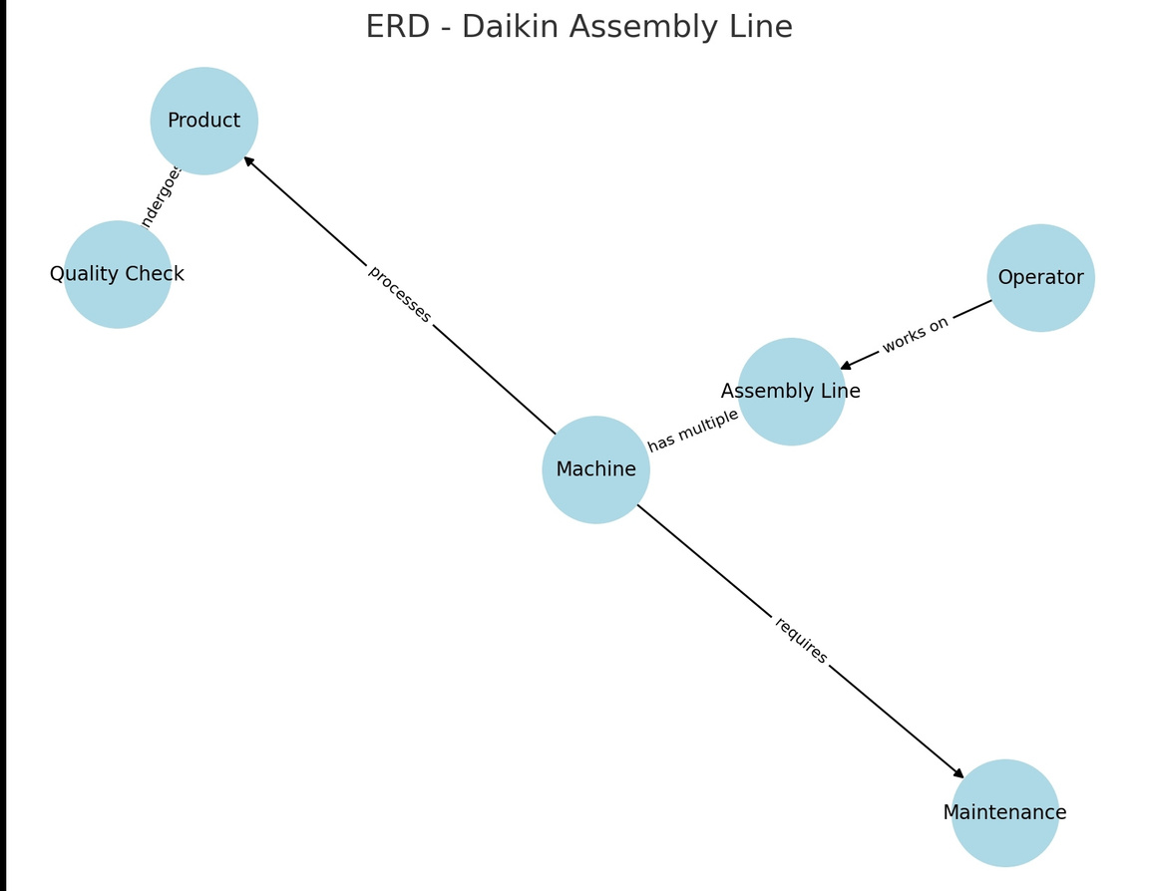

Slide 5
DJIME - Training & Excellence Center
• DJIME FOCUSES ON SKILL DEVELOPMENT IN HVAC AND MANUFACTURING.
• OFFERS HANDS-ON TRAINING FOR STUDENTS.
• PARTNERSHIP WITH INSTITUTIONS FOR PRACTICAL LEARNING EXPERIENCES.

Slide 6
Benefits of the Industrial Visit
• GAIN INSIGHTS INTO REAL-WORLD MANUFACTURING OPERATIONS.
• UNDERSTAND LEAN PRODUCTION TECHNIQUES & AUTOMATION.
• EXPOSURE TO INDUSTRY STANDARDS & CAREER OPPORTUNITIES.

Slide 7
Thank you

