Slide 1


DEPARTMENT OF INFORMATION TECHNOLOGY
Project name : AIR QUALITY MONITORING
Team name : Proj_224787_Team_5
Team members :
Arun kumar S(113321205007)
Ganesh J(113321205014)
Hariharan U (113321205016)
Akilan K(113321205005)

Slide 2

Project Definition
Developing an IoT-based air quality monitoring system involves defining key parameters, such as the types of pollutants to measure (e.g., PM2.5, CO2)
Desired accuracy levels, sensor placement, data transmission protocols, and user interface requirements for real-time tracking.
Addressing air quality monitoring challenges involves identifying issues like inadequate sensor coverage, data accuracy concerns, real-time data accessibility, and public awareness.
Crafting a problem definition entails specifying the target pollutants, outlining spatial requirements for monitoring, and considering factors like sensor calibration and maintenance for reliable and actionable air quality information.
2

Slide 3

Objective
1.Data Accuracy.
2.Alert Mechanism.
3.User-Friendly Interface.
4.Integration with IoT Networks.
5.Historical Data Analysis.
6.Public Awareness.
7.Remote Maintenance.
8.Scalability.
3

Slide 4
IOT SENSOR DEVICE:
Sensor Selection: Choose appropriate sensors for key pollutants (e.g., PM2.5, CO2, NO2) based on accuracy, sensitivity, and environmental suitability.
Power Efficiency: Design sensors for optimal power consumption to prolong battery life, considering energy-efficient technologies like low-power modes and sleep cycles.
Data Transmission Protocol: Select an efficient and secure communication protocol for transmitting data from sensors to the central monitoring system, considering factors like range and data rate.
Integration with IoT Platforms:Ensure compatibility with popular IoT platforms for seamless data integration, management, and analysis.
4

Slide 5
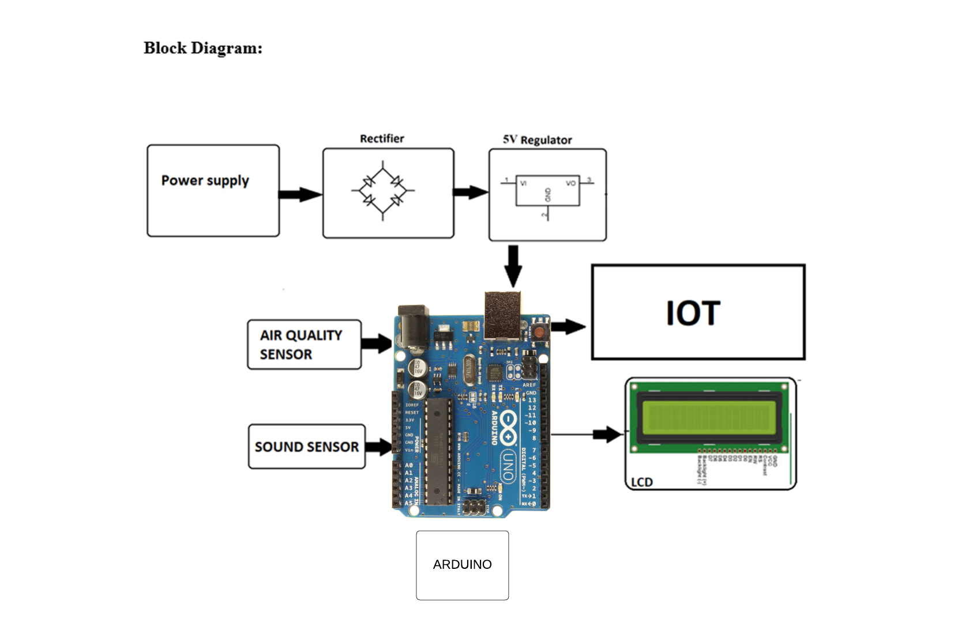
IOT DESIGN:
5

Slide 6
REAL TIME INFORMATION FLATFORM:
User-Friendly Interface:Design an intuitive interface accessible to commuters, providing clear and real-time information on air quality levels along different transit routes.
Mobile App Compatibility: Create a mobile app that enables users to access air quality information on the go, fostering informed decision-making regarding travel routes and modes of transportation.
Route Recommendations: Implement a feature that suggests alternative transit routes or modes based on current air quality conditions, prioritizing routes with better air quality.
Alert System:* Integrate an alert mechanism that notifies commuters of significant changes in air quality, prompting them to consider adjustments to their travel plans.
Public Awareness Campaigns:* Use the platform to raise awareness about air quality issues, promoting sustainable transportation choices and behaviors that contribute to improved air quality.

Slide 7
INTEGRATION APPROACH:
Sensor Integration: Connect air quality sensors to a centralized data collection system using standard communication protocols (e.g., MQTT, HTTP) to ensure seamless data flow.
IoT Platform Integration: Integrate the air quality monitoring system with established IoT platforms (e.g., AWS IoT, Azure IoT) for efficient data management, storage, and analysis.
Data Storage Integration: Connect the system to a robust data storage solution (e.g., relational databases, NoSQL databases) for secure and scalable storage of air quality data.
Real-time Data Processing: Implement real-time data processing mechanisms to analyze incoming data streams, identify patterns, and generate timely insights.
API Development: Create APIs to facilitate integration with external systems, allowing for easy access to air quality data by third-party applications, services, or platforms.
GIS Integration: Incorporate Geographic Information System (GIS) integration for spatial analysis, enabling visualization of air quality data on maps and supporting location-based decision-making.
7

Slide 8
Thank you

