Slide 1
MINI PROJECT
Name | Anusha S Patil K Anusha Rao S Srinivas
Registration Numbers | 241059027 | 241059032 | 241059033
Branch | M.E in Cyber Security
Project Title | Static code Analyzer Tool
Guide | Mr. Satyanarayan Shenoy

Slide 2
CONTENTS
Introduction
Literature Review
Objective
Operational Flow
Functional Requirements
Implementation
Work Done
References

Slide 3
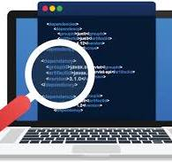
INTRODUCTION
A Static Code Analyzer (SCA) is a tool that examines source code without executing it to identify bugs, security vulnerabilities, and code quality issues.
The primary goal is to ensure maintainability, security, and efficiency in Python codebases.
Wirestock. (n.d.). AI image generator. Wirestock. Retrieved September 09, 2024, from https://wirestock.io/ai-image-generator

Slide 4
LITERATURE REVIEW
Authors | Title | Tools | Key Findings
H. B. Hassan, Q. I. Sarhan, Á. Beszédes | Evaluating Python Static Code Analysis Tools Using FAIR Principles | Prospector, Pylint, SonarQube, Pynocle | Assesses Python static analysis tools using FAIR principles. Identifies strengths and limitations in findability, accessibility, interoperability, and reusability. Proposes a web app for developers to compare and choose tools.
D. R. I. Peiris, N. Kodagoda | Static Code Analyzer to Enhance Developer Productivity | Nil | Develops a static analysis tool using AST for code structure issues. Aims to improve coding practices by detecting issues early. Future improvements include AI/ML integration for better detection.

Slide 5
LITERATURE RVIEW
Authors | Title | Tools | Key Findings
T. Dong, L. Chen, Z. Xu, B. Yu | Static Type Analysis for Python | CodeSonar, Klocwork, Coverity, PyLint, Pyflakes | Develops PType, a static type analysis tool using type inference. Constructs constraint graphs to detect type inconsistencies. Suggests integration with other analysis tools for a complete solution.
H. Gulabovska, Z. Porkoláb | Towards More Sophisticated Static Analysis Methods of Python Programs | PType | Investigates symbolic execution as a superior static analysis method. Enhances error detection accuracy by analyzing code paths more deeply. Recommends integrating SAT solvers like Z3 for better precision.

Slide 6
LITERATURE REVIEW
Authors | Title | Tools | Key Findings
J. Ruohonen, K. Hjerppe, K. Rindell | A Large-Scale Security-Oriented Static Analysis of Python Packages in PyPI | Bandit | Uses Bandit to analyze security vulnerabilities in PyPI packages. Finds widespread weak security practices in Python packages. Recommends refining vulnerability prediction models and tracking security trends over time

Slide 7
OBJECTIVE
Identify Common Code Defects and Vulnerabilities.
Develop a Basic Static Code Analysis Tool.
Design an interface for users to upload, scan, and review code analysis reports.

Slide 8
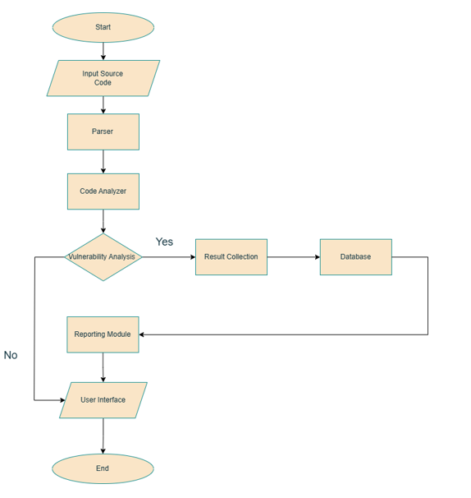
OPERATIONAL FLOW

Slide 9
FUNCTIONAL REQUIREMENTS
Software Requirements
• Programming Language : Python
• Operating System : Windows 7 and above
• IDE : VS code
Hardware Requirements
• Processor : Dual-Core CPU(e.g., Intel Core i3 or higher)
• RAM : 4GB and above
• Hard Disk : 500GB

Slide 10
IMPLEMENTATION
Input Source Code
Users upload python files (.py) for analysis.
Parsing
The code is tokenized and structured using pythons AST module.
Code Analysis
Inspects for syntax errors, security vulnerabilities, and unused variables.
Vulnerability Analysis
Checks for defects and stores detected issues in a database.
Result collection and database storage
Categorizes vulnerabilities by severity and logs them.
Reporting module and reviewing
Generates reports in JSON, HTML, or CSV formats.

Slide 11
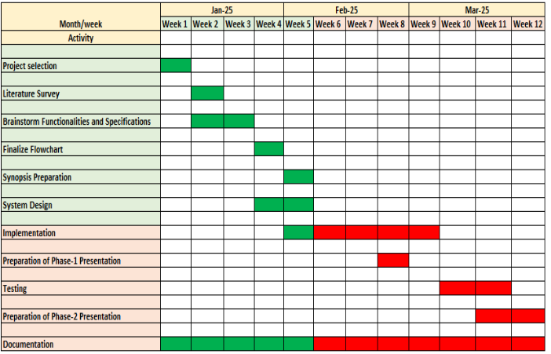


WORK DONE
Figure: Gantt Chart of Project Timeline

Slide 12
WORK DONE
Week 1
Week 2
Week 3
Finalized requirements, features and project scope and organized folder structure.
Set up GitHub repository with README for task documentation.
Set up the required libraries and servers for development of frontend and backend.
Researched static code analysis tools and created a project synopsis.
Developed file upload feature with frontend interface and FastAPI backend. Resolved CORS issues and redefined UI design.

Slide 13
WORK DONE
Week 4 and 5
Stabilized file upload feature and worked on integration of frontend and backend. Working more on the analyzer module to give the detailed report.
Week 6
Generating reports.
Build a dynamic results table in React.
Ensure proper integration between UI and backend.
Week 7
Test UI components with Jest/React Testing Library.
Conduct integration testing to verify end-to-end functionality.

Slide 14
WORK DONE
Week 8 and 9
Implement robust error handling.
Optimize scanning logic for better performance.
Week 10
Refactor backend and frontend code for maintainability.
Conduct another round of integration testing.
Week 11-12
Perform final testing and resolve any bugs.
Prepare user documentation and technical specifications.

Slide 15
BACKEND CODE STRUCTURE
Backend
│
├── analyzer/
│ ├── __init__.py
│ ├── advancedsecurity_checker.py
│ ├── analyze.py
│ ├── code_complexity_checker.py
│ ├── dependency_checker.py
│ ├── security_checker.py
│ ├── semantic_checker.py
│ └── syntax_analyzer.py
├── inputhandler/
├── tests/
├── uploads/
├── utils/
|── run_analyzer.py

Slide 16
FUNCTIONAL REQUIREMENTS
Software Requirements
• Programming Language : Python
• Operating System : Windows 7 and above
• IDE : VS code
Hardware Requirements
• Processor : Dual-Core CPU(e.g., Intel Core i3 or higher)
• RAM : 4GB and above
• Hard Disk : 500GB

Slide 17
REFERENCES
[1] H. B. Hassan, Q. I. Sarhan and Á. Beszédes, "Evaluating Python Static Code Analysis Tools Using FAIR Principles," in IEEE Access, vol. 12, pp. 173647-173659, 2024, doi: 10.1109/ACCESS.2024.3503493.
[2] D. R. I. Peiris and N. Kodagoda, "Static Code Analyser to Enhance Developer Productivity," 2023 IEEE 8th International Conference for Convergence in Technology (I2CT), Lonavla, India, 2023, pp. 1-6, doi: 10.1109/I2CT57861.2023.10126395.
[3] H. Gulabovska and Z. Porkoláb, "Towards More Sophisticated Static Analysis Methods of Python Programs," 2019 IEEE 15th International Scientific Conference on Informatics, Poprad, Slovakia, 2019, pp. 000225-000230, doi: 10.1109/Informatics47936.2019.9119307.

Slide 18
REFERENCES
[4] T. Dong, L. Chen, Z. Xu and B. Yu, "Static Type Analysis for Python," 2014 11th Web Information System and Application Conference, Tianjin, China, 2014, pp. 65- 68, doi: 10.1109/WISA.2014.20.
[5] J. Ruohonen, K. Hjerppe and K. Rindell, "A Large-Scale Security-Oriented Static Analysis of Python Packages in PyPI," in 2021 18th International Conference on Privacy, Security and Trust (PST), Auckland, New Zealand, 2021, pp. 1-10, doi: 10.1109/PST52912.2021.9647791.

Slide 19
THANK YOU

