Slide 1



08/11/2025
SMARTQUIZ HUB
Smart. Simple. Secure — the future of online assessment

Slide 2





Our team
Md Wayez Rahman
SM Kawshik Ahmed Kanak
Sazid Hossain Antu
Nusrat Nisha
20232010010
20232012010
20232145010
20232153010

Slide 3

Instructed By
ZAHRUL JANNAT PEYA
ASSISTANT PROFESSOR
DEPARTMENT OF COMPUTER SCIENCE AND ENGINEERING
NORTH WESTERN UNIVERSITY, KHULNA

Slide 4


Objectives and Goals
Clarify the project's main overall objectives and goals.
Goal # 1
Goal # 2
Goal # 3
Automate quiz creation and evaluation
Enhance exam integrity and fairness
Provide insightful performance analytics

Slide 5
Technical Framework
🛠️TECHNOLOGY STACK
Frontend: HTML5, CSS3, JavaScript, Bootstrap
Backend: PHP (Procedural / OOP)
Database: MySQL
Server: XAMPP
Security: Custom Authentication System
🔗 DATABASE DESIGN
• 9 NORMALIZED TABLES
• SECURE RELATIONSHIPS
• OPTIMIZED QUERIES
• BACKUP & RECOVERY
🏗️SYSTEM ARCHITECTURE
ThREE-TIER ARCHITECTURE:
1. PRESENTATION LAYER – UI/UX
2. APPLICATION LAYER – PHP BUSINESS LOGIC
3. DATA LAYER – MYSQL DATABASE

Slide 6


Timeline
1st Quarter
2nd Quarter
3rd Quarter
4th Quarter
User interaction (Front end layer)
Application processing
(Backend Layer)
Data Management (Database Layer)
Security & Server Operations

Slide 7
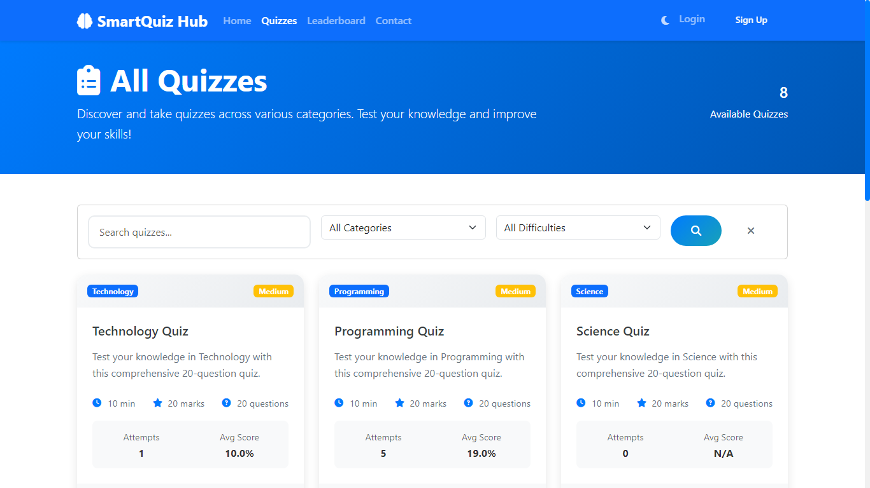
A smart platform for creating, managing, and analyzing quizzes efficiently — ensuring automation, fairness, and insightful performance tracking.
01
02
Supports adaptive question delivery and randomized sets to maintain exam integrity.
03
Provides real-time analytics and automated grading to simplify instructor workload.

Slide 8
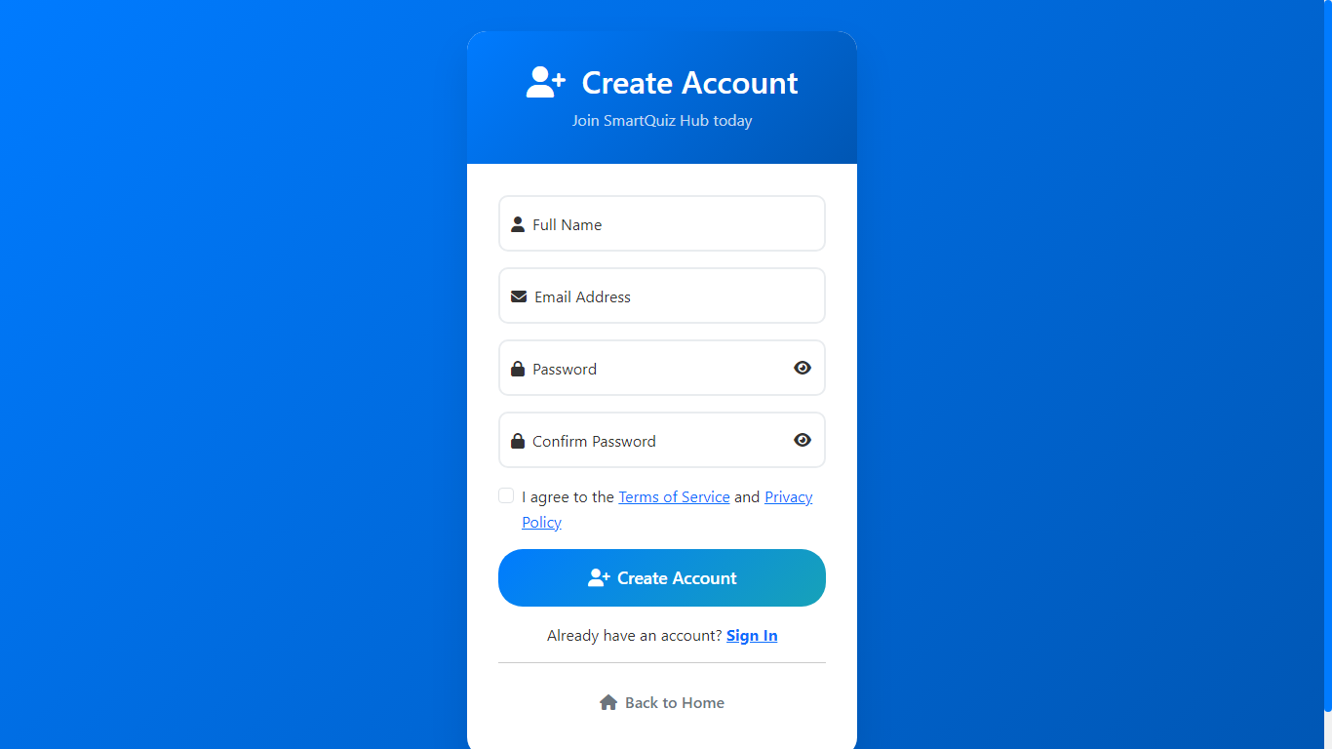

Log-In Panel
Secure login panel for students and admins with role-based access control.

Slide 9
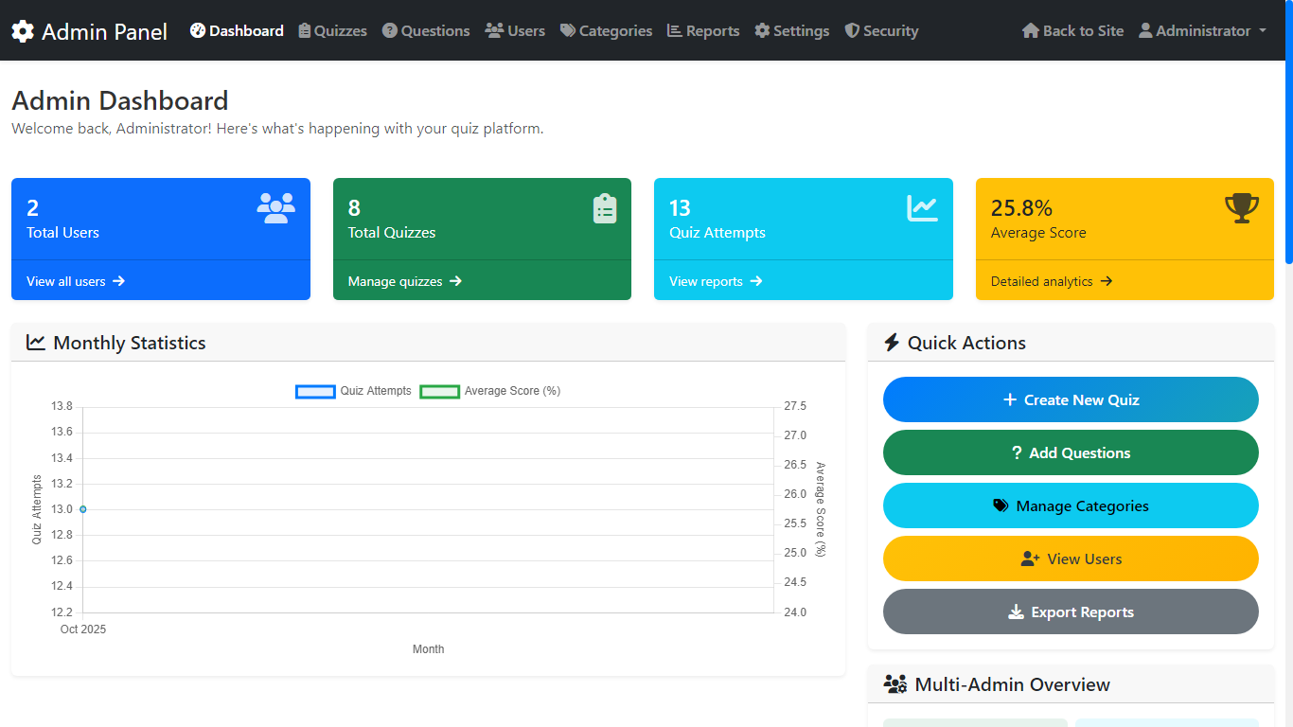
Admin Panel
Central dashboard for managing users, quizzes, and results.

Slide 10
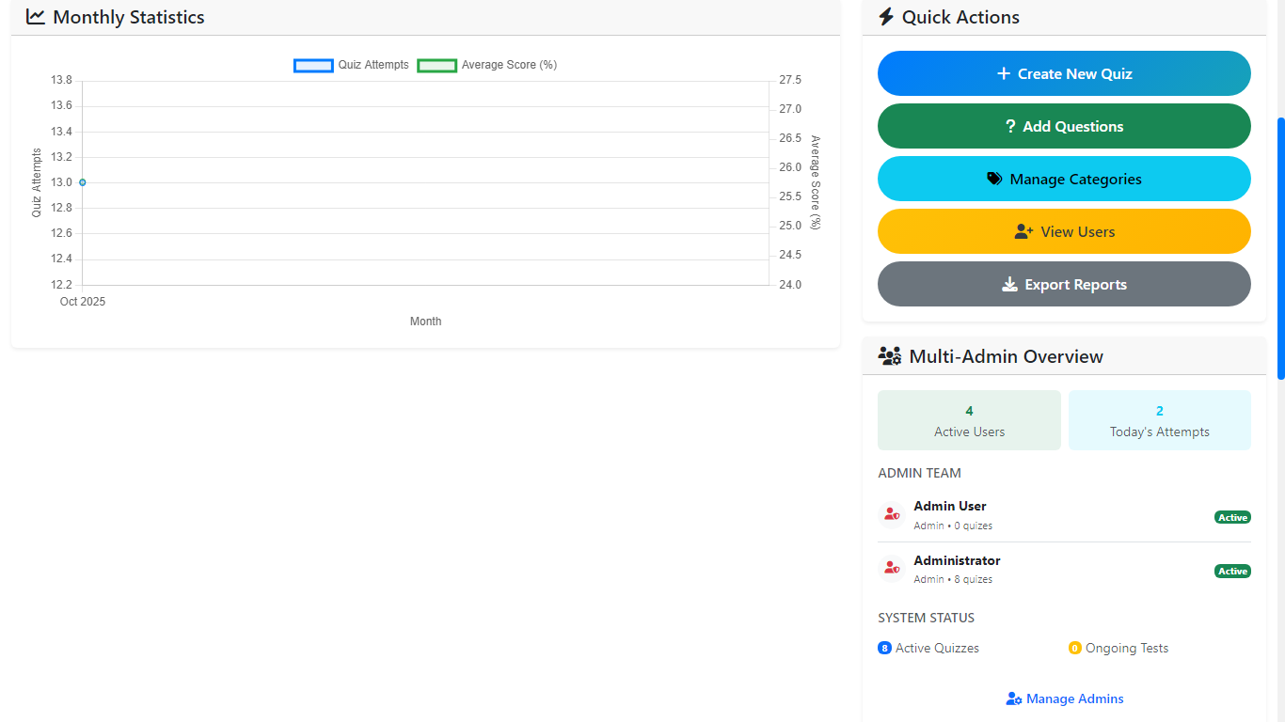
Admin Panel
The admin dashboard provides complete control over quizzes, users, and system settings.

Slide 11
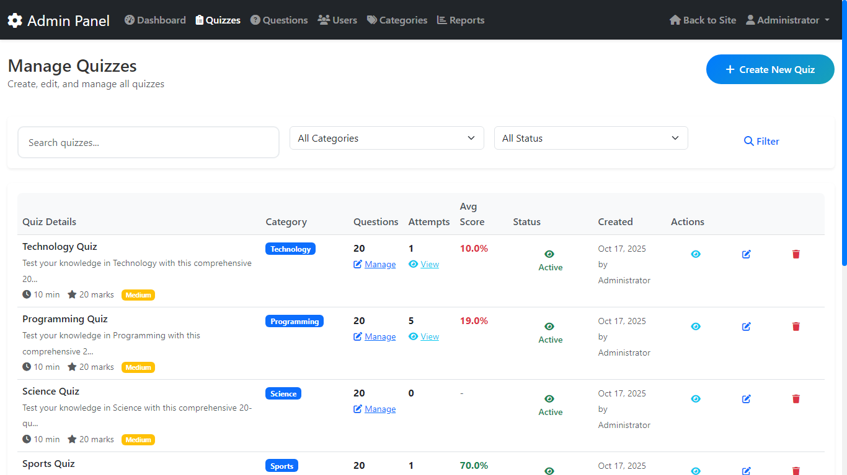
Admin Panel
Admins can create, edit, and organize quizzes effortlessly from one place.

Slide 12
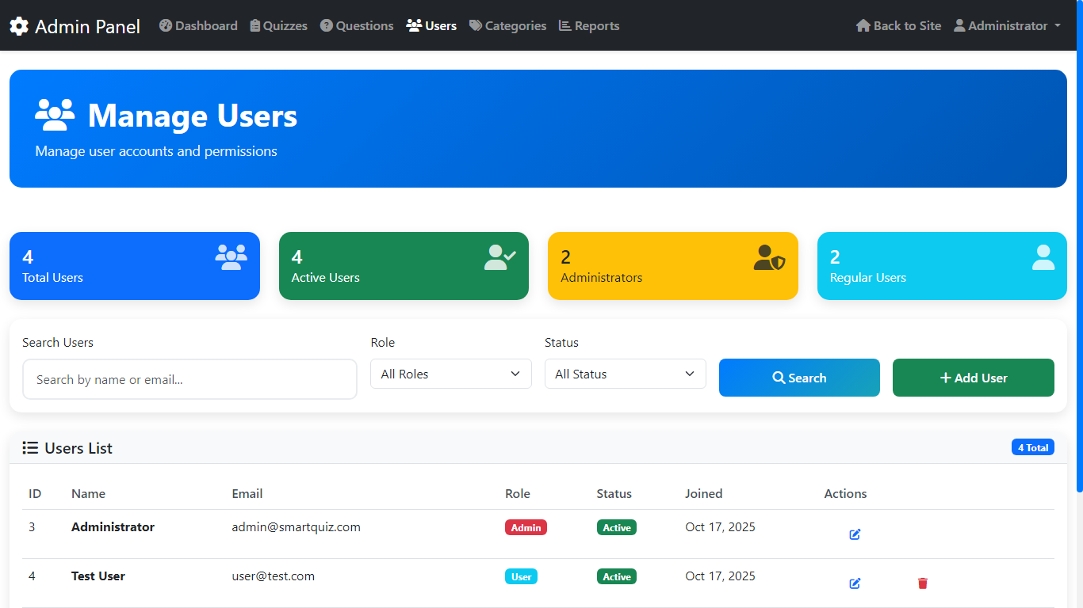
Admin Panel
Admins can create, edit, and organize quizzes effortlessly from one place.

Slide 13
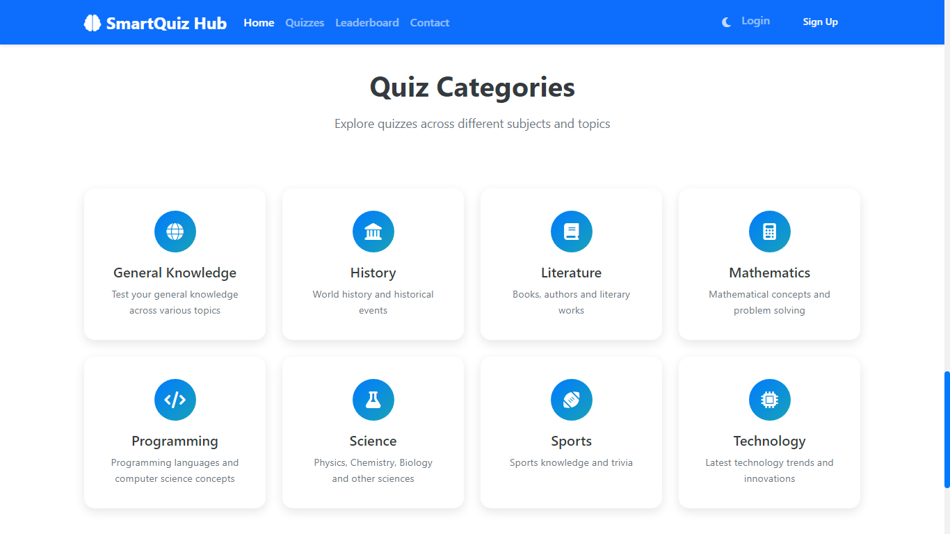
Quiz Categories
Organizes quizzes into customizable categories for easy management and navigation.

Slide 14
Quiz Customization
#1
Choose from multiple quiz types — objective, descriptive, or mixed.
#2
Set difficulty levels to match learner proficiency.
#3
Enable adaptive progression for personalized assessment.

Slide 15
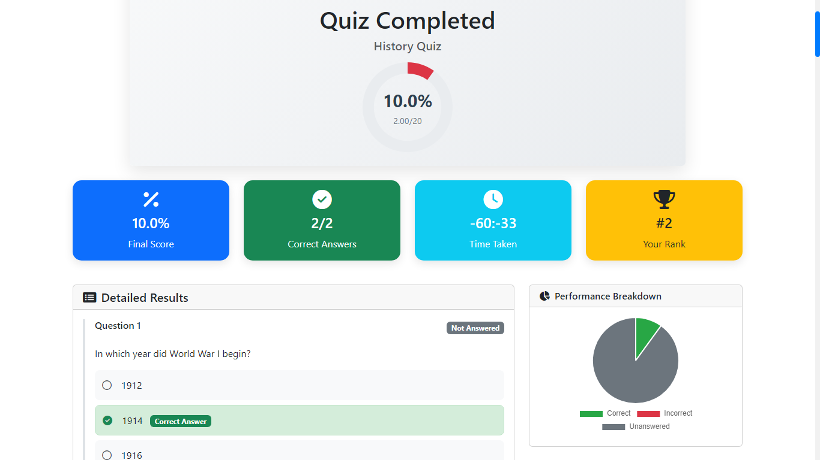
Self Assessment
Take a moment to reflect on your strengths, areas for growth. This quick self-evaluation will help you set meaningful goals moving forward.

Slide 16
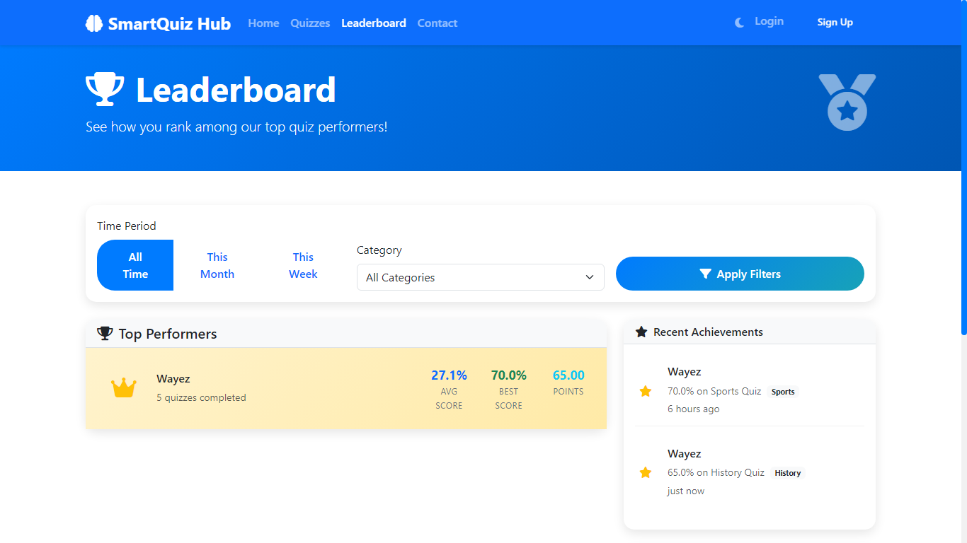
Performance Ranking
Displays top performers with real-time score updates.

Slide 17
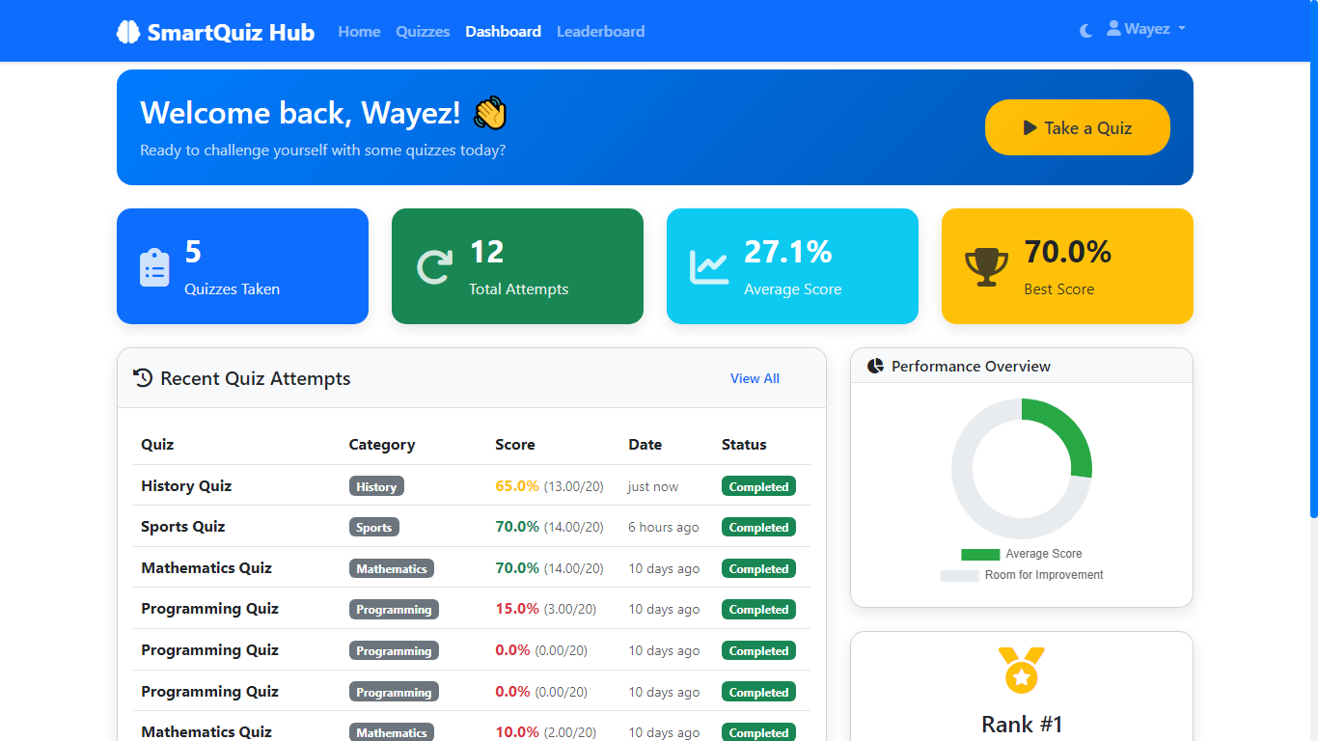
Achievements
Performance Dashboard: Your Quiz Stats at a Glance

Slide 18
Thank you
CONTACT US
E-mail
smartquiz34@yahoo.com
Social Media
@smartquiz
Phone
+013-766-7530
Address
36 Zakaria St., Khulna
www.smartquizhub.com

