Slide 1
Startup Database and Recommendation Engine
Work In Progress
K Iwasaki
kaiwasaki@berkeley.edu

Slide 2
Table of Contents
Introduction
Problem
Project Overview
Data collection and preprocessing
Data Collection and Preprocessing Scheme
Data Collection and Preprocessing Approach
Data Scraping
Data Extraction: Company Name from Article
Data Extraction: Company Address
Data Extraction: Industry Attributes
Data Exploration and Visualization
Data Exploration to Recommendation Generation
Summary Statistics, Variable Category, and NAs
Univariate analysis
Bivariate analysis
Recommendation Engine
Recommendation Engine - KNN
Feature Transformation and Engineering
Recommendation Output
Closing
Future Development
File Directories

Slide 3
Problem: Finding Good Startup is Hard
For job seekers, finding a startup that matches their interests is hard because:
Overwhelming information available online
So many information sources to check
Need to synthesize information
Need to check information frequently
So many texts to read
Job seekers are highly biased
Frustration, Time waste, Not finding company that matches your interests

Slide 4





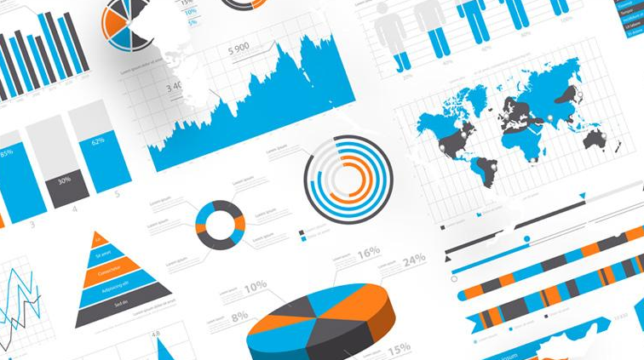

Project Overview: Finding the Best Startup For You
Create end-to-end solution from data collection, to database generation, to generation of recommendation for startups that matches your interests.
Data Collection/Preprocessing
Startup Database
Recommendation Engine
10 articles x 100 pages
~300 searches
Company name
Company size
Money raised
Industry
Description
HQ Location
…
Data Exploration and Visualization
~ 300 company profiles

Slide 5
Data Collection and Preprocessing Scheme
Data Collection and Preprocessing
Data Exploration/ Visualization
Recommendation Engine
Scrape the articles about Series C fundraising from TechCrunch (article.csv)
Preprocessing1. Extract
Preprocesisng2. Extract company names
Preprocessing3. Extract funding_round and money_raised
Scrape the website links to LinkedIn Company Profiles from Google Search
(linkedin_link_list.csv)
Preprocessing4. Merge the two CSV files
Preprocessing5. Validate company names
Scrape the company profile for each company from LinkedIn
(linkedin_profiles.csv)
Preprocessing6. Merge the two CSV files
Preprocessing7. Extract locations
Preprocessing8. Assign industry attributes
Article link
Article title
Article excerpt
Published at
Company Name
Funding Round
Money Raised
Link to LinkedIn Company Profile
Company Name
Founded
Industry
Specialties
Website Link
Description
Also-viewed
Location
Industry attributes
Location

Slide 6

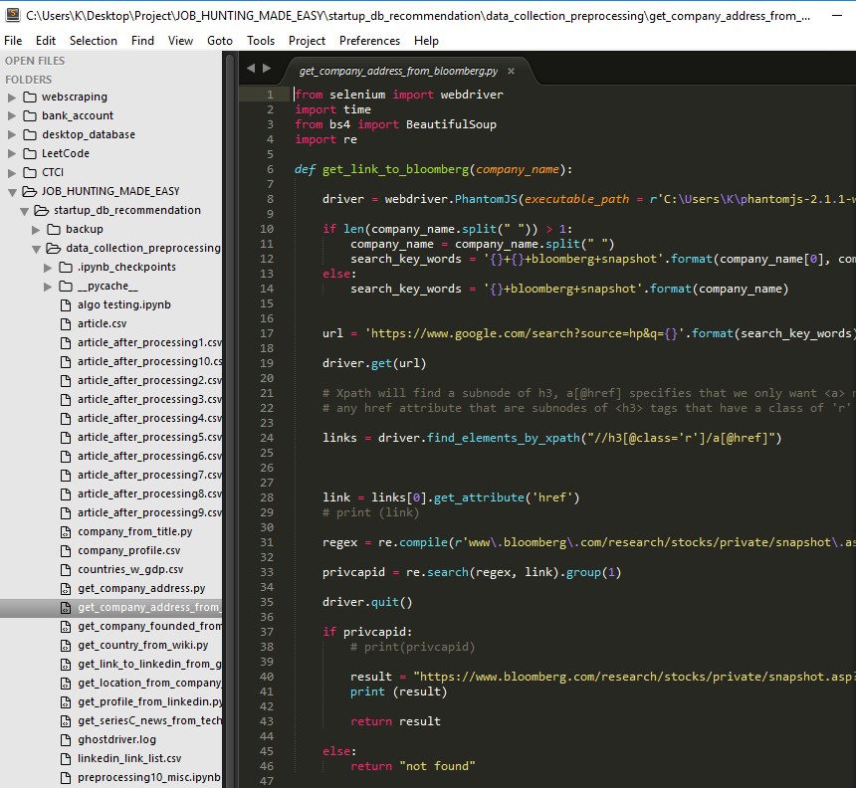
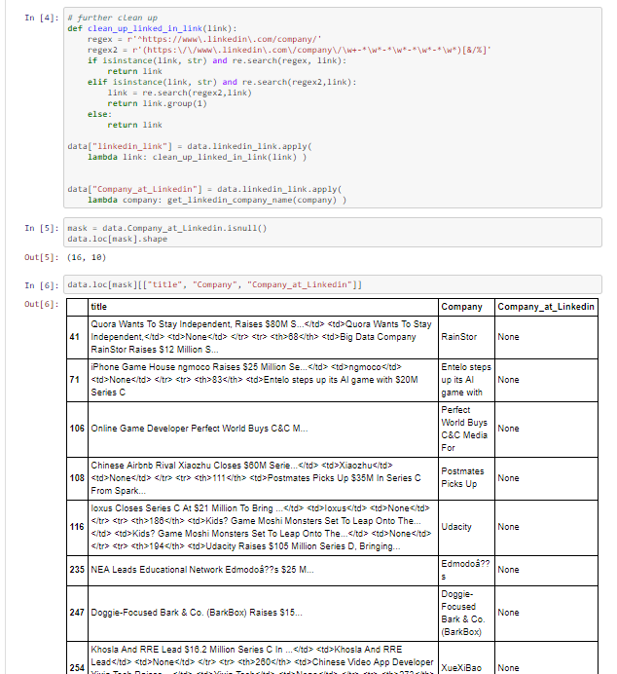
Data Collection and Preprocessing Approach
Data Collection and Preprocessing
Data Exploration/ Visualization
Recommendation Engine
Think what information we want for the database and for the recommendation engine
Write codes and extract information from the target source
Error analysis: Confirm if we get what we want and verify missing data and why
Company name
Company size
Money raised
Industry
Description
HQ Location
…

Slide 7
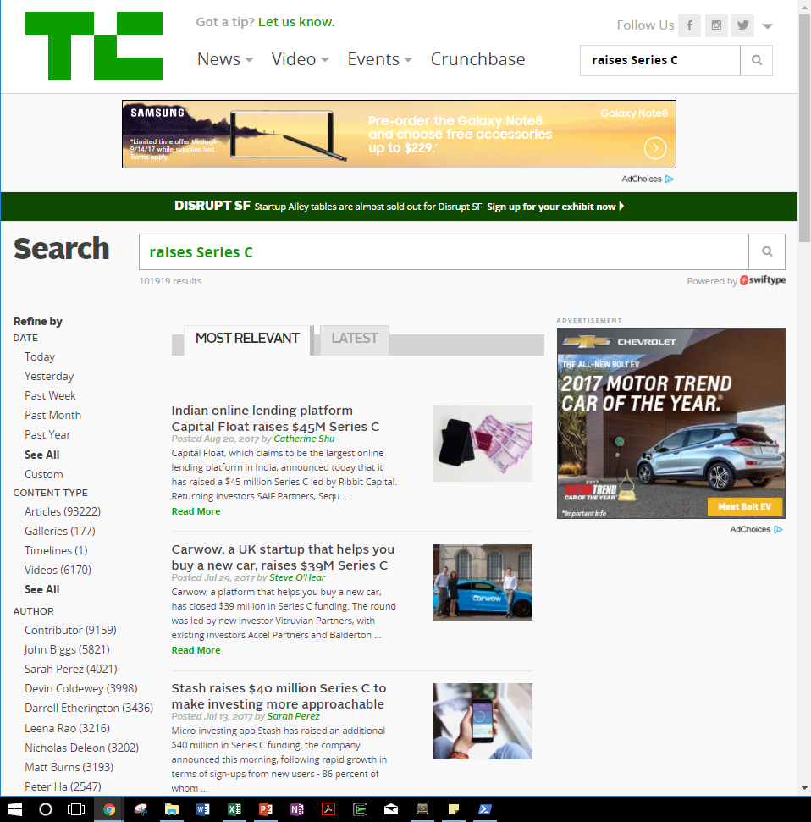
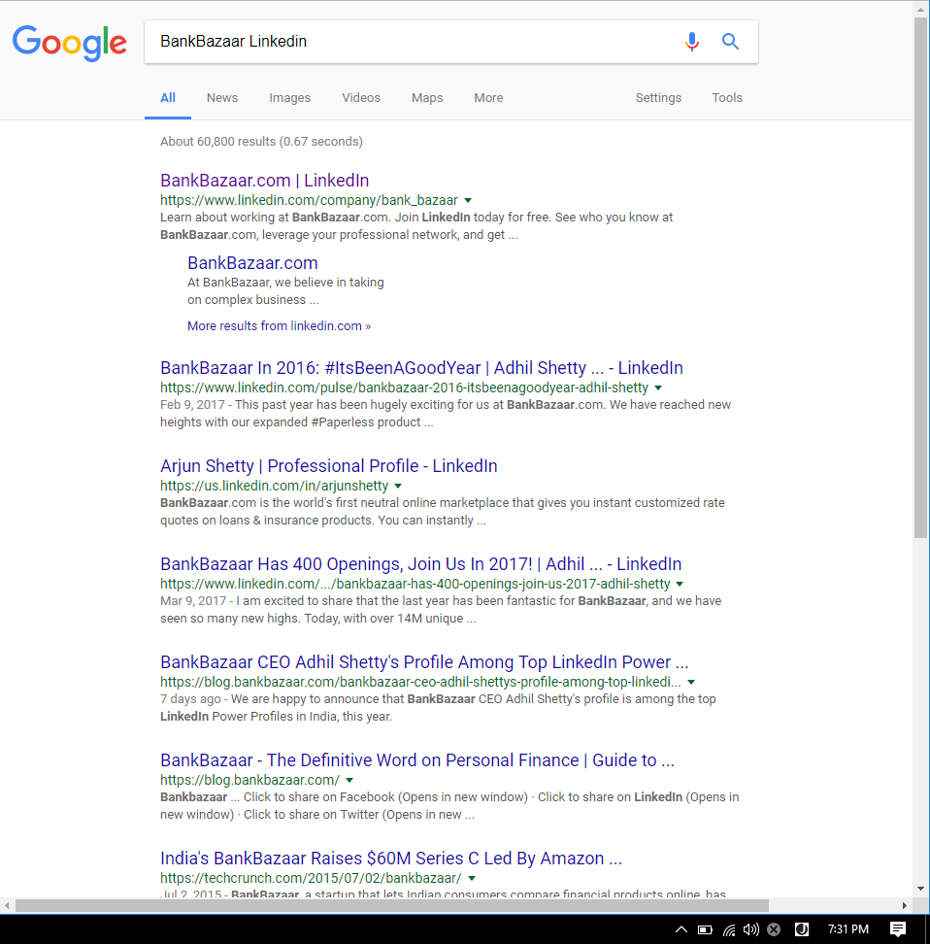
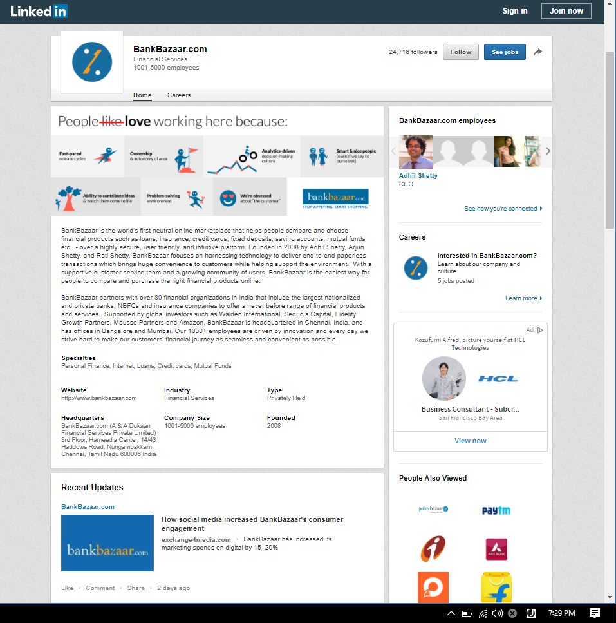
Data Scraping
Data Collection and Preprocessing
Data Exploration/ Visualization
Recommendation Engine
Tasks: Use Selenium and BeautifulSoup to scrape information the target websites.
get_seriesC_news_from_techcrunch.py
Input: key words “raises Series C”
Output: articles in csv file
get_link_to_linkedin_from_google.py
Input: company name
Output: a link to company profile at LinkedIn
get_profile_from_linkedin.py
Input: a link to company profile
Output: company profiles in csv file

Slide 8
Data Extraction: Company Name from Article Title
Data Collection and Preprocessing
Data Exploration/ Visualization
Recommendation Engine
Once we collect the articles, next step is extract company names from the article titles.
Challenge: a company name is irregular: it can be one word, two words, or more. It often is a mix of verb, noun, or others. Below are typical patterns that a company name shows up in an article title.
"Stash raises $40 million Series C to make investing more approachable“
"Data Storage Company Scale Computing Raises $17 Million Series C"
“Pivotal confirms Series C round is actually over $650 million“
"After bump in the road, Movinga raises $17M Series C“
"Carwow, a UK startup that helps you buy a new car, raises $39M Series “
"Confirmed: London fintech Curve raises $10M Series A“
Company names, Key verbs, decorative words

Slide 9
Algorithm for Company Name Extraction
Data Collection and Preprocessing
Data Exploration/ Visualization
Recommendation Engine
Solution: algorithm to extract a company name, leveraging sentence structures of the articles that are scraped from TechCrunch. Also double-check the company name when googling it later to look for a link for a company profile page at LinkedIn. Check company_from_title.py for the codes
Step1:
Split the sentence by a key verb and keep the head
Remove “, word word … ,”
If one or two words remained=> done Else: => Step2
Step2:
Split the sentence by a key noun and keep the tail
If one or two words remained=> done Else: => Step2
Step3:
Split the sentence by “$” and keep the head
Split the sentence by “Series” and keep the head

Slide 10
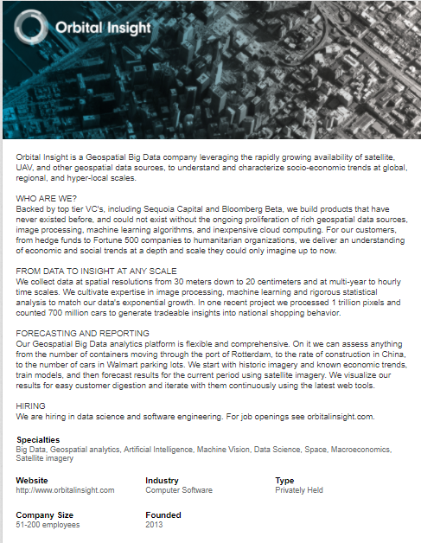
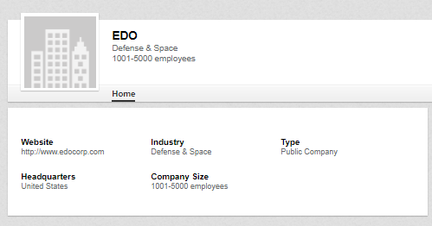
Data Extraction: Company Address
Data Collection and Preprocessing
Data Exploration/ Visualization
Recommendation Engine
Company address is import input for the recommendation engine because many of us care where we work at.
Challenge: Some companies don’t input their company address at LinkedIn. Some companies are based outside of US and thus their addresses have different formatting.
It only says United States for Headquarters.
It doesn’t have address at all.

Slide 11
Solution to extract/revise Company Address
Data Collection and Preprocessing
Data Exploration/ Visualization
Recommendation Engine
Solution: Multi-step approach: first focus on label countries and then focus on US companies to extract zip code.
Step1: Complete labeling by countries
Country list scraped from Wikipedia --- get_country_from_wiki.py
Extract country information from features collected so far
Step2: Focus on the US companies and get zip code for them
For missing or insufficient information
Google Search --- get_comnay_address.py
Company Website --- get_location_from_company_website.py
Bloomberg --- get_company_address_from_Bloomberg.py
Step3: Gain state, city, geo location from the zip code for US companies
Use two python modules to capture city and state because both of them have some missing data

Slide 12
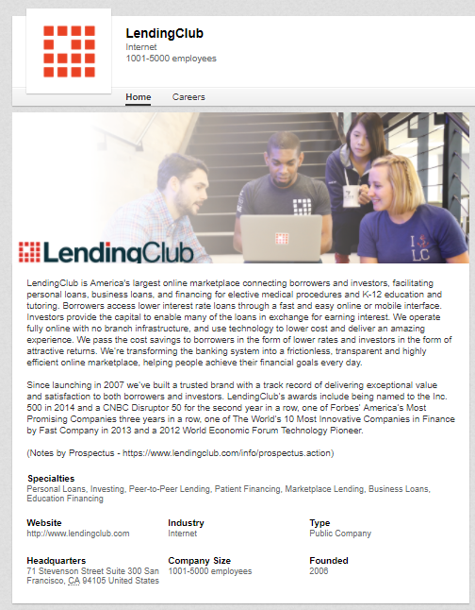
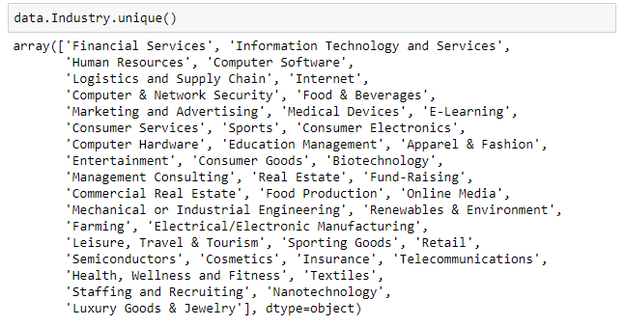
Data Extraction: Industry Attributes from Description
Data Collection and Preprocessing
Data Exploration/ Visualization
Recommendation Engine
Challenges: Industries have been arbitrarily assigned to companies. As a result, there are 49 unique industries for about 300 companies. There are three problems in order for recommendation engine to work:
Some industries are quite similar thus should be merged.
Some industries have lots of companies such as Computer Software. They should be split into more smaller segment.
one industry is not sufficient to describe a nature of a company because its business is often a combination of different elements. For example, the company below is internet x financial service, instead of internet alone

Slide 13
Algorithm to Assign Industry Attributes to Each Company
Data Collection and Preprocessing
Data Exploration/ Visualization
Recommendation Engine
Solution Part1: algorithm to simplify the industry classification by merging some industries so that minor industry labels are eliminated
Industry (Original) | Industry_consolidated (New)
[“Apparel & Fashion”, “Consumer Goods”, “Consumer Services”, “Cosmetics”, “Luxury Goods & Jewelry”, “Retail”, “Leisure, Travel & Tourism”, “Sporting Goods”, “Textiles”] | Consumers Goods & Services
[“Computer Software”] | Computer Software
[“Computer & Network Security”, “Computer Hardware”] | Computer & Network Security & Hardware
[‘E-Learning’, ‘Education Management’] | Education
[“Entertainment”] | Entertainment
[“Marketing and Advertising”] | Marketing and Advertising
[“Farming”, “Food & Beverages”, “Food Production”, “Restaurants”] | Food Business
[“Insurance”, “Fund-Raising”, “Financial Services”] | Financial Services
[“Information Technology and Services”] | Information Technology and Services
[“Internet”, “Online Media”] | Internet
[“Commercial Real Estate”, “Real Estate”] | Real Estate
[‘Health, Wellness and Fitness’, ‘Medical Devices’, “Sports”] | Healthcare_health
[“Human Resources”, “Staffing and Recruiting”] | Human Resources
[“Telecommunications”, “Renewables & Environment”, “Logistics and Supply Chain”] | Infrastructure
[“Semiconductors”, “Nanotechnology”, “Biotechnology”, “Management Consulting”, “Electrical/Electronic Manufacturing” “Mechanical or Industrial Engineering” ] | Niche

Slide 14
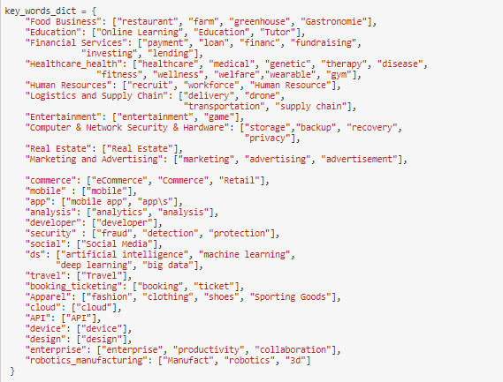
Algorithm to Assign Industry Attributes to Each Company
Data Collection and Preprocessing
Data Exploration/ Visualization
Recommendation Engine
Solution Part2: Algorithm to add new features to represent company businesses better based on the key words in appeared in company profiles

Slide 15
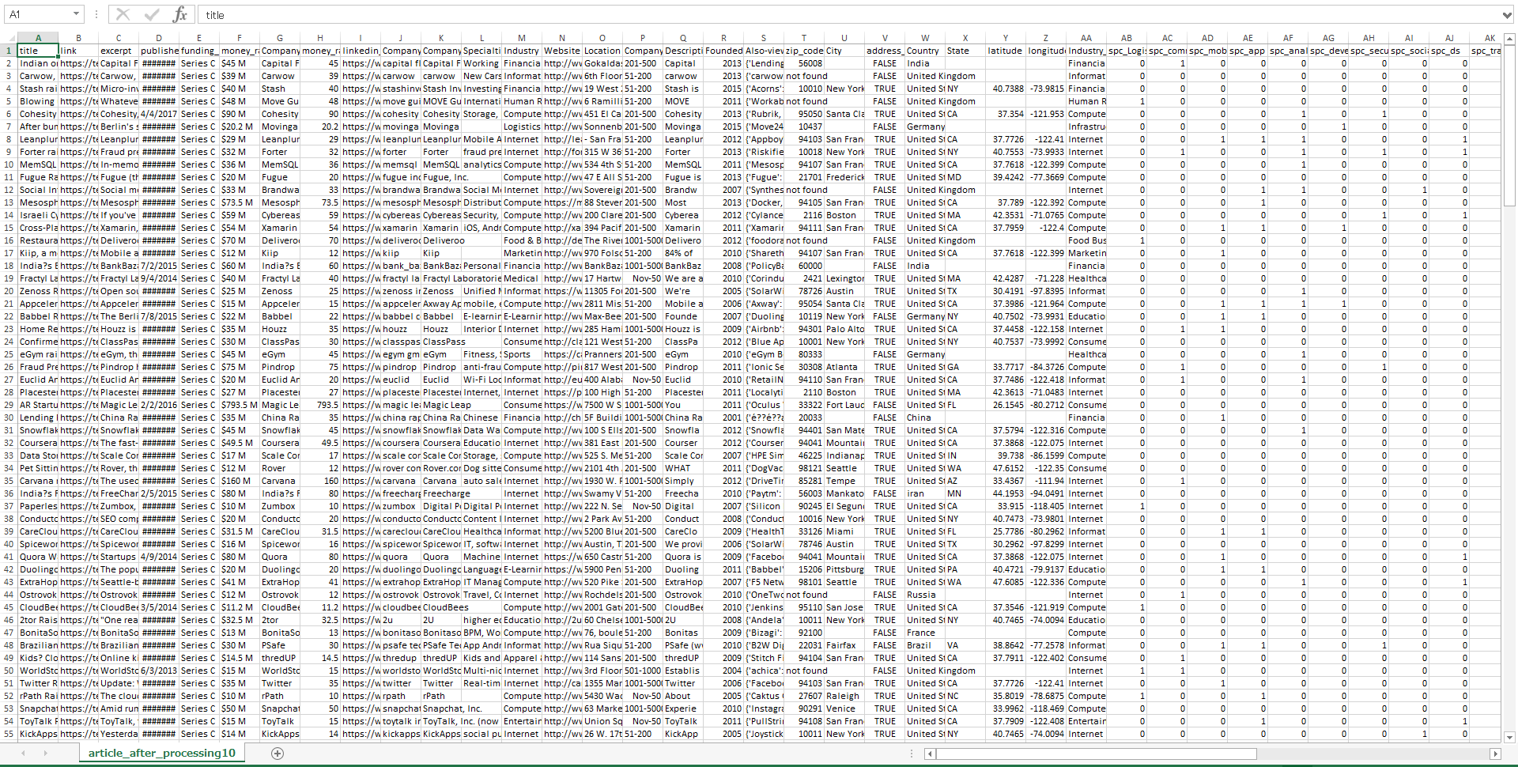
Now Database is Set! --- 232 rows by 47 columns

Slide 16
Data Exploration to Recommendation Generation
Data Collection and Preprocessing
Data Exploration/ Visualization
Recommendation Engine
Data exploration is to gain insights for algorithm selection, feature selection, feature transformation through following steps:
Summary statistics, variable category, NA value detection
Univariate analysis
Bivariate analysis
Documentation and codes:
Based on the inputs from the data exploration, we create the recommendation and generate recommendations in the following steps:
Algorithm Selection
Feature Transformation and Engineering
Recommendation Output
Documentation and codes:
Data Exploration/ Visualization
Recommendation Engine

Slide 17
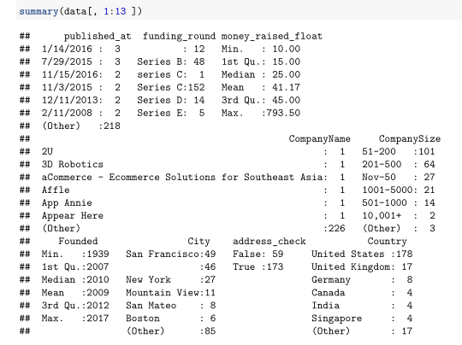
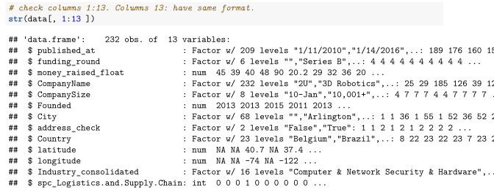
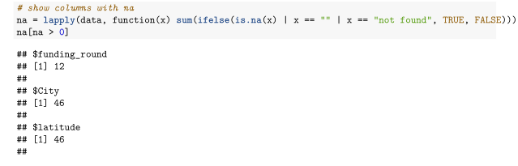
Summary Statistics, Variable Category, and NA values
Data Collection and Preprocessing
Data Exploration/ Visualization
Recommendation Engine
Refer the document for the details:

Slide 18
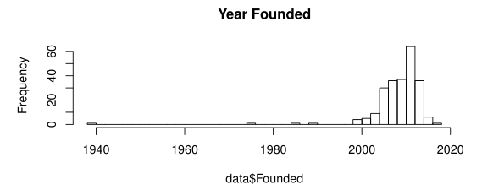
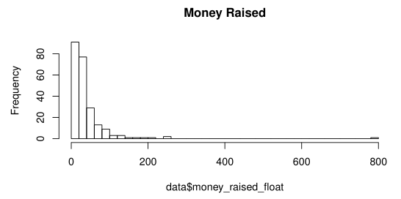
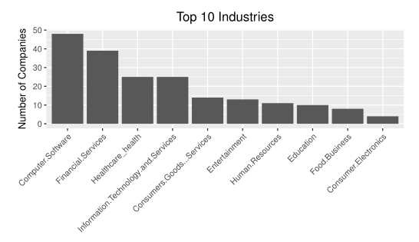
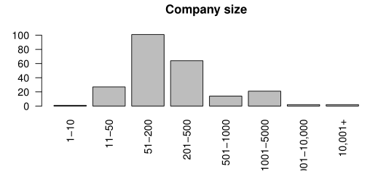
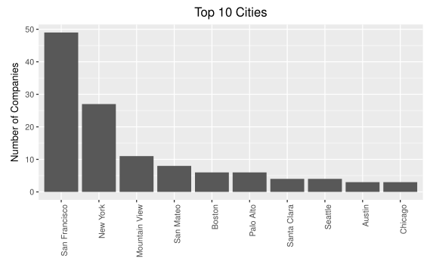
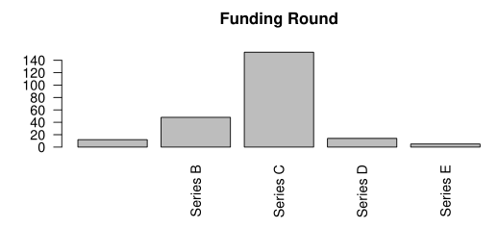
Univariate analysis
Data Collection and Preprocessing
Data Exploration/ Visualization
Recommendation Engine
Refer the document for the details:

Slide 19
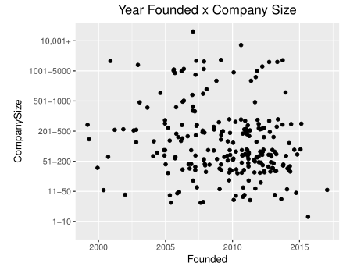
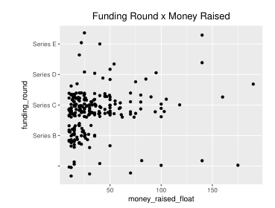
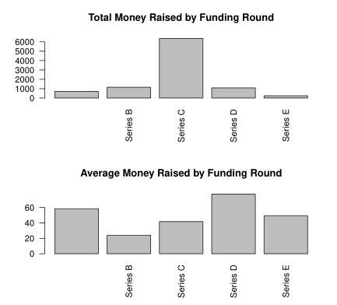
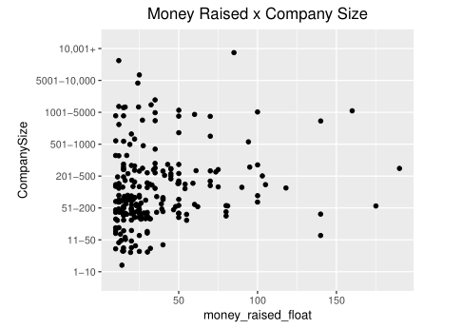
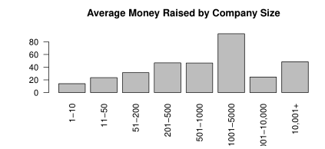
Bivariate analysis
Data Collection and Preprocessing
Data Exploration/ Visualization
Recommendation Engine
Refer the document for the details:

Slide 20
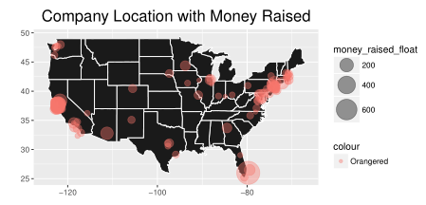
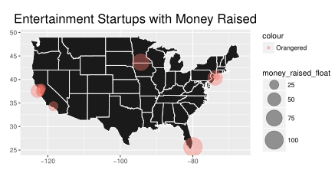
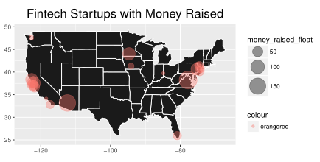
Bivariate analysis
Data Collection and Preprocessing
Data Exploration/ Visualization
Recommendation Engine
Refer the document for the details:

Slide 21
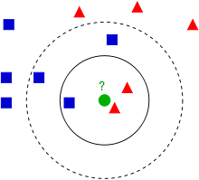
Recommendation Engine – K-Nearest Neighbor
Data Collection and Preprocessing
Data Exploration/ Visualization
Recommendation Engine
How the recommendation engine should work:
Given user inputs such as industry, company size, and year founded, it provides a few companies that matches the inputs.
Algorithm choice: K-nearest neighbors (KNN)
Justification for the choice: KNN works well for multi-class problems like this problem where we want to assign the user input to a label (company) as outputs out of all the different labels. It also produces several neighbors which we can use as a secondary recommendations for the user.
How KNN works: A green dot as the user input and other dots are startups in the database. KNN calculates the distance between the green dot and other dots and come up with K dots that are closest to the green dot. The shorter the distance is is, the better matches between the input and the neighbors are. These neighbors become the recommendation.

Slide 22
Feature Transformation and Engineering
Data Collection and Preprocessing
Data Exploration/ Visualization
Recommendation Engine
KNN requires features to be scaled properly because KNN is distance-based algorithm and calculates a selected distance metric between the user inputs and each example of the training data.
This implies that KNN only takes a numeric variable and a dummy variable. Thus, I made transformations as followings for the features.
Features
Money Raised
Company Size
Location
Year Founded
Industry
Log transformation to handle outliers
Binning
Convert city to geo coordinate
Removal of outliers
Key word matching
Transformations
Min max transformation
Min max transformation
Min max transformation
Min max transformation
Dummy variables
Refer the document for the details:

Slide 23
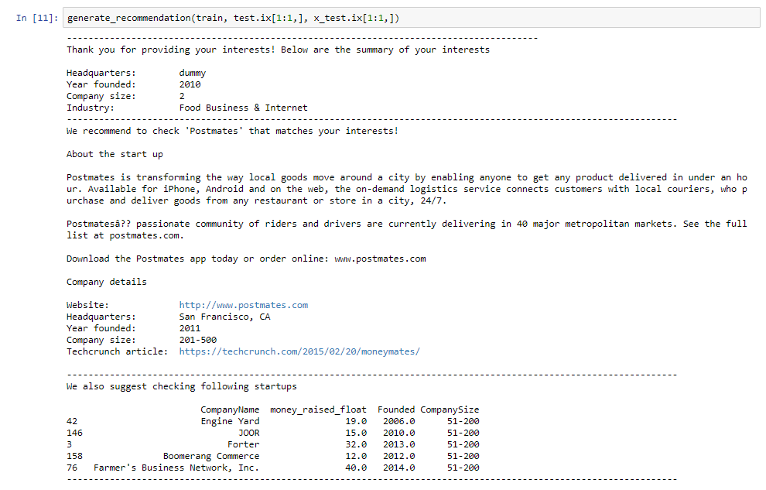
Recommendation Output
Data Collection and Preprocessing
Data Exploration/ Visualization
Recommendation Engine
Summery of user inputs
Summary of the top recommendation
Secondary recommendations
Refer the document for the details:

Slide 24
Future Development
Data collection | Incorporate more data sources such as Glassdoor. Create data pipeline that is based on once a day batch processing from multiple data sources. Improve algorithms for various data extraction works by utilizing existing NLP packages.
Data storage | Store the data in database such as PostgreSQL for better data management and data retrieving capability.
Data preprocessing | Clean up codes and streamline the process. Incorporate better handlings.
Recommendation Engine | Store companies also-viewed for each company profile at linked in Graph DB such as Neo4j and generate startup recommendations based on the DB.
Interface | Create a Web application using Flask and develop GUI to enable users to input their preferences and to view recommendation outputs.

Slide 25
File Directories 1 – data_collection_preprocessing folder
File name
company_from_title.py
get_company_address.py
get_company_address_from_Bloomberg.py
get_company_founded_from_Bloomberg.py
get_country_from_wiki.py
get_link_to_linkedin_from_google.py
get_location_from_company_website.py
get_profile_from_linkedin.py
get_seriesC_news_from_techcrunch.py
preprocessing1_extract_info.ipynb
preprocessing2_extract_company_name.ipynb
preprocessing3_clean_up.ipynb
preprocessing4_merge_two_csv.ipynb
preprocessing5_validate_company_names.ipynb
preprocessing7_location.ipynb
preprocessing8_location2.ipynb
preprocessing9_industry.ipynb
preprocessing10_misc.ipynb

Slide 26
File Directories 2
Folder | File name
explatory_data_analysis | explatory_data_analysis.pdf
 | explatory_data_analysis.rmd
recommendation | PCA.ipynb
 | recommendation.ipynb

