Slide 1
Startup Database and Recommendation Engine
Work In Progress
K Iwasaki
kaiwasaki@berkeley.edu

Slide 2
Table of Contents
Problem
Solution
Challenges and trouble-shoots
Data collection and preprocessing scheme
Data scraping
Data Extraction: Company name from article
Algorithm for company name extraction
Algorithm to assign industry attributes to each company
Recommendation Engine
Data visualization
Future Development

Slide 3
Problem: Finding Good Startup is Hard
Overwhelming information available online
So many information sources to check
Need to synthesize information
Need to check information frequently
So many texts to read
Job seekers are highly biased
Frustration, Time waste, Not finding company that matches your interests

Slide 4





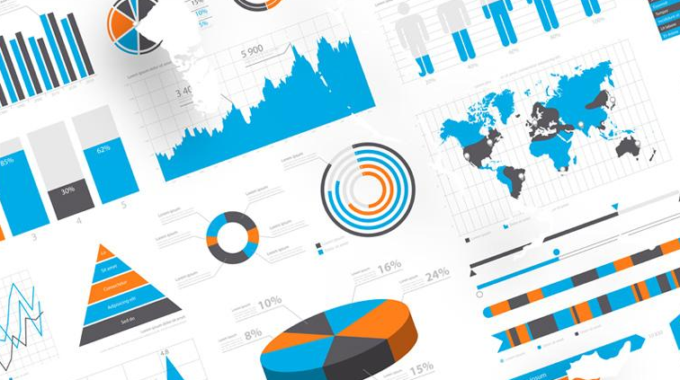

Project Overview: Finding the Best Startup For You
Create end-to-end solution from data collection, to database generation, to generation of recommendation for startups that matches your interests.
Data collection/preprocessing
Startup Database
Recommendation
10 articles x 100 pages
~300 searches
Data visualization
~ 300 company profiles

Slide 5

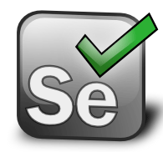




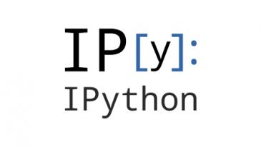

Project Flow
Data Scraping
Data Extraction
Data Extraction
Data Exploration/ Visualization
Recommendation Engine
Key tasks
Key tools

Slide 6
Data Collection and Preprocessing Scheme
Scrape the articles about Series C fundraising from TechCrunch (article.csv)
Preprocessing1. Extract
Preprocesisng2. Extract company names
Preprocessing3. Extract funding_round and money_raised
(table1)
Scrape the website links to LinkedIn Company Profiles from Google Search
(linkedin_link_list.csv)
Preprocessing4. Merge two CSV files
Preprocessing5. Validate company names
Scrape the company profile for each company from LinkedIn
(linkedin_profiles.csv)
Preprocessing6. Merge two CSV files
Preprocessing7. Extract locations
Preprocessing8. Assign industry attributes
Article link
Article title
Article excerpt
Published at
Company Name
Funding Round
Money Raised
Link to LinkedIn Company Profile
Company Name
Founded
Industry
Specialties
Website Link
Description
Also-viewed
Location
Industry attributes
Location

Slide 7
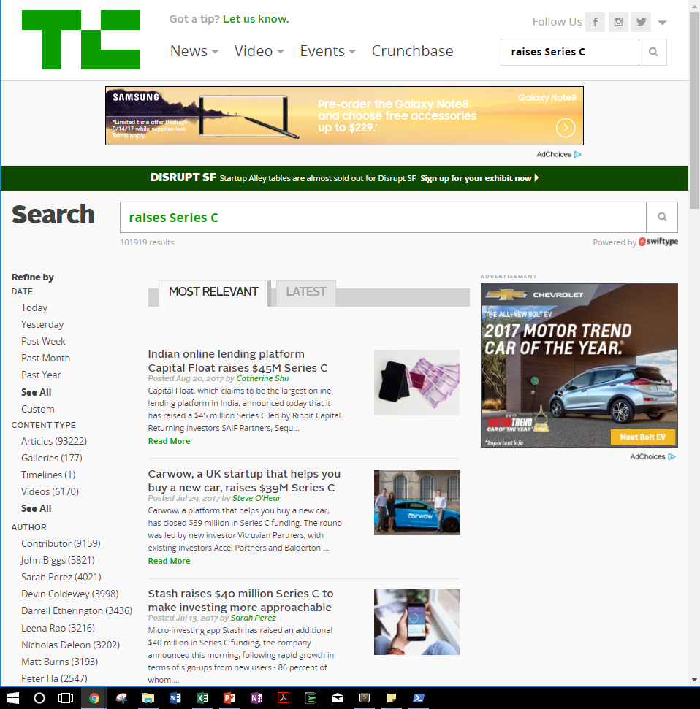
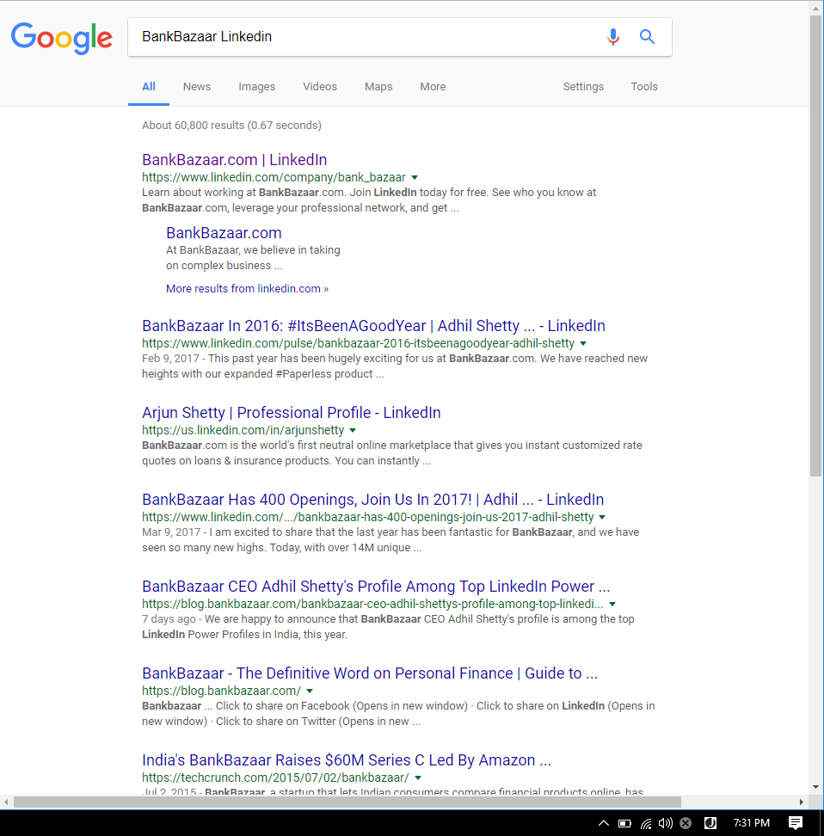
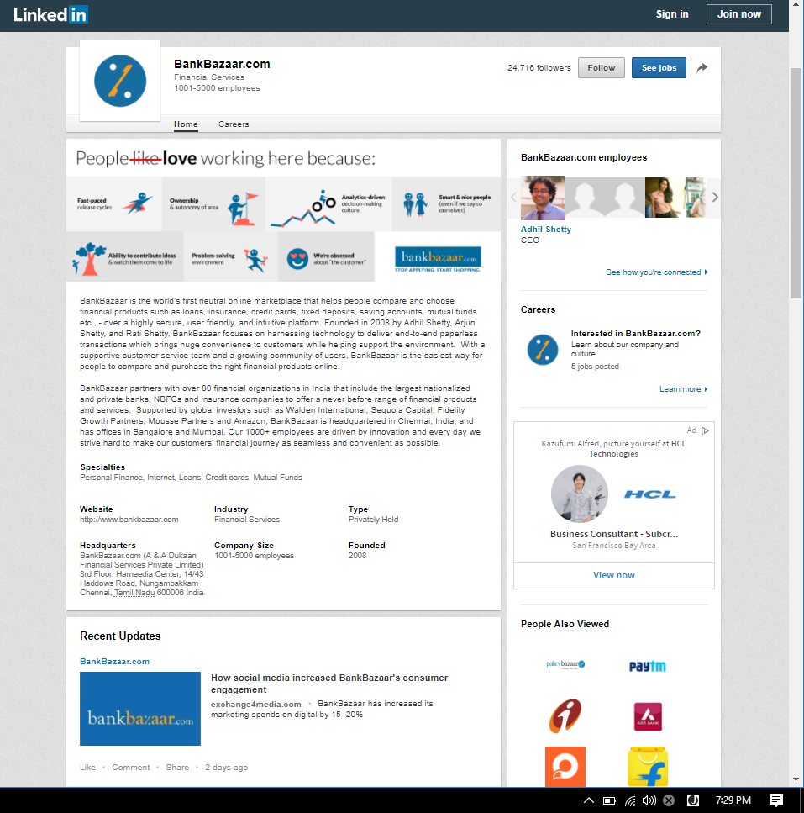
Data Scraping
Tasks: Use Selenium and BeautifulSoup to scrape information the target websites.
Python file:
Input: Key word
Output:

Slide 8



Data Extraction: Company Name from Article Title
Challenges: a company name is irregular: it can be one word, two words, or more and it often is a mix of verb, noun, or others.
Capital Float
Move Guides
MemSQL

Slide 9
Algorithm for Company Name Extraction
Solution: algorithm to extract a company name, leveraging sentence structures of the articles that are scraped from TechCrunch
Step1:
Split the sentence by a key verb and keep the head
Remove “, word word … ,”
If one or two words => done
Else: => Step2
Step2:
Split the sentence by a key noun and keep the tail
Step3:
Split the sentence by “$” and keep the head
Split the sentence by “Series” and keep the head

Slide 10
Data Extraction: Company Address
Challenges: Missing. Insufficient. Non-US Address. (Wrong). Want to gain geo-coding.

Slide 11
Solution to sort out Company Address
Step1: Complete labeling by countries.
Country list scraped from Wikipedia
Step2: Focus on the US companies. Gain ZIP code
For missing or insufficient information
Google Search
Company Website
Bloomberg
Step3: Gain state, city, geo loation based on ZIP code
Use two python modules to capture city, state. This is to double check

Slide 12
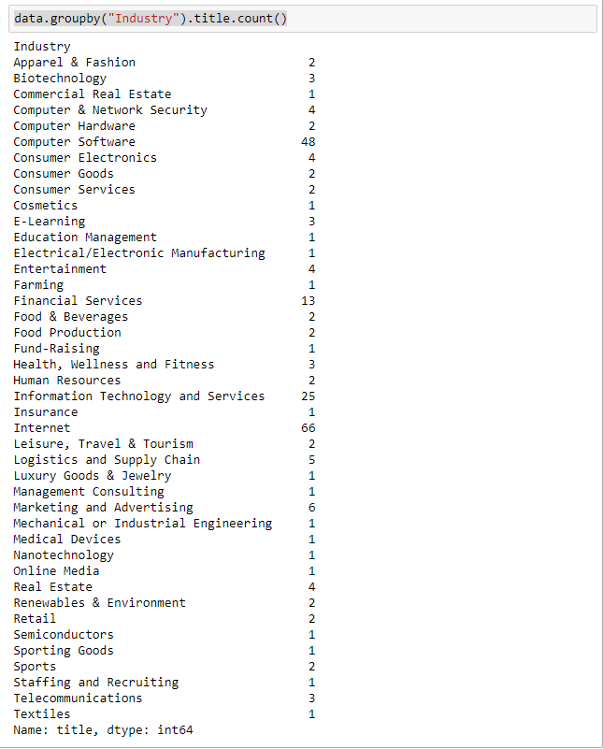
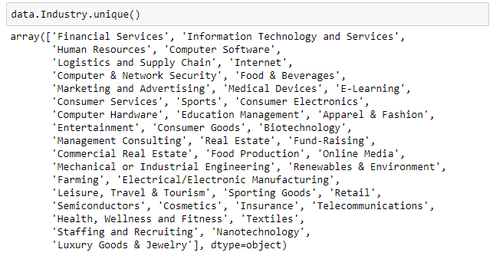
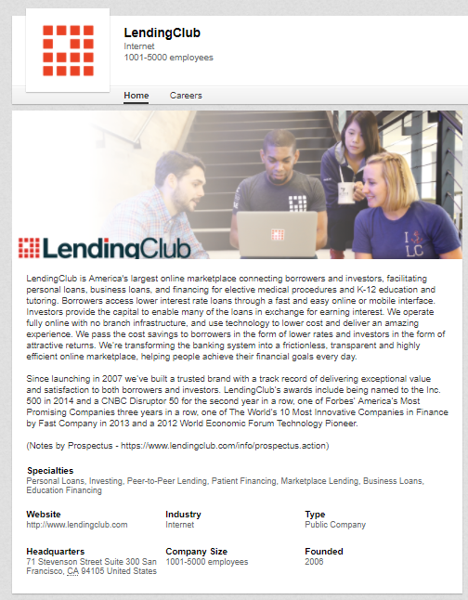
Data Extraction: Industry Attributes from Description
Challenges: Industries have been arbitrarily assigned to companies. As a result, there are 49 unique industries for about 300 companies. There are three problems in order to recommendation engine to work: 1) Some industries are quite similar thus should be merged. 2) Some industries have lots of companies such as Computer Software. They should be split into more smaller segment. 3) one industry is not sufficient to describe a nature of a company because its business is often combination of different elements. For example, the company below is internet x financial service, instead of internet alone

Slide 13
Algorithm to assign industry attributes to each company
Solution: algorithm to simplify the industry classification by merging some industries and to add new features to represent company businesses better
Industry | Industry_consolidated
[“Apparel & Fashion”, “Consumer Goods”, “Consumer Services”, “Cosmetics”, “Luxury Goods & Jewelry”, “Retail”, “Leisure, Travel & Tourism”, “Sporting Goods”, “Textiles”] | Consumers Goods & Services
[“Computer Software”] | Computer Software – 48
[“Computer & Network Security”, “Computer Hardware”] | Computer & Network Security & Hardware 6
[‘E-Learning’, ‘Education Management’] | Education
[“Entertainment”] | Entertainment
[“Marketing and Advertising”] | Marketing and Advertising - 6
[“Farming”, “Food & Beverages”, “Food Production”, “Restaurants”] | Food Business
[“Insurance”, “Fund-Raising”, “Financial Services”] | Financial Services
[“Information Technology and Services”] | Information Technology and Services (Tricky) - 25
[“Internet”, “Online Media”] | Internet - 68
[“Commercial Real Estate”, “Real Estate”] | Real Estate
[‘Health, Wellness and Fitness’, ‘Medical Devices’, “Sports”] | Healthcare_health
[“Human Resources”, “Staffing and Recruiting”] | Human Resources
[“Telecommunications”, “Renewables & Environment”, “Logistics and Supply Chain”] | Infrastructure - Energy/Telecomunications/Logistics and Supply Chain/ Transportation
[“Semiconductors”, “Nanotechnology”, “Biotechnology”, “Management Consulting”, “Electrical/Electronic Manufacturing” “Mechanical or Industrial Engineering” ] | Niche

Slide 14
Database

Slide 15
Data Visualization
Clustering
Ranking by Industry
Plots ---
Word cloud

Slide 16
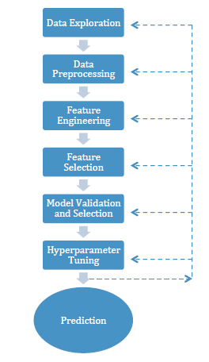
Recommendation Engine
Algorithm choice: K-nearest neighbor
Justification:
Input:
Output:
How the algo works
Requirement: scaling, check outliers (feature transformation)

Slide 17
Feature Engineering
Feature engineering
Money Raised
CompanySize
Location
Founded
Industry

Slide 18
PCA

Slide 19
Recommendation Output
Recommendation Output

Slide 20
Future Development – Current vs. Future
Data collection | Eliminate manual processing work Incorporate more data sources Create data pipeline (real time => Storm?) Improve algos => utilize NLP modules more
Data storage | DB – PostgreSQL
Data processing
Data analysis
Data visualization
Recommendation Engine | Graph => Neo4j
Interface | GUI. Web App Flask

Slide 21
Appendix

Slide 22
Project Description in resume
Startup (Database and) Recommendation Engine
Developed an application to collect startup information from TechCrunch, Google, and LinkedIn to create a database of startups. (Selenium, BeautifulSoup AWS, Python)
Store the data in Postgres SQL
Implemented K-nearest neighbor algorithm to make suggestions for which start up to work for ( ).
Implemented Clustering to visualize/analyze startups
Graph (Neo4j)
Benefit: Reduce days of random search into minutes
Also emphasize skills
Emphasize error analysis, problem solving

Slide 23
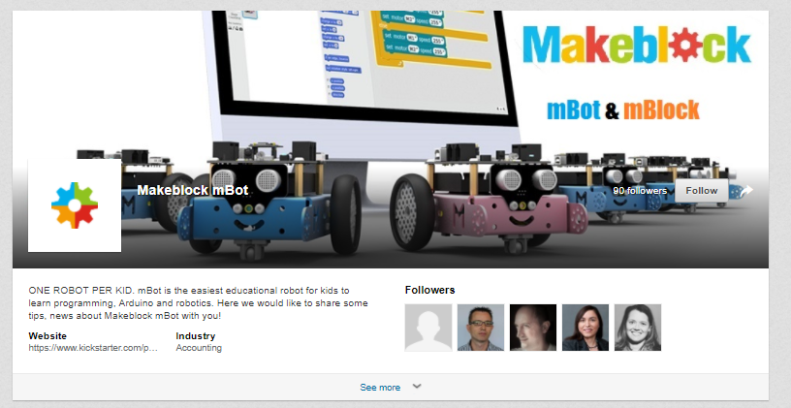
Limited information at linkedin

Slide 24
Title
Text
Text
Text
Text
Text
Text
Text
Text

Slide 25
Text
Text
Text
Week1:
Week2:
Week3:
Week4:
Week5:
Week6-8
Text
Text

Slide 26
Getting a job is one of the most important decision making in life, however, it is the most time consuming and confusing process.
Recruiting Process
Common Pains
Job Hunting Made Easy
How to keep up with industry/company/tech news?
Overwhelming information is available
How to find a job?
So many information sources to check
How to find a company and its information?
Need to synthesize information
How to prepare for a interview?
Need to check information frequently
How to investigate corporate culture?
So many texts to process
How to decide where to live?
Job seekers are highly biased

