Slide 1
Internship presentation
K Ananthamoorthi Holla
4MW21AI021

Slide 2
Contents
Introduction
About Company & internship
Internship work
Projects made
Certification
Conclusion

Slide 3
Introduction
Hello, I am K Ananthamoorthi engineering student at Smvitm Bantakal
In this presentation, I will share my internship experience at Wipro Enterprises, where I worked on two key projects.

Slide 4
About the Company
Wipro Enterprises is a leading global company with diverse business interests including FMCG, infrastructure engineering, and lighting. It has a rich history of innovation and excellence.
Key achievements include market leadership in various sectors and a strong global presence.

Slide 5
Internship Overview
My internship lasted for One months, from 2 Nov 2023 to 25 Nov 2023
I worked with the IT and Development teams.
The main objectives were to gain practical experience and contribute to real-world projects.

Slide 6
Internship Work Overview
Conducted research and development for web applications.
Collaborated with team members to design and implement features.
Participated in regular team meetings and project updates.
Enhanced my skills in HTML, CSS, JavaScript,Web frameworks,API, Database, and other web development tools.

Slide 7
Project 1 - Market Survey App
Developed a market survey application to gather customer feedback and insights.
Technologies Used:
- HTML, CSS, JavaScript for front-end development.
- Firebase for backend data storage and real-time updates.
- Deployed on Netlify for hosting.
Key Features:
- User-friendly interface for survey participants.
- Secure data collection and storage.
- Real-time data updates and analysis.

Slide 8
Project 1 - Key Achievements and Challenges
Key Achievements:
- Successfully created a functional survey app within the internship period.
- Integrated real-time data updates using Firebase.
Challenges Faced:
- Ensuring data security and privacy.
- Optimizing the app for performance and scalability.
Overcoming Challenges:
- Implemented encryption for data security.
- Utilized Firebase's capabilities for efficient data management.

Slide 9
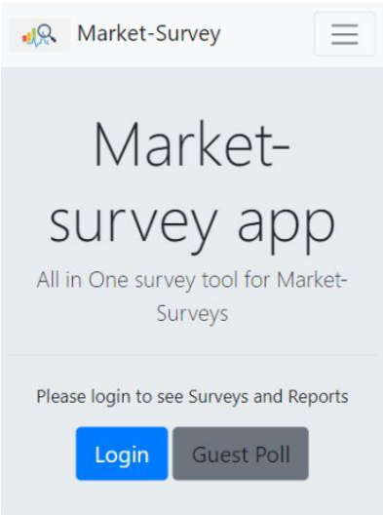
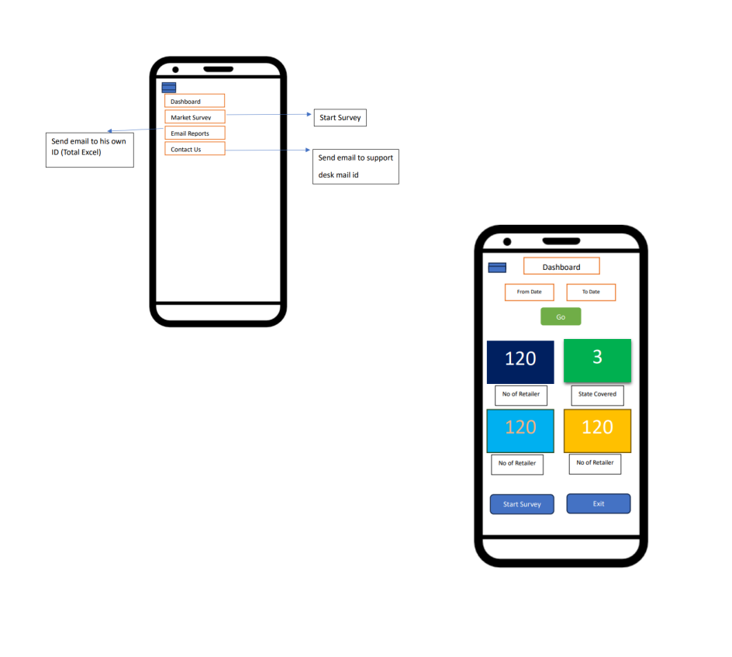
#cant include tool due to company policy

Slide 10
Project 2 - Wipro Vendor Portal Webapp
Developed a web application for vendor management to streamline interactions and transactions.
Technologies Used:
- HTML, CSS, JavaScript for front-end.
- Backend technologies and frameworks used (Next JS)
Key Features:
- User management and authentication.
- Vendor information and transaction records.
- Data integration with existing systems.

Slide 11
Project 2 - Key Achievements and Challenges
Key Achievements:
- Delivered a comprehensive vendor portal webapp.
- Improved vendor interaction efficiency.
Challenges Faced:
- Integrating the portal with existing systems.
- Ensuring data consistency and accuracy.
Overcoming Challenges:
- Worked closely with senior developers to integrate with existing systems.
- Implemented robust data validation techniques.

Slide 12
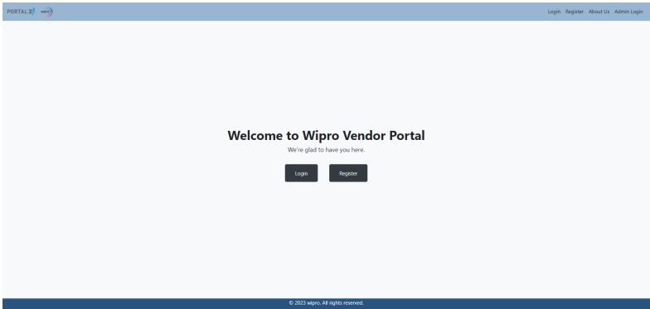
#cant include tool due to company policy

Slide 13
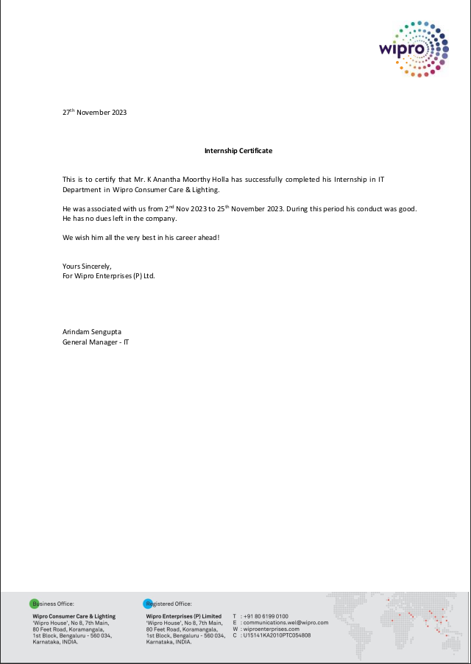
Certification
Here is my internship certificate from Wipro Enterprises.

Slide 14
Conclusion
This internship was a valuable learning experience where I developed technical and professional skills.
I look forward to applying these skills in future projects and career opportunities.
Thank you for your attention. Any questions?

