Slide 1
Smart Fan
By Kabir Anirudh

Slide 2
Motivation
In the current world, we cannot expect when and how the temperature changes, therefore it will be a hectic task to make the fans on and off. There is a need to automate this task i.e, making the fan ON when temperature is high and making it OFF when the temperature is low, so to solve this problem I came up with this idea.

Slide 3
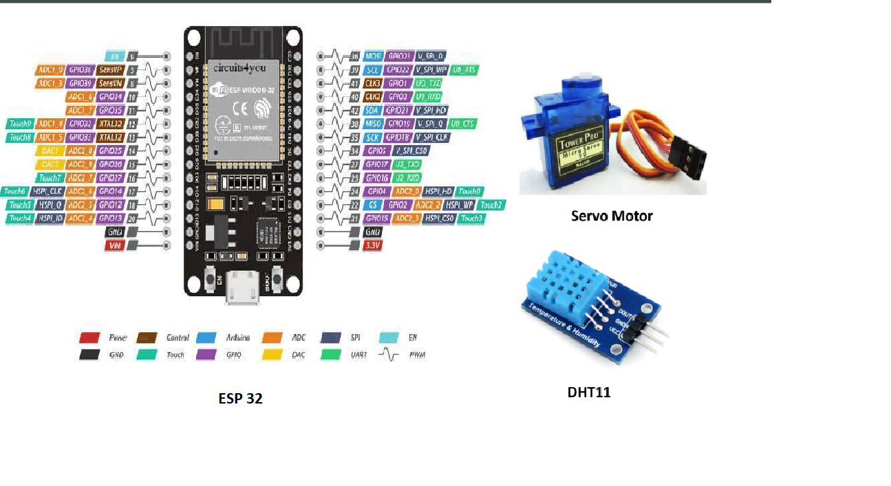
Required Components

Slide 4
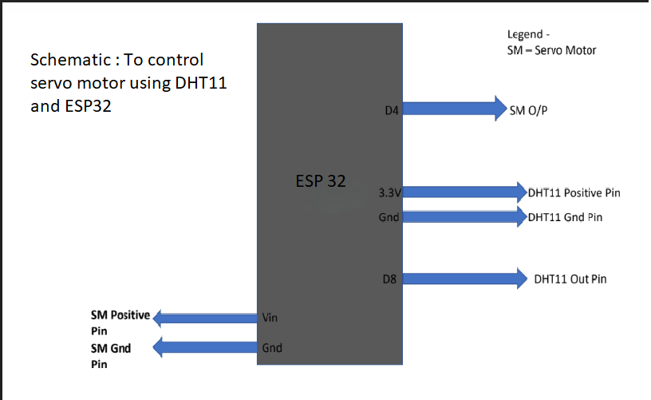
Block Diagram

Slide 5
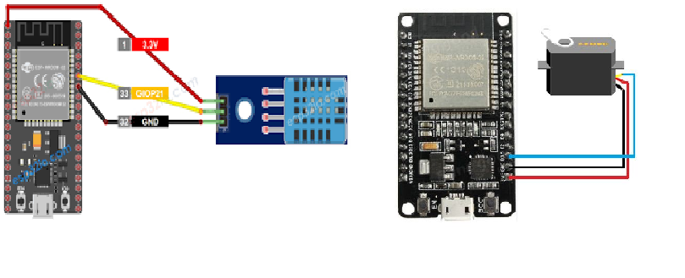
Circuit Diagram
Note: Both DHT11 and Servo Motor will be connected to single ESP32, for clear demonstration I have provided individual circuit diagrams

Slide 6
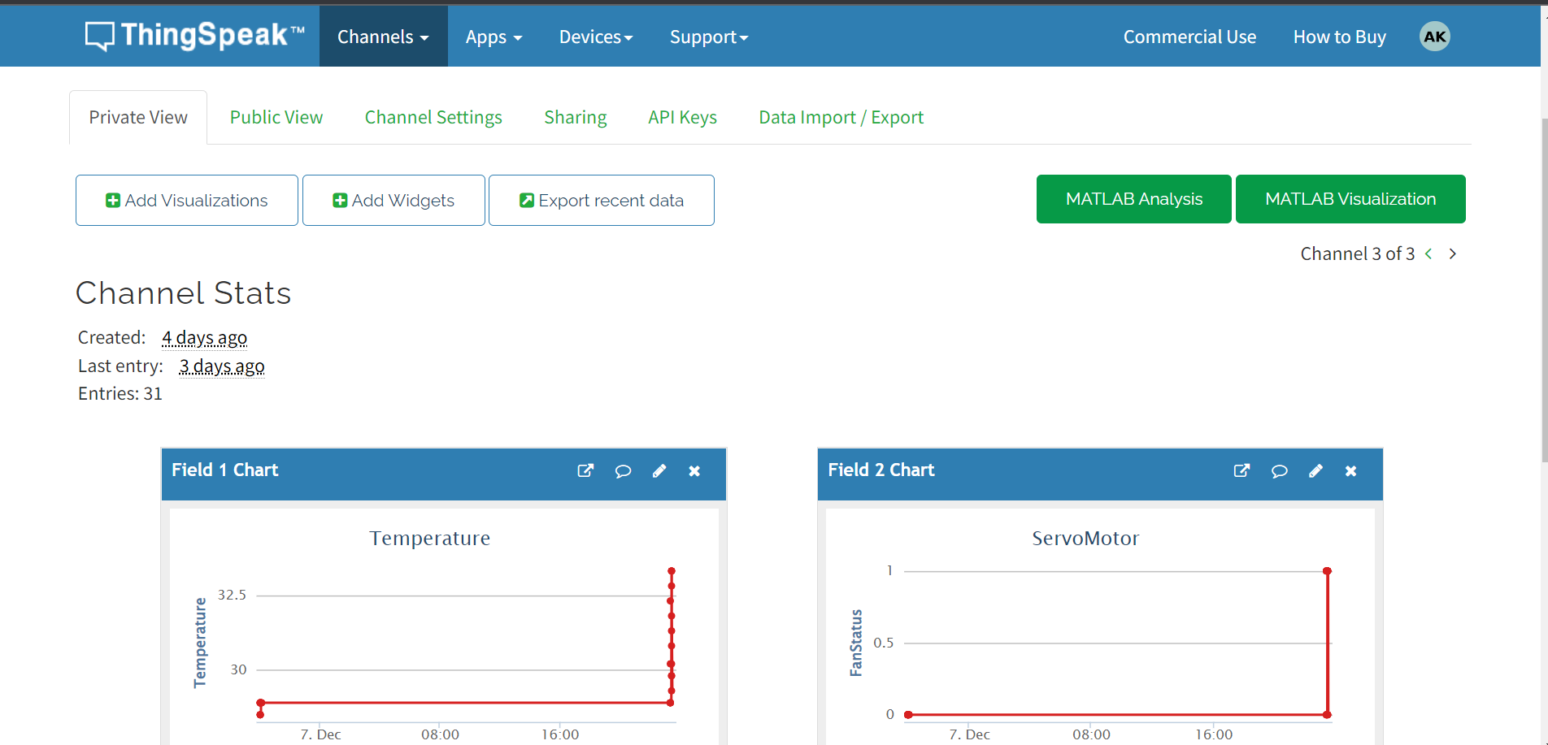
ThingSpeak

Slide 7
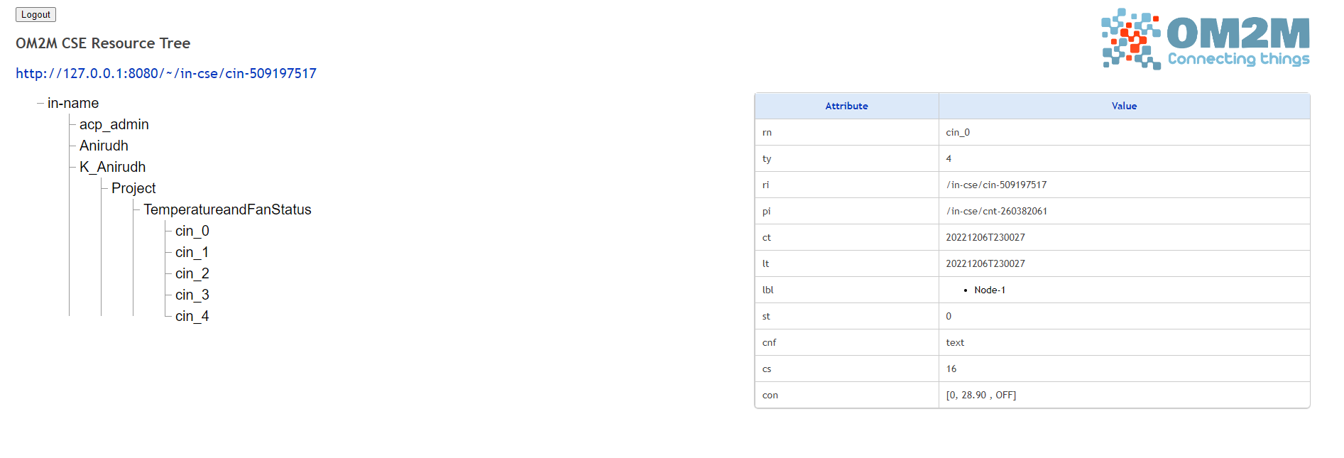
Onem2m resource tree
Each instance of TemperatureandFanStatus is of the form
[test_timestamp, temperature_recorded, status_of_Fan]

Slide 8
Data Validation
If the Value recorded through the DHT11 sensor is greater than 35 degrees there will be change in servo motor position.
Else, there is no change in servo Motor reading.
In the resource tree, Each instance of TemperatureandFanStatus is of the form
[test_timestamp, temperature_recorded, status_of_Fan]
If the temperature_recorded >30 degrees then the status_of_Fan should be ‘ON’
Else, status_of_Fan should be ‘OFF’

Slide 9
How I implemented?
Getting the current temperature from DHT11
If that temperature reading is high, say greater than 30 degrees then rotate the servo motor
Upload the temperature and degrees by which servo motor rotating in Thingspeak.
Upload the temperature and servo motor value in OneM2M resource tree.

Slide 10
Inferences
From the project I came to know the importance of IOT sensors like DHT11 through which we can automate the tasks.
I also came to know the importance of selecting a good processor in order to do the tasks hassle free.
Able to find how to post the data into ThingSpeak server and into onem2m resource tree.
GitHub link
https://github.com/K-Anirudh/IOT_Project_IIITH

Slide 11
Thank you

