Slide 1
Word World
Team- 06
K. Anirudh – 1602-20-737-124
S. Manmateja – 1602-20-737-145
A. Nithin – 1602-20-737-148

Slide 2
Abstract
The main aim of the project is to write a python script which produces platform where the user can test his/her technical skills by playing this game. This can be played by anyone who has basic technical knowledge, this game actually consists of three levels (easy, medium, hard), user should select a level to play the game, depending on the user’s choice the level of questions would be varied, as a part of this game a picture will be displayed and the user have to guess the required word which is asked in that image or the image would be related to that word and the user have to enter that word, user can also enter his answer in the form of voice through the voice option available in the window. If the entered word is correct then 10 points will be added to the player’s score else no points would be awarded.

Slide 3
Action-wise use cases
Player | System
Player details | Takes the player details as input
Select level | Displays menu and prompts the player to choose a level
Answer | Prompts the user to enter the answer
Evaluates | Evaluates the answer provided by the player
Update score | Updates the player score after evaluation
View score | Displays the current score of the player
Voice | Prompts the system to take answer in the form of voice
Next | Displays the next question

Slide 4
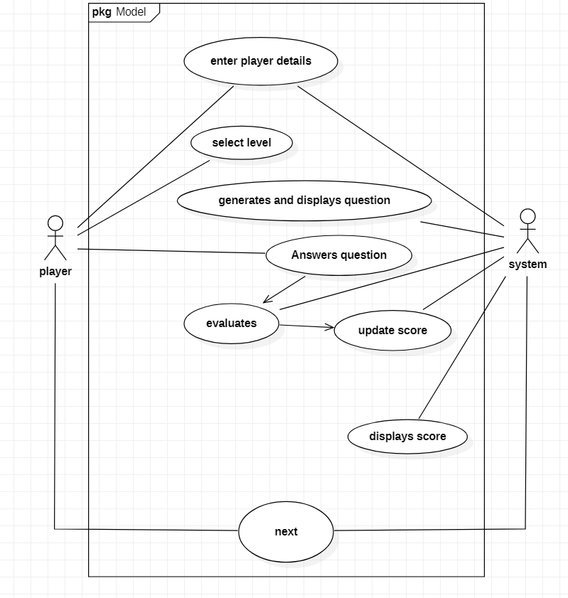
Use case diagram

Slide 5
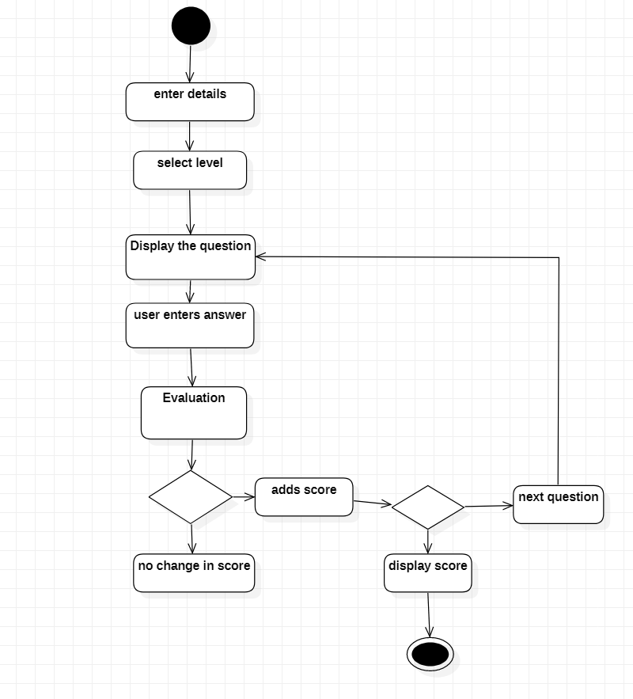
Activity diagram

Slide 6
Technology used
Hardware requirements
Minimum 4 GB of RAM
Core i3 or above versions
Software requirements
Python interpreter
Following libraries are used
Tkinter
PIL
speech_recognition
pyttsx3
time

Slide 7
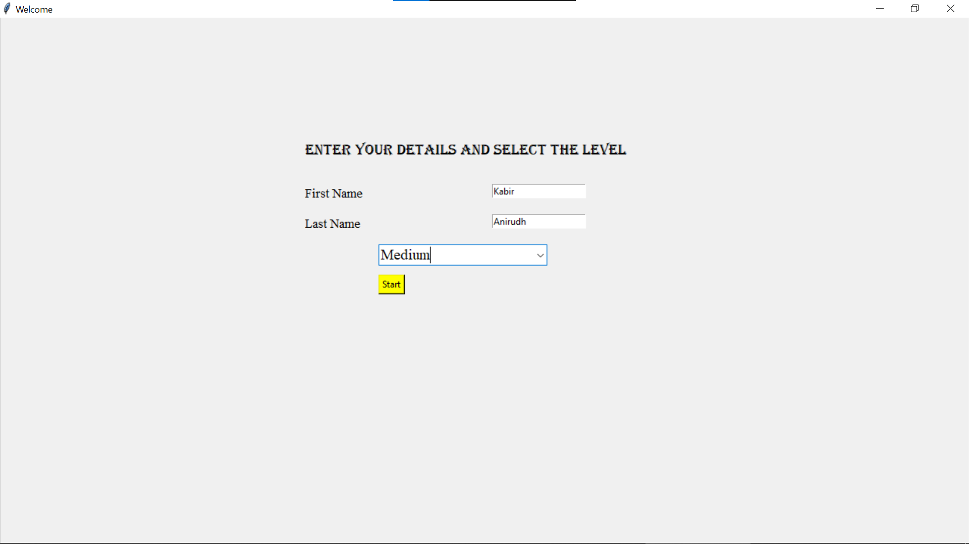
Execution Screenshots
Welcome window

Slide 8
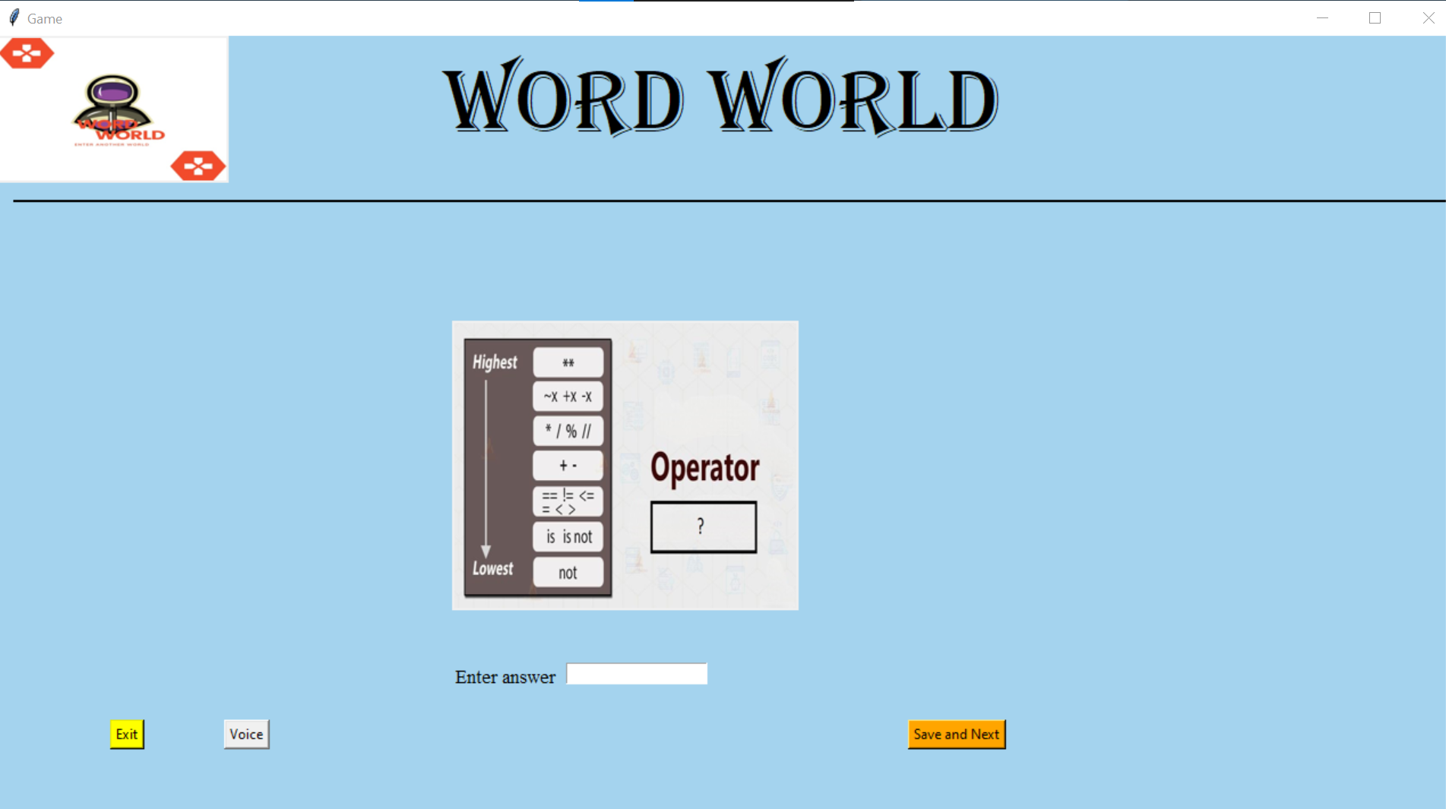
Level implementation ( upon clicking start )

Slide 9
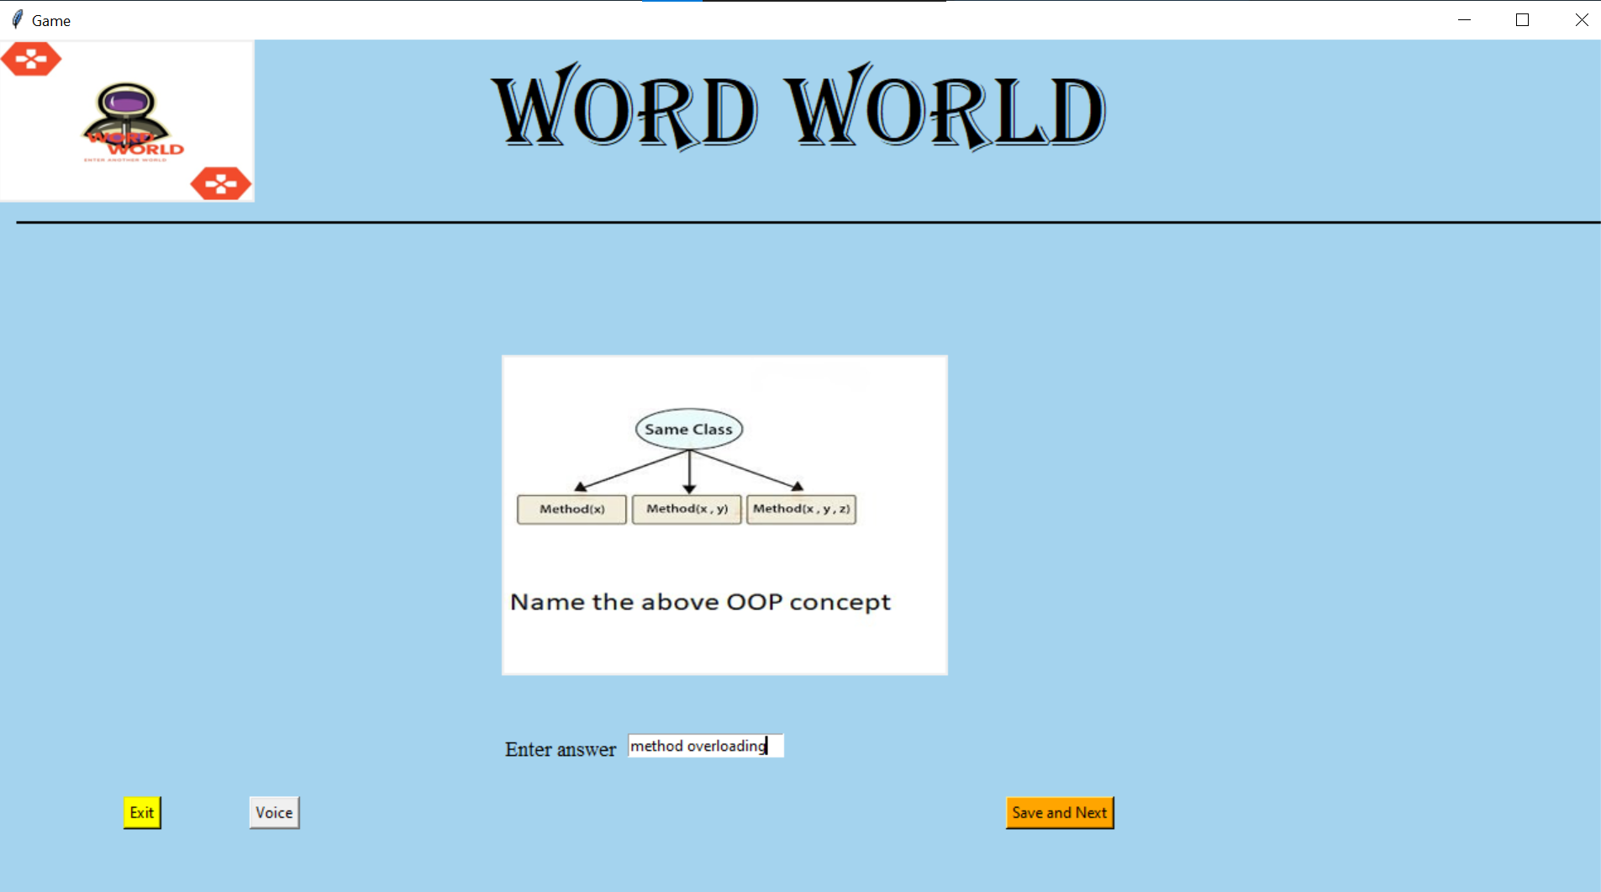
Answering the question in text box

Slide 10
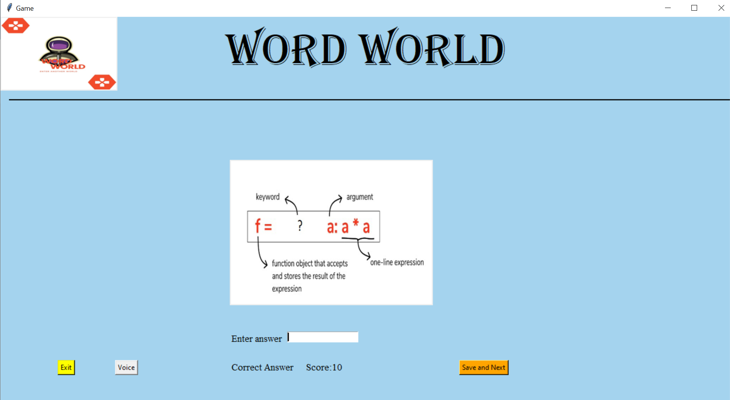
Displaying evaluation result, score and next question upon clicking save and next

Slide 11
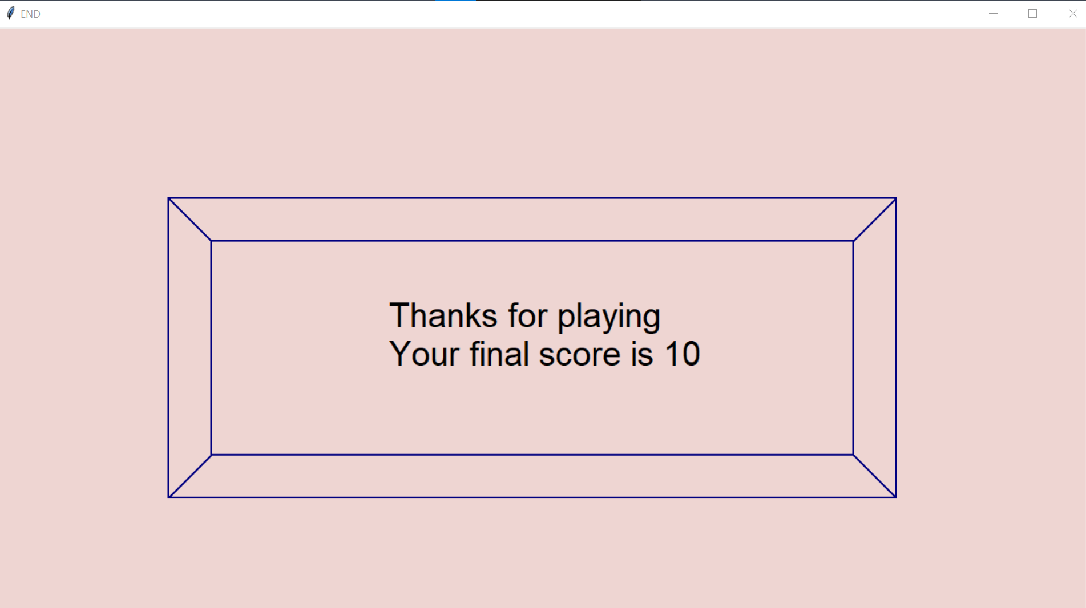
Final window display upon clicking Exit or at the end of game

Slide 12
Conclusion and Future work
Word world is a game which is designed to test one’s skills, this is designed in a way that anyone can use it easily. This game emphasizes on the fact that humans can remember things for longer time when they try to memorize the things in the form of images. This game also emphasizes the saying learning by playing. It took lot of efforts from us to put this project into prominence and learnt many new things during this project.
Future work:
This idea can be further improved by implementing it with an application for various OS and it will be helpful to learn something in an innovative and effective way
This can be extended for online multiplayer by using Sockets/Networking and Pygame
Can be implemented as spell checker

Slide 13
Thank You

