Slide 1
Credit Risk Prediction
Kalla Bharath Vardhan – CT20244449467
Notes:
ID=d924773e-9a16-4d6d-9803-8cb819e99682 Recipe=text_billboard Type=TextOnly Variant=0 FamilyID=AccentBoxWalbaum_Zero

Slide 2

Agenda
Introduction
Why this method?
Methodology
Architecture Diagram
Results and Discussion
Challenges and Resolutions
Conclusion

Slide 3
Introduction
Financial institutions need reliable credit risk assessment to identify how likely their borrowers will fail to meet loan payments. The proposed system employs unsupervised learning through GMM to group and evaluate credit data of customers. The goal is to understand the discrimination power between good and bad credit profiles through dataset simulation using GMM alongside other clustering methods.

Slide 4
Why this method?
Gaussian Mixture Models function effectively at discovering concealed patterns when data lacks proper labeling or has restricted information availability. Unlike K-Means which works with spherical clusters of equivalent dimensions GMM supports elliptical clusters and represents data through multiple Gaussian distribution mixtures. Its flexible nature makes GMM appropriate for modeling various real-world credit behaviors since customer financial profiles do not require perfect cluster homogeneity.

Slide 5
Methodology
1. Data Preprocessing: The missing values in dataset within the categorical columns like Checking, Savings accounts were replaced to maintain consistency. Performed Label Encoding on categorical columns to convert categorical values into numerical values for extra efficiency with Machine Learning algorithms. 2. Feature Scaling and Dimensionality Reduction: All features were standardized using “StandardScaler”, to normalize the input values into a common scale. Principal Component Analysis(PCA) is used to reduce dimensionality and noise, which retained 95% variance, ensuring more efficient clustering and improving performance.

Slide 6
Methodology
3. Clustering with Gaussian Mixture Model(GMM, n=2): GMM was applied with two components, “good” and “bad” credits. It basically a probabilistic clustering method in which the data is assumed to be generated from a mixture of Gaussians. The cluster labels were aligned with the simulated ground truth using a precision-based label alignment function.

Slide 7
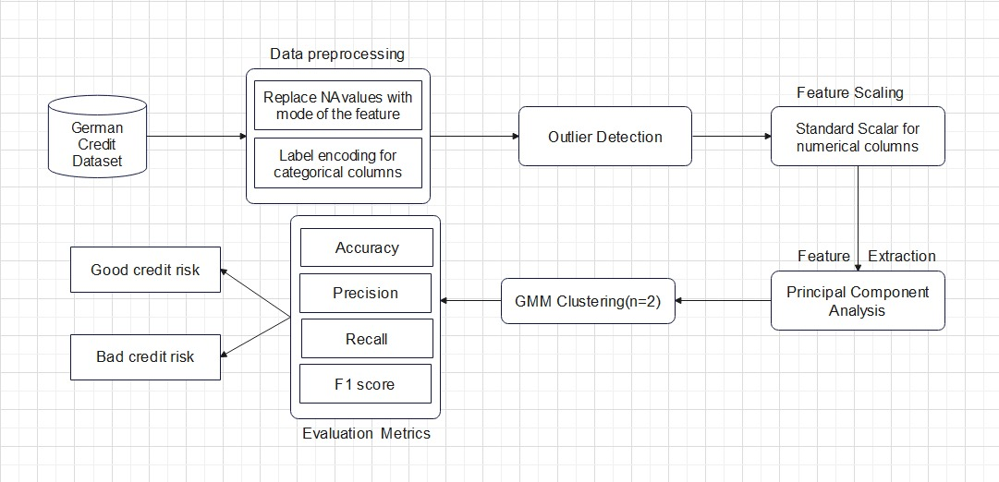
Architecture Diagram

Slide 8
Results and Discussion
Performance Metrics | Values
Accuracy | 83.6%
Precision | 68.72%
Recall | 65.49%
F1-Score | 67.07%

Slide 9
Results and Discussion
These metrics helps us to know the performance of GMM model despite the unsupervised learning. The alignment function ensures that even if the cluster labels were flipped, we can evaluate the meaningfully. The above metrics shows that GMM could reasonably capture credit risk patterns using the given features and PCA space.

Slide 10
Challenges and Resolutions
1. The dataset did not include explicit “good credit” or “bad credit” labels – To resolve, created simulated labels using a domain-inspired heuristic—customers with high loan amounts and long durations are more likely to default. 2. Many features could introduce noise and reduce clustering efficiency – To resolve, applied PCA to retain key information while reducing dimensionality. 3. Categorical variables can’t be directly used in clustering – To resolve, applied label encoding to convert them into numeric representations.

Slide 11
Conclusion
The project shows that unsupervised learning through Gaussian Mixture Models provides effective credit risk analysis when only unlabeled information is available. Through domain-related label simulation techniques and proper data preprocessing we reached meaningful evaluation of clustered data. GMM provides valuable pattern and profile group detection in a data-oriented and flexible fashion without replacing fully supervised methods.

Slide 12




Thank you
Kalla Bharath Vardhan – CT20244449467
bharathvardhankalla@gmail.com
https://tcs-hackathon-kbv.onrender.com/

