Slide 1
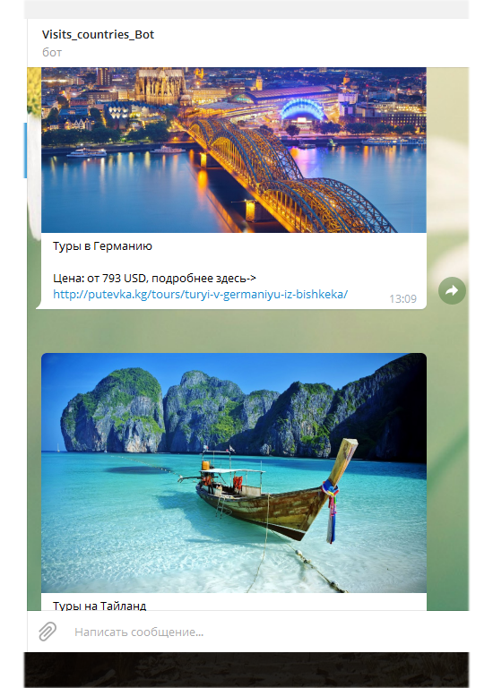
Let-s-visit_other_countries
Azatbek Ilichbekov;

Slide 2
Used Libraries
pyTelegramBotAPI
Telebot
-It can be added by command: pip install pyTelegramBotAPI pip install telebot

Slide 3
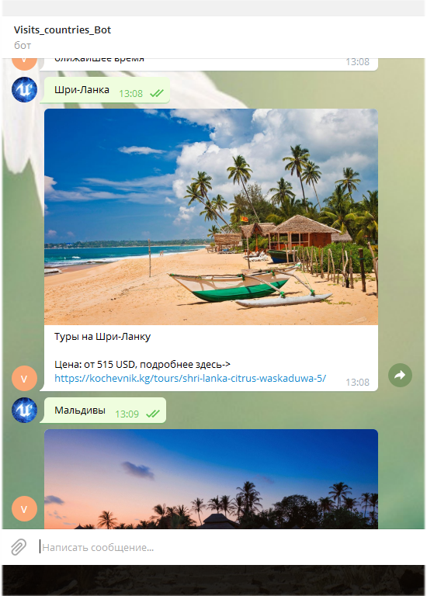
What can do this bot?
This bot can demonstrates
the vouchers with
profitable prices.
Shows for clients the
image of those countries
and prices with the links.
Main job of this bot is to
show the way for countries
with vouchers.

