Slide 1
Let-s-visit_other_countries bot Azatbek Ilichbekov Erlan Kerimbekov
Notes:
Оригинальные шаблоны для презентаций: https://presentation-creation.ru/powerpoint-templates.html
Бесплатно и без регистрации.

Slide 2

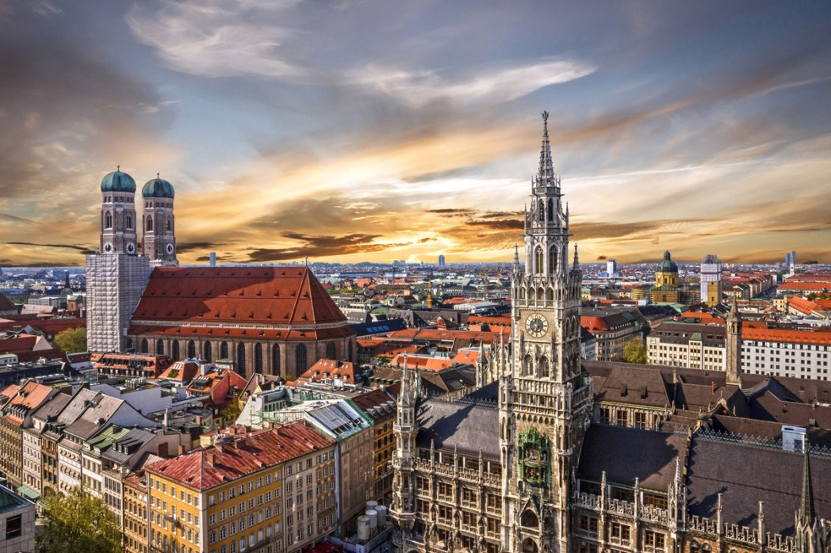
Used libraries
pyTelegramBotAPI
Telebot
-It can be added by command: -pip install pyTelegramBotAPI
-pip install telebot

Slide 3
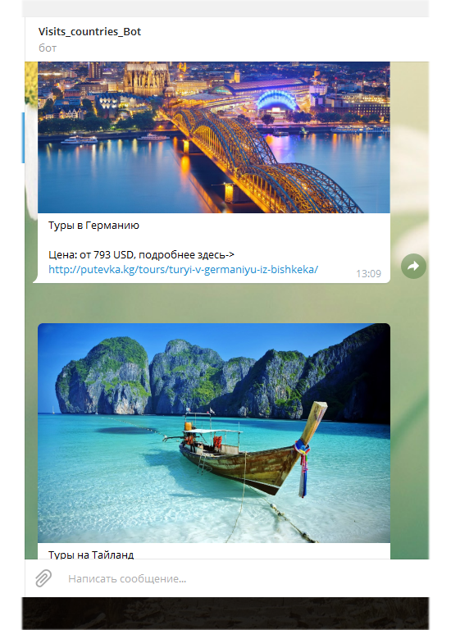
What can do this bot?
This bot can demonstrates
the vouchers with
profitable prices.
Shows for clients the
image of those countries
and prices with the links.
Main job of this bot is to
show the way for countries
with vouchers.

Slide 4
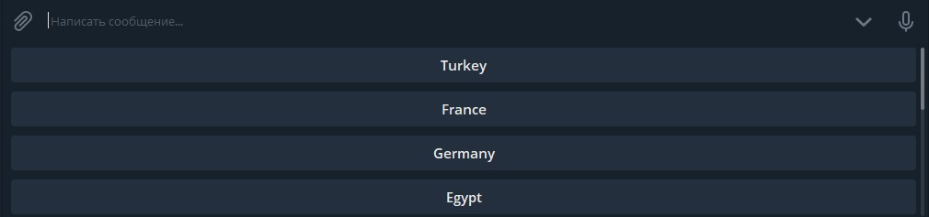
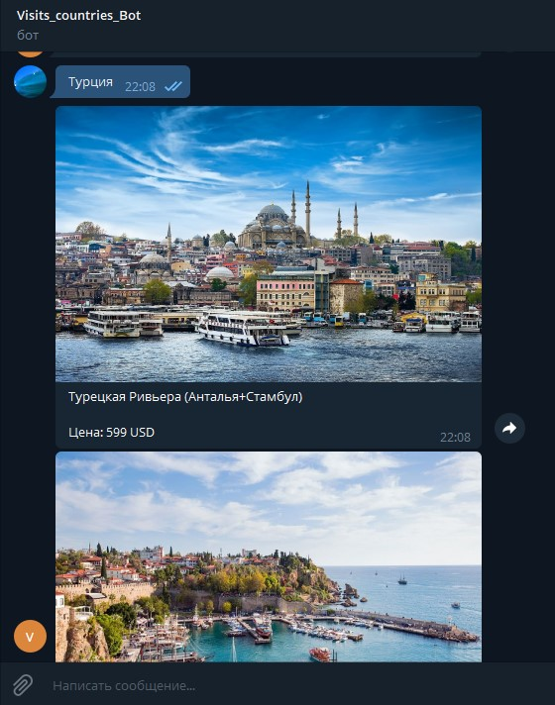
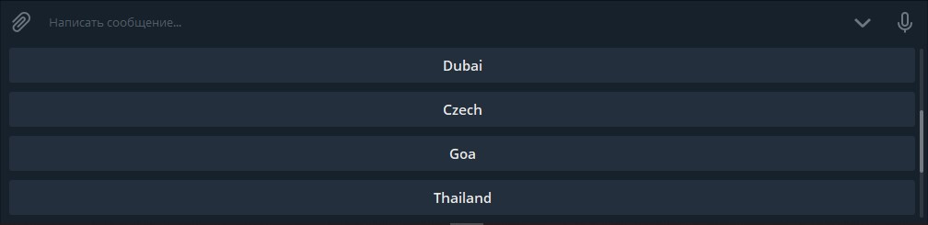
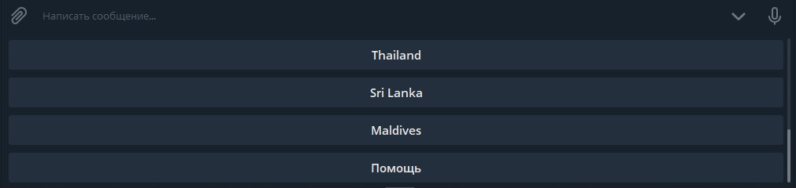
It can suggest you to travel to 10 different countries

Slide 5
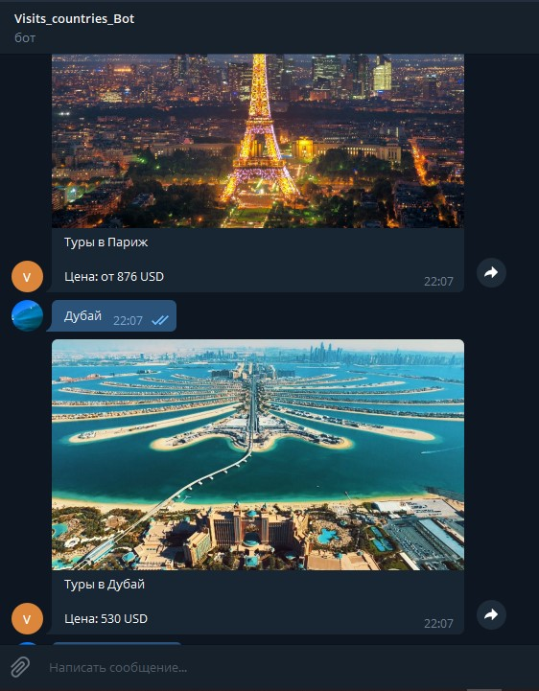
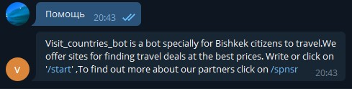
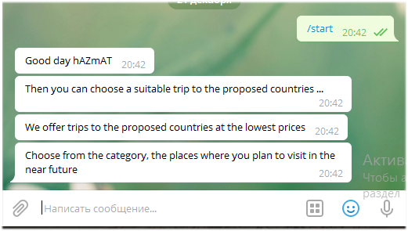
It sorts websites and helps to suggest the best country and hotel

