Slide 1
MLP vs SVM from Problem 6
Team Name: Mic Van Van
Member: Kazuki Fujita
Kaito Ogino
Haruki Maeda

Slide 2
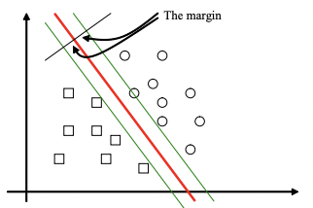
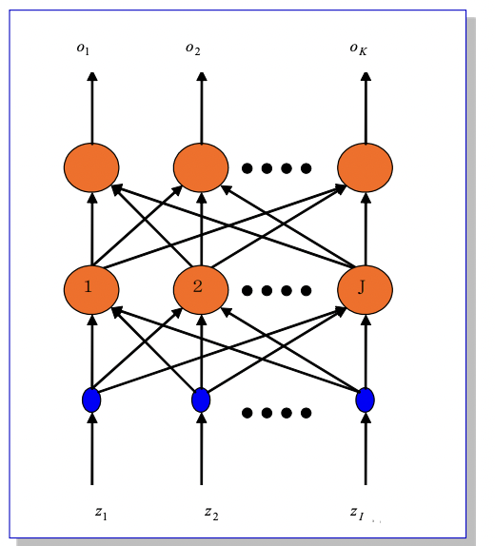
What is SVM?
SVM(Support Vector Machine):
Algorithm for pattern classification
Proposed by V. Vapnik at AT&A in 1995
The important feature of SVM is to make decisions with the maximum margin.
MLP(Multi Layer Perceptron):
This network is a three layer perceptron, also called three layer feed forward neural network.
Best Border

Slide 3
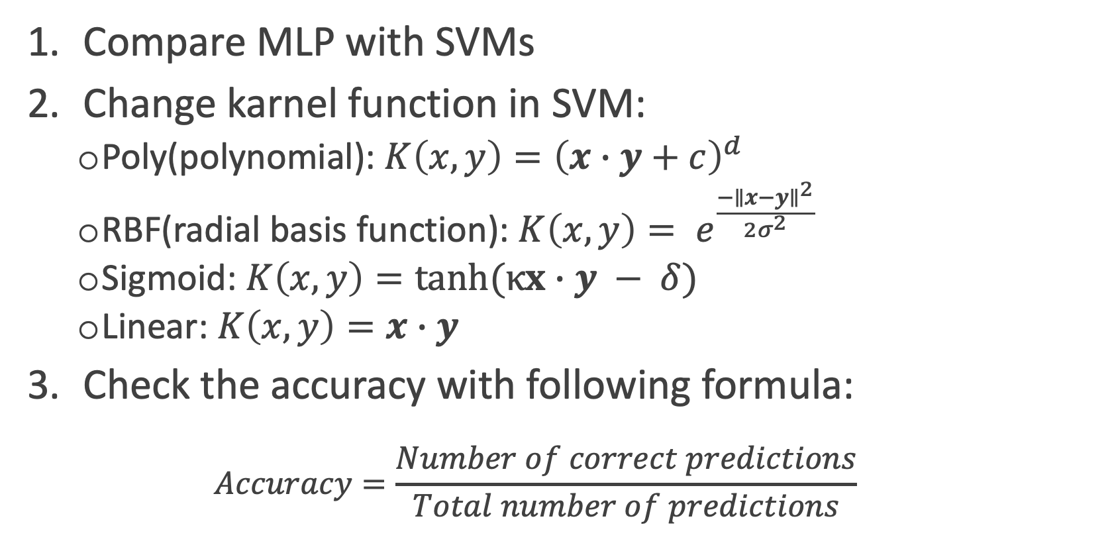
Experiments
Procedure:
Compare MLP with SVMs
Change karnel function in SVM:
Poly(polynomial): ${K\left(x,y\right)=\left(x∙y+c\right)}^{d}$
RBF(radial basis function): $K\left(x,y\right)= e^{\frac{{−∥x−y∥}^{2}}{2σ^{2}}}$
Sigmoid: $K\left(x,y\right)=tanh(κx∙y − δ)$
Linear: $K\left(x,y\right)=x∙y$
Check the accuracy with following formula:
$$Accuracy=\frac{Number of correct predictions}{Total number of predictions}$$

Slide 4
Hyper Parameter in MLP
Hyper parameters:
MLP: hidden layer size, other is default setting of scikit-learn
SVM: default setting of scikit-learn
Evaluate hidden layer size:
Parameter set: [3, 5, 7, 10, 100]
ここに各値の結果の表とかを載せる

Slide 5
Data Sets
From UCI machine learning repository:
Iris Data Set
Wine Data Set
Breast Cancer Wisconsin Data Set
Optical Recognition of Handwritten Digits Data Set
Number of classes, Number of instances in Train and Test split in each datasets

Slide 6
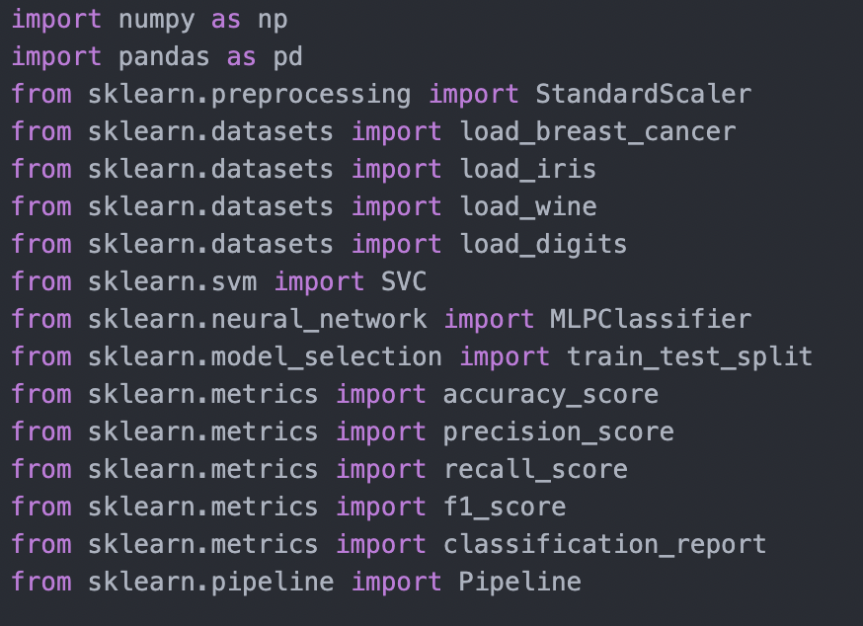
Tools
Programing Language:
Python 3.9.9
Scikit-learn:
Python package for machine learning
This pachage produces modules to establish and to evaluate SVM and MLP.
Modules of sklearn which were used in the experiment

Slide 7
Results

Slide 8
discussion

Slide 9
Conclusion

