Slide 1
Team 11 Final Project MLP vs SVM from Project 6
We do not have
much time!!!!
Member
m5261108 Kazuki Fujita m5261110 Mizuki Goto
m5261132 Kaito Ogino m5261147 Haruki Maeda

Slide 2
Past Activities
We decided a leader for each Project to divide the amount of Tasks.
We did our self-assessment in Table 2.
Project number | Leader of the project | Report author
Project 1 | Kazuki Fujita | Kazuki Fujita
Project 2 | Kaito Ogino | Kaito Ogino
Project 3 | Haruki Maeda | Haruki Maeda
Project 4 | Mizuki Goto | Mizuki Goto (Bonus: Kazuki Fujita)
Project 5 | Kazuki Fujita | Kazuki Fujita
Project 6 | Kaito Ogino Haruki Maeda | Kaito Ogino Haruki Maeda
Member | Rate
m5261108 Kazuki Fujita | 30%
m5261110 Mizuki Goto | 10%
m5261108 Kaito Ogino | 30%
m5261108 Haruki Maeda | 30%
Table 2: Team contribution rate (total: 100%)
Table 1: Task assignment list

Slide 3
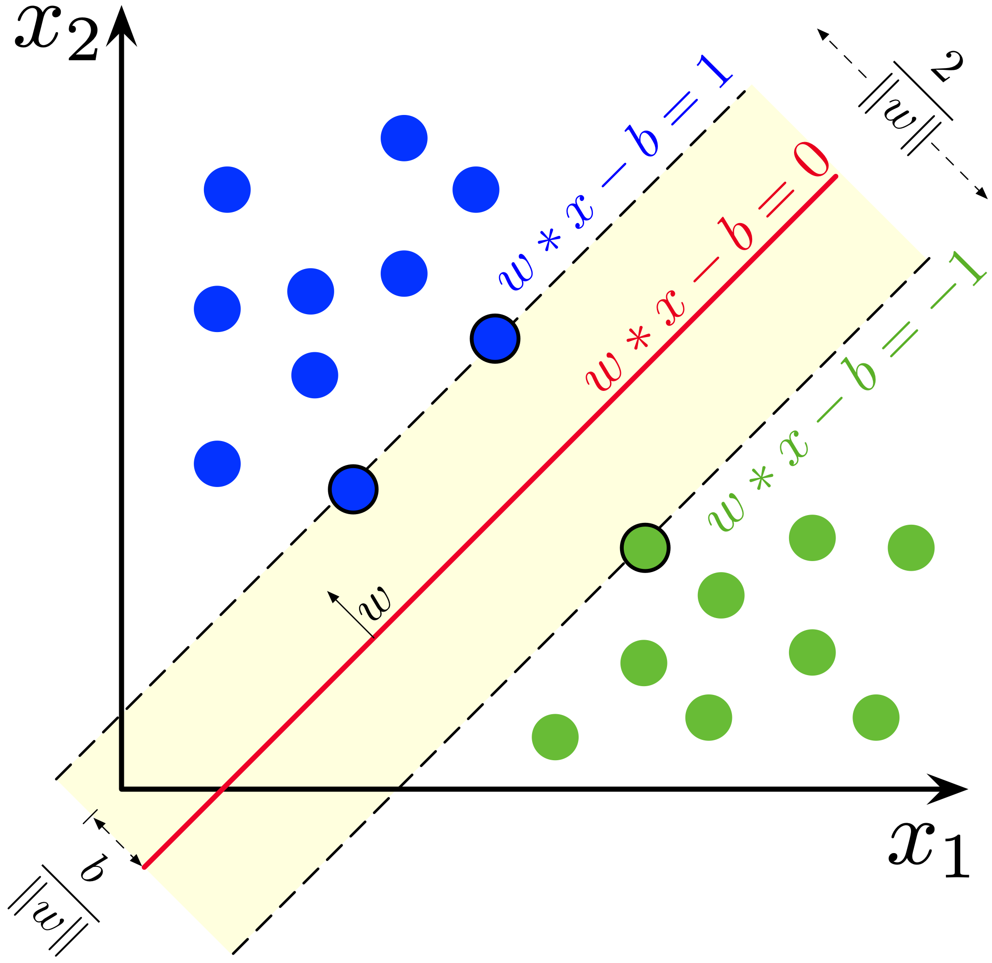
Introduction: Support Vector Machine
SVM(Support Vector Machine)
A supervised learning model with an algorithm for pattern classification [1]
It select a hyperplane so that the distance from it to the nearest data point on each side is maximized.
Figure 1: Maximum margin hyperplanes and margins for SVMs trained on a 2-class sample. [2]
[1] Cortes, Corinna, and Vladimir Vapnik. "Support-vector networks." Machine learning 20.3 (1995): 273-297.
[2] Wikipedia. “Support-vector machine” https://commons.wikimedia.org/wiki/File:SVM_margin.png

Slide 4
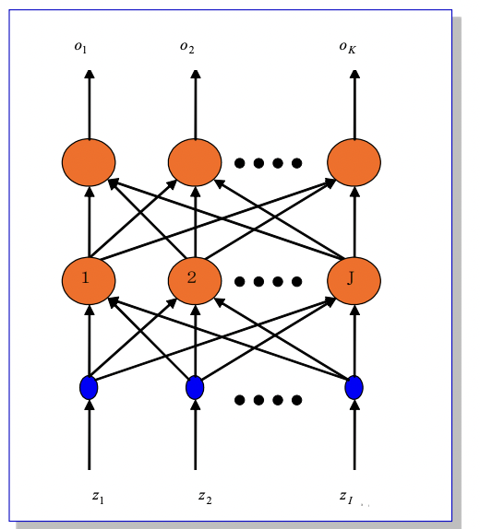
Introduction: Multilayer Perceptron
Multilayer Perceptron (MLP)
A fully connected class of feedforward artificial neural network (ANN)
It consists of at least three layers of nodes: an input layer, a hidden layer and an output layer.
It utilizes a supervised learning technique called backpropagation for training.
Figure 1: Network structure of MLP

Slide 5
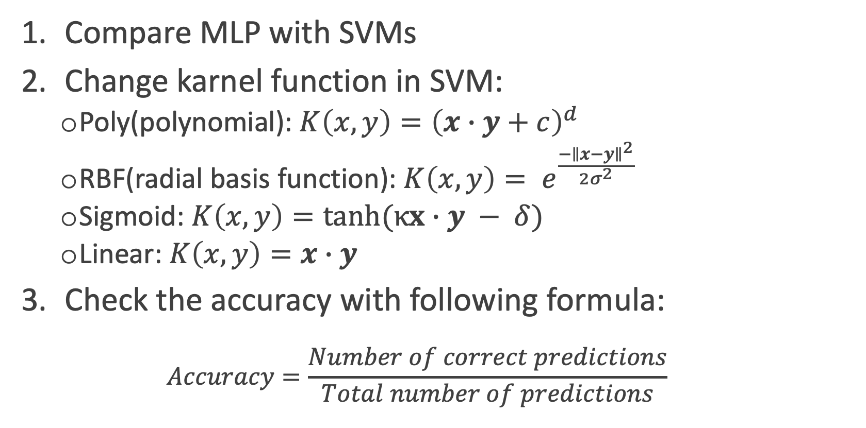
Experiments
Procedure:
Compare MLP with SVMs
Change karnel function in SVM:
Poly(polynomial): ${K\left(x,y\right)=\left(x∙y+c\right)}^{d}$
RBF(radial basis function): $K\left(x,y\right)= e^{\frac{{−∥x−y∥}^{2}}{2σ^{2}}}$
Sigmoid: $K\left(x,y\right)=tanh(κx∙y − δ)$
Linear: $K\left(x,y\right)=x∙y$
Check the accuracy with following formula:
$$Accuracy=\frac{Number of correct predictions}{Total number of predictions}$$

Slide 6
Data Sets
From UCI machine learning repository:
Iris Data Set
Wine Data Set
Breast Cancer Wisconsin Data Set
Optical Recognition of Handwritten Digits Data Set
Table 3: Number of classes, Number of instances in Train and Test split in each datasets

Slide 7
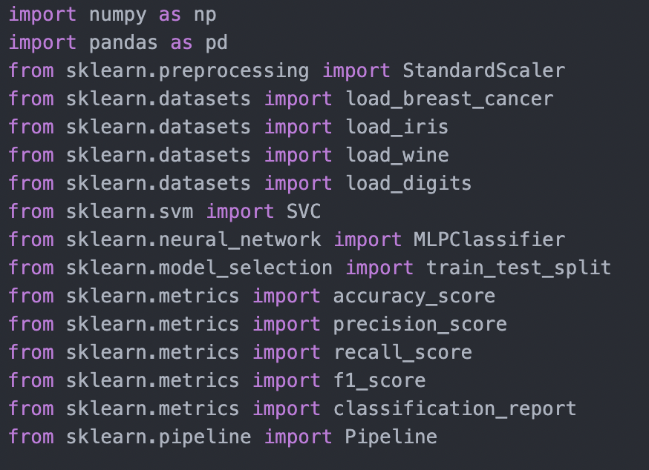
Tools
Programing Language:
Python 3.9.9
Scikit-learn:
Python package for machine learning
This pachage produces modules to establish and to evaluate SVM and MLP.
Figure 1: Modules of sklearn which were used in the experiment

Slide 8
Hyper Parameter in MLP
Setting Hyper parameters:
SVM: default setting of scikit-learn
MLP: hidden layer size, other is default setting of scikit-learn
Evaluate hidden layer size:
Parameter set: [3, 5, 7, 10, 100]
The average of accuracy if hidden layer size set 10 was the best score.
So, hidden layer size in experiment was defined 10.
Table 4: Evaluate hidden layer size
Notes:
Next, we explain Hyper Parameter in MLP.
Hyper parameters of SVM are default setting of scikit-learn, while them of MLP are original hidden layer size and default setting of others,
We calculate accuracy of MLP if hidden layer size is 3, 5, 7, 10 and 100. this table is that result.
From this table, we found the average of accuracy if hidden layer size set 10 was the best score.
So, So, hidden layer size in experiment was defined 10.

Slide 9
Results
Result 1: Results for each dataset
Notes:
結果から、
MLPが時間かかる
RBFが他のカーネル関数よりもデータセットによらず安定して高いAccuracyのスコアを出している。
Next, we explain results of the experiments of SVMs and MLP each datasets.
The results show 2 views.
First, MLP’s time is about 100 times against SVMs.
Second, RBF scores consistently high not depend datasets than other kernel functions.

Slide 10
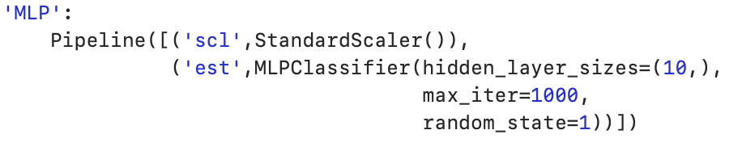
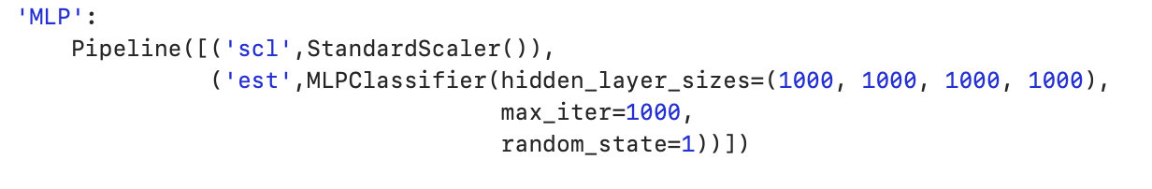
Discussion
MLP takes time more than SVMs. However, the accuracy of SVMs are little higher than MLP’s.
We consider if we implement with more neurons and layers, we will get higher MLP’s accuracy.
Number of hidden layer: 1 -> 4
Each hidden layer size: 10 -> 1000
Figure 1: Increase in hidden layers
Notes:
RBFが安定してるとれざるとでいう

Slide 11
Result of the changes
The more neurons and layers we used, the higher accuracy we got.
MLP takes huger time than before the changes, but there are no differences between RBF performance and MLP one.
Result 2: Comparison before and after increasing the hidden layer
Notes:
RBFと比較した

Slide 12
Conclusion
SVM achieved similar performance with less time than MLP.
We couldn’t optimize hyperparameters (number of hidden layers and each hidden layer size) of MLP and SVM.
If we do that, we will be able to get better performance (accuracy and run time).

Slide 13
Thank you

