Slide 1

Determining Ancestry using data from the 1000 Genomes project
Violet Bui, Elizabeth Dashwood, Mark Peck, & Katrina Witt

Slide 2
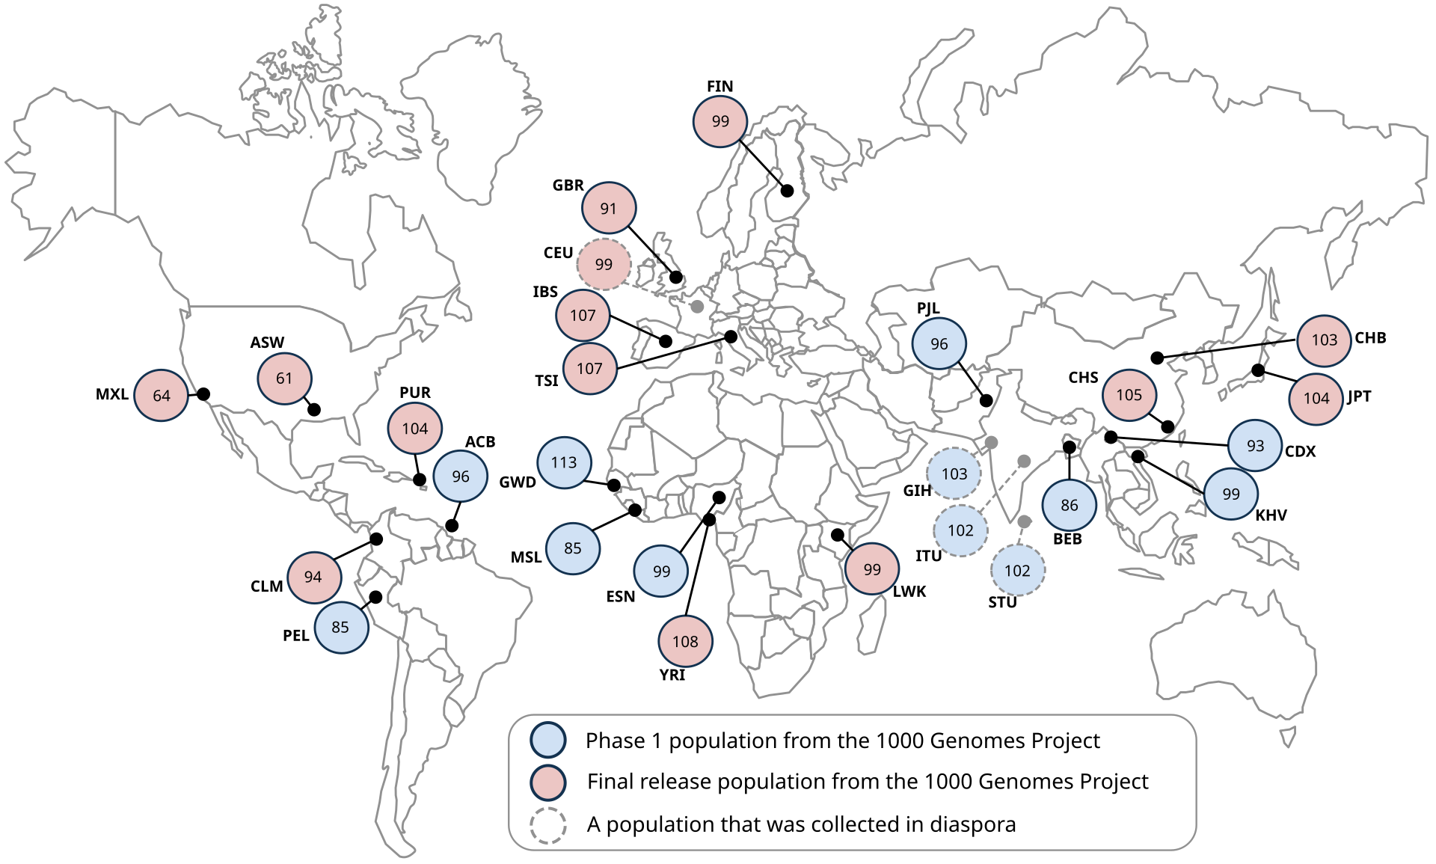
Data source: 1000 genomes project
Between 2008 and 2015, the 1000 Genomes Project Consortium brought together researchers from 8 countries worldwide (China, Italy, Japan, Kenya, Nigeria, Peru, UK, USA)
Create a catalogue of human genetic variations in different populations
Identify individual Single Nucleotide Polymorphisms (SNPs) driving these variations, inc. variations by ancestry
Data collection occurred over 4 key phases:
Pilot: 697 persons from 7 populations
Phase 1: 1092 persons from 14 populations
Phase 2: 2504 persons from 26 populations
Phase 3: several new genes sequenced
Final dataset: 2,504 persons from 26 populations

Slide 3









Data processing pipeline:
Ingestion
AWS S3
.csv files
Storage
Pandas
Preprocessing
TensorFlow – One Hot Encoding
Transformation
hv plot
Training
TensorFlow
Scikit-learn
Keras-tuner
Evaluation
Scikit-learn –
Confusion matrix
Classification report
Deployment
Scikit-learn –
Visualisation
Tableau
OS Module
Scikit-learn
Confusion matrix
Classification report

Slide 4
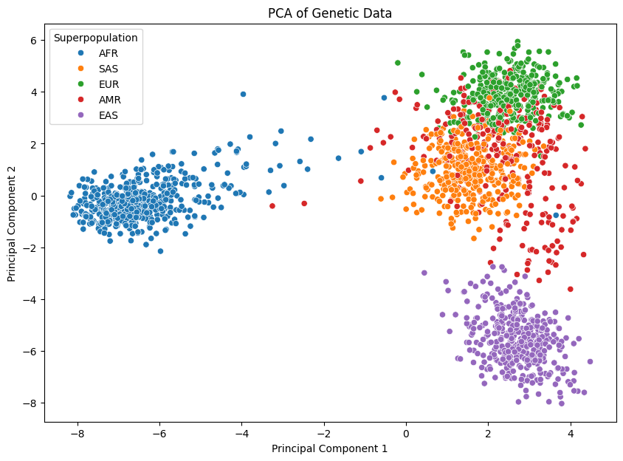
Results: pca
Two principal components clearly distinguished African and East Asian ancestry groups
Unsurprisingly, high degree of overlap between European, American, & South American ancestry groups
Suggests need for more complex classification methods to distinguish these

Slide 5
Results: Neural network
Target variable (i.e., ancestry superpopulation) represents a categorical outcome with 5 classes:
New package: tensorflow.keras.utils import to_categorical()
New activation function: ‘softmax’
New loss function: ‘categorical_crossentropy’

