Slide 1
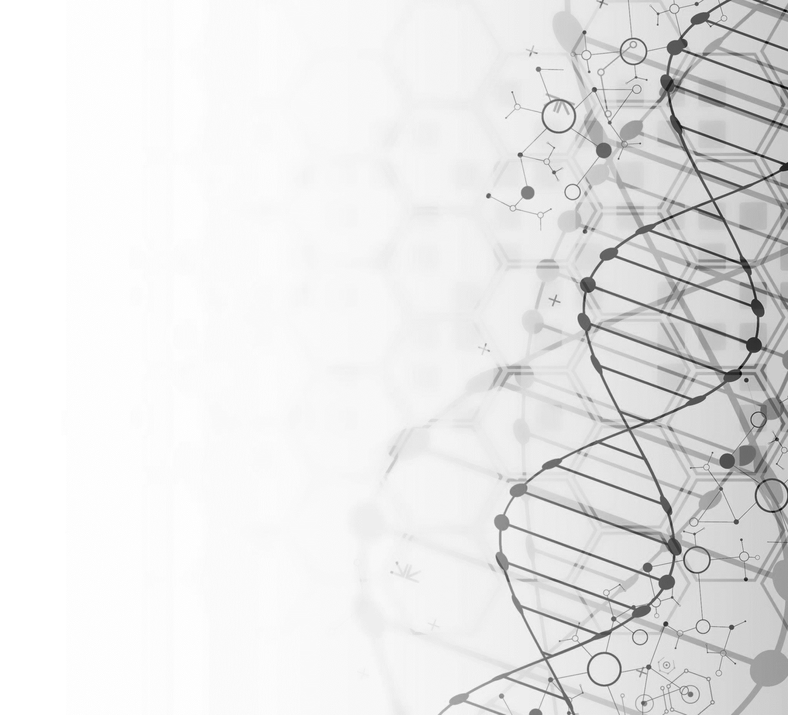
Determining Ancestry using data from the 1000 Genomes project
Violet Bui, Elizabeth Dashwood, Mark Peck, & Katrina Witt

