Slide 1

Determining Ancestry using data from the 1000 Genomes project
Violet Bui, Elizabeth Dashwood, Mark Peck, & Katrina Witt

Slide 2
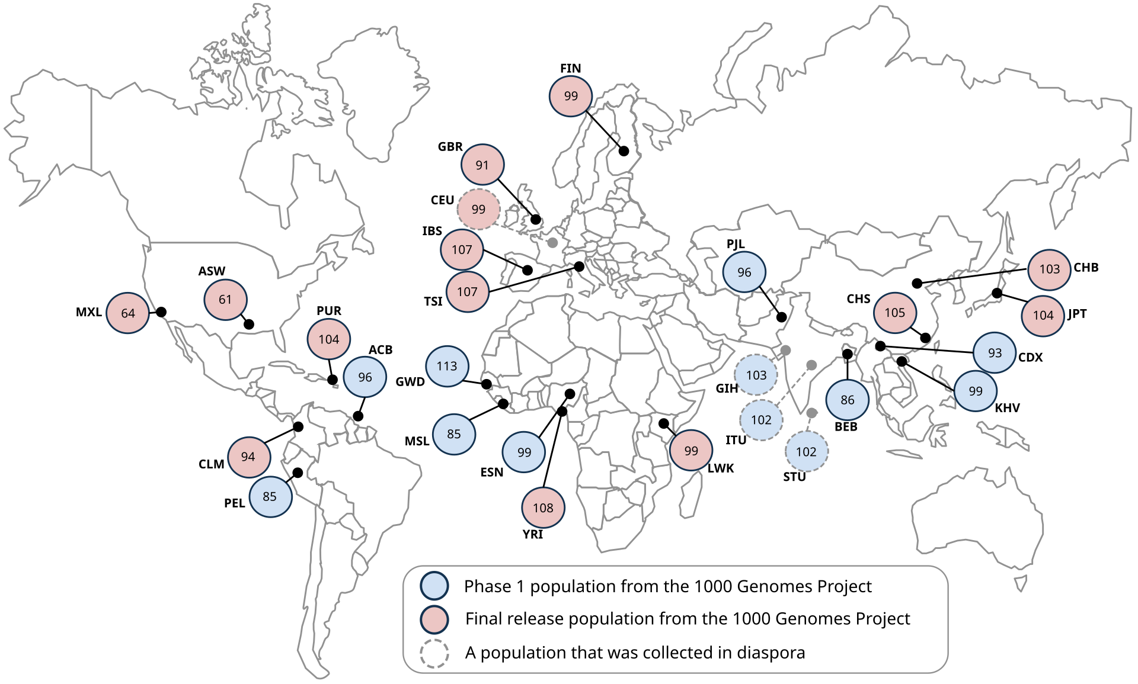
Data source: 1000 genomes project
Between 2008 and 2015, the 1000 Genomes Project Consortium brought together researchers from 8 countries worldwide (China, Italy, Japan, Kenya, Nigeria, Peru, UK, USA)
Create a catalogue of human genetic variations in different populations
Identify individual Single Nucleotide Polymorphisms (SNPs) driving these variations, inc. variations by ancestry
Data collection occurred over 4 key phases:
Pilot: 697 persons from 7 populations
Phase 1: 1092 persons from 14 populations
Phase 2: 2504 persons from 26 populations
Phase 3: several new genes sequenced
Final dataset: 2,504 persons from 26 populations

Slide 3










Data processing pipeline:
Ingestion
AWS S3
.csv files
Storage
Pandas
Preprocessing
TensorFlow – One Hot Encoding
Transformation
hv plot
Training
TensorFlow
Scikit-learn
Keras-tuner prince
Evaluation
Scikit-learn –
Confusion matrix
Classification report
Deployment
Scikit-learn –
Visualisation
Tableau
OS Module
Scikit-learn
Confusion matrix
Classification report

Slide 4
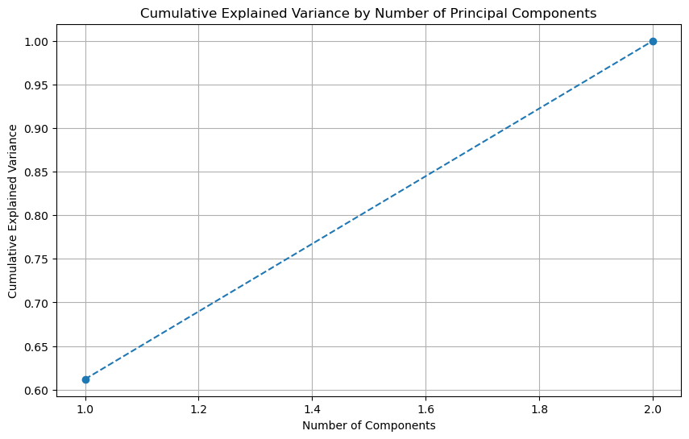
Results: MCA
SNIPs categorised according to standard mapping (from dbSNP):
AA or CC: reference/reference
AT or CG: reference/alternate
TT or GG: alternate/alternate
MCA implemented using prince package
Cumulative explained variance:
Component 1: 0.61
Component 2: 1.00

Slide 5
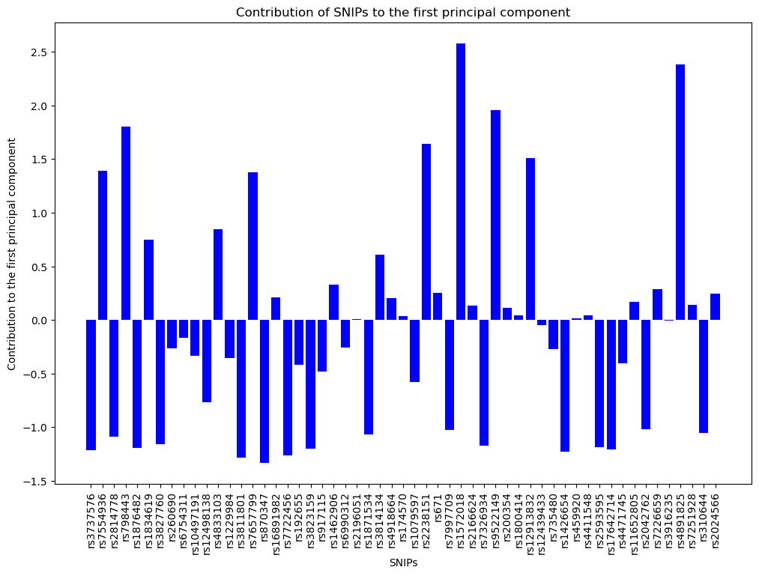
first component:
Mental illness risk:
rs798443: COMT gene, risk of mental illness, esp. risk of schizophrenia
rs9511149: stress response
Diabetes & CVD risk:
rs4833103: insulin sensitivity
rs7657799: reg of blood pressure
rs2238151: reg of glucose
rs4891825: CVD risk
Physical features:
rs12913832: eye colour, esp. determination of brown vs. blue

Slide 6
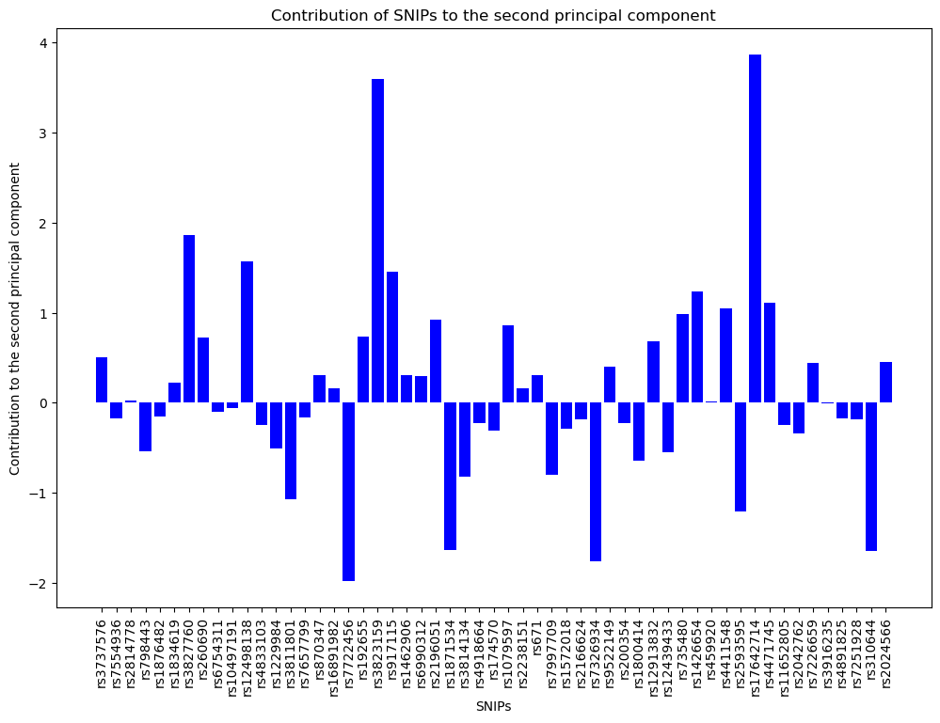
second component:
Cancer risk:
rs3813159: how the body responds to inflammatory signals
rs917115: cell growth in relation to hormone signalling
rs17642714: cell growth regulation
rs7722456: cancer metastasis
Obesity:
rs10644: reg of energy & fat storage

Slide 7
Results: Neural network
Target variable (i.e., ancestry superpopulation) represents a categorical outcome with 5 classes:
New package: tensorflow.keras.utils import to_categorical()
New activation function: ‘softmax’
New loss function: ‘categorical_crossentropy’

