Slide 1

Determining Ancestry using data from the 1000 Genomes project
Violet Bui, Elizabeth Dashwood, Mark Peck, & Katrina Witt

Slide 2
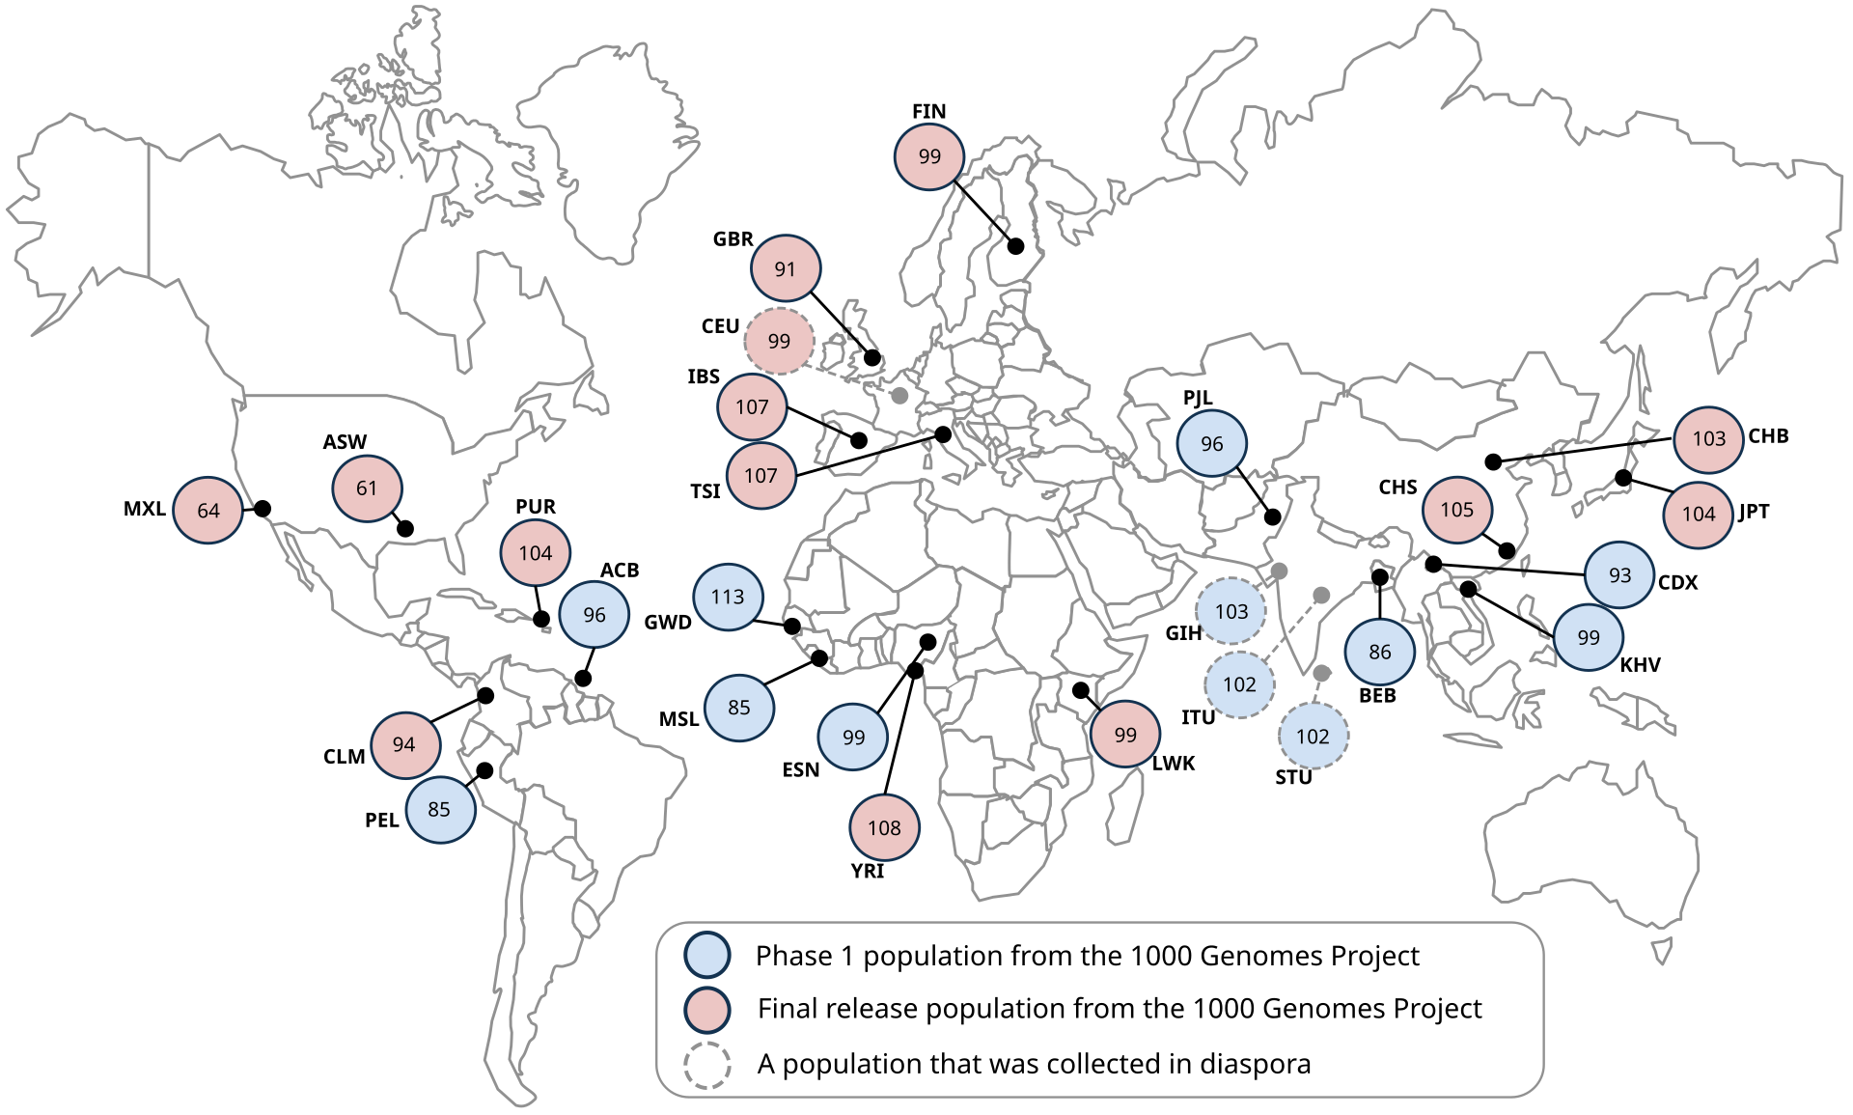
Data source: 1000 genomes project
Between 2008 and 2015, the 1000 Genomes Project Consortium brought together researchers from 8 countries worldwide (China, Italy, Japan, Kenya, Nigeria, Peru, UK, USA)
Create a catalogue of human genetic variations in different populations
Identify individual Single Nucleotide Polymorphisms (SNPs) driving these variations, inc. variations by ancestry
Data collection occurred over 4 key phases:
Pilot: 697 persons from 7 populations
Phase 1: 1092 persons from 14 populations
Phase 2: 2504 persons from 26 populations
Phase 3: several new genes sequenced
Final dataset: 2,504 persons from 26 populations

Slide 3










Data processing pipeline:
Ingestion
AWS S3
.csv files
Storage
Pandas
Preprocessing
TensorFlow – One Hot Encoding
Dimensionality Reduction
prince
Training
TensorFlow
Keras-tuner
Evaluation
Scikit-learn –
Confusion matrix
Classification report
Deployment
Scikit-learn –
Visualisation
Tableau
OS Module
Confusion matrix
Classification report

Slide 4
Preprocessing:
Problems with pca (Principal Component Analysis)

Slide 5
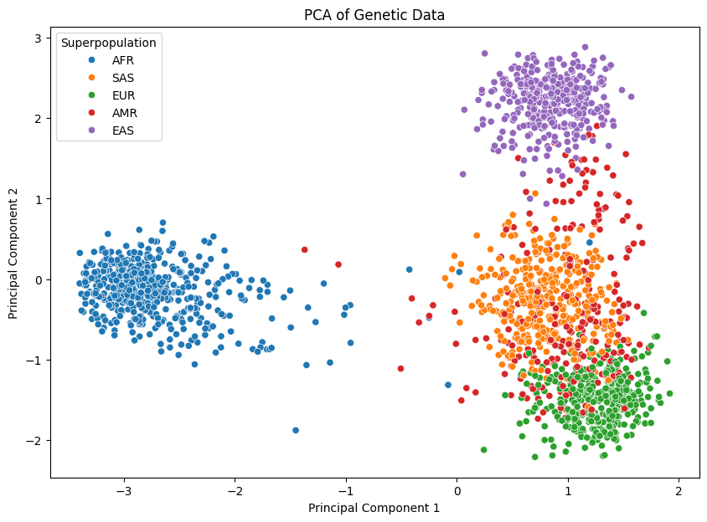
Results: PCA
SNPs one-hot encoded
Matrix converted to sparse
Explained variance:
Component 1: 0.1483
Component 2: 0.879

Slide 6
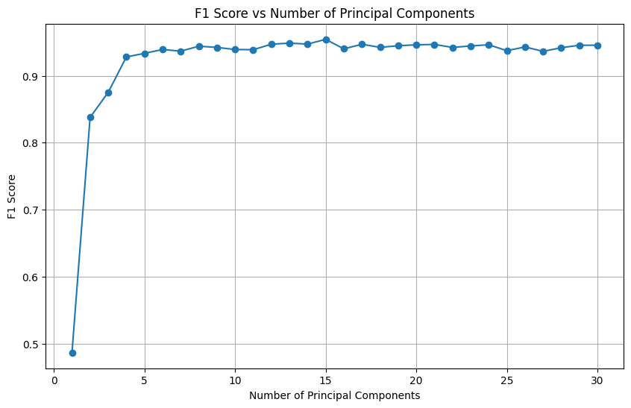
F1-Score
Train test split
Random Forest Classifier
Confusion Matrix
Precision
Recall

Slide 7
Dimensionality Reduction:
Multiple correspondence analysis (MCA)

Slide 8
There is debate as to how many AISNPs are sufficient to determine an individual's ancestry:
Kidd et al (2014): 55
Seldin et al (2011): 128
Is it possible to reduce this dimensionality further?
Multiple Correspondence Analysis (MCA):
Explore and visualise relationships between multiple nominal or original categorical variables in a dataset
As opposed to PCA for continuous data
Creates a set of new variables (dimensions) that represent the original categorical variables in a reduced form

Slide 9
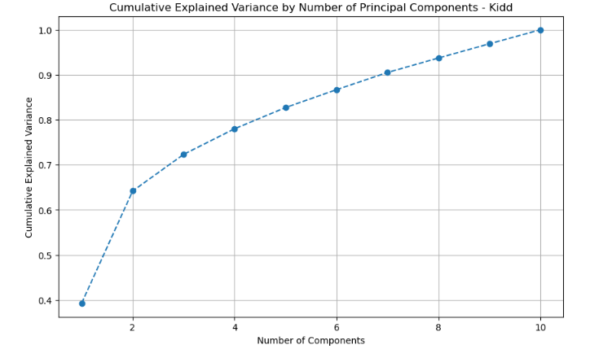
Results:
SNIPs categorised according to standard mapping (from dbSNP):
AA or CC: reference/reference
AT or CG: reference/alternate
TT or GG: alternate/alternate
MCA implemented using prince package
Elbow plot identified 2 components
Explained variance:
Kidd: 61% and 39%, respectively
Seldin: 68% and 32%, respectively

Slide 10
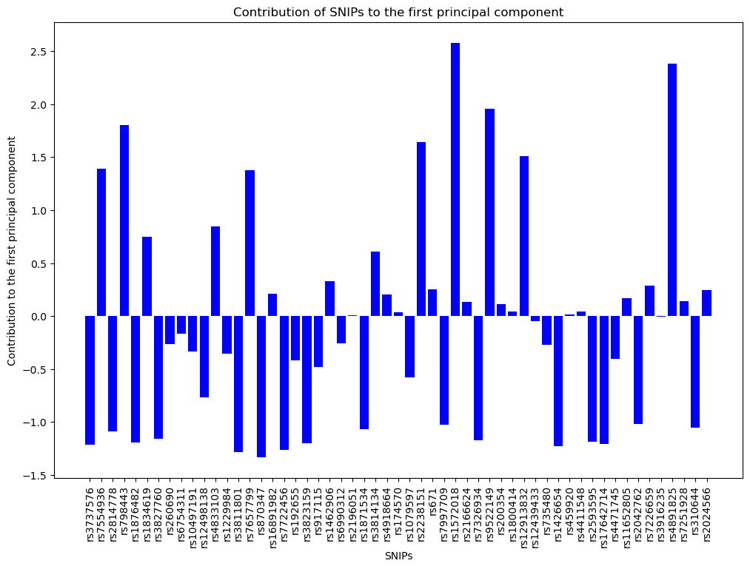
Mental illness risk:
rs798443: COMT gene, risk of mental illness, esp. risk of schizophrenia
rs9511149: stress response
Diabetes & CVD risk:
rs4833103: insulin sensitivity
rs7657799: reg of blood pressure
rs2238151: reg of glucose
rs4891825: CVD risk
Physical features:
rs12913832: eye colour, esp. determination of brown vs. blue

Slide 11
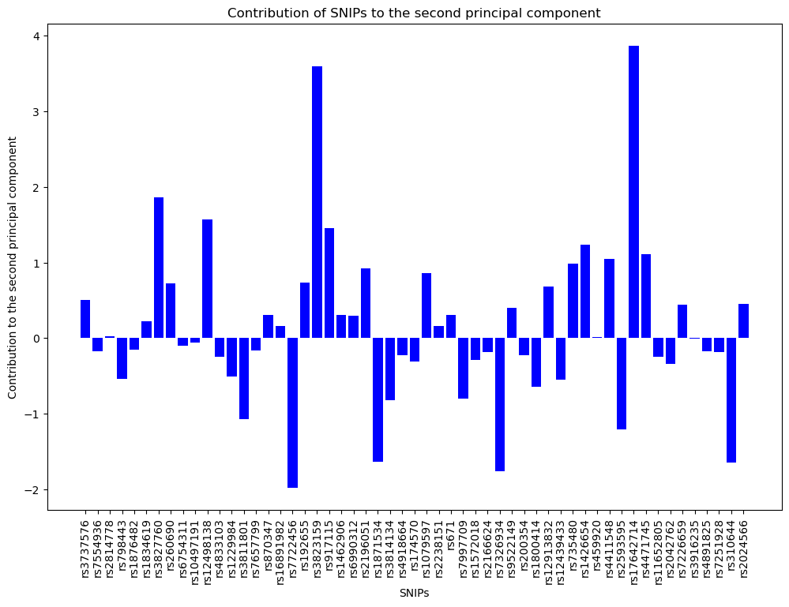
Cancer risk:
rs3813159: how the body responds to inflammatory signals
rs917115: cell growth in relation to hormone signalling
rs17642714: cell growth regulation
rs7722456: cancer metastasis
Obesity:
rs10644: reg of energy & fat storage

Slide 12
Conclusions:
Two components explained dimensionality in both Kidd and Seldin datasets:
Component 1: linked with diabetes and CVD risk
Component 2: linked with cancer risk
Some evidence these are linked with ancestry:
Diabetes: higher risk in South Asians and Africans compared to Europeans
CVD: higher risk in South Asians compared to Europeans
Cancer:
Higher risk of breast, lung, and colorectal cancers in Europeans
Higher risk of prostate cancer in Africans
Higher risk of oral and pharyngeal cancers in South Asians
However, these components do not neatly distinguish individuals of different ancestries

Slide 13
Classifying ancestry:
Neural networks

Slide 14
Results: Neural network
Target variable (i.e., ancestry superpopulation) represents a categorical outcome with 5 classes:
New package: tensorflow.keras.utils import to_categorical()
New activation function: ‘softmax’
New loss function: ‘categorical_crossentropy’

Slide 15
Interpreting the Results:
Visualisation through Tableau

Slide 16
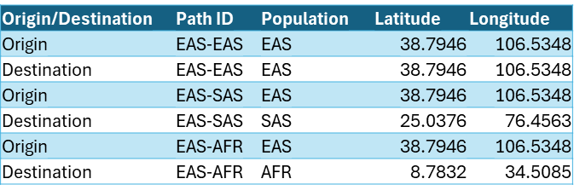
Preparing the Data
Wanted a map which shows relations between two regions
Tableau has a built-in path maker, but the formatting must be very specific

Slide 17
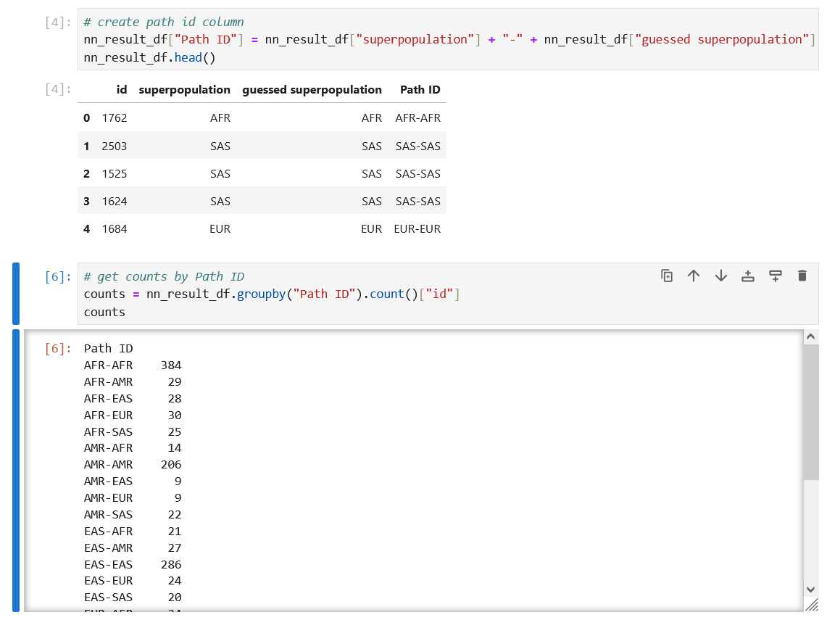
Preparing the Data
Another csv with just the Path ID and the count of that path was made

Slide 18
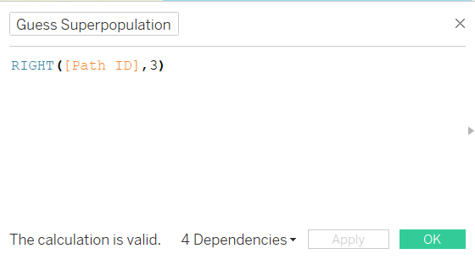
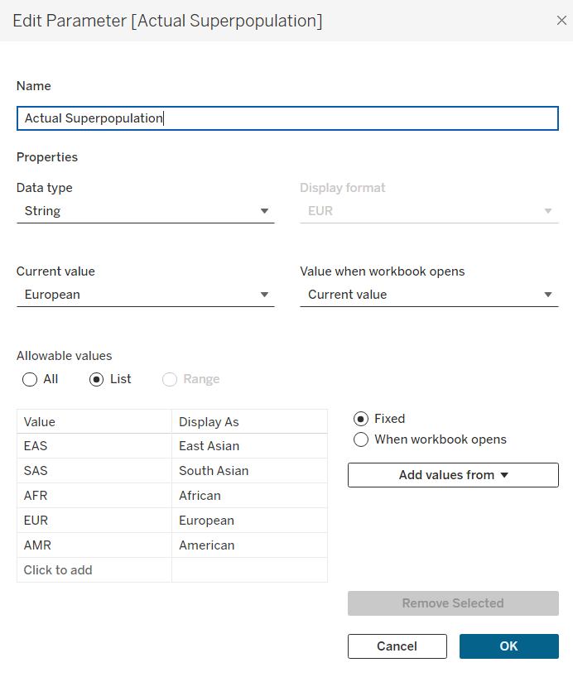
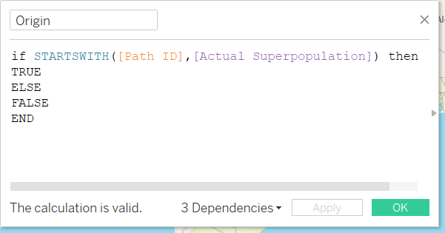
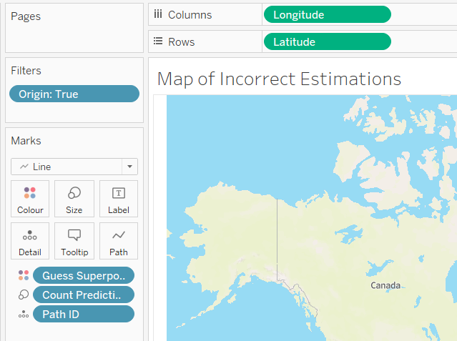
Making the Map
3. Calculated field to choose colour of line
1. Parameter to choose which superpopulation to display
2. Filter to only get paths which start with parameter
4. Longitude on Columns, Latitude on Rows
Path ID on Detail, graph set to “Line”
Guess Superpopulation on Colour, Count of Predictions on Size

Slide 19
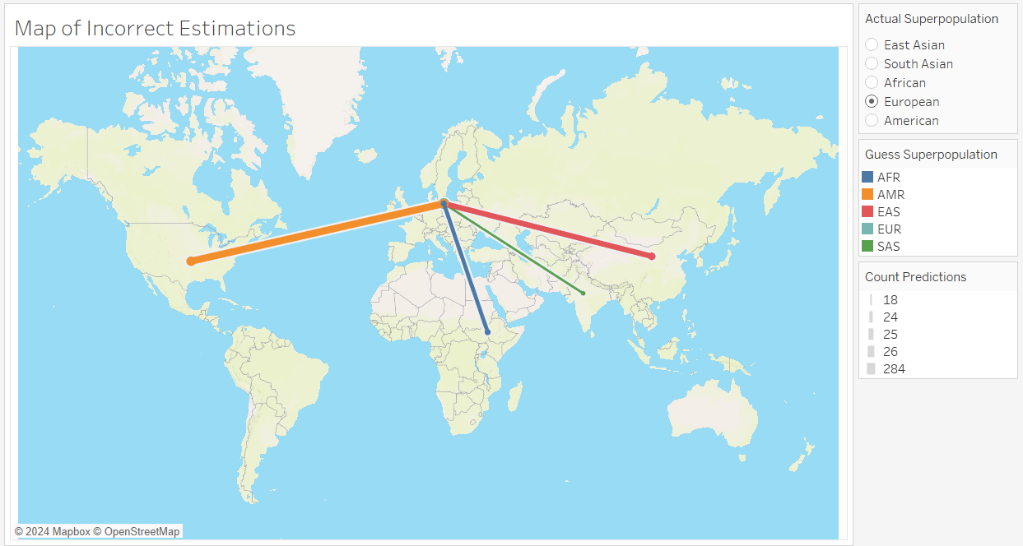
the Map:
https://public.tableau.com/app/profile/violet.bui/viz/1000genomesMachineLearningVisualisations/Estimations?publish=yes

