Slide 1

Determining Ancestry using data from the 1000 Genomes project
Violet Bui, Elizabeth Dashwood, Mark Peck, & Katrina Witt

Slide 2
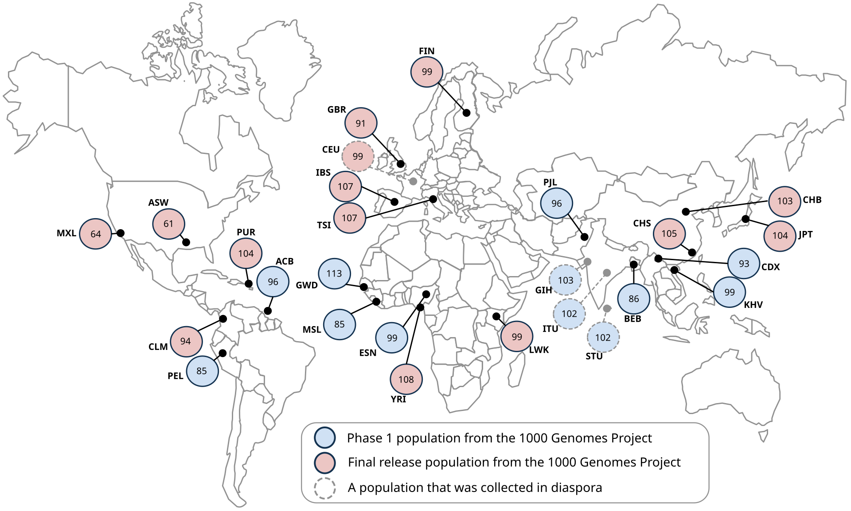
Data source: 1000 genomes project
Between 2008 and 2015, the 1000 Genomes Project Consortium brought together researchers from 8 countries worldwide (China, Italy, Japan, Kenya, Nigeria, Peru, UK, USA)
Create a catalogue of human genetic variations in different populations
Identify individual Single Nucleotide Polymorphisms (SNPs) driving these variations, inc. variations by ancestry
Data collection occurred over 4 key phases:
Pilot: 697 persons from 7 populations
Phase 1: 1092 persons from 14 populations
Phase 2: 2504 persons from 26 populations
Phase 3: several new genes sequenced
Final dataset: 2,504 persons from 26 populations

Slide 3










Data processing pipeline:
Ingestion
AWS S3
.csv files
Storage
Pandas
Preprocessing
TensorFlow – One Hot Encoding
Dimensionality Reduction
prince
Training
TensorFlow
Keras-tuner
Evaluation
Scikit-learn –
Confusion matrix
Classification report
Deployment
Scikit-learn –
Visualisation
Tableau
OS Module
Confusion matrix
Classification report

Slide 4
Preprocessing:
Problems with pca (Principal Component Analysis)

Slide 5
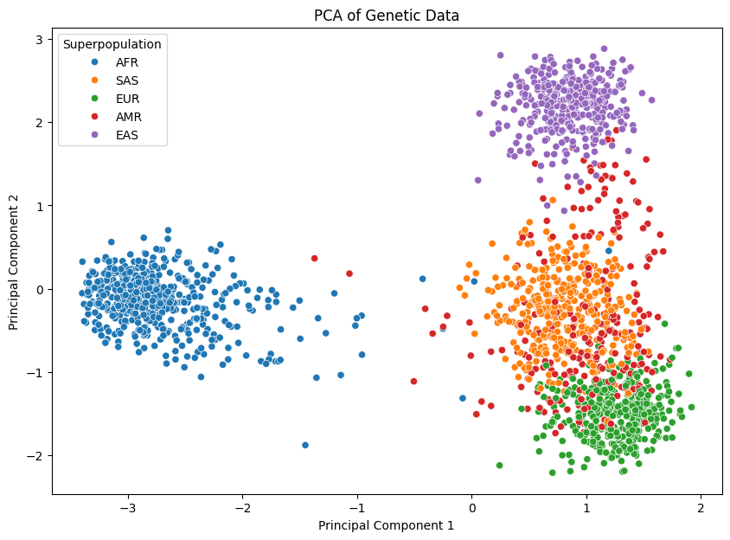
Results: PCA
SNPs one-hot encoded
Matrix converted to sparse
Explained variance:
Component 1: 0.1483
Component 2: 0.0879

Slide 6
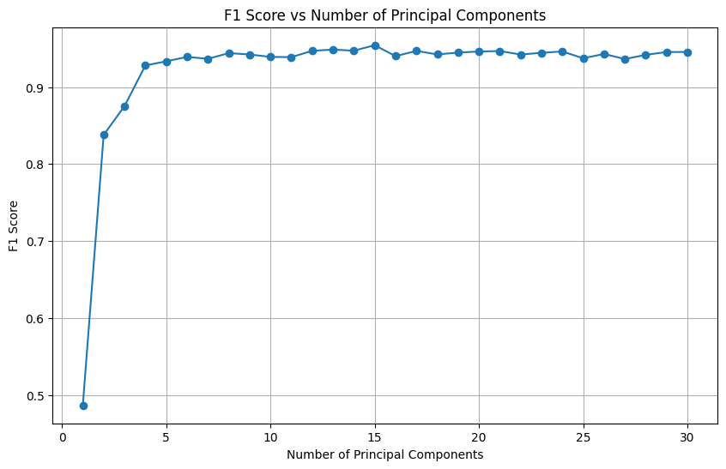
F1-Score
Train test split
Random Forest Classifier
Confusion Matrix
Precision
Recall

Slide 7
Dimensionality Reduction:
Multiple correspondence analysis (MCA)

Slide 8
There is debate as to how many AISNPs are sufficient to determine an individual's ancestry:
Kidd et al (2014): 55
Seldin et al (2011): 128
Is it possible to reduce this dimensionality further?
Multiple Correspondence Analysis (MCA):
Explore and visualise relationships between multiple nominal or original categorical variables in a dataset
As opposed to PCA for continuous data
Creates a set of new variables (dimensions) that represent the original categorical variables in a reduced form

Slide 9
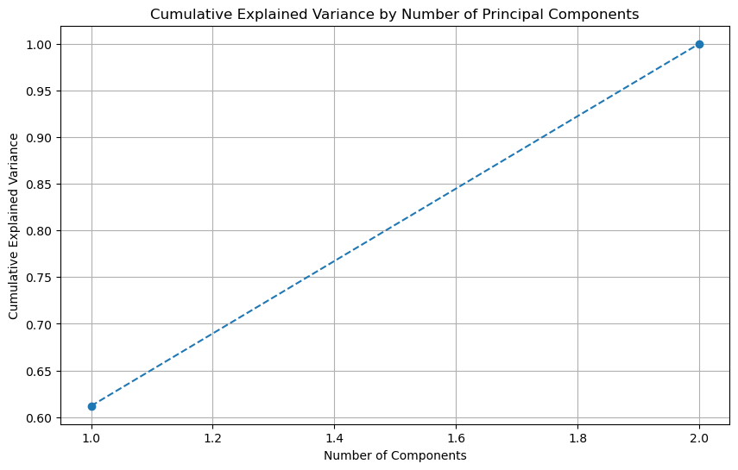
Results:
SNIPs categorised according to standard mapping (from dbSNP):
AA or CC: reference/reference
AT or CG: reference/alternate
TT or GG: alternate/alternate
MCA implemented using prince package
Cumulative explained variance:
Component 1: 0.61
Component 2: 1.00

Slide 10
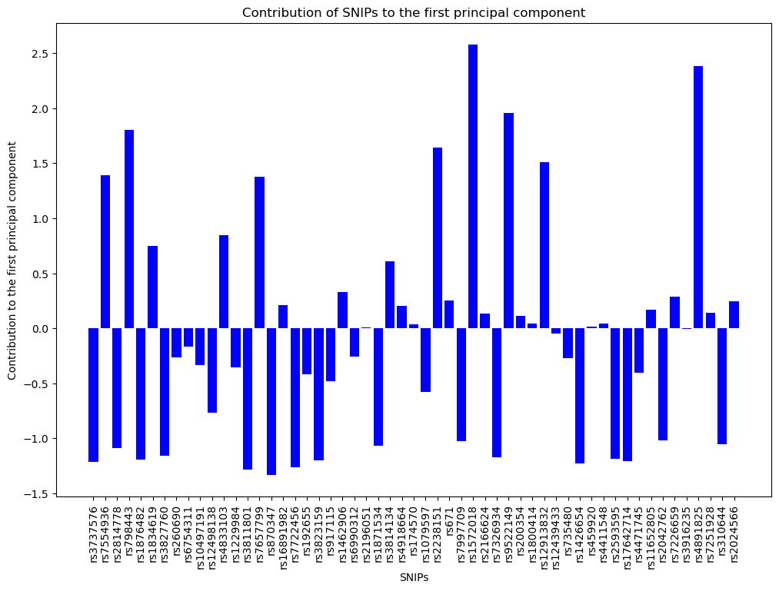
Mental illness risk:
rs798443: COMT gene, risk of mental illness, esp. risk of schizophrenia
rs9511149: stress response
Diabetes & CVD risk:
rs4833103: insulin sensitivity
rs7657799: reg of blood pressure
rs2238151: reg of glucose
rs4891825: CVD risk
Physical features:
rs12913832: eye colour, esp. determination of brown vs. blue

Slide 11
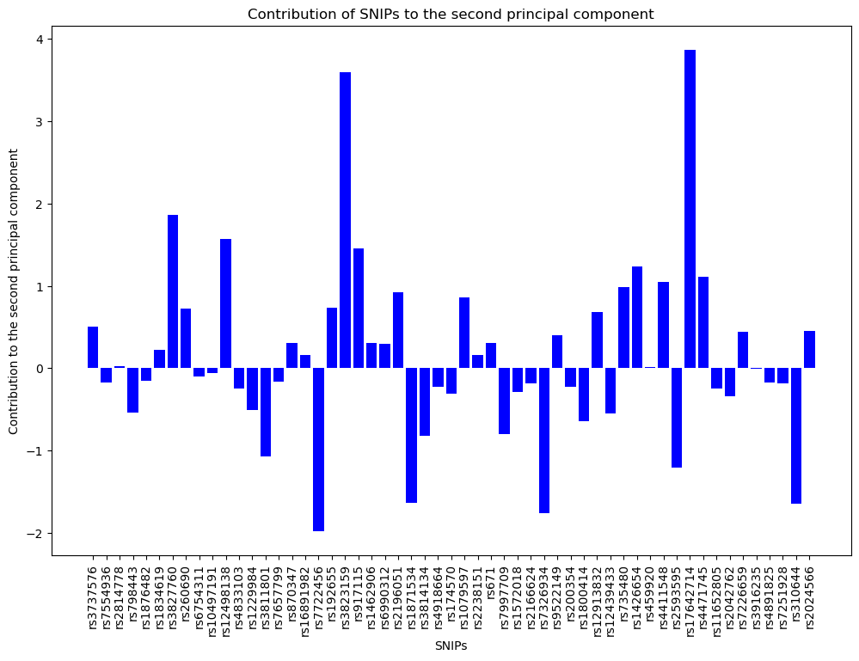
Cancer risk:
rs3813159: how the body responds to inflammatory signals
rs917115: cell growth in relation to hormone signalling
rs17642714: cell growth regulation
rs7722456: cancer metastasis
Obesity:
rs10644: reg of energy & fat storage

Slide 12
Conclusions:
Two components explained dimensionality:
Component 1: linked with diabetes and CVD risk
Component 2: linked with cancer risk
There is some evidence these are linked with ancestry:
Diabetes: higher risk in South Asians and Africans compared to Europeans
CVD: higher risk in South Asians compared to Europeans
Cancer:
Higher risk of breast, lung, and colorectal cancers in Europeans
Higher risk of prostate cancer in Africans
Higher risk of oral and pharyngeal cancers in South Asians
However, these factors do not neatly distinguish individuals of different ancestries

Slide 13
Classifying ancestry:
Neural networks

Slide 14
Results: Neural network
Target variable (i.e., ancestry superpopulation) represents a categorical outcome with 6 classes:
Dependencies:
scikit-learn model_selection to import train_test_split
scikit-learn preprocessing to import StandardScaler and OneHotEncoder
tensorflow
pandas
numpy
New output layer scenario: 6 output classes (AFR, AMR, EAS, EUR, SAS, Unknown(NaN))
New activation function: ‘softmax’
New loss function: ‘sparse_categorical_crossentropy’

Slide 15
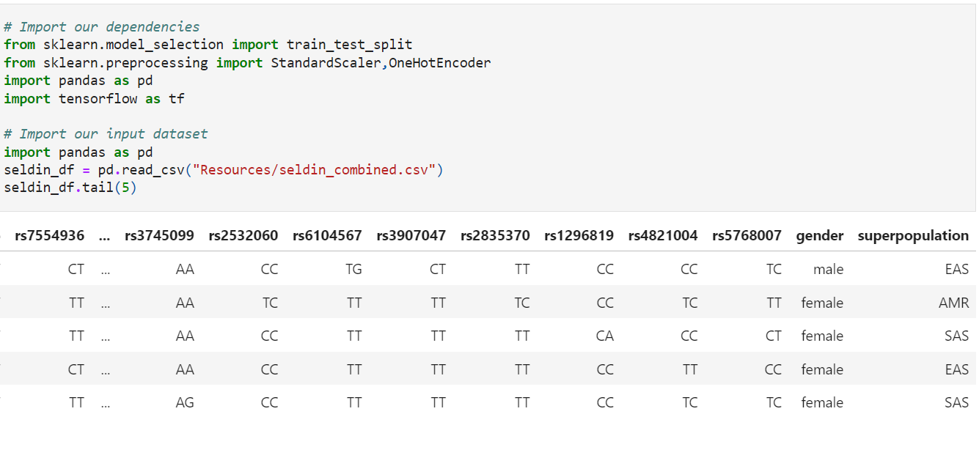
Neural NETWORK - DEPENDENCIES AND INPUT DATA

Slide 16
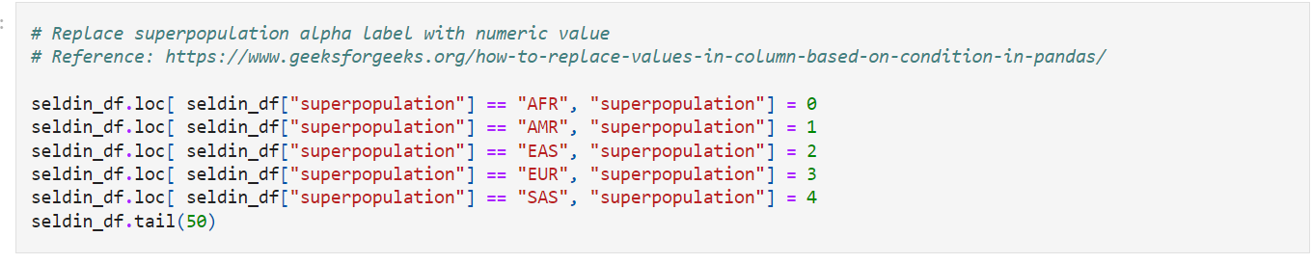
Neural NETWORK – ENCODING THE TARGET

Slide 17
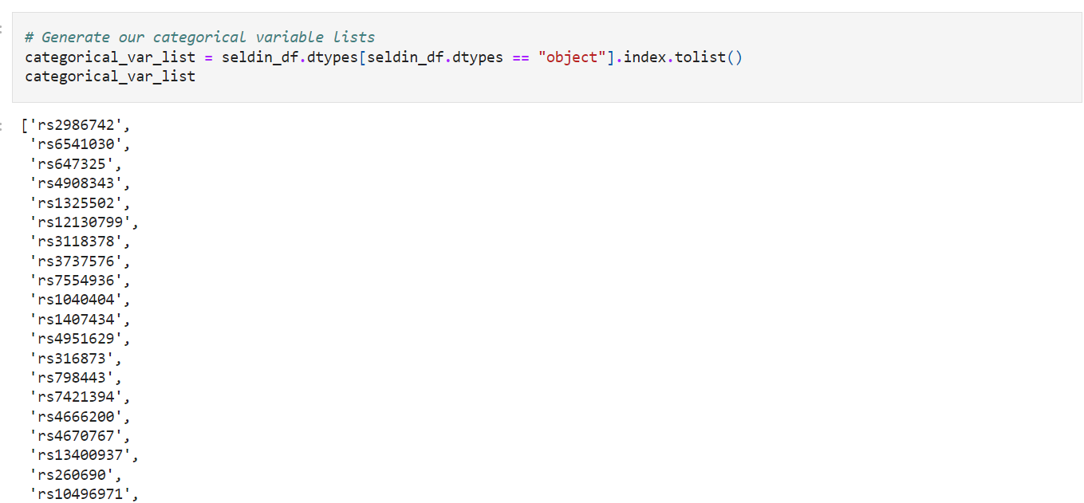
Neural NETWORK – CATEGORICAL FEATURES

Slide 18
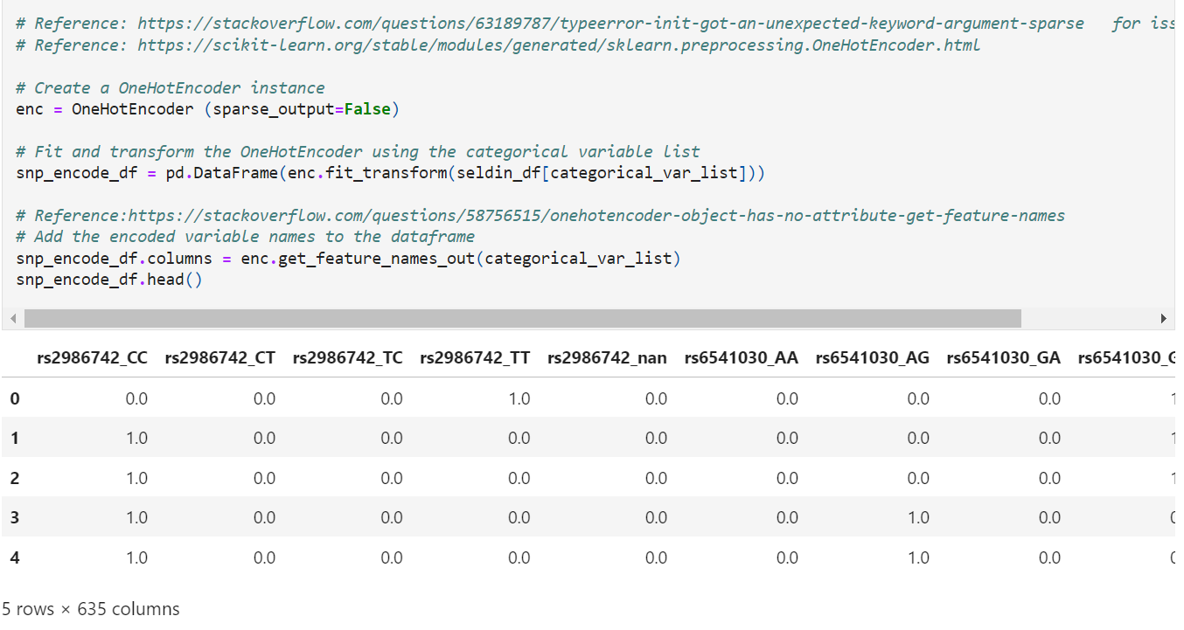
Neural NETWORK – ENCODING THE CATEGORICAL FEATURES

Slide 19
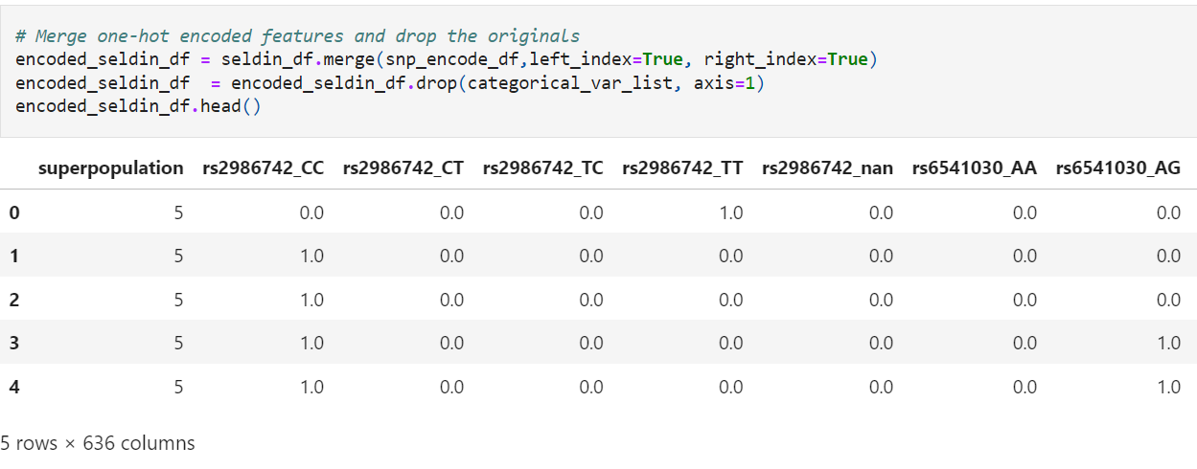
Neural NETWORK – MERGE ENCODED TARGETS AND FEATURES

Slide 20
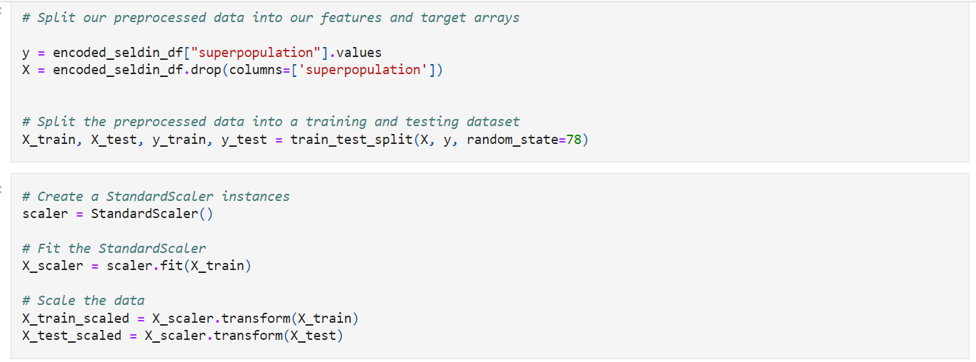
Neural NETWORK – SET TARGET & FEATURES, TRAIN_ TEST_SPLIT and SCALE

Slide 21
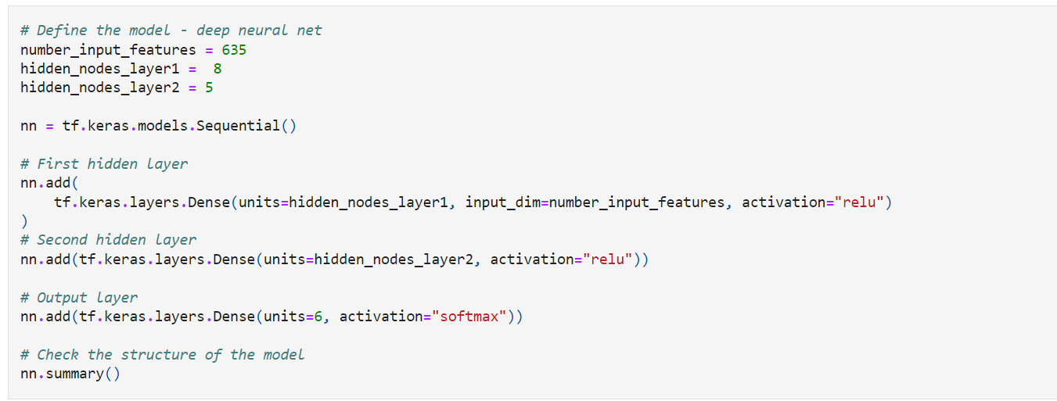
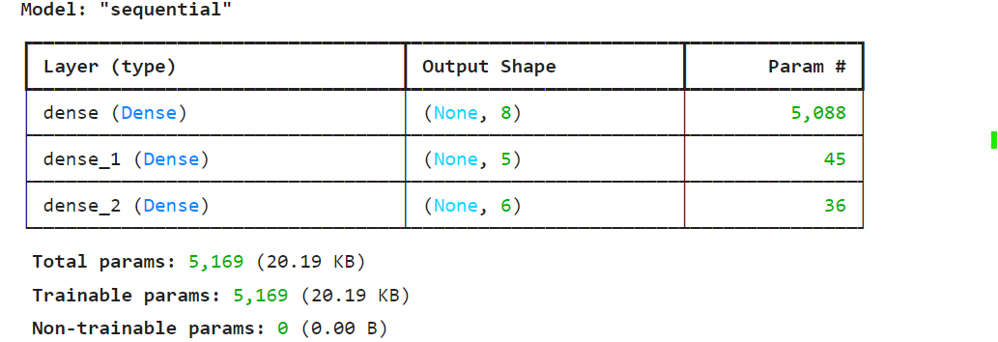
Neural NETWORK – DEFINE SEQUENTIAL MODEL

Slide 22
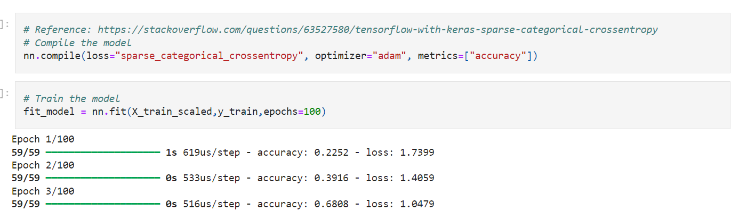
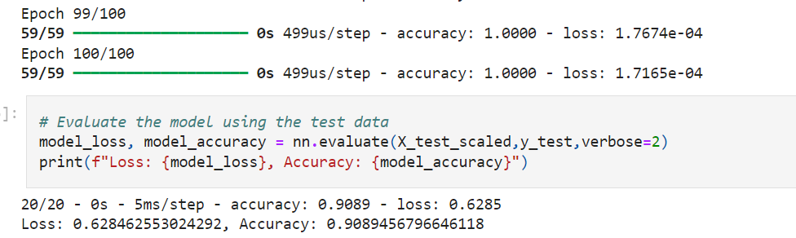
Neural NETWORK – COMPILE AND FIT AND EVALUATE MODEL

Slide 23
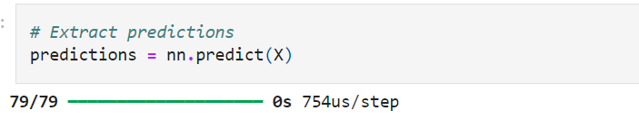
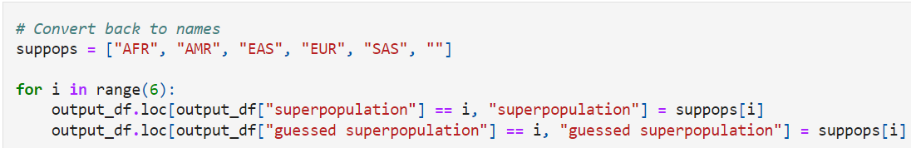
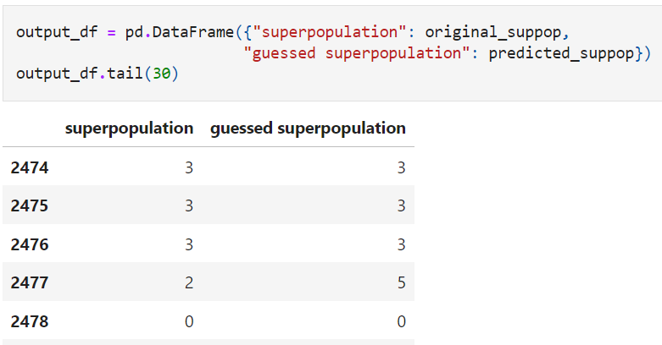
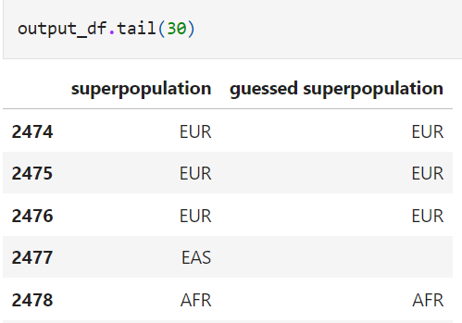
NEURAL NETWORK - PREDICTIONS
Code for predictions by Violet Bui

