Slide 1
MedicApp
Built by: Frandel Wanjawa.

Slide 2
Content:
Links
Approach
Design
Solution
Conclusion

Slide 3
Links
Admin
/master :login page
/admin-register :register page
Normal user
/ :login page
/register :register page
Deployed links:
Frontend- https://medicapp-l95e.onrender.com/
Backend- https://medicappbackend.onrender.com/

Slide 4
Approach
The MedicApp takes advantage of react and vite for the frontend and django for the backend.
The database is postresql based.
The building was initiated by setting up react and vite as well as django using the terminal.
Built part of the backend, then some of the frontend then worked on the remaining backend and frontend simultaneously.
After functionality testing, I deployed the site on render(the web service, database and static site)

Slide 5
Design
The design phase was informed by various issues that I opened on git that were informed by the requirements.
The following flowchart gives a summary of the design phase
Link to the backend
Build sign up and sign in pages
Progressive adjustments
Build landing page for admin
Is the product good ?
Build normal user landing page
Build pages for each dashboard
Final solution

Slide 6
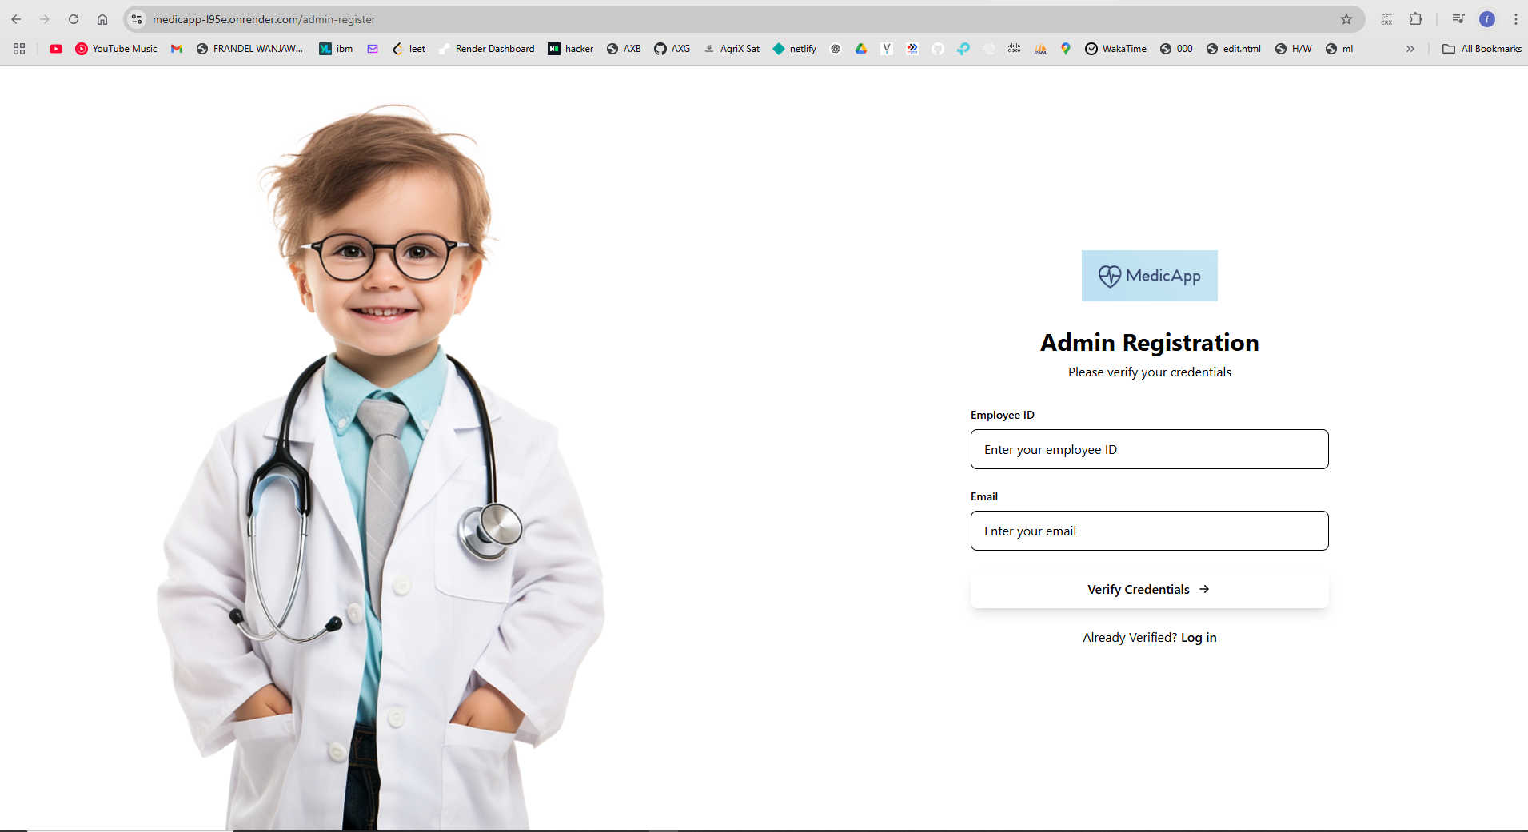
Solution
The solution is explained in the following images

Slide 7
Ordinary user registration page

Slide 8
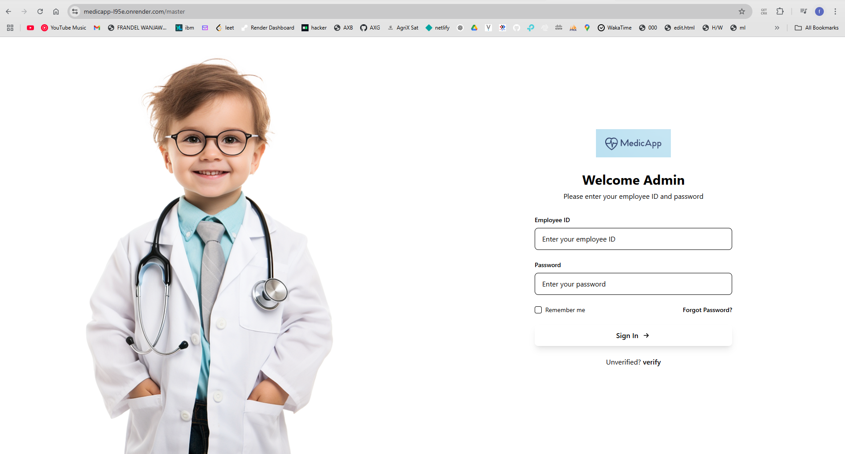

Slide 9
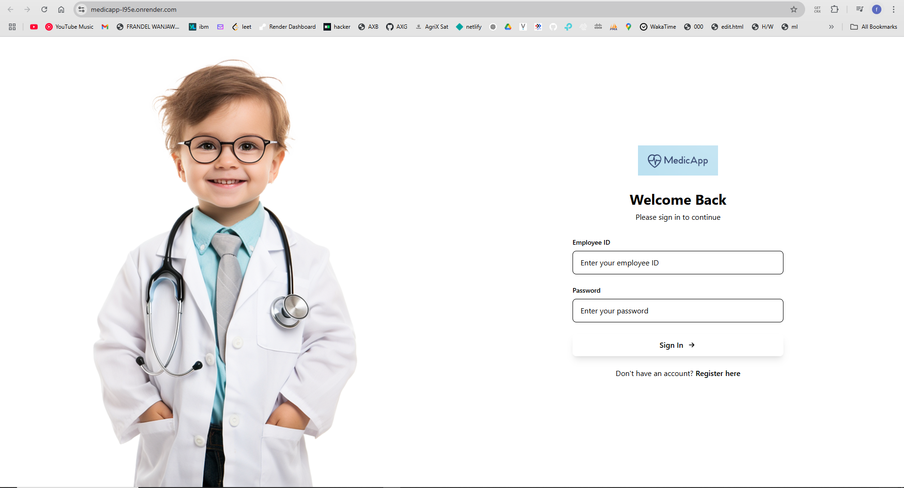
Ordinary user login

Slide 10
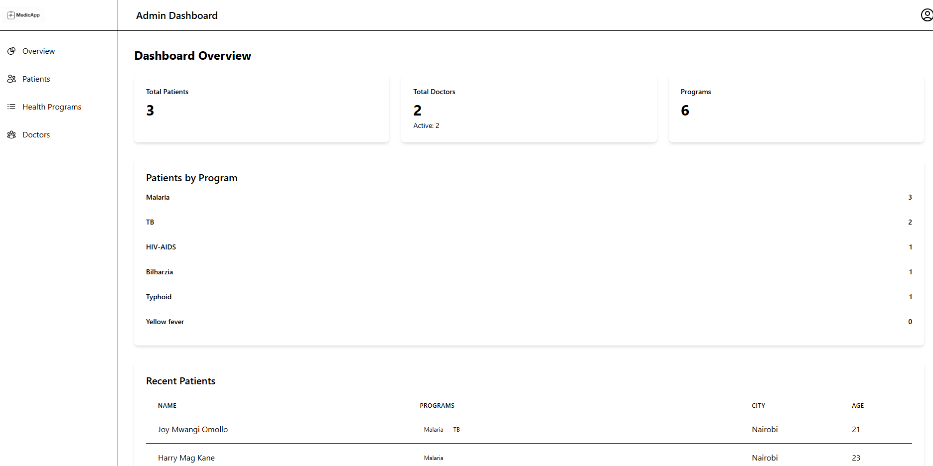
Admin user dashboard

Slide 11
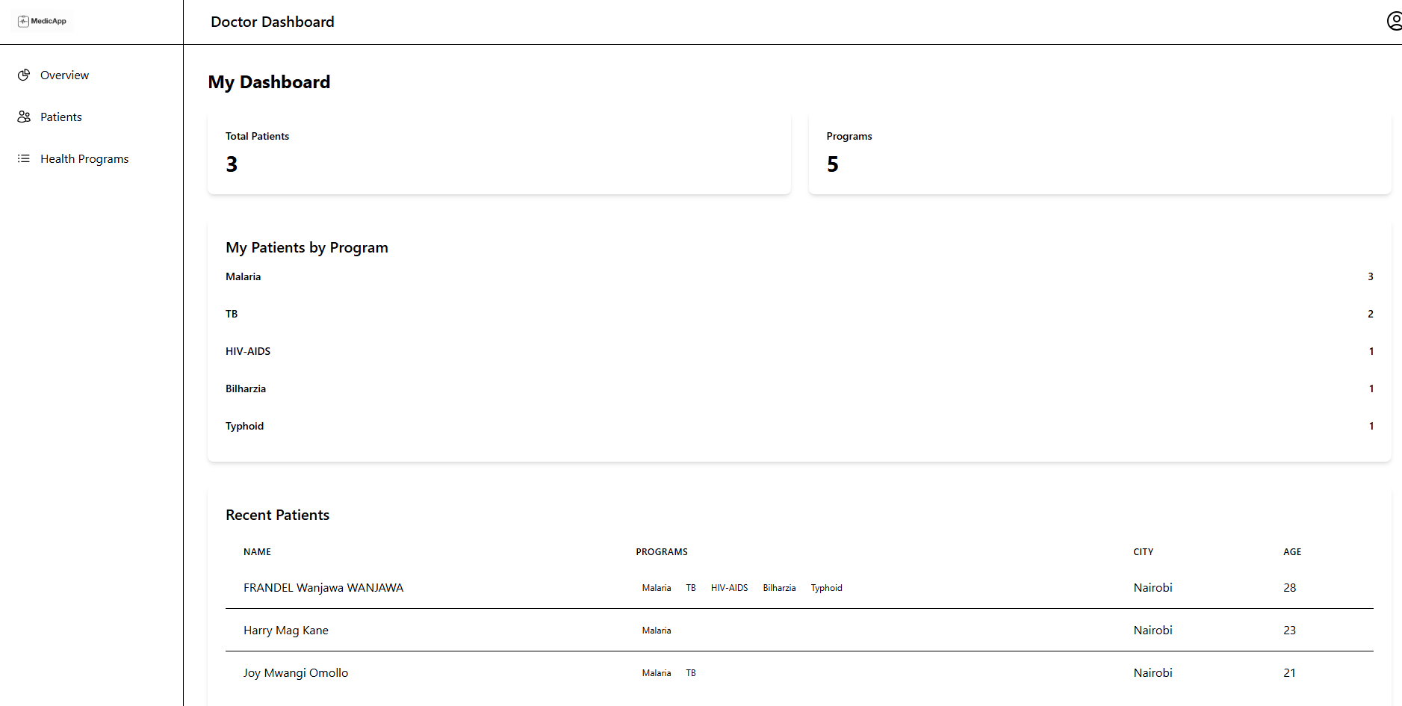
Ordinary user dashboard

Slide 12
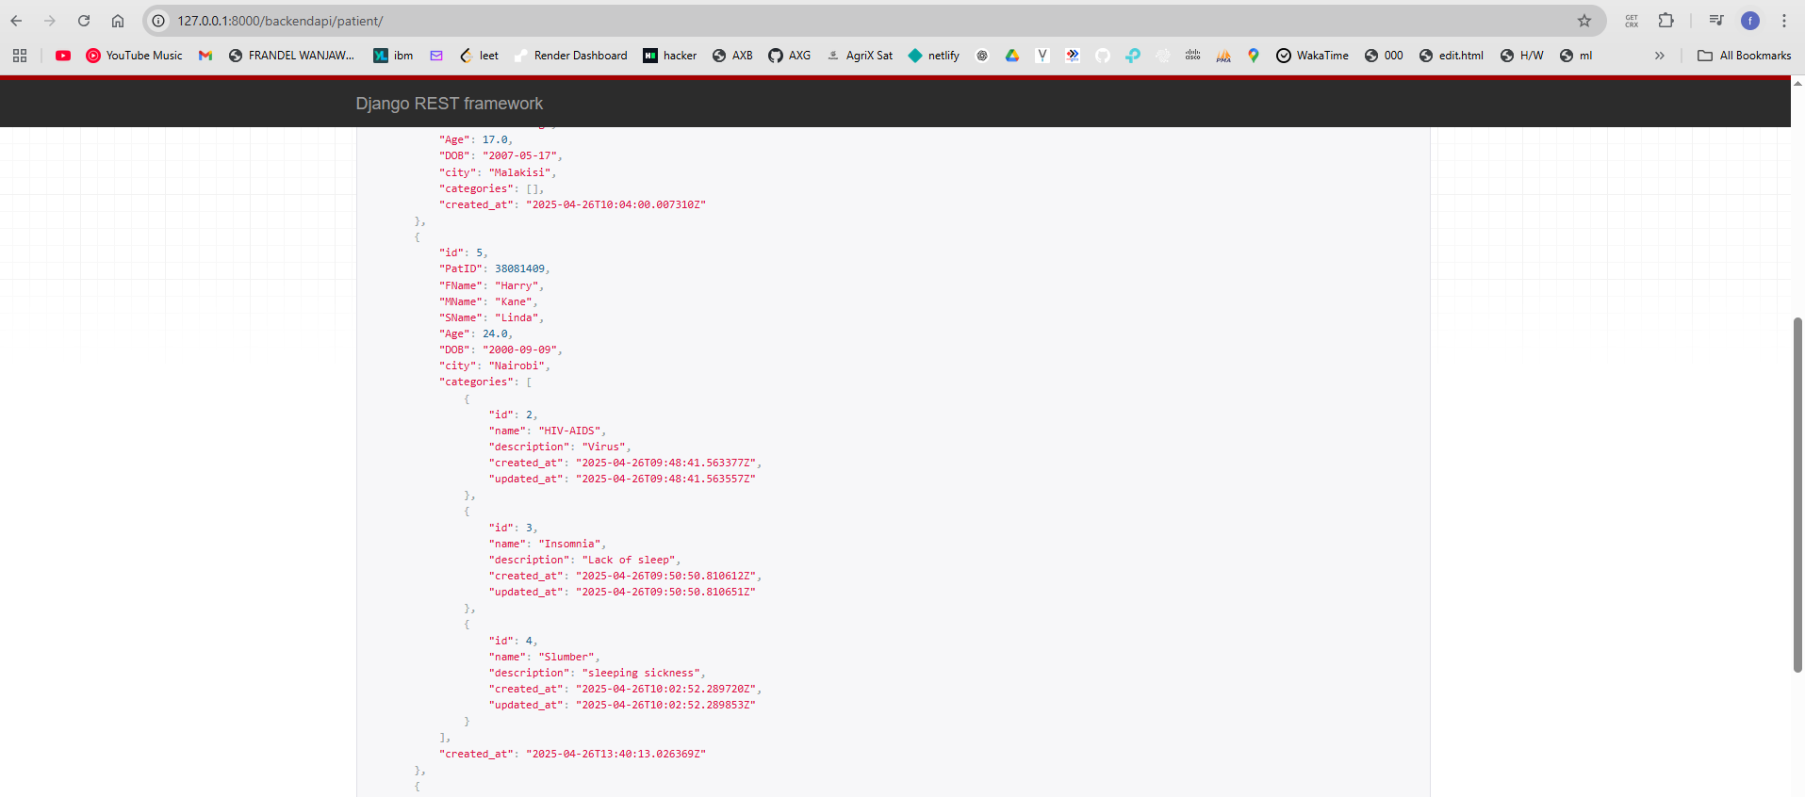
Api that can be interfaced with another system

Slide 13
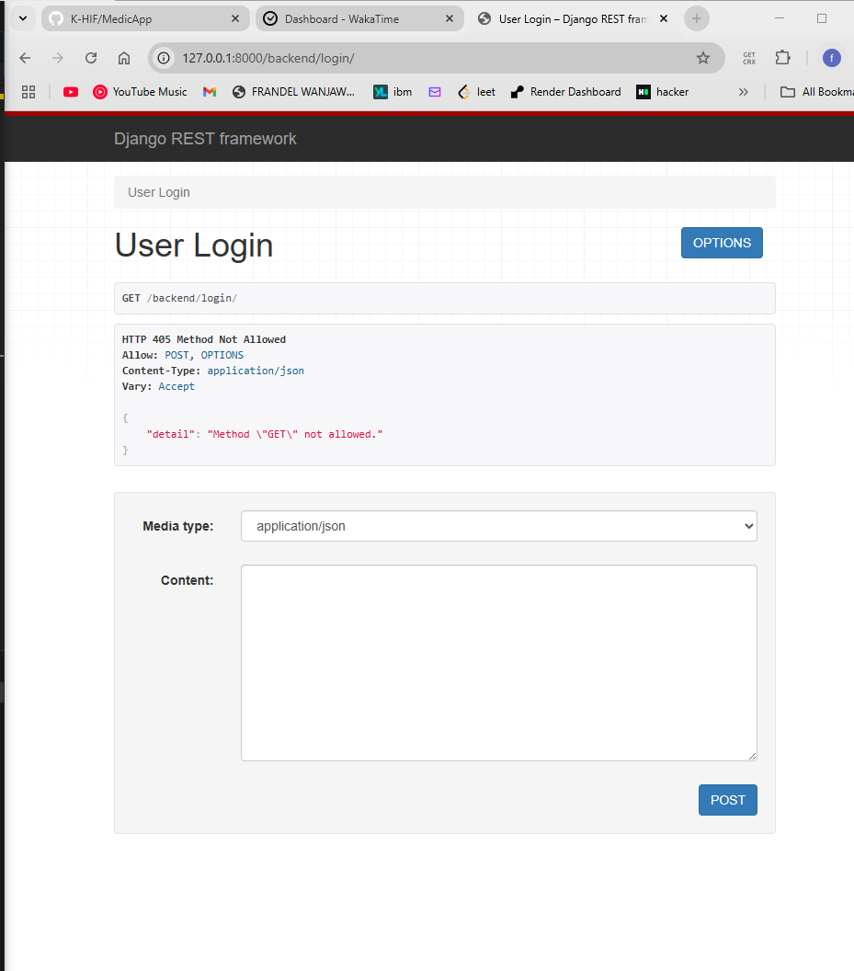
API view implementation

Slide 14
Conclusion
The system is a simple health information system that has the folloeing functionalities:
A user can:
Create a health program – e.g., TB, Malaria, HIV, etc.
Register a new client in the system.
Enroll a client in one or more programs.
Search for a client from a list of registered clients.
View a client's profile, including the programs they are enrolled in.
And an api has been implemented to expose the client profile.

Slide 15
The End

