Slide 1
Mann Kendall test results for all indices
RH-SAS: 08/21/2023

Slide 2
Housekeeping/thought process
81 surveys included (indicated as “1”-ForModelUse)-> 32 surveys resulted in significant monotonic trends
Where possible, surveys were tested as full time series and as “modern series” (e.g., 2009-present)—mainly the trends remain the same, but some deviation occurred (e.g., “U”-shaped series)
A full output summary exists on the Sharefile site

Slide 3
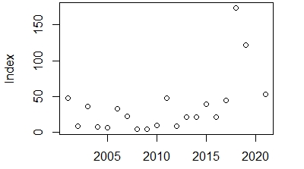
Survey #7—Gulf of Maine, MENH_spring-trawl (BLH)
Moderate increase in BLH abundance detected throughout the series, and higher rate in modern period
Full series: Tau=0.32, p=0.055 (marginal)
Modern: Tau=0.64, p=0.005

Slide 4
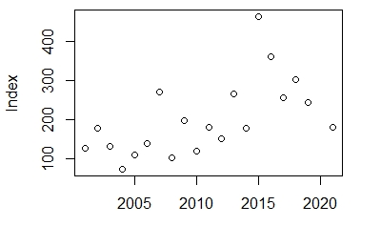
Survey #5—Gulf of Maine, MENH_spring-trawl (ALE)
Moderate increase in ALE abundance detected throughout the series, and no change in modern series
Full series: Tau=0.43, p=0.009

Slide 5
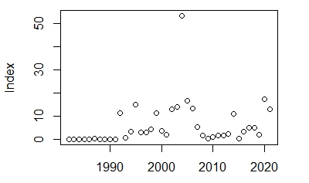
Survey #29—Merrymeeting Bay, ME_beach-seine (BLH)
Moderate increase in YOY-BLH abundance detected throughout the series, but higher positive trend in the modern series
Full series: Tau=0.39, p=0.0005
Modern: Tau=0.59, p=0.006

Slide 6
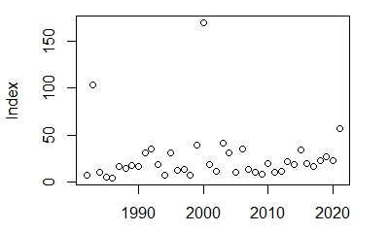
Survey #172—Merrymeeting Bay, ME_beach-seine (ALE)
Moderate increase in YOY-ALE abundance detected throughout the series, but more rapid trend in the modern series
Full series: Tau=0.2, p=0.07 (marginal)
Modern: Tau=0.59, p=0.006

Slide 7
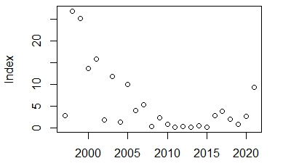
Survey #170—Great Bay, NH_beach-seine (BLH)
Moderate decrease in YOY-BLH abundance detected throughout the series, but modern period displays opposite trend
Full series: Tau= -0.36, p=0.01
Modern: Tau=0.37, p=0.09

Slide 8
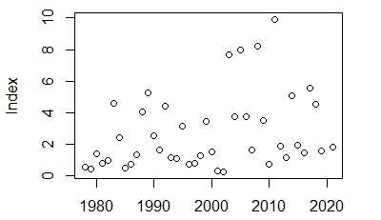
Survey #27—N. of Cape Cod, MA_trawl (ALE)
Moderate increase in YOY-ALE abundance detected throughout the series, no change in modern period
Full series: Tau=0.24, p=0.02

Slide 9
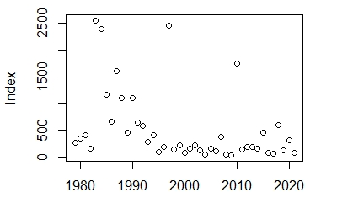
Survey #121—Conneticut River, CTR_seine (BLH)
Moderate decrease in YOY-BLH abundance detected throughout the series, no change in modern period
Full series: Tau= -0.36, p=0.0006

Slide 10
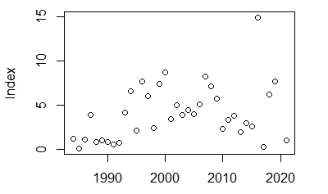
Survey #22—Long Island Sound, LIS_trawl (ALE)
Moderate increase in ALE abundance detected throughout the series, no change in modern period
Full series: Tau=0.21, p=0.065
(marginal)

Slide 11
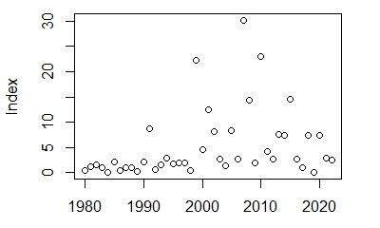
Survey #152—Hudson River, NY_RH_beach-seine (ALE)
Moderate increase in YOY-ALE abundance detected throughout the series, no change in modern period
Full series: Tau=0.32, p=0.003

Slide 12
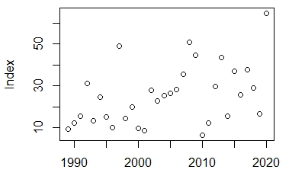
Survey #165—New Jersey, NJ_trawl (BLH)
Moderate increase in BLH abundance detected throughout the series, no change in modern period
Full series: Tau=0.33, p=0.007

Slide 13
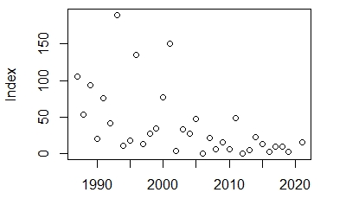
Survey #137—Delaware River, NJ_SB_seine (BLH)
Moderate decrease in YOY-BLH abundance detected throughout the series, no change in modern period
Full series: Tau= -0.43, p=0.0004

Slide 14
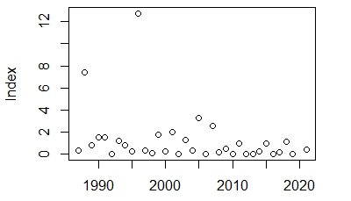
Survey #133—Delaware River, NJ_SB_seine (ALE)
Moderate decrease in YOY-ALE abundance detected throughout the series, slight positive trend in modern period
Full series: Tau= -0.24, p=0.05
Modern: Tau=0.05, p=0.89

Slide 15
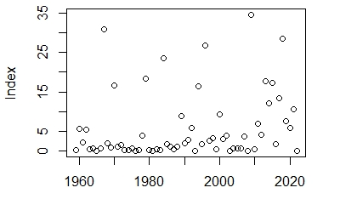
Survey #192—Choptank River, MDDNR_juve.fish (BLH)
Moderate increase in YOY-BLH abundance detected throughout the series, no change in modern period
Full series: Tau=0.21, p=0.02

Slide 16
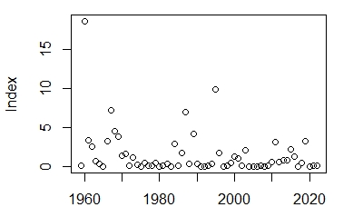
Survey #191—Choptank River, MDDNR_juve.fish (ALE)
Moderate decrease in YOY-ALE abundance detected throughout the series, no change in modern period
Full series: Tau= -0.16, p=0.07 (marginal)

Slide 17
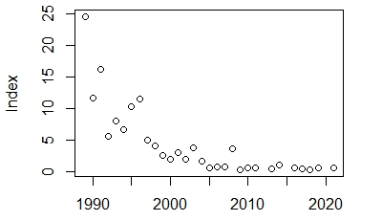
Survey #91—Nanticoke River, MD_comm.fyke net (BLH)
Moderate decrease in Adult-BLH abundance detected throughout the series, but trend may be reaching a plateau
Full series: Tau= -0.73, p=1.5e10⁻⁸
Modern: Tau=0.13, p=0.65

Slide 18
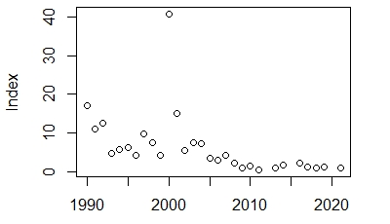
Survey #89—Nanticoke River, MD_comm.fyke net (ALE)
Moderate decrease in Adult-ALE abundance detected throughout the series, but trend may be reaching a plateau
Full series: Tau= -0.62, p=2.5e10⁻⁶
Modern: Tau=0.11, p=0.72

Slide 19
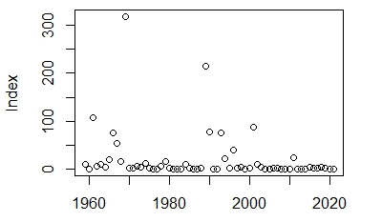
Survey #85—Nanticoke River, MDDNR_juve.fish (BLH)
Moderate decrease in YOY-BLH abundance detected throughout the series, and trend continues through modern series
Full series: Tau= -0.23, p=0.007
Modern: Tau=0, p=1

Slide 20
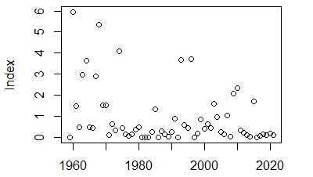
Survey #82—Nanticoke River, MDDNR_juve.fish (ALE)
Moderate decrease in YOY-ALE abundance detected throughout the series, and trend continues through modern series
Full series: Tau= -0.19, p=0.03
Modern: Tau= -0.38, p=0.09

Slide 21
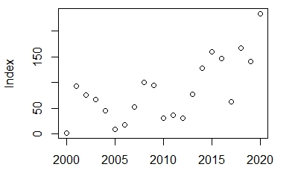
Survey #112—Rappahannock River, VADWR_CPUE_SS (BLH)
Moderate increase in Adult-BLH abundance detected throughout the series, and trend continues through modern series
Full series: Tau=0.47, p=0.003
Modern: Tau=0.58, p=0.01

Slide 22
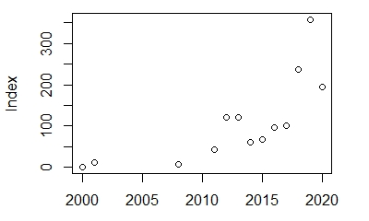
Survey #159—Chickahominy River, VADWR_CPUE_SS (BLH)
Moderate increase in Adult-BLH abundance detected throughout the series
Full series: Tau=0.72, p=8.0e10⁻⁴

Slide 23
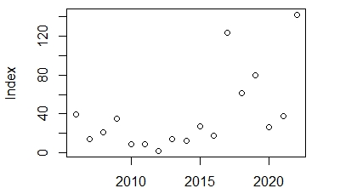
Survey #119—Chowan River, Chowan_electro. (BLH)
Moderate increase in Adult-BLH abundance detected throughout the series
Full series: Tau=0.35, p=0.053 (marginal)

Slide 24
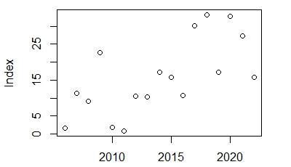
Survey #117—Chowan River, Chowan_electro. (ALE)
Moderate increase in Adult-ALE abundance detected throughout the series
Full series: Tau=0.49, p=0.007

Slide 25
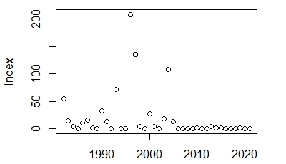
Survey #41—Albemarle Sound, Albemarle_trawl (BLH)
Long term decline in Adult-BLH abundance detected, but plateau since 2009
Full series: Tau= -0.29, p=0.01
Modern: Tau=0.04, p=0.9

Slide 26
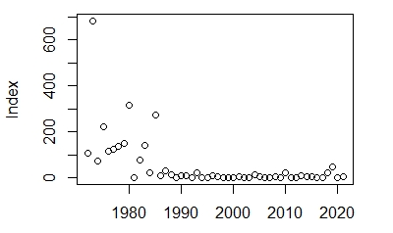
Survey #35—Albemarle Sound, Albemarle_seine (BLH)
Long term decline in YOY-BLH abundance detected, but plateau since 2009
Full series: Tau= -0.38, p=9.7e10⁻⁵
Modern: Tau=0.18, p=0.43

Slide 27
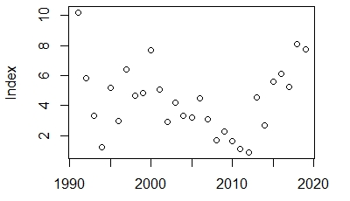
Survey #34—Albemarle Sound, Albemarle_IGNS (BLH)
Non-significant long term (slight) decline in Adult-BLH abundance indicated, but a moderate increase in Adult-BLH abundance detected (since 2009)
Full series: Tau= -0.07, p=0.59
Modern: Tau=0.64, p=0.008

Slide 28
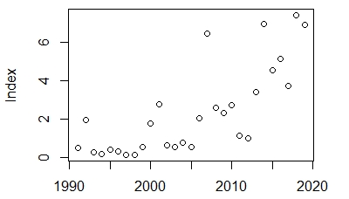
Survey #32—Albemarle Sound, Albemarle_IGNS (ALE)
Moderate increase in Adult-ALE abundance detected (full series, and since 2009)
Full series: Tau=0.63, p=2.0e10⁻⁶
Modern: Tau=0.56, p=0.02

Slide 29
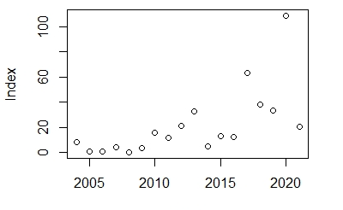
Survey #160—Neuse River, Neuse_electrofishing (BLH)
Moderate increase in Adult-BLH abundance detected
Tau=0.59, p=0.0007

Slide 30
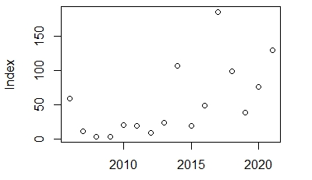
Survey #201—St. Johns River, SJ_pushnet (BLH)
Moderate increase in YOY-BLH abundance detected
Tau=0.47, p=0.01

Slide 31
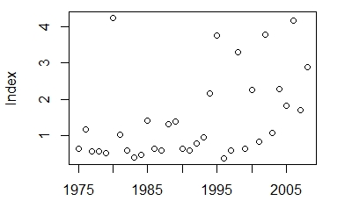
Survey #9—NEFSC, Fall_Albatross (ALE)
Moderate increase in Adult-ALE abundance detected
Tau=0.37, p=0.002

Slide 32
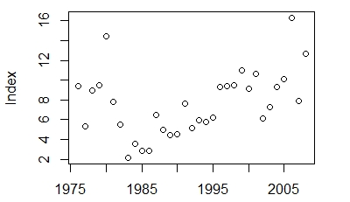
Survey #13—NEFSC, Spring_Albatross (ALE)
Moderate increase in Adult-ALE abundance detected
Tau=0.34, p=0.006

Slide 33
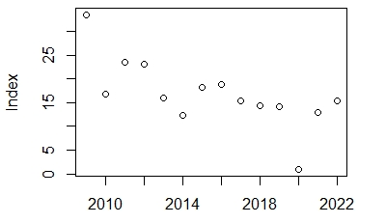
Survey #15—NEFSC, Spring_Bigelow (ALE)
Moderate decrease in Adult-ALE abundance detected
Tau= -0.58, p=0.004

Slide 34
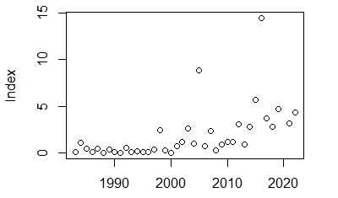
Survey #21—NEFSC, Summer_Shrimp (ALE)
Moderate increase in Adult-ALE abundance detected
Tau=0.56, p=5.0e10⁻⁷

Slide 35
Summary
32 (significant result) surveys with the following trends:
19 increasing, 11 decreasing with ~8 surveys approximating zero in modern period:
Delaware River (137, 133—both species, YOY)
Nanticoke River (91, 89, 85, 82—both species, YOY + Adult)
Albemarle Sound (41 + 35—both species, YOY)

Slide 36
Summary, pt. 2
2 surveys that are “U”-shaped:
* Adult surveys (both spp.) in Albemarle Sound indicate increase in abundance over modern period
“U”-shaped trends
Survey | Location | Tau_full | P-val | Tau_mod | P-val
NH_beach-seine (BLH) | Great Bay, NH | -0.36 | 0.01 | 0.37 | 0.09
Albemarle_IGNS (BLH) | Albemarle Sound, NC | -0.07 | 0.59 | 0.64 | 0.008

