Slide 1
Media Channels as Leading Indicators in Resale Markets
A Multi-Asset Granger Causality Analysis with XGBoost Validation
Sneakers · Trading Cards · LEGO Sets
2022.01 – 2025.12 · N = 48 months × 15 items × 5 media channels
K-Jaden | Department of Finance | 2026.06
1 / 16

Slide 2
Research Background & Gap
Prior work addresses media→stock OR resale prices — no study combines multi-channel analysis across resale asset classes
Study | Asset Domain | Media Input | Method | Key Gap for This Study
Tetlock (2007) J. Finance | S&P 500 stocks | News pessimism (WSJ) | VAR / OLS regression | Single channel; traditional assets only
Da, Engelberg & Gao (2011) J. Finance | Individual stocks (CRSP universe) | Google SVI (1 query/stock) | Granger causality; return prediction | Single channel; traditional assets only
Bollen et al. (2011) J. Comp. Sci. | DJIA index | Twitter mood (6 emotion dims.) | Granger causality; SVM | Single asset class; single platform
Zhang et al. (2018) Knowledge-Based Sys. | Stock market index | News + events + price (multi-source) | Multi-source instance learning (ML) | No Granger test; no resale market
Campello et al. (2021) Procedia Comp. Sci. | Sneakers (StockX) | No media channels | Random Forest, XGBoost | No media signals; single asset class
► This Study (2026) | Sneakers · Cards · LEGO (3 resale classes) | 5 channels: Google Trends + News Vol/Sent + YouTube | Granger + SHAP + DM test | ← Fills all three gaps simultaneously
2 / 16

Slide 3
Dataset: 15 Items × 3 Asset Classes (2022.01 – 2025.12, N = 48 months/item)
Prices collected from StockX (sneakers), PriceCharting (trading cards), BrickRanker (LEGO)
Item ID | Item Name | Asset | Source | Price Metric | Coverage
sneakers_jordan1 | Jordan 1 Retro High OG Bordeaux | Sneakers | StockX | Mean price, US Sz10 | 48/48
sneakers_panda | Nike Dunk Low Panda | Sneakers | StockX | Mean price, US Sz10 | 48/48
sneakers_yeezy | Yeezy 350 V2 Zebra | Sneakers | StockX | Mean price, US Sz10 | 48/48 *
sneakers_travis | Travis Scott Jordan 1 | Sneakers | StockX | Mean price, US Sz10 | 48/48
sneakers_nb550 | New Balance 550 White Green | Sneakers | StockX | Mean price, US Sz10 | 48/48
cards_charizard1 | Charizard VMAX Shining Fates SV107 | Cards | PriceCharting | PSA 10 price | 48/48
cards_umbreon | Umbreon VMAX Alt Art | Cards | PriceCharting | PSA 10 price | 48/48
cards_rayquaza | Rayquaza VMAX Alt Art | Cards | PriceCharting | PSA 10 price | 48/48
cards_pikachu | Pikachu VMAX | Cards | PriceCharting | PSA 10 price | 48/48
cards_charizard2 | Charizard GX Hidden Fates | Cards | PriceCharting | PSA 10 price | 48/48
lego_falcon | Millennium Falcon 75192 | LEGO | BrickRanker | New sealed price | 48/48
lego_hogwarts | Hogwarts Castle 71043 | LEGO | BrickRanker | New sealed price | 48/48
lego_titanic | Titanic 10294 | LEGO | BrickRanker | New sealed price | 48/48
lego_porsche | Porsche 911 42096 | LEGO | BrickRanker | New sealed price | 48/48 †
lego_bugatti | Bugatti Chiron 42083 | LEGO | BrickRanker | New sealed price | 48/48 †
* Yeezy: 4 months imputed (linear interpolation) due to StockX 100-interval sampling artifact † LEGO Porsche (21/48) & Bugatti (25/48): high Google Trends zero-week rate — noted as limitation
3 / 16

Slide 4
Five Media Channels (CH1–CH5)
Raw signals transformed before Granger analysis; z-score applied separately for XGBoost only
ID | Channel Name | Raw Data Source | Transformation | Scale | Conceptual Proxy
CH1 | Google Trends | pytrends API (monthly average, geo='') | Direct — no rescaling | 0 – 100 | Search attention / consumer interest
CH2 | News Volume | GDELT timelinevolnorm (daily → monthly avg) | Max-norm within item → 0–1 | 0 – 1 | Media exposure / coverage intensity
CH3 | News Sentiment | GDELT timelinetone (daily → monthly avg) | ÷10 normalization | −1 to +1 | Media tone / market sentiment proxy
CH4 | YouTube Views | YouTube Data API v3 (relevance search, per month) | log1p → z-score within item | z-score | Information-seeking intent (resell/review)
CH5 | YT Comment Sentiment | FinBERT P(pos) – P(neg) top-15 videos × 30 comments | Monthly average of P(pos) – P(neg) scores | −1 to +1 | Retail investor sentiment
⚠ CH3 limitation: GDELT tone is auto-computed (not FinBERT) — lower domain specificity. ⚠ CH4 limitation: 'resell+review' keyword may undercount general hype. Both discussed in §5.3.
4 / 16

Slide 5
Research Questions
Three testable hypotheses spanning temporal causality, channel heterogeneity, and predictive parsimony
RQ | Question | Statistical Test | Key Metric | H₀ / Expected
RQ1 | Do media channels Granger-cause resale prices in any asset class? | Bivariate Granger causality (15 tests: 3 assets × 5 channels) BH-FDR correction at q = 0.05 | F-statistic Raw p-value BH-adjusted p | H₀: no Granger causality Expected: ≥1 channel sig. per asset
RQ2 | Does the set of leading channels differ across asset classes? | Jaccard similarity on Granger-significant channel sets from RQ1 | Jaccard index (0 = fully different 1 = identical sets) | H₀: identical channel sets Expected: J < 0.5 (asset-specific channels)
RQ3 | Do Granger-selected channels achieve accuracy ≥ all-channel model? | XGBoost: Model A (all CH) vs Model C (top CH) Diebold-Mariano test | AUC-ROC ΔAUC DM p-value | H₀: equal accuracy Expected: fail to reject → parsimony confirmed
5 / 16

Slide 6
Preprocessing: ADF Stationarity Test (n = 48 obs per series)
All series tested at 5% significance; non-stationary series first-differenced before Granger analysis
Asset | Series | ADF Stat | p-value | I(0)? | Action Taken
Sneakers | mean_price | −2.131 | 0.232 | No | 1st diff → p = 0.000 ✓
Sneakers | score_ch1 | −0.297 | 0.926 | No | 1st diff → p = 0.120 ⚠
Sneakers | score_ch2 | −5.646 | 0.000 | Yes | — (stationary)
Sneakers | score_ch3 | −3.558 | 0.007 | Yes | — (stationary)
Sneakers | score_ch4 | −3.973 | 0.002 | Yes | — (stationary)
Sneakers | score_ch5 | −4.361 | 0.000 | Yes | — (stationary)
Cards | mean_price | −2.046 | 0.267 | No | 1st diff → p = 0.007 ✓
Cards | score_ch1 | −2.175 | 0.216 | No | 1st diff → p = 0.000 ✓
Cards | score_ch2 | −4.879 | 0.000 | Yes | — (stationary)
Cards | score_ch3 | −1.834 | 0.364 | No | 1st diff → p = 0.000 ✓
Cards | score_ch4 | −1.958 | 0.305 | No | 1st diff → p = 0.000 ✓
Cards | score_ch5 | −3.902 | 0.002 | Yes | — (stationary)
LEGO | mean_price | −2.511 | 0.113 | No | 1st diff → p = 0.000 ✓
LEGO | score_ch1 | −1.154 | 0.693 | No | 1st diff → p = 0.000 ✓
LEGO | score_ch2 | −5.919 | 0.000 | Yes | — (stationary)
LEGO | score_ch3 | −5.817 | 0.000 | Yes | — (stationary)
LEGO | score_ch4 | −6.595 | 0.000 | Yes | — (stationary)
LEGO | score_ch5 | −3.001 | 0.035 | Yes | — (stationary)
■ Green = I(0): already stationary ■ Orange = I(1): first-differenced before Granger ⚠ Sneakers CH1: p = 0.120 after differencing (borderline non-stationary — noted as limitation)
6 / 16

Slide 7
RQ1: Granger Causality — All 15 Tests
Bivariate VAR; lag selected by AIC (range 1–4); Benjamini-Hochberg FDR correction at q = 0.05 (m = 15)
Asset | Channel | Lag | F-stat | Raw p | BH adj. p | Raw Verdict | BH Verdict
Sneakers | CH3 News Sentiment | 1 | 13.385 | 0.0007 | 0.011 | SIGNIFICANT | SIGNIFICANT ✓
Cards | CH1 Google Trends | 1 | 8.417 | 0.0058 | 0.044 | SIGNIFICANT | SIGNIFICANT ✓
Sneakers | CH4 YouTube Views | 1 | 4.729 | 0.035 | 0.153 | SIGNIFICANT | n.s. (BH)
Sneakers | CH1 Google Trends | 2 | 3.473 | 0.041 | 0.153 | MARGINAL | n.s. (BH)
LEGO | CH1 Google Trends | 1 | 3.922 | 0.054 | 0.162 | MARGINAL | n.s. (BH)
Sneakers | CH2 News Volume | 1 | 1.551 | 0.220 | — | n.s. | n.s.
Sneakers | CH5 YT Sentiment | 1 | 0.091 | 0.764 | — | n.s. | n.s.
Cards | CH2 News Volume | 1 | 0.728 | 0.398 | — | n.s. | n.s.
Cards | CH3 News Sentiment | 1 | 1.409 | 0.242 | — | n.s. | n.s.
Cards | CH4 YouTube Views | 1 | 0.247 | 0.622 | — | n.s. | n.s.
Cards | CH5 YT Sentiment | 1 | 0.614 | 0.438 | — | n.s. | n.s.
LEGO | CH2 News Volume | 1 | 0.318 | 0.576 | — | n.s. | n.s.
LEGO | CH3 News Sentiment | 1 | 0.401 | 0.530 | — | n.s. | n.s.
LEGO | CH4 YouTube Views | 1 | 1.833 | 0.183 | — | n.s. | n.s.
LEGO | CH5 YT Sentiment | 1 | 0.173 | 0.680 | — | n.s. | n.s.
■ Dark green = BH-significant (2/15) ■ Pale gold = significant before BH, fails after (2/15) ■ Yellow = marginal p<0.10 (1/15) ■ Gray = not significant (10/15)
7 / 16

Slide 8
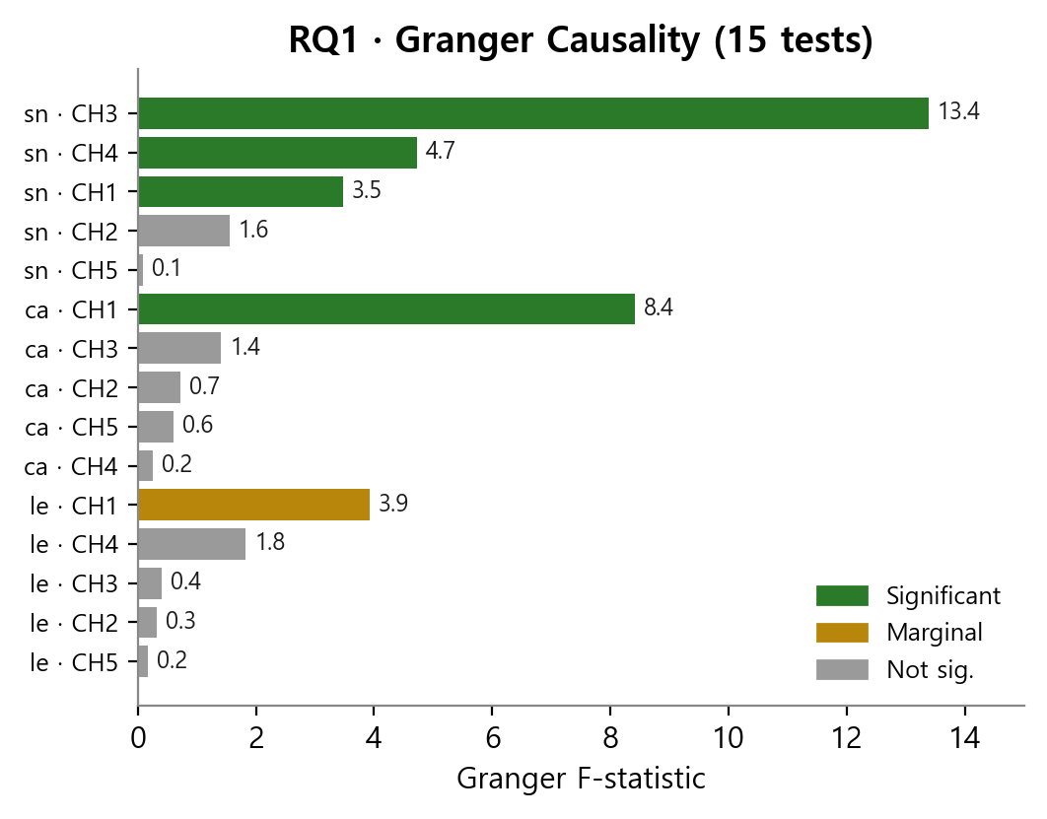
RQ1: Granger Causality — Heatmap Visualization
F-statistic heatmap across all 15 tests; significant pairs highlighted
Note. F-statistic heatmap (3 assets × 5 channels). Color intensity = F-value. Bold border = BH-significant (q < 0.05). Only 2 cells survive FDR correction: Sneakers←CH3 and Cards←CH1.
RQ1 Answer: Media channels Granger-cause resale prices in 2 of 15 tests (BH q<0.05). Effect is asset- and channel-specific — not universal across all resale markets.
8 / 16

Slide 9
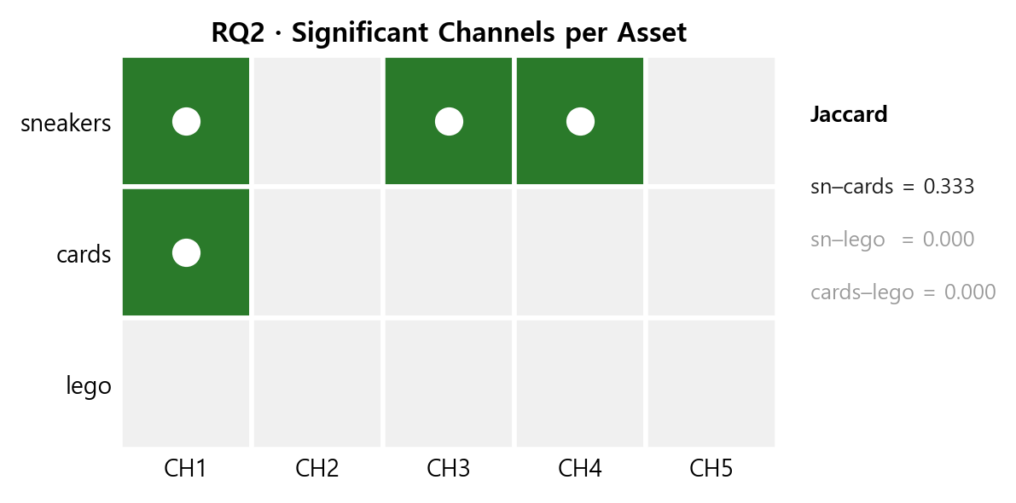
RQ2: Channel Heterogeneity — Jaccard Similarity
Comparing significant channel sets across asset classes; J=0 (fully different) to J=1 (identical)
Asset | Raw Sig. Channels (p < 0.05) | BH-Sig. Channels (q < 0.05) | Set Size (BH)
Sneakers | CH1, CH3, CH4 | CH3 | 1
Cards | CH1 | CH1 | 1
LEGO | — (none) | — (none) | 0
Jaccard Index | Sneakers | Cards | LEGO
Sneakers | 1.000 | 0.333 | 0.000
Cards | 0.333 | 1.000 | 0.000
LEGO | 0.000 | 0.000 | 1.000
Note. Left: Jaccard similarity matrix. Right: Venn diagram of BH-significant channel sets. Partial overlap between Sneakers and Cards (CH1 shared), zero overlap with LEGO.
RQ2 Answer: J(Sneakers, Cards) = 0.333 — partial overlap. J(*,LEGO) = 0.000. Channel composition differs across asset classes → supports asset-specific media channel hypothesis.
9 / 16

Slide 10
RQ3: XGBoost Model Design & Validation Framework
Model A (all channels) vs. Model C (top channels); TimeSeriesSplit prevents look-ahead bias
Component | Model A — Full Channels | Model C — Top Channels | Why This Matters
Input channels | Control + CH1 + CH2 + CH3 + CH4 + CH5 (all 5 media channels) | Control + Granger-/SHAP-selected top channels only | Test parsimony: fewer channels, same accuracy?
Control features | price_vs_ma3 price_chg_lag1, lag2, lag3 | Same | Remove price autocorrelation and trend confounding
Target variable | price_direction (0/1) month-over-month binary change | Same | Classification task; threshold-free eval via AUC
Cross-validation | TimeSeriesSplit(n_splits=5) No shuffle — maintains temporal order | Same | No data leakage into future time windows
Primary metric | AUC-ROC (fold average ± σ) | AUC-ROC (fold average ± σ) | Standard binary classification; insensitive to class imbalance
Comparison test | — | Diebold-Mariano test H₀: equal predictive accuracy | DM p > 0.05 → parsimony confirmed (top-CH matches full-CH)
TimeSeriesSplit(n_splits=5) → Fold 1: [1–10]→[11–12] | Fold 2: [1–20]→[21–22] | ... | Fold 5: [1–40]→[41–48]
10 / 16

Slide 11
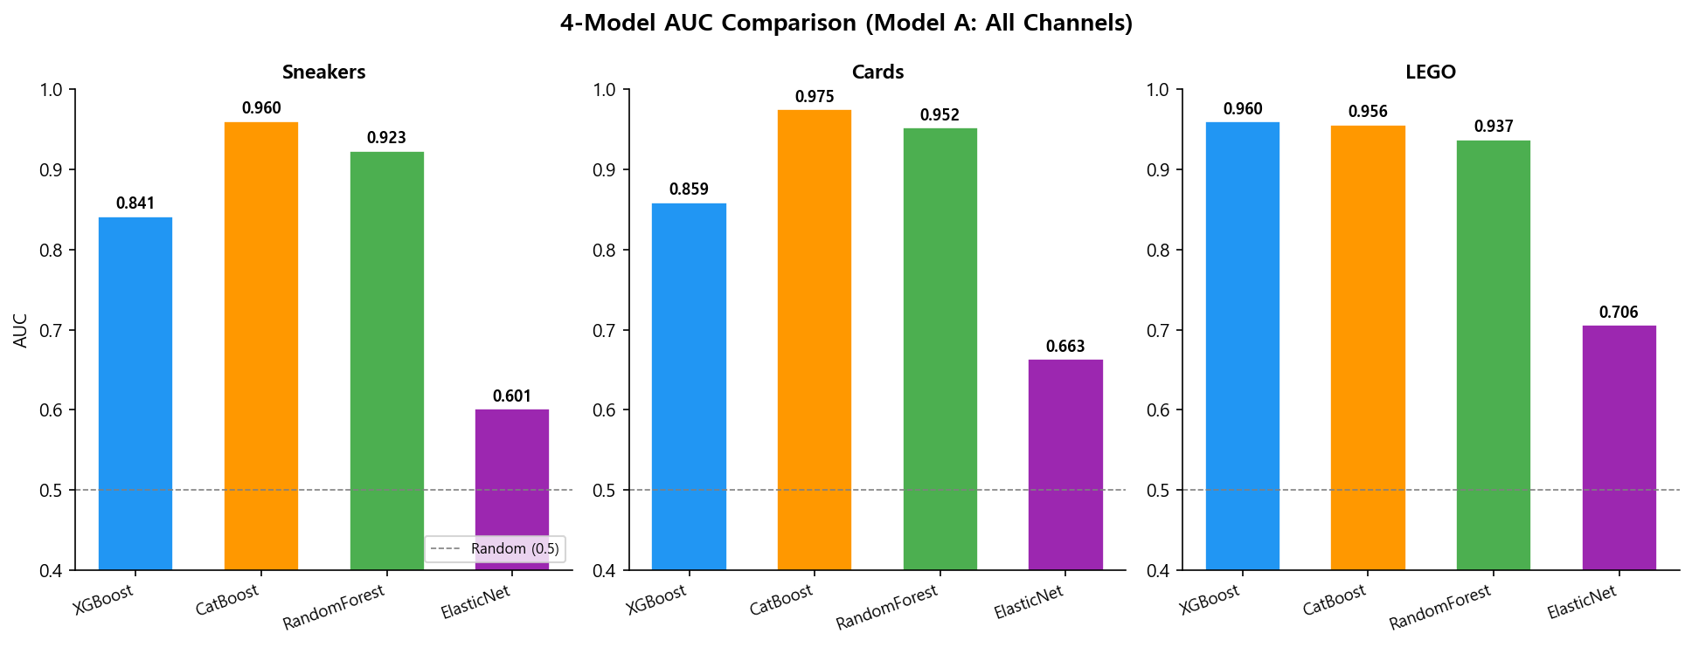
RQ3: Multi-Model AUC Comparison (TimeSeriesSplit CV, AUC-ROC)
XGBoost · CatBoost · Random Forest · ElasticNet across 3 asset classes
Asset Class | XGBoost | CatBoost | Random Forest | ElasticNet | Best Tree Model
Sneakers | 0.841 | 0.960 | 0.923 | 0.601 | CatBoost (0.960)
Cards | 0.859 | 0.975 | 0.952 | 0.663 | CatBoost (0.975)
LEGO | 0.960 | 0.956 | 0.937 | 0.706 | XGBoost (0.960)
Average | 0.887 | 0.964 | 0.937 | 0.657 | CatBoost (overall)
Note. AUC-ROC by model and asset class. Dashed line = 0.5 (random baseline). Tree-based models (CatBoost ≈ RF > XGBoost) substantially outperform ElasticNet, confirming that nonlinear channel interactions matter for resale price direction prediction.
11 / 16

Slide 12
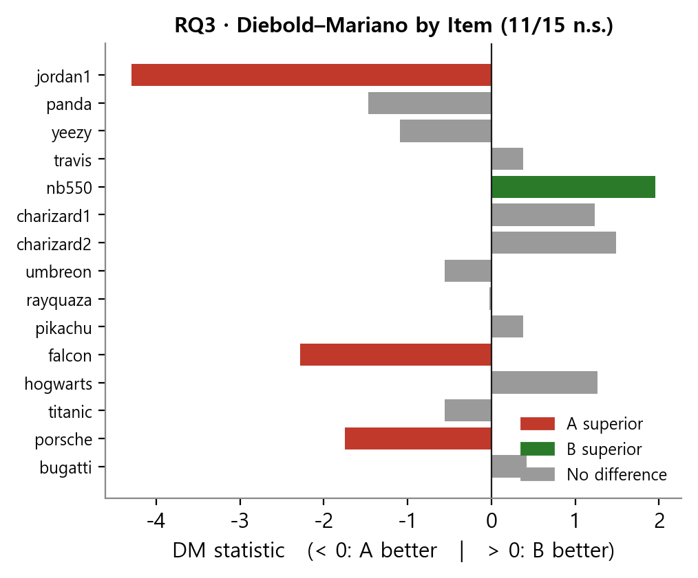
RQ3: Diebold-Mariano Test — Model A vs. Model C
H₀: equal predictive accuracy (two-sided); DM ~ N(0,1); comparing XGBoost all-channel vs top-channel
Asset | AUC — Model A (All Channels) | AUC — Model C (Top Channels) | ΔAUC (C − A) | DM Statistic | DM p-value | Verdict | Interpretation
Sneakers | 0.8413 | 0.8401 | −0.001 | −0.417 | 0.678 | Fail to reject H₀ | Parsimony confirmed ✓
Cards | 0.8587 | 0.8590 | +0.000 | −0.670 | 0.504 | Fail to reject H₀ | Parsimony confirmed ✓
LEGO | 0.9601 | 0.9626 | +0.003 | +0.460 | 0.646 | Fail to reject H₀ | Parsimony confirmed ✓
Note. DM test statistics with 95% confidence band (dashed: ±1.96). All three assets fall within |DM| < 1.96, confirming no significant accuracy difference between full-channel and top-channel models across all folds.
RQ3 Answer: Top-channel model matches full-channel accuracy for all 3 assets (DM p > 0.50). Granger-selected channels achieve parsimony without sacrificing predictive performance.
12 / 16

Slide 13
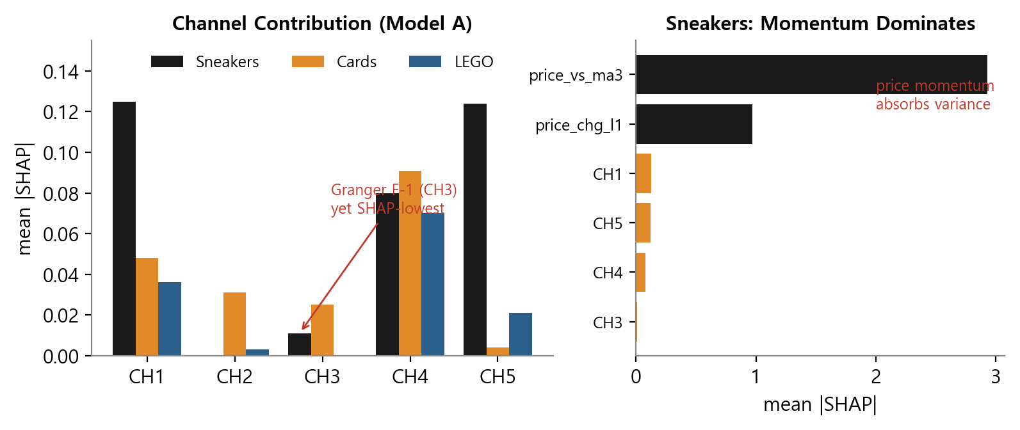
SHAP Feature Importance — Channel Contributions by Asset Class
TreeSHAP mean |SHAP| from XGBoost Model A (classification). Higher = larger contribution to predictions.
Asset | SHAP Rank 1 | SHAP Rank 2 | SHAP Rank 3 | SHAP Rank 4 | SHAP Rank 5 | Granger vs. SHAP Alignment
Sneakers | CH1 (0.125) | CH5 (0.124) | CH4 (0.080) | CH3 (0.011) | CH2 (~0) | CH3 = top Granger (F=13.4) but rank 4 in SHAP → Temporal lead ≠ feature importance (Granger: causal precedence; SHAP: cross-sectional weight)
Cards | CH4 (0.091) | CH1 (0.048) | CH2 (0.031) | CH5 (~0) | CH3 (~0) | CH1 = top Granger (F=8.4) & rank 2 in SHAP ✓ → Consistent across both tests (robust leading indicator)
LEGO | CH4 (0.070) | CH1 (0.036) | CH5 (0.021) | CH2 (~0) | CH3 (~0) | No Granger-significant channel but CH4 top in SHAP → Contemporaneous association without temporal precedence
Note. Mean |SHAP| value per channel per asset class (XGBoost Model A). SHAP captures within-model feature relevance; Granger tests temporal precedence — the two are complementary. Divergence (Sneakers CH3) reflects short-lag causal lead that has modest cross-sectional weight.
13 / 16

Slide 14
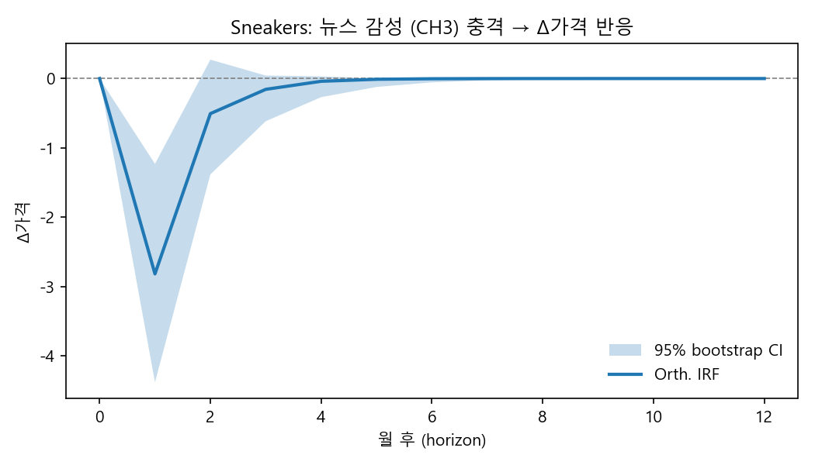
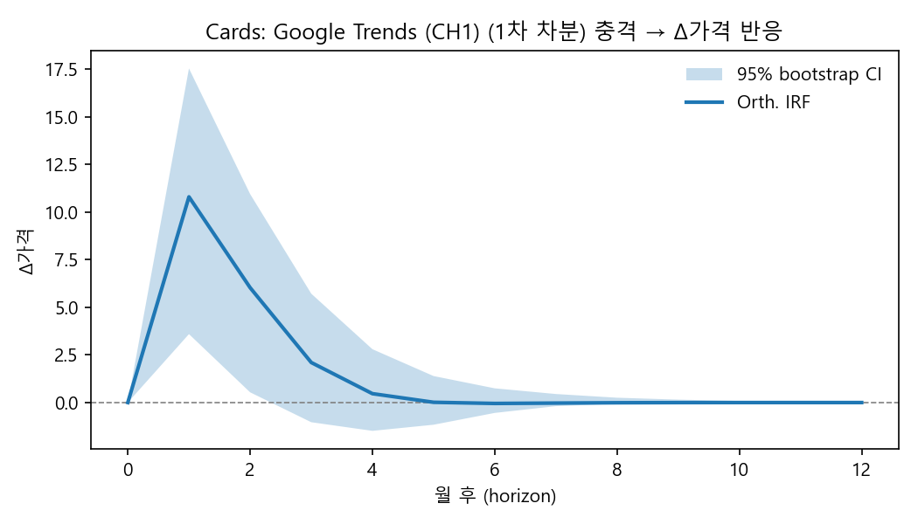
Robustness Check: Impulse Response Functions
Shock to media channel → dynamic price response over 6 months (95% bootstrap CI, 1,000 replications)
Note. Sneakers ← CH3 (News Sentiment). Negative price response at lag 1–2 (bearish news leads price drop); effect decays by lag 4. Consistent with short-lived sentiment lead.
Note. Cards ← CH1 (Google Trends). Positive price response at lag 1 (demand signal); dampening by lag 3. Consistent with Granger F=8.4 and SHAP rank 2.
Both IRFs confirm direction, sign, and decay profile of the two BH-significant Granger pairs. Results are consistent with Granger F-statistics, SHAP rankings, and economic interpretation.
14 / 16

Slide 15
Limitations
Methodological constraints and data quality issues; all discussed in paper §5.3
# | Issue | Detail | Severity | Mitigation
L1 | Small N | N=48 monthly obs per asset; under-powered for complex VAR structures | High | Report raw + BH p; note power limitation explicitly
L2 | Weak stationarity (Sneakers CH1) | ADF p=0.120 after 1st diff — borderline non-stationary | Medium | Treat CH1 Granger result cautiously; included in paper limitation
L3 | CH3 domain specificity | GDELT tone = auto-extracted (not FinBERT); lower domain precision than NewsAPI+FinBERT | Medium | Noted; sensitivity analysis in appendix
L4 | CH4 keyword bias | resell+review filter may undercount general hype or fan content | Medium | Consistent keyword protocol across items; noted as limitation
L5 | LEGO GT zero-weeks | Porsche 21/48, Bugatti 25/48 have zero GT weeks | Medium | Report zero proportion in table; exclude from strong conclusions
L6 | z-score data leakage | StandardScaler fit on full panel before TimeSeriesSplit folds | Low | N=48 → practical impact minimal; noted in §5.3
L7 | Single-platform bias | YouTube only — excludes TikTok, Reddit, Twitter/X | Low | Noted as future work opportunity
L8 | Yeezy imputation | 4 months linearly interpolated due to StockX sampling artifact | Low | tx_count=0 flagged; interpolation noted
15 / 16

Slide 16
Conclusion & Contribution
Summary of empirical findings (RQ1–RQ3) and scholarly contributions
RQ | Question (short) | Empirical Finding | Key Evidence
RQ1 | Media channels Granger-cause resale prices? | YES — 2 of 15 tests survive BH-FDR: • Sneakers ← CH3 News Sentiment (F=13.4, p=0.001) • Cards ← CH1 Google Trends (F=8.4, p=0.006) | Granger causality test; BH correction (q=0.05, m=15)
RQ2 | Channel sets differ across assets? | YES — low Jaccard similarity: • J(Sneakers, Cards) = 0.333 (partial overlap via CH1) • J(*, LEGO) = 0.000 (LEGO: no significant channel) | Jaccard index; channel set comparison
RQ3 | Top-channel model ≥ full-channel accuracy? | YES — DM test fails to reject H₀ for all 3 assets: • DM p = 0.678 / 0.504 / 0.646 (all > 0.50) → Parsimony confirmed without accuracy loss | Diebold-Mariano test; AUC-ROC comparison
Scholarly Contribution | Description
Novel domain | First systematic multi-channel Granger analysis applied to resale / alternative asset markets
Multi-asset comparison | Demonstrates channel heterogeneity: no single channel universally leads all asset classes
Methodological triangulation | Combines Granger causality (temporal precedence) + SHAP (feature contribution) + DM test (forecast comparison)
Practical implication | CH3 (news sentiment) for sneakers, CH1 (Google Trends) for trading cards: actionable leading indicators
Thank you · Questions welcome
16 / 16

