Slide 1














DIVVY’S ROAD TRIP
Presented by Jyoshnavi

Slide 2
About the Company:
Cyclistic is a bike-sharing company in Chicago, which has since expanded to include a fleet of 5,824 geotracked bicycles stationed at 692 locations across Chicago. The bikes can be unlocked at one station and returned to any other station within the network at any time. Individuals buying single-ride or full-day passes fall into the category of casual riders, while those acquiring annual memberships become recognized as Cyclistic members.
About the Dataset:
The data is publicly available on an AWS server. We were tasked to work with an entire year of data, so I downloaded zipped files (CSV format) containing data from January 2023 to December 2023, one file for each month.

Slide 3
Data Structure:
ride_id: This is a unique identifier assigned to each bike ride. It's like a reference number for the trip.
rideable_type: This column indicates the type of bike used in the ride. It can be "electric_bike" or "classic_bike".
started_at: This shows the date and time when the ride began. The format is YYYY-MM-DD HH:MM:SS.
ended_at: This shows the date and time when the ride ended. The format is the same as the started_at column.
start_station_name: This specifies the name of the docking station where the ride started.
start_station_id: This is a unique identifier for the starting docking station. It complements the start_station_name.

Slide 4
start_lat: This represents the latitude coordinate of the starting docking station.
start_lng: This represents the longitude coordinate of the starting docking station. These coordinates might be useful for mapping the station's location.
end_station_name: This specifies the name of the docking station where the ride ended.
end_station_id: This is a unique identifier for the ending docking station. It complements the end_station_name.
end_lat: This represents the latitude coordinate of the ending docking station.
end_lng: This represents the longitude coordinate of the ending docking station. These coordinates might be useful for mapping the station's location.
member_casual: This column indicates whether the rider was a member (member) or a casual user (casual) of the bike-sharing service.

Slide 5
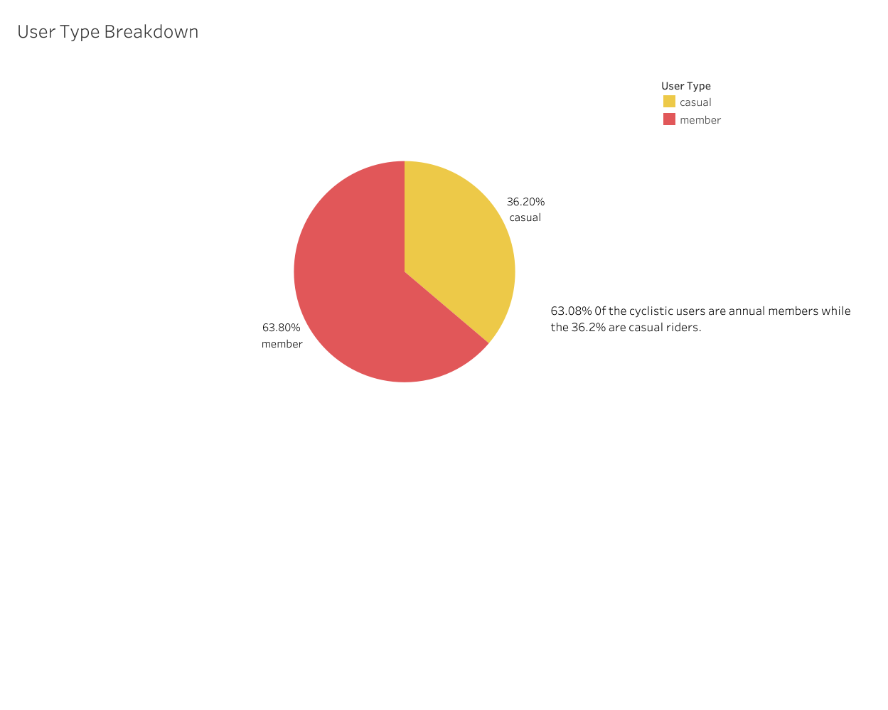

Slide 6
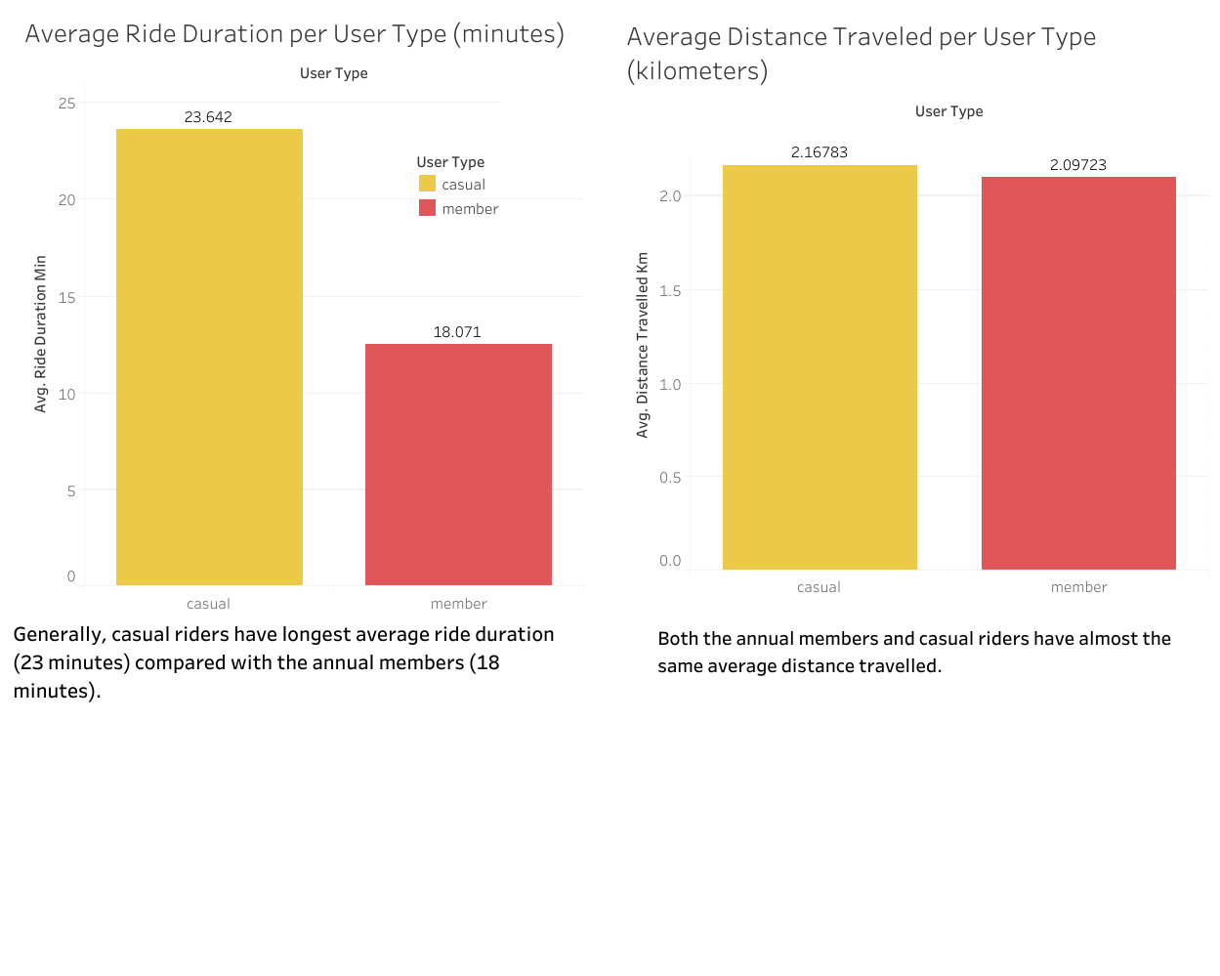

Slide 7
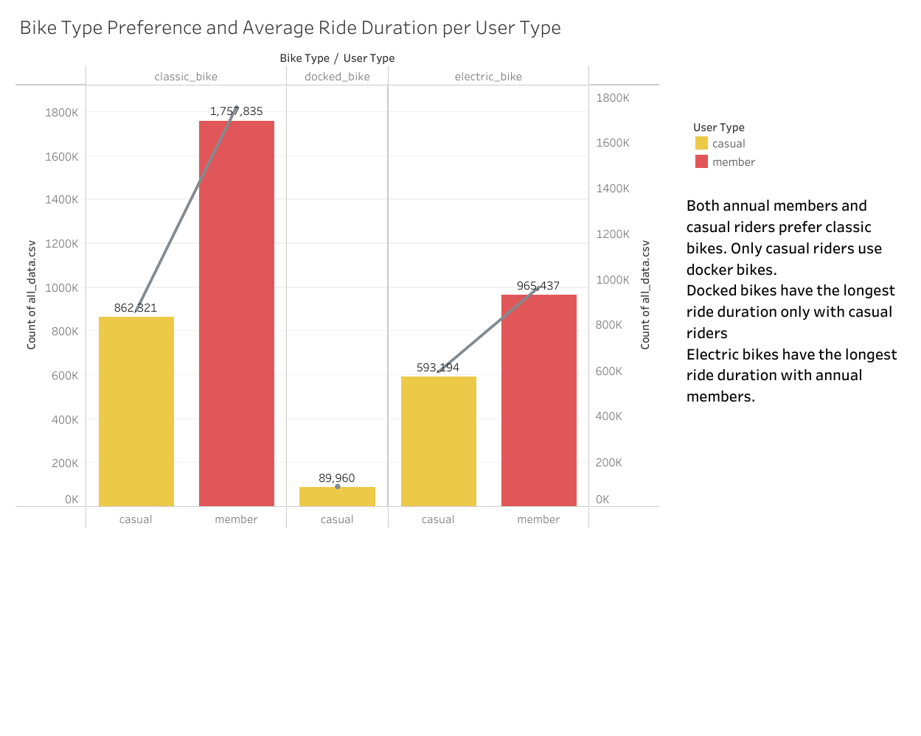

Slide 8
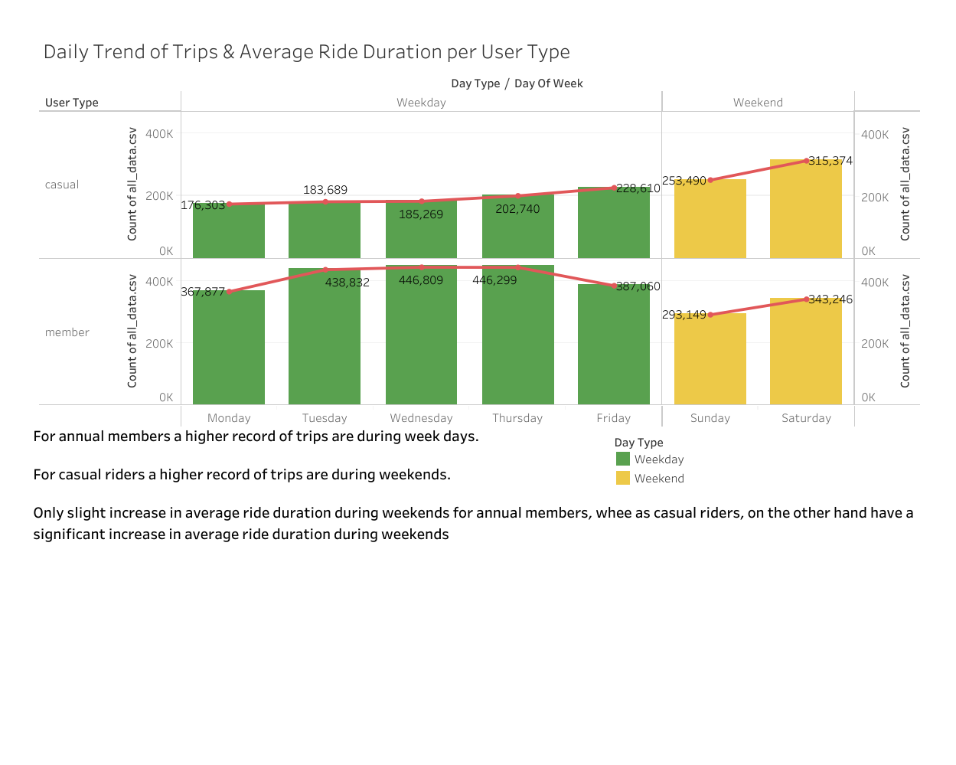

Slide 9
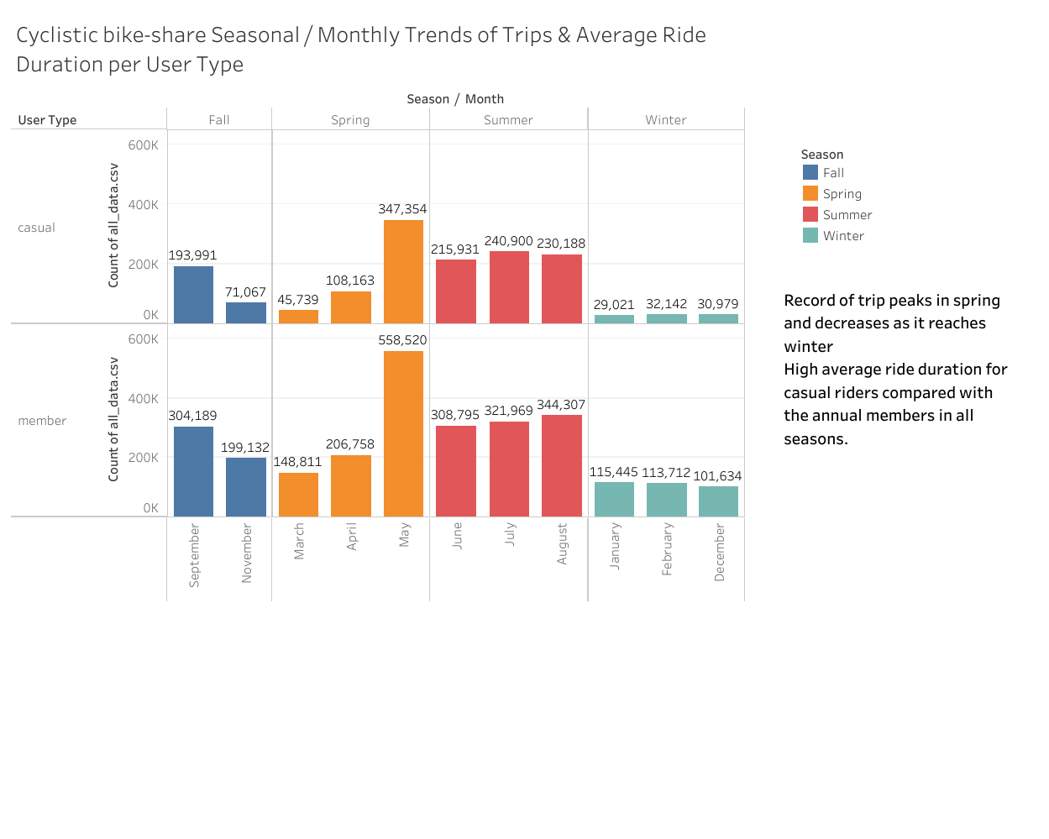

Slide 10
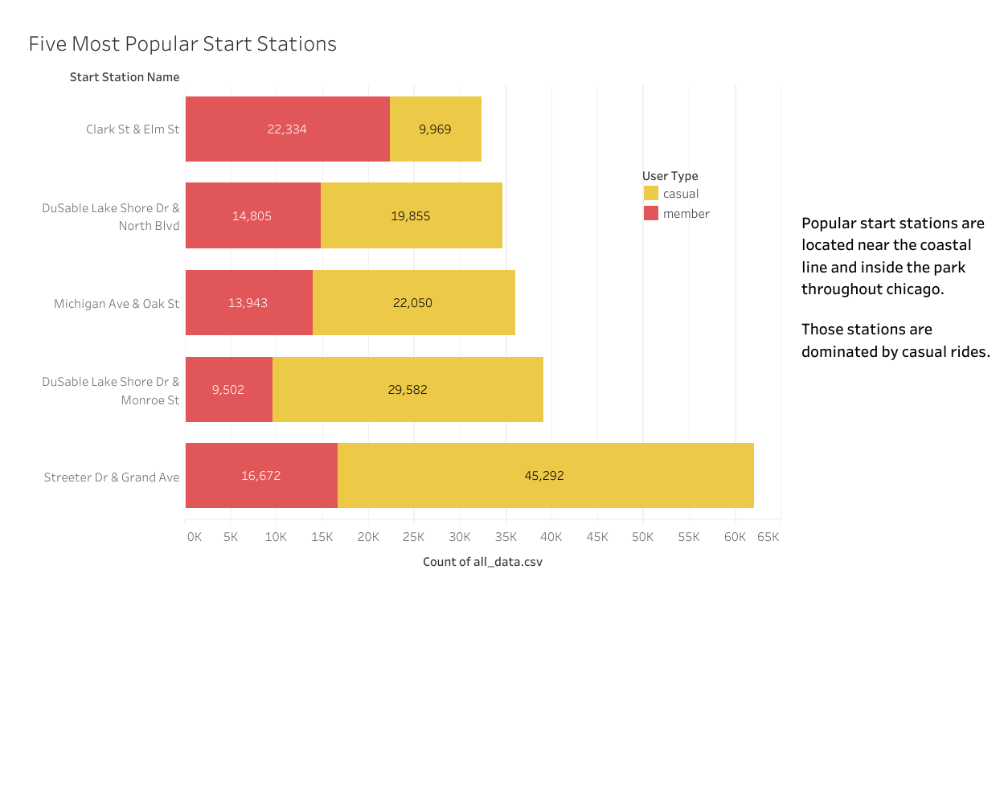

Slide 11
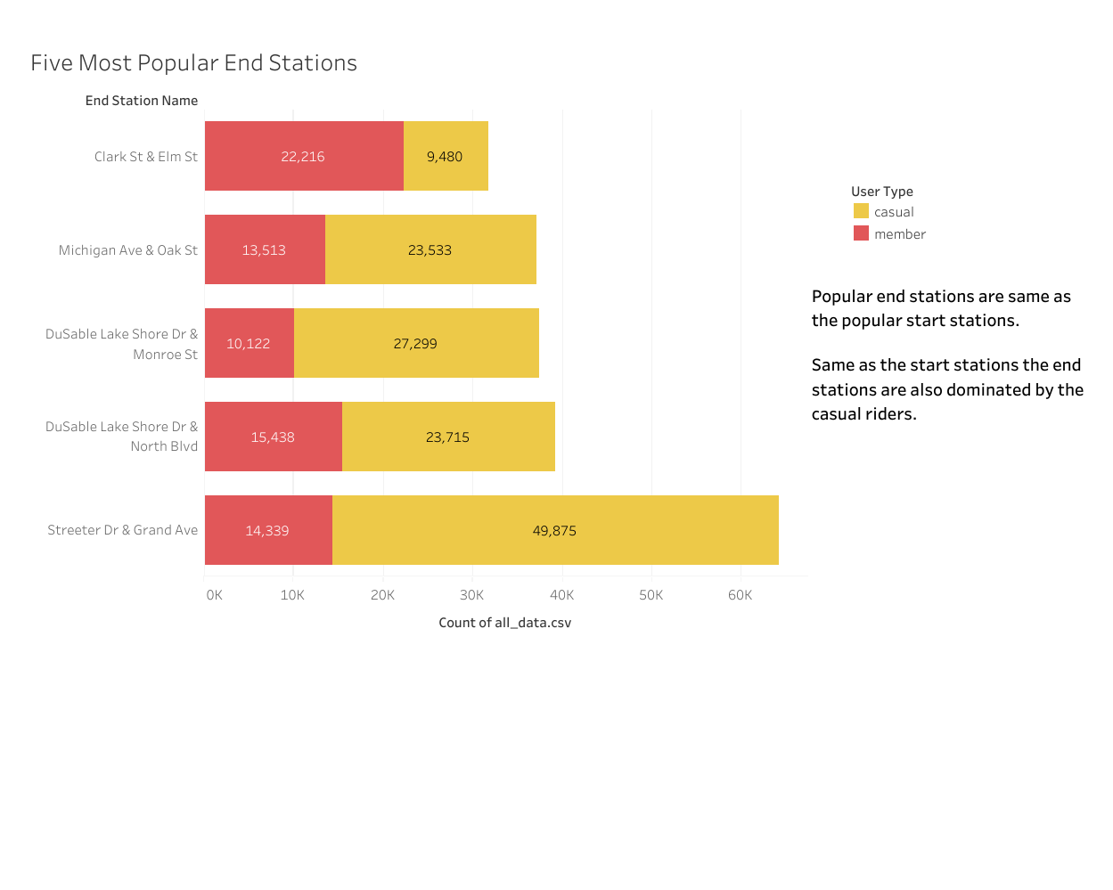

Slide 12
Conclusions
63% of the total Cyclistic users are annual members while 36% are casual riders.
Both annual members and casual riders prefer classic bikes. Only casual riders use docked bikes.
Generally, casual riders have the longest average ride duration (23 minutes) compared with annual members (18 minutes).
Both annual members and casual riders have almost the same average distance traveled.
Docked bikes have the longest average ride duration which only casual riders use. Classic bikes have the longest average ride duration for annual members.
Most trips are recorded on Saturday.
There are more trips during spring and at least during winter.

