Slide 1
KRISHNAVENI.K
B.TECH / IT – A
2021PITIT129
Final Project
3/21/2024 Annual Review

Slide 2
PROJECT TITLE
IRIS FLOWER CLASSIFICATION
( SVM ALGORITHM )
3/21/2024 Annual Review

Slide 3


AGENDA
Problem Statement: Unveiling the Bottleneck
Project Overview: Charting the Course
Target Audience: Who Benefits?
The Power of Engineering: Our Solution
The Wow Factor: Unveiling the Magic
Modeling the Solution: Building the Engine
Unveiling the Results: The Proof is in the Data
3/21/2024 Annual Review

Slide 4

PROBLEM STATEMENT
Develop a machine learning model using the Support Vector Machine (SVM) algorithm to classify iris flowers based on their sepal and petal characteristics. The goal is to accurately predict the species of iris flowers (setosa, versicolor, or virginica) given measurements of sepal length, sepal width, petal length,
and petal width.
3/21/2024 Annual Review

Slide 5

PROJECT OVERVIEW
The Iris Flowers Classification project aims to develop a machine learning model utilizing the Support Vector Machine (SVM) algorithm to classify iris flowers based on their sepal and petal characteristics. The ultimate goal is to accurately predict the species of iris flowers, namely setosa, versicolor, or virginica, using measurements of sepal length, sepal width, petal length, and petal width with the help of different kernels of SVM.
3/21/2024 Annual Review

Slide 6
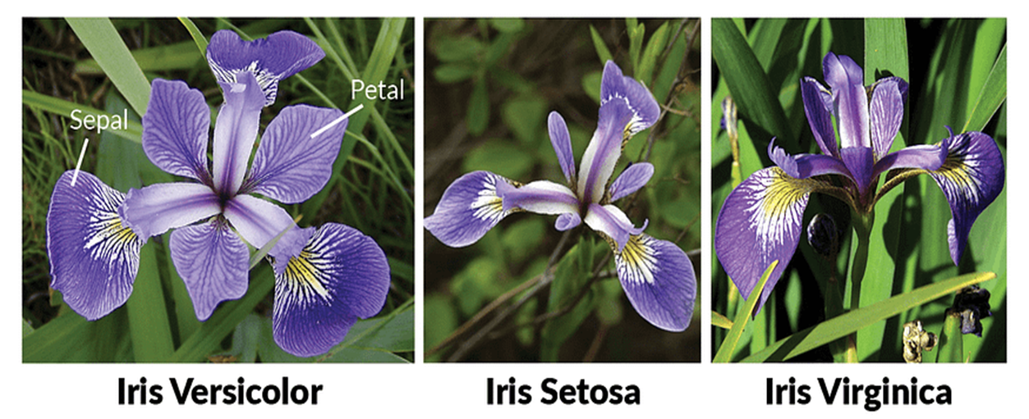
Images
Iris flower can be classified into three based on there sepal length , petal length , sepal width , petal width they are listed below

Slide 7

WHO ARE THE END USERS?
Botanists and Biologists:
May find the classification model useful for identifying and categorizing iris flowers based on their characteristics.
Horticulturists and Gardeners:
May utilize the model to identify and classify different iris species, aiding in plant breeding, cultivation, and landscaping projects.
Educators and Students:
May use the model for educational purposes, such as demonstrating classification techniques and species identification methods.
Conservationists and Environmentalists:
May benefit from the model's ability to identify and monitor different iris species, aiding in biodiversity assessments and habitat conservation initiatives.
Commercial Nurseries and Florists:
May use the model to accurately classify iris flowers, ensuring the correct labeling and marketing of their products.
3/21/2024 Annual Review

Slide 8

YOUR SOLUTION
Solution:
The proposed solution involves developing a machine learning model using the Support Vector Machine (SVM) algorithm to classify iris flowers based on their sepal and petal characteristics. This model will be trained on the Iris dataset, which contains measurements of sepal length, sepal width, petal length, and petal width for different iris species.
To classify the three different types of the iris flower more precisely , we used different kernels of SVM (Support Vector Machine) such as ,
Linear Kernel
Polynomial Kernel
Gaussian Radial Basis Function (RBF) Kernel
Sigmoid Kernel
3/21/2024 Annual Review

Slide 9
value proposition refers to a clear statement that outlines the unique benefits or value that the project delivers to its stakeholders. It communicates the specific advantages or solutions that the project offers to address classification of Iris problem, the following are the value propositions ;
Value Proposition
Accurate Classification
Automated Species Identification
Improved Decision-Making
Enhanced Efficiency
Educational Resource
Potential for Integration

Slide 10

THE WOW IN YOUR SOLUTION
The "wow" factor in my solution lies in the comprehensive exploration and optimization of various SVM kernels to achieve the most precise classification of iris flowers.
By leveraging different kernel functions such as Linear, Polynomial, Gaussian Radial Basis Function (RBF), and Sigmoid, I aim to unlock the full potential of SVM in accurately predicting the species of iris flowers based on their sepal and petal characteristics.
Instead of relying on a single kernel, I employed a diverse set of SVM kernels to capture different types of relationships and patterns present in the Iris dataset.
Each kernel is carefully optimized to maximize the precision of iris flower classification.
The use of multiple kernels enhances the robustness and flexibility of our solution.
3/21/2024 Annual Review

Slide 11
MODELLING
Data Exploration and Preprocessing:
Explore the Iris dataset to understand its structure and characteristics.
Preprocess the data, which includes handling missing values, scaling features, and encoding categorical variables.
Model Development with SVM:
Implement the SVM algorithm for multi-class classification using appropriate kernel functions (e.g., linear, polynomial, radial basis function).
Fine-tune SVM hyperparameters such as the regularization parameter (C) and kernel parameters to optimize model performance.
Model Evaluation:
Evaluate the SVM model's performance using various metrics such as accuracy, precision, recall, and F1-score.
Visualize confusion matrices and ROC curves to assess classification performance and model robustness.

Slide 12
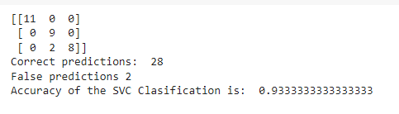
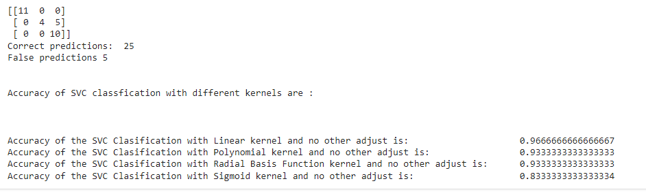
RESULTS
https://colab.research.google.com/drive/1VKn4Wl-5wiz9WEZ4QRxRnRRJuDj3Zal7#scrollTo=ndUPxbRpwJVJ&line=23&uniqifier=1

