Slide 1
RESTING TREMOR SUPPRESSION DEVICE
EE300W CAPSTONE PROJECT

Slide 2
TABLE OF CONTENTS
RESTING TREMOR SUPPRESSION DEVICE
Introduction
Treatment Options
Scope & Goals
Selected approach
Future plans
References

Slide 3
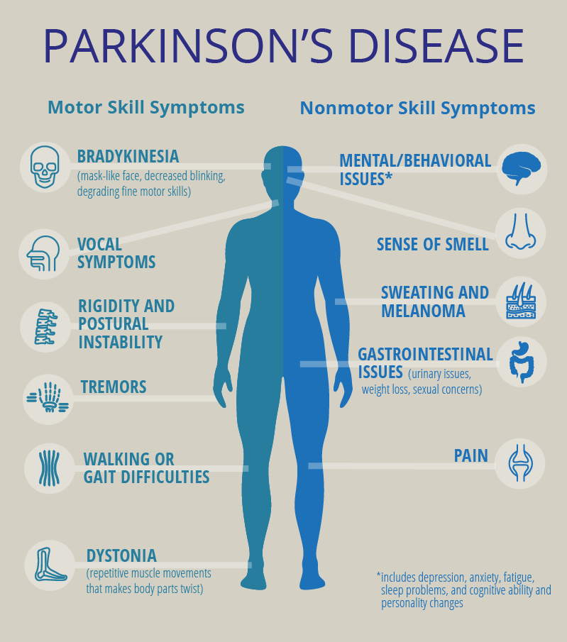
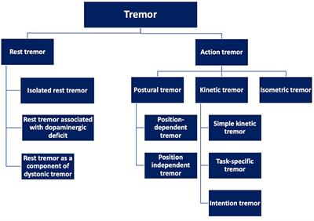
INTRODUCTION
RESTING TREMOR SUPPRESSION DEVICE
What is Parkinson’s disease?
  P.D. symptoms
What is tremor?
  Different kinds of tremor
  Effects of tremor and need for suppression
Rest tremor vs Action tremor frontiersin
P.D. symptoms pcori

Slide 4
TREATMENT OPTIONS
RESTING TREMOR SUPPRESSION DEVICE
Deep Brain Stimulation (D.B.S.)
Allopathic Medication
Neuromuscular Electrical Stimulation
Passive Suppression Orthoses

Slide 5
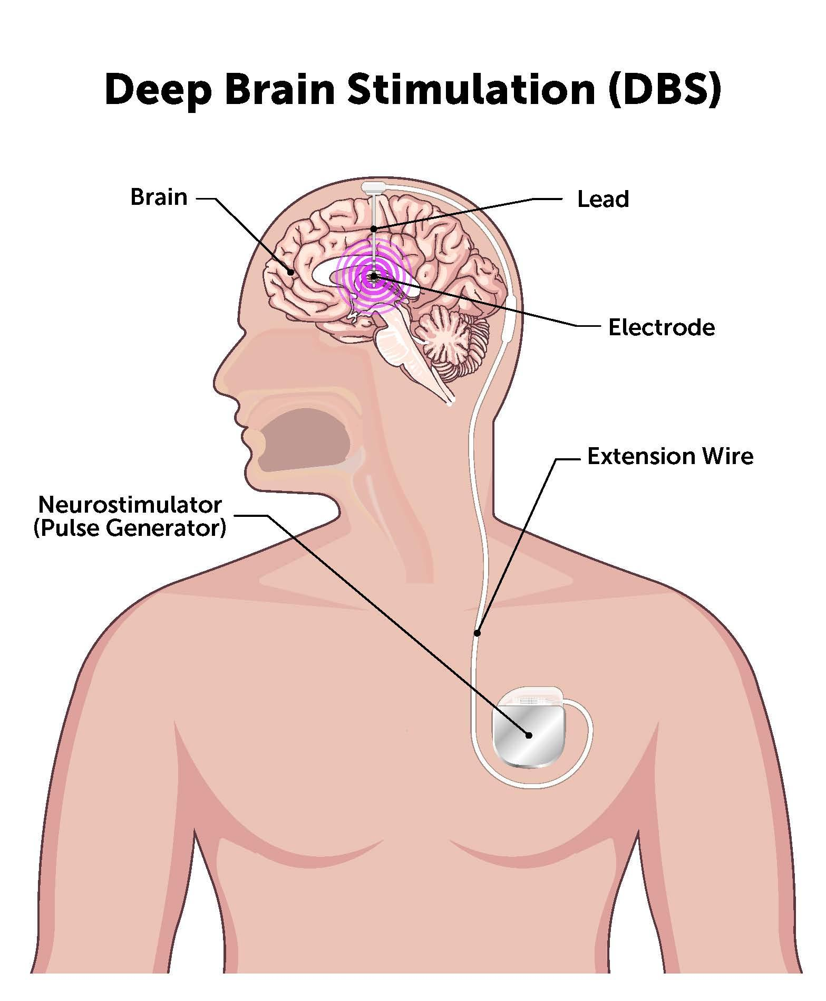
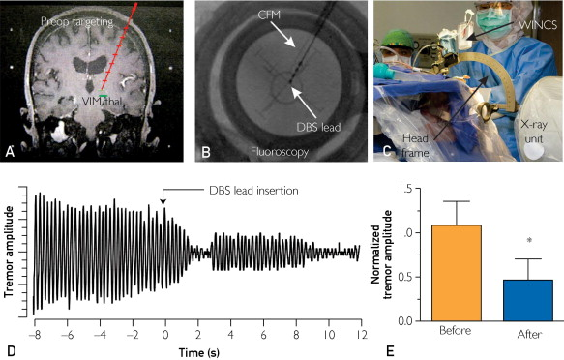
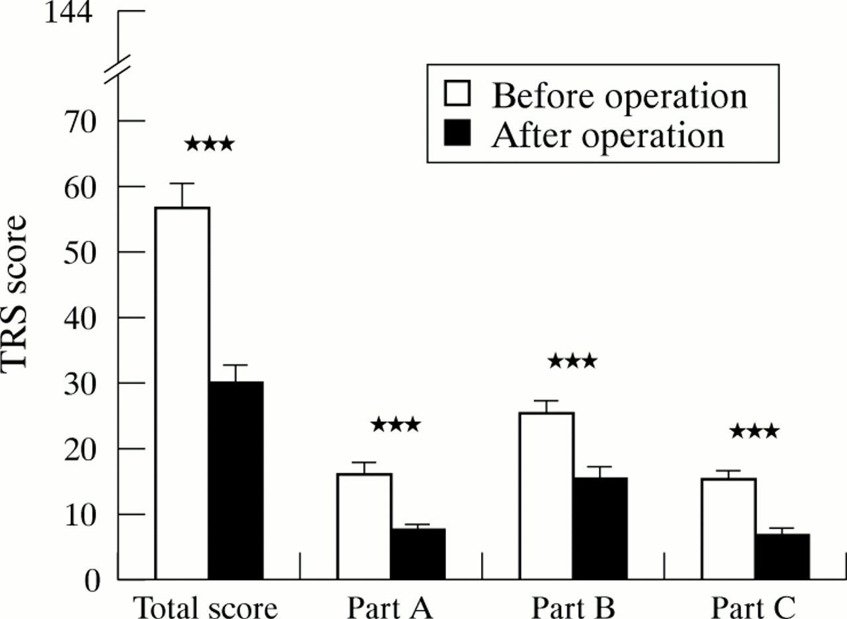
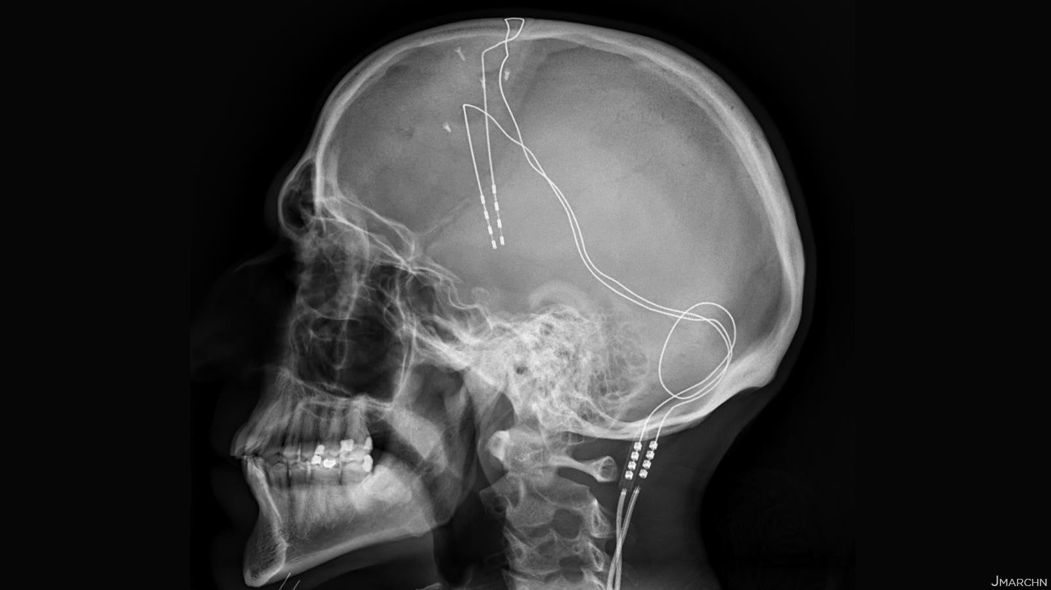
DEEP BRAIN STIMULATION (D.B.S.)
RESTING TREMOR SUPPRESSION DEVICE
Procedure:
  Electrodes implanted in the thalamus
  Signal generator implanted
Results:
  Mean amplitude reduction: 54%
Problems:
  Invasive surgery required
D.B.S. X-ray medpagetoday(2021)
Tremor score before vs after D.B.S. procedure bmj
D.B.S. procedure and tremor amplitude graphs elsevierhealth
D.B.S. components parkinsonsNSW

Slide 6
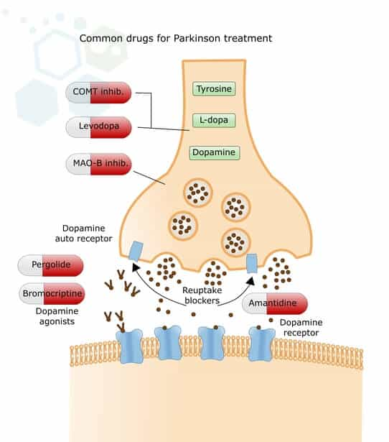
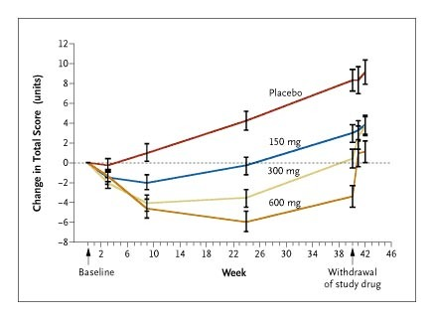
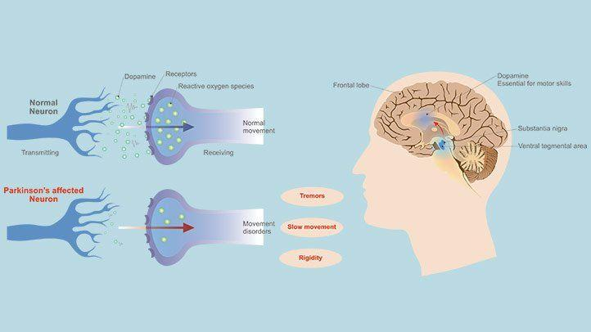
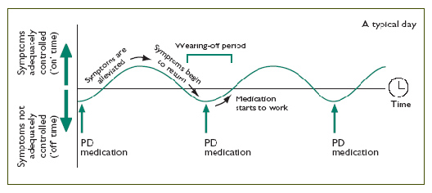
ALLOPATHIC MEDICATION
RESTING TREMOR SUPPRESSION DEVICE
Mechanism:
  Facilitate the production of Dopamine
  Prevent the reuptake of Dopamine
Results:
  Significant reduction of symptoms
Problems:
  Regular re-administration of drugs needed
  Possible side effects and drug interactions
Administration of P.D. medication vs symptom severity epda
Base cause of P.D. everydayhealth
Change in tremor score vs medication dose nejm
Working mechanism of P.D. medication stemcellthailand

Slide 7
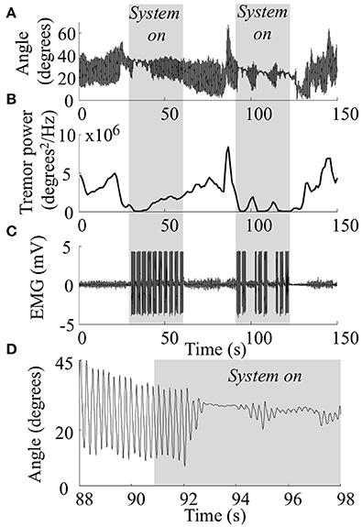
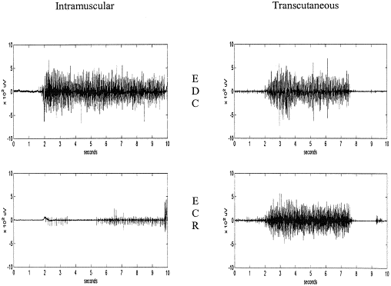
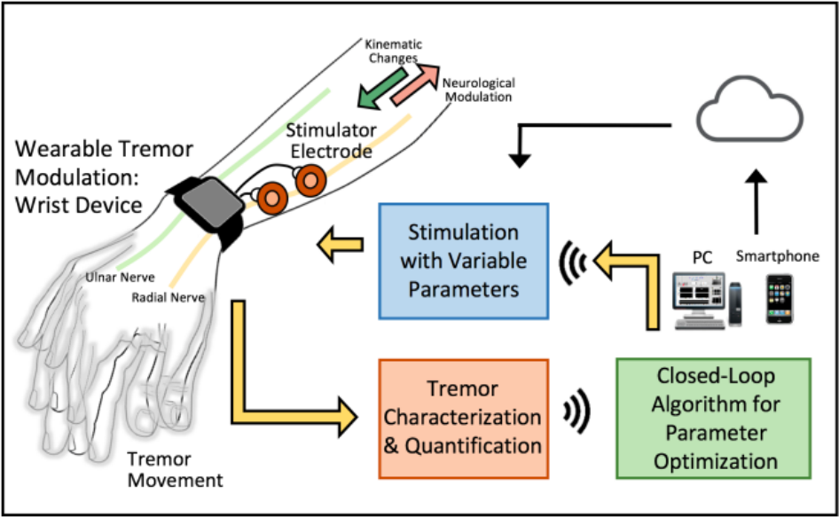
NEUROMUSCULAR ELECTRICAL STIMULATION
RESTING TREMOR SUPPRESSION DEVICE
Types:
  Primarily Peripheral Nerve Stimulation and Electrical Muscular Stimulation
Mechanism:
  Trigger muscular reactions
  Tremor characteristics influence stimulus
Results:
  Moderate reduction in tremor motion
Problems:
  Placement of electrodes has to be precise
Change in tremor motion elsevierhealth
Change in tremor characteristics frontiersin
NMES functioning embs

Slide 8
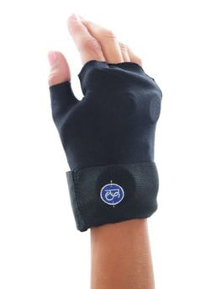
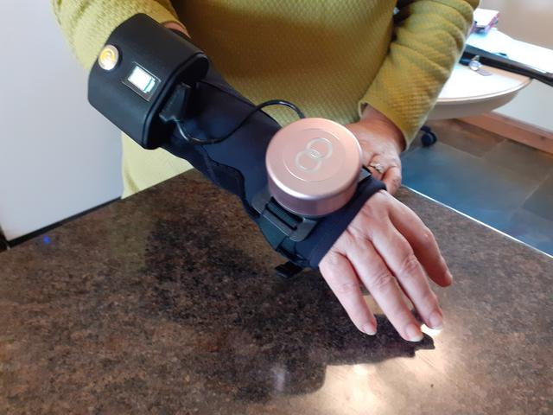
PASSIVE SUPPRESSION ORTHOSES
RESTING TREMOR SUPPRESSION DEVICE
Rely on gyroscopic stabilisation or restrictive gear to reduce tremor magnitude
Problems:
  Bulky and cumbersome
GyroGlove reutersmedia
Steadi-one glove readi-steadi

Slide 9
SCOPE AND GOALS
RESTING TREMOR SUPPRESSION DEVICE
Suppression of resting tremor in P.D. patients
Use sensor data to determine motion type
Perform all computation off-line and in real-time
User performs voluntary movement upon receiving feedback

Slide 10
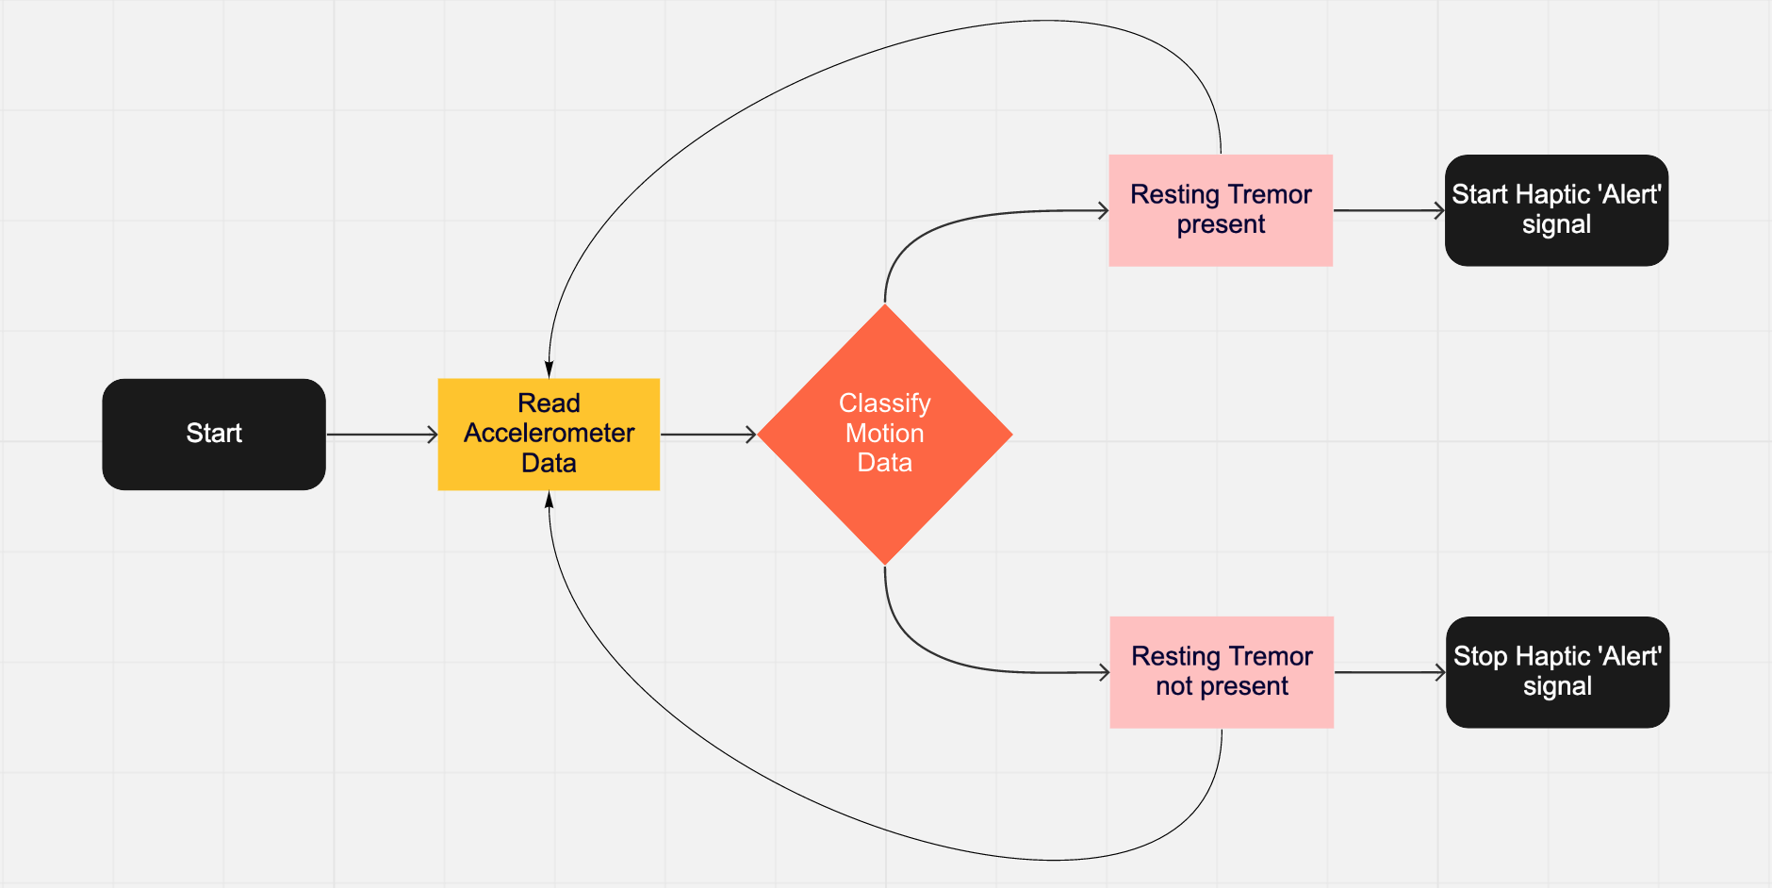
SELECTED APPROACH
RESTING TREMOR SUPPRESSION DEVICE
‘Brains’ of the project
Collection and processing of data
Classification of data to motion type
Feedback system for user
High level diagram of computation

Slide 11
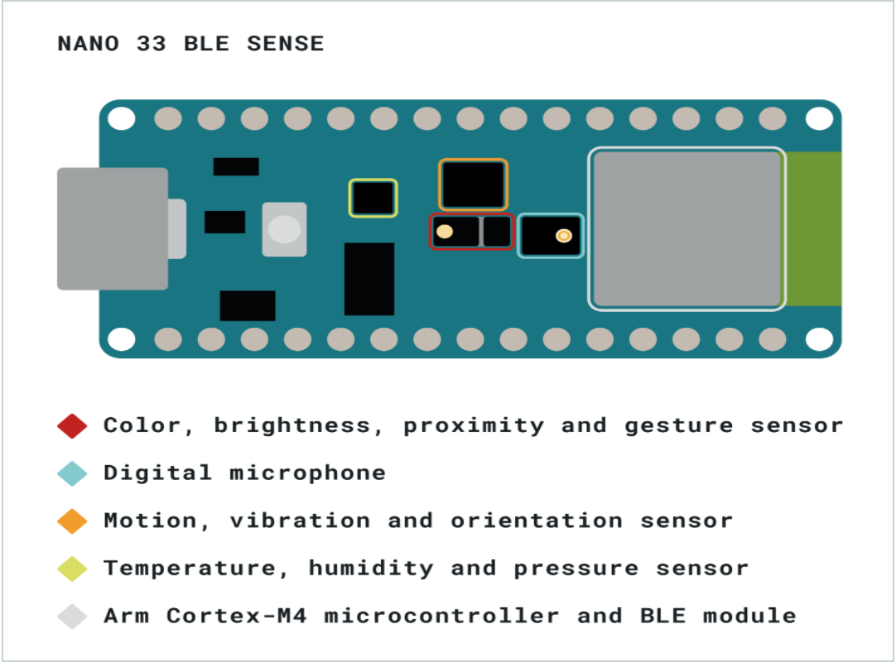
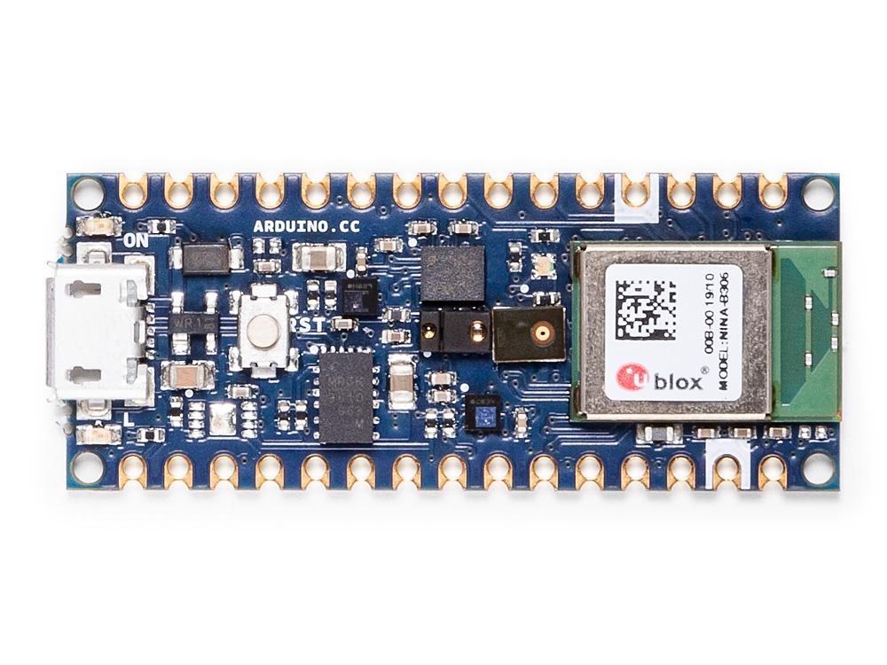
‘BRAINS’ OF THE PROJECT
RESTING TREMOR SUPPRESSION DEVICE
Arduino Nano 33 BLE Sense
Arduino Nano 33 BLE Sense arduino(2020)
Component placement arduino(2020)

Slide 12
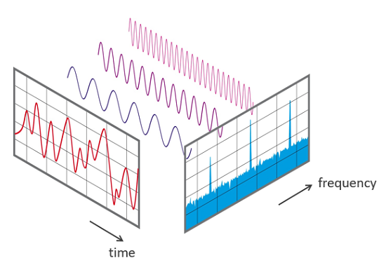
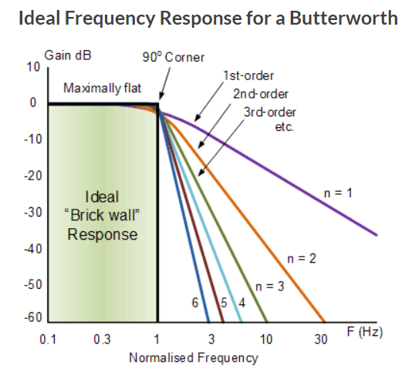
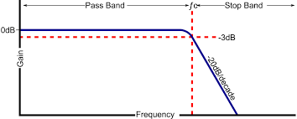
PROCESSING OF DATA
RESTING TREMOR SUPPRESSION DEVICE
Splitting data into fixed windows
6th order Butterworth filter
Fourier Transform
Frequency domain and spectral power features extracted
Low-pass filter
Fourier transform nti-audio
Butterworth filter imgur

Slide 13

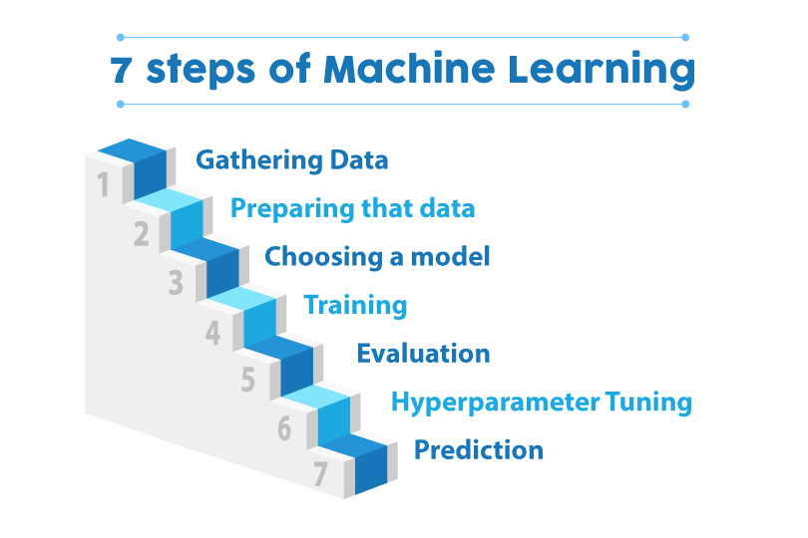

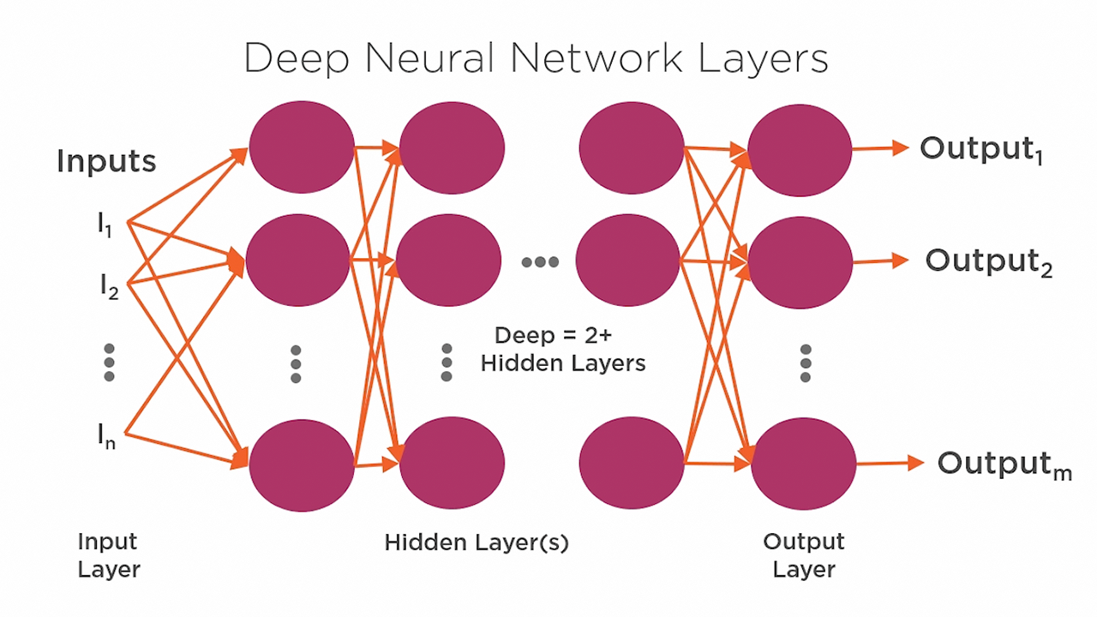
CLASSIFICATION OF DATA TO MOTION TYPE
RESTING TREMOR SUPPRESSION DEVICE
What are machine learning, and neural networks?
  Neural Network Classifier built around the Keras library
      Enables fast experimentation with deep neural networks
Basic working of Neural Networks pluralsight
cloudfront
amazonaws

Slide 14
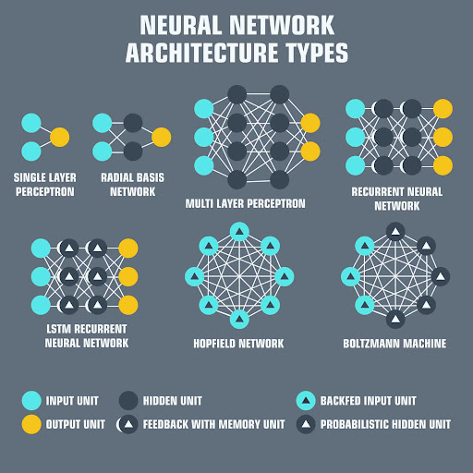
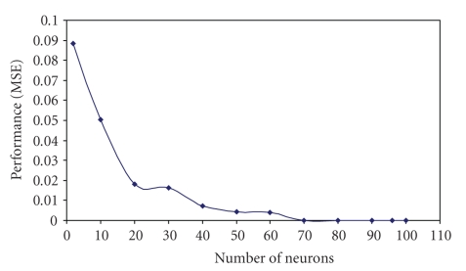
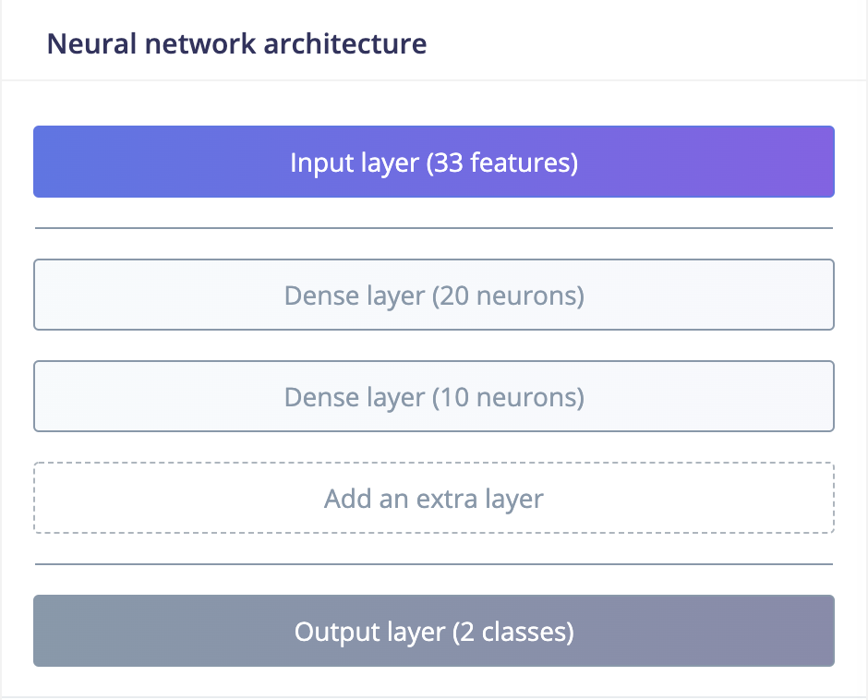
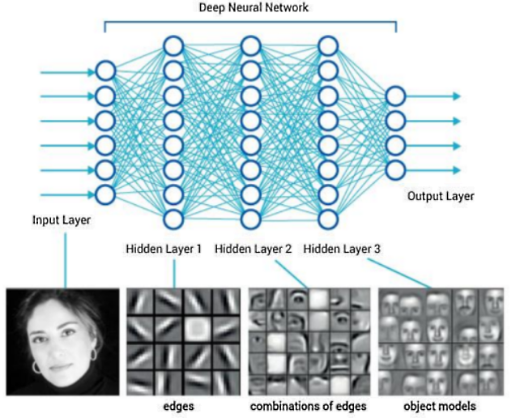
CHOOSING THE BEST STRUCTURE FOR THE NEURAL NETWORK
RESTING TREMOR SUPPRESSION DEVICE
Types of neural network layers
How to choose the number of layers?
How to choose the number of neurons in each layer?
Required number of layers opengenus
Chosen NN architecture
Mean Squared Error vs number of neurons in a layer abbod maysam f.(2010)

Slide 15
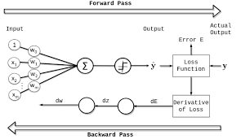
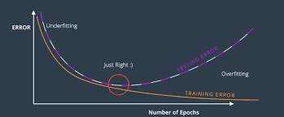
TRAINING OF THE NEURAL NETWORK
RESTING TREMOR SUPPRESSION DEVICE
How is a neural network trained?
Number of training epochs?
Single training epoch
Number of training epochs vs. error%

Slide 16
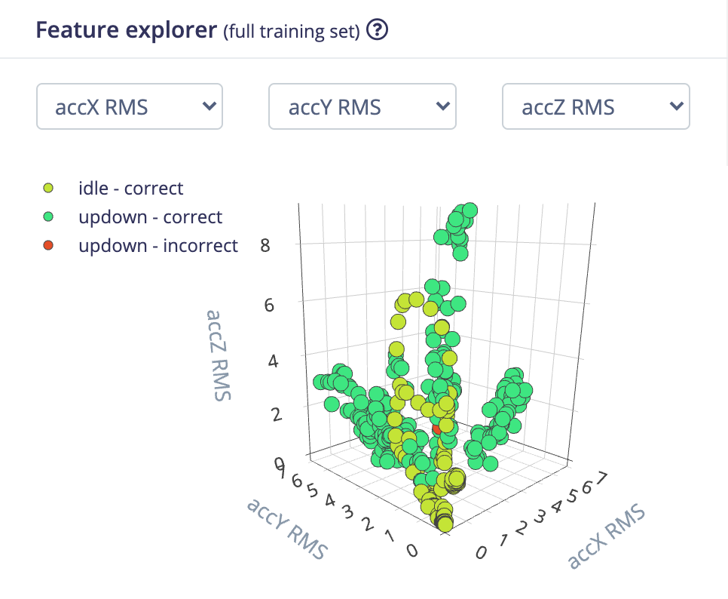

RESULTS
RESTING TREMOR SUPPRESSION DEVICE
Accuracy: 90%
Loss: 0.650

Slide 17
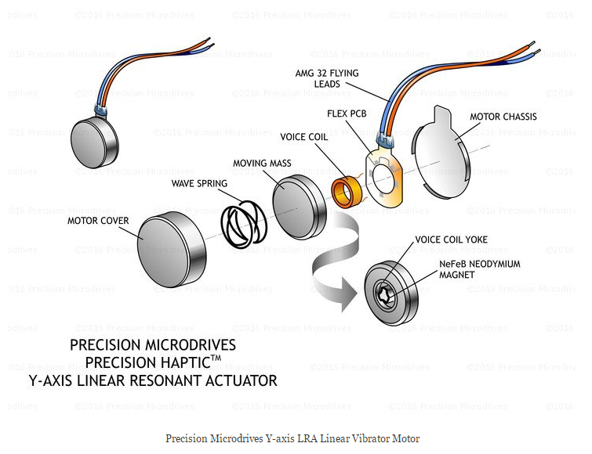
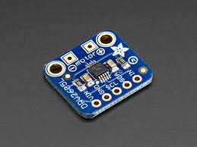
FEEDBACK MECHANISM
RESTING TREMOR SUPPRESSION DEVICE
Haptic feedback using DRV2605L and ERM motor
  Waveform generation for the motor
DRV2605L Haptic Motor Controller adafruit
Eccentric Rotating Mass Motor Construction sparkfun

Slide 18
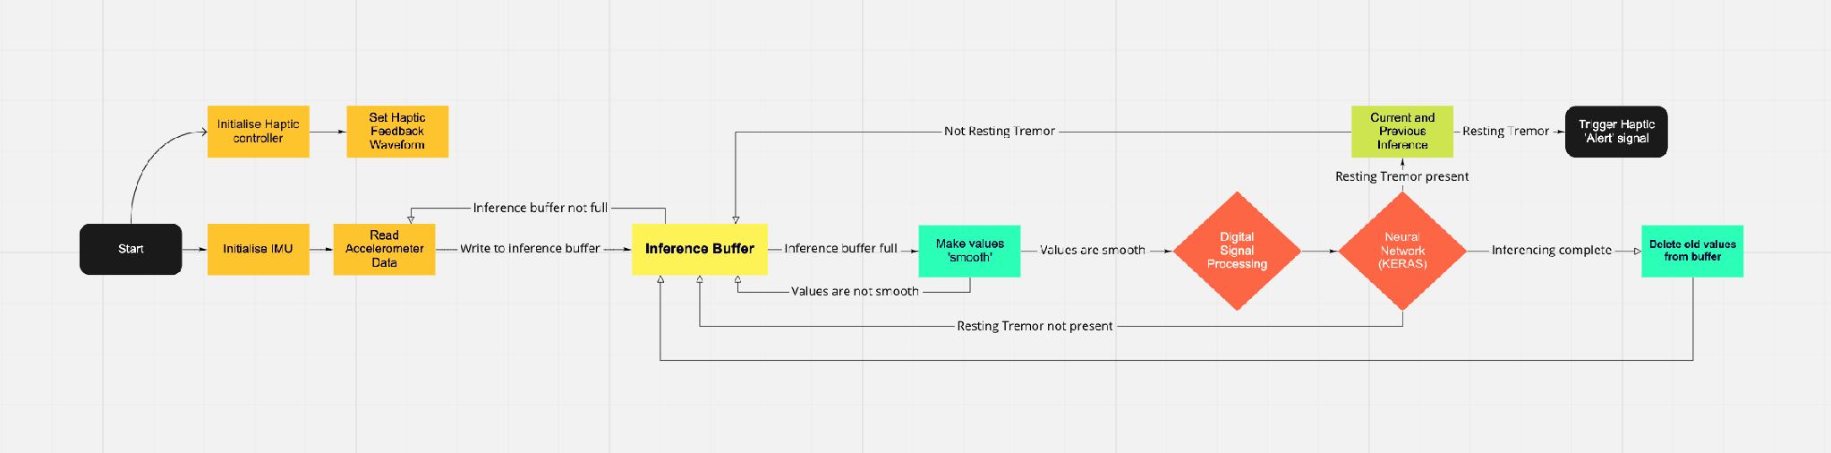
LOW LEVEL DIAGRAM
RESTING TREMOR SUPPRESSION DEVICE
Low level diagram of computation

Slide 19
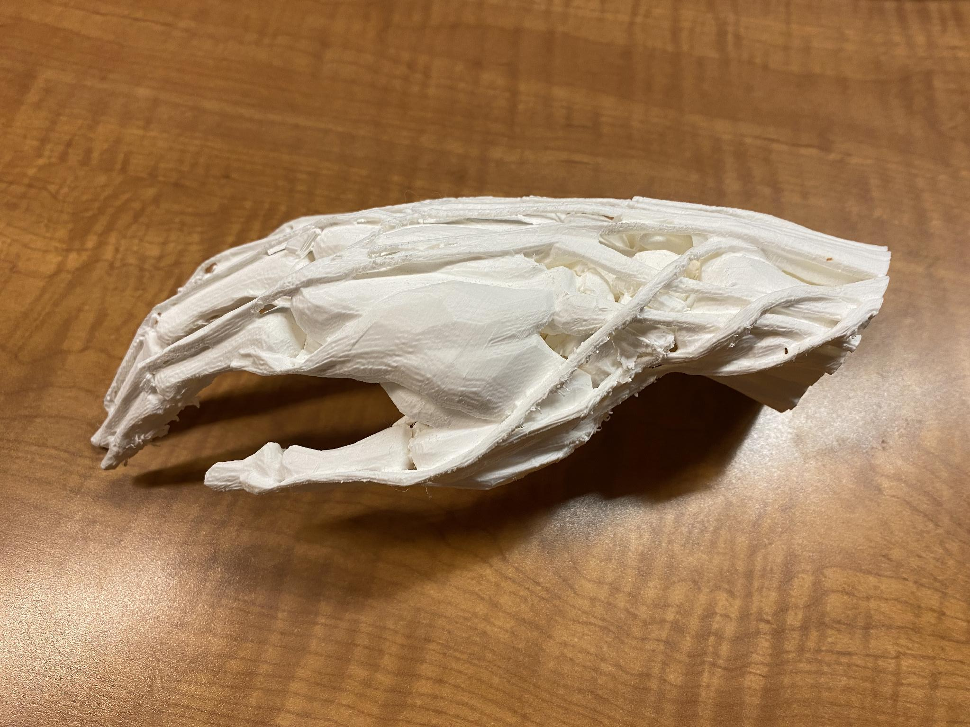
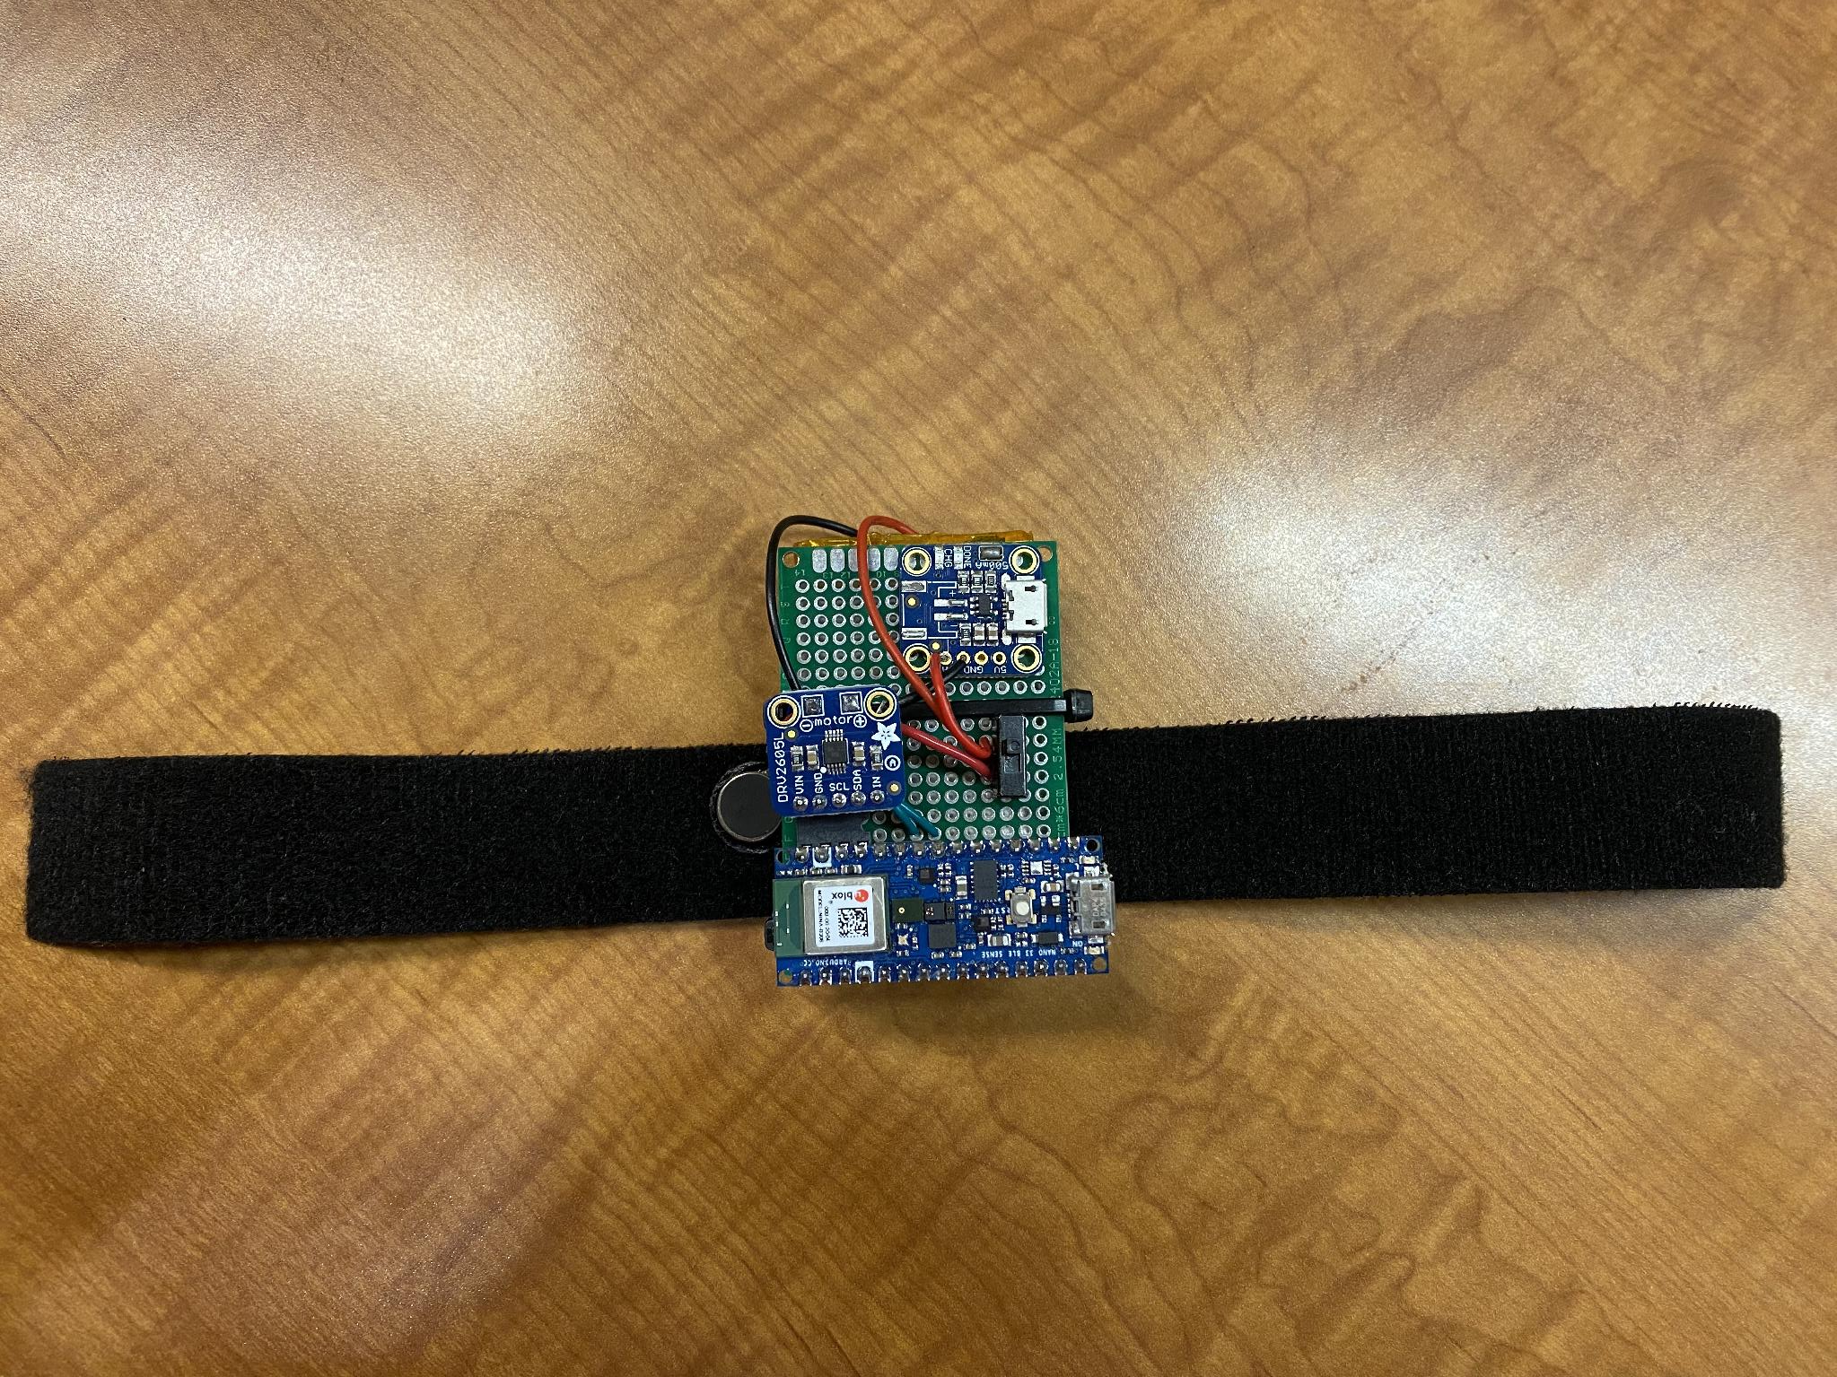
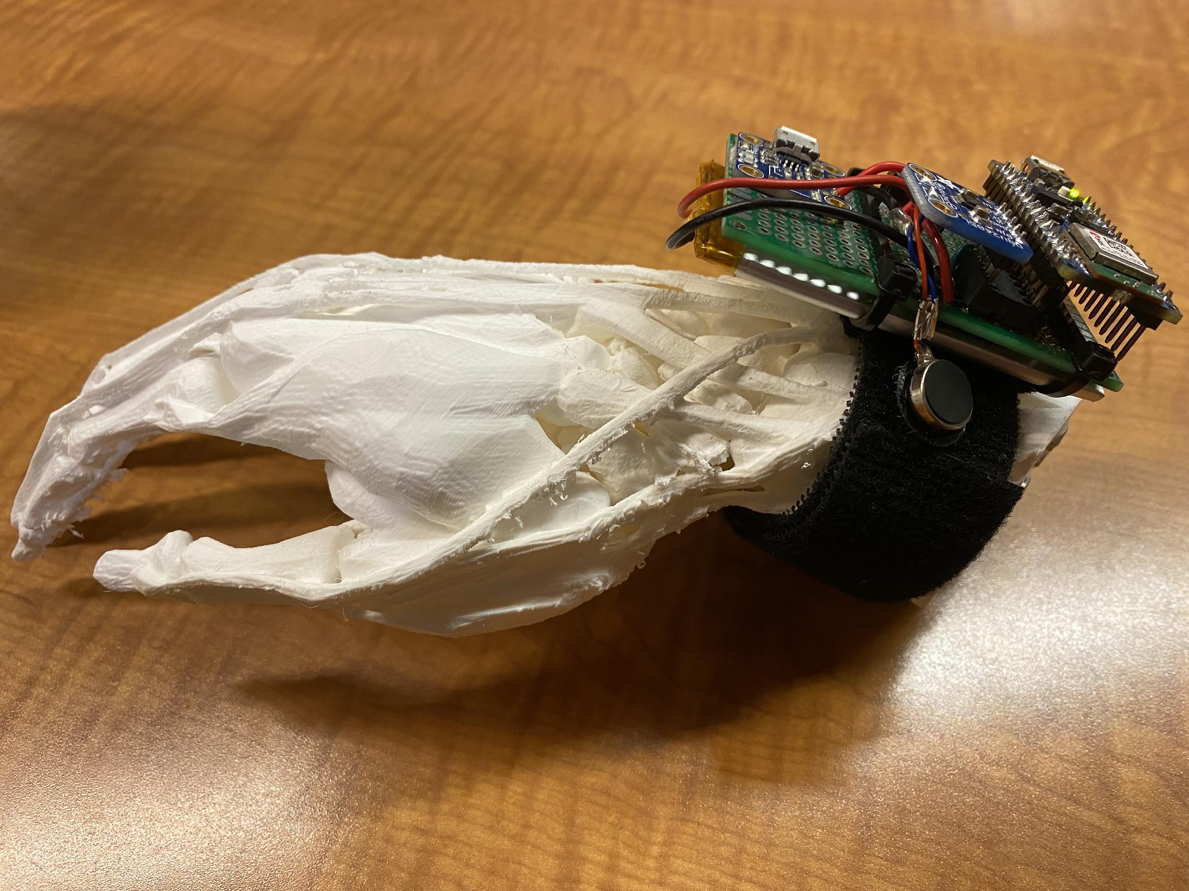
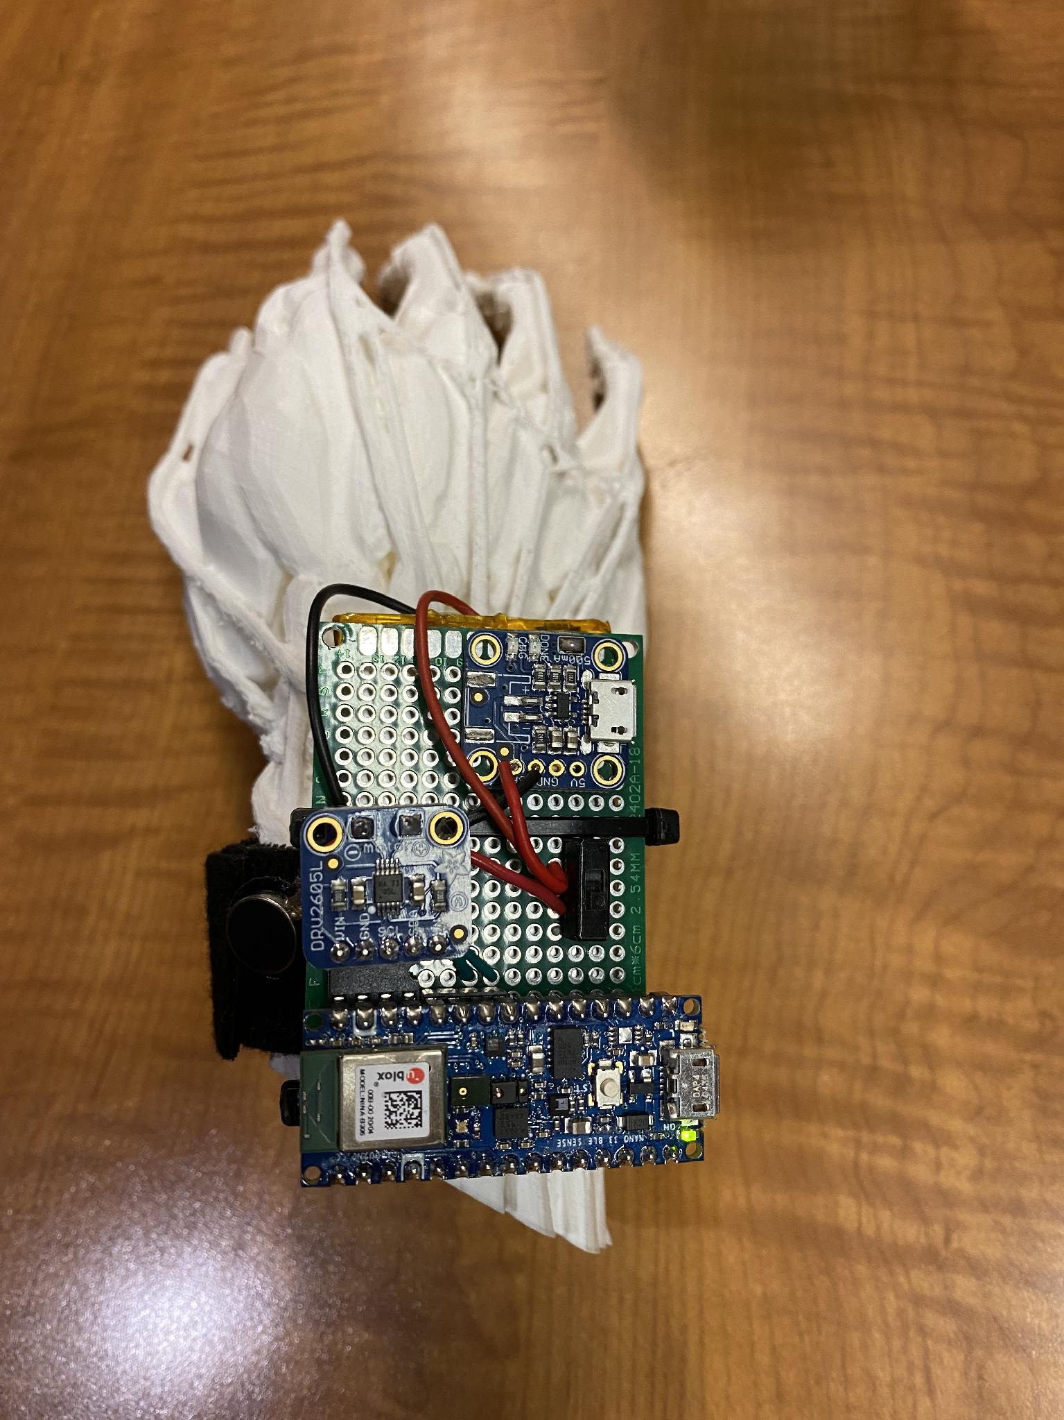
PROTOTYPE
RESTING TREMOR SUPPRESSION DEVICE
Device affixed onto hand
Device affixed onto hand
Human hand model with peripheral nerves and tendons
Prototype device

Slide 20
FUTURE PLANS
RESTING TREMOR SUPPRESSION DEVICE
Distinguish between Essential tremor and resting tremor in P.D. patients
  Added suppression of Essential tremor
Assign UPDRS scores to classifications
Tracking disease progression
BLE updates to phone
Upload collected data to cloud for future re-training

Slide 21
REFERENCES
RESTING TREMOR SUPPRESSION DEVICE
Better lives. together. Parkinson's Foundation. (n.d.). Retrieved December 13, 2021, from https://www.parkinson.org/?gclid=CjwKCAjw7--KBhAMEiwAxfpkWGUFDZdNUkjpQK2UfgomqH_siVChfxAtLQhK4Ly7Qfo_dfQNywysVRoCka0QAvD_BwE&utm_source=google&utm_medium=adgrant&utm_campaign=&utm_term=parkinson%27s+disease.
Nelson, A. (n.d.). Parkinson's tremors: Types, symptoms, and treatment. WebMD. Retrieved December 13, 2021, from https://www.webmd.com/parkinsons-disease/parkinsons-tremors.
Tass P;Smirnov D;Karavaev A;Barnikol U;Barnikol T;Adamchic I;Hauptmann C;Pawelcyzk N;Maarouf M;Sturm V;Freund HJ;Bezruchko B; (n.d.). The causal relationship between subcortical local field potential oscillations and Parkinsonian resting tremor. Journal of neural engineering. Retrieved December 13, 2021, from https://pubmed.ncbi.nlm.nih.gov/20083863/.
Muscles that move the wrist: Acland's video atlas of human anatomy. Muscles that move the wrist | Acland's Video Atlas of Human Anatomy. (n.d.). Retrieved December 13, 2021, from https://aclandanatomy.com/multimediaplayer.aspx?multimediaid=10528077.
Principles of electrophysiological assessments for movement disorders. Journal of Movement Disorders. (n.d.). Retrieved December 13, 2021, from https://www.e-jmd.org/journal/view.php?number=273.
Gallego, J. A., Dideriksen, J. L., Holobar, A., Ibáñez, J., Glaser, V., Romero, J. P., Benito-León, J., Pons, J. L., Rocon, E., & Farina, D. (2015, June 10). The phase difference between neural drives to antagonist muscles in essential tremor is associated with the relative strength of supraspinal and afferent input. Journal of Neuroscience. Retrieved December 13, 2021, from https://www.jneurosci.org/content/35/23/8925.
Different types of electrical stimulation – the name game. Myolyn. (2020, March 12). Retrieved December 13, 2021, from https://myolyn.com/different-types-of-electrical-stimulation-the-name-game/.
Hao, M.-Z., Xu, S.-Q., Hu, Z.-X., Xu, F.-L., Niu, C.-X. M., Xiao, Q., & Lan, N. (2017, July 14). Inhibition of parkinsonian tremor with cutaneous afferent evoked by transcutaneous electrical nerve stimulation - journal of Neuroengineering and Rehabilitation. BioMed Central. Retrieved December 13, 2021, from https://jneuroengrehab.biomedcentral.com/articles/10.1186/s12984-017-0286-2.
Pascual-Valdunciel, A., Hoo, G. W., Avrillon, S., Barroso, F. O., Goldman, J. G., Hernandez-Pavon, J. C., & Pons, J. L. (2021, February 15). Peripheral electrical stimulation to reduce pathological tremor: A Review - Journal of Neuroengineering and Rehabilitation. BioMed Central. Retrieved December 13, 2021, from https://jneuroengrehab.biomedcentral.com/articles/10.1186/s12984-021-00811-9.
R;, J. O. T. C. A. C. B. (n.d.). Tremor's glove-an innovative electrical muscle stimulation therapy for intractable tremor in parkinson's disease: A randomized sham-controlled trial. Journal of the neurological sciences. Retrieved December 13, 2021, from https://pubmed.ncbi.nlm.nih.gov/28991711/.
Project emma. Microsoft Research. (2020, November 12). Retrieved December 13, 2021, from https://www.microsoft.com/en-us/research/project/project-emma/#!news-and-awards.
Kim, J., Wichmann, T., Inan, O. T., & Deweerth, S. P. (2020, April 6). A wearable system for attenuating essential tremor based on peripheral nerve stimulation. IEEE journal of translational engineering in health and medicine. Retrieved December 13, 2021, from https://www.ncbi.nlm.nih.gov/pmc/articles/PMC7313727/.

