Slide 1
IPv6 Network Addresses
Notes:
7 – IP Addressing
7.2 – IPv6 Network Addresses

Slide 2
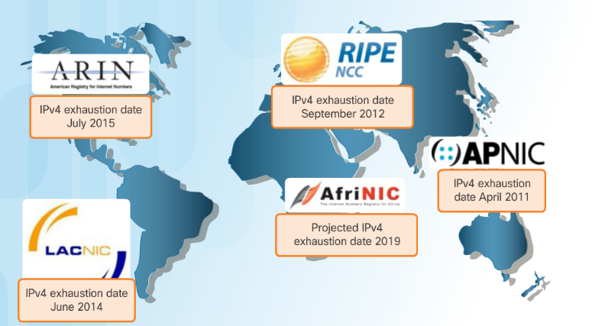
IPv4 Issues The Need for IPv6
IPv6 versus IPv4:
Has a larger 128-bit address space
340 undecillion addresses
Solves limitations with IPv4
Adds enhancement like address auto-configuration.
Why IPv6 is needed:
Rapidly increasing Internet population
Depletion of IPv4
Issues with NAT
Internet of Things
Notes:
7.2 – IPv6 Network Addresses
7.2.1– IPv4 Issues
7.2.1.1 – The Need for IPv6

Slide 3
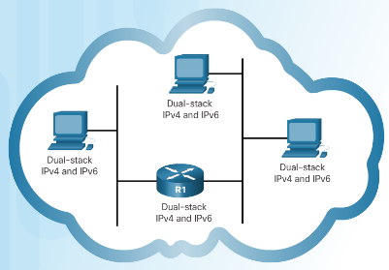
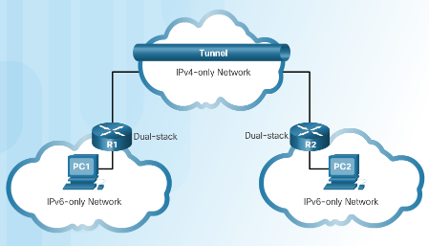
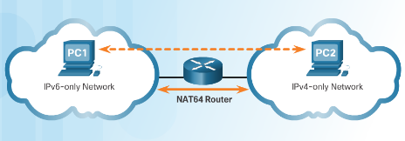
IPv4 Issues IPv4 and IPv6 Coexistence
Migration from IPv4 to IPv6 Techniques
Dual stack - Devices run both IPv4 and IPv6 protocol stacks simultaneously.
Tunneling - The IPv6 packet is encapsulated inside an IPv4 packet.
Translation - Network Address Translation 64 (NAT64) allows IPv6-enabled devices to communicate with IPv4 devices.
Notes:
7.2 – IPv6 Network Addresses
7.2.1– IPv4 Issues
7.2.1.2 – IPv4 and IPv6 Coexistence

Slide 4
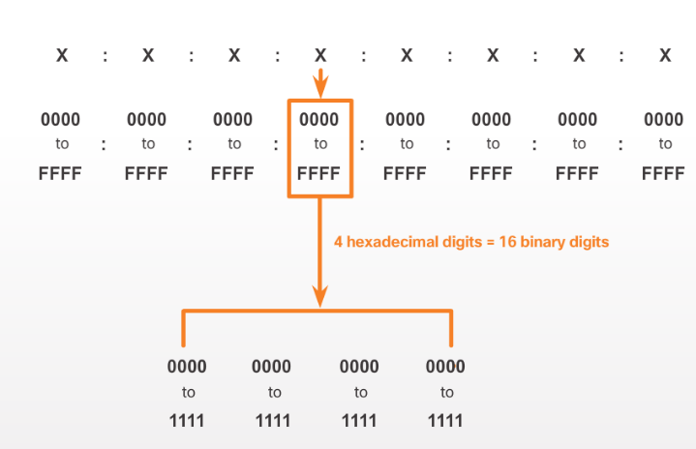
IPv6 Addressing IPv6 Address Representation
IPv6 Addresses:
128 bits in length
Every 4 bits is represented by a single hexadecimal digit
Hextet - unofficial term referring to a segment of 16 bits or four hexadecimal values.
Notes:
7.2 – IPv6 Network Addresses
7.2.2– IPv6 Addressing
7.2.2.1 – IPv6 Address Representation

Slide 5
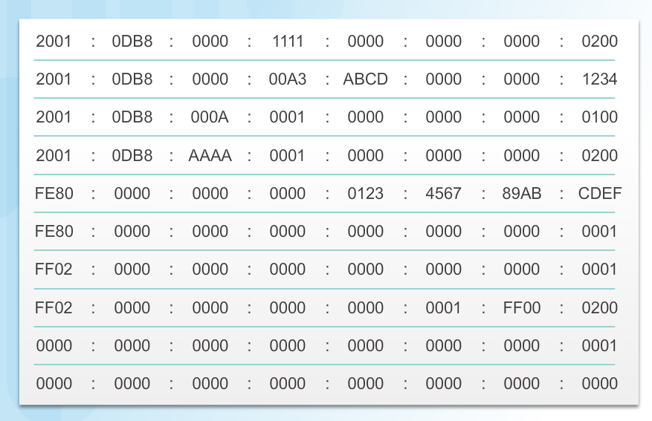
IPv6 Addressing IPv6 Address Representation (Cont.)
Preferred format for IPv6 representation
Notes:
7.2 – IPv6 Network Addresses
7.2.2– IPv6 Addressing
7.2.2.1 – IPv6 Address Representation (Cont.)

Slide 6
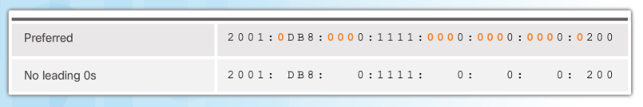
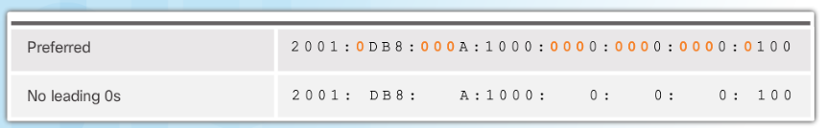
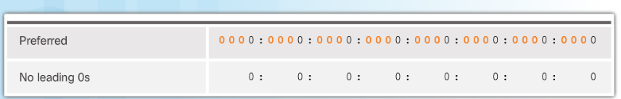
IPv6 Addressing Rule 1 – Omit Leading 0s
In order to reduce or compress IPv6
First rule is to omit leading zeros in any hextet.
Notes:
7.2 – IPv6 Network Addresses
7.2.2– IPv6 Addressing
7.2.2.2 – Rule 1 – Omit Leading 0s

Slide 7
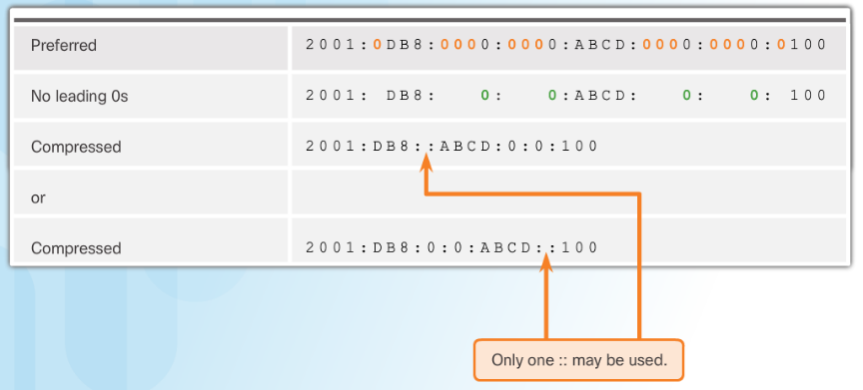
IPv6 Addressing Rule 2 – Omit All 0 Segments
Rule 2 – Omit All 0 Segments
A double colon (::) can replace any single, contiguous string of one or more 16-bit segments (hextets) consisting of all 0s.
Notes:
7.2 – IPv6 Network Addresses
7.2.2– IPv6 Addressing
7.2.2.3 – Rule 2 – Omit All 0 Segments

Slide 8
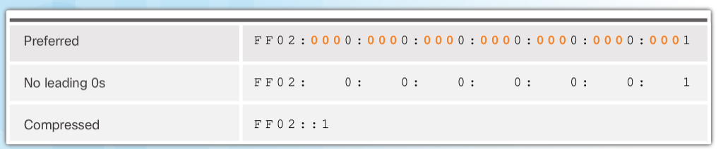
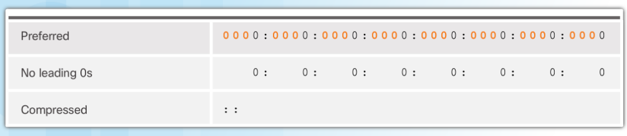
IPv6 Addressing Rule 2 – Omit All 0 Segments (Cont.)
Rule 2 – Omit All 0 Segments
A double colon (::) can replace any single, contiguous string of one or more 16-bit segments (hextets) consisting of all 0s.
Notes:
7.2 – IPv6 Network Addresses
7.2.2– IPv6 Addressing
7.2.2.3 – Rule 2 – Omit All 0 Segments (Cont.)

Slide 9
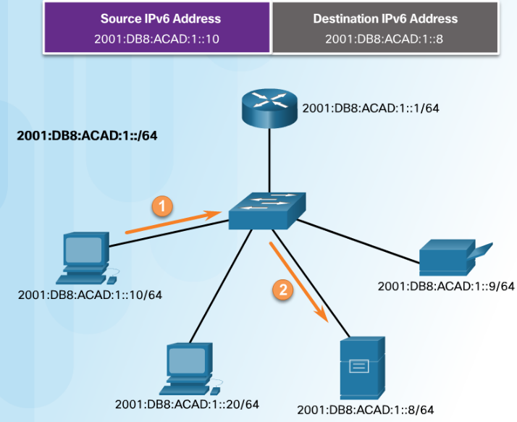
Types of IPv6 Addresses IPv6 Address Types
Three types of IPv6 addresses:
Unicast- Single source IPv6 address.
Multicast - An IPv6 multicast address is used to send a single IPv6 packet to multiple destinations.
Anycast - An IPv6 anycast address is any IPv6 unicast address that can be assigned to multiple devices.
Notes:
7.2 – IPv6 Network Addresses
7.2.3 – Types of IPv6 Addresses
7.2.3.1 – IPv6 Address Types

Slide 10
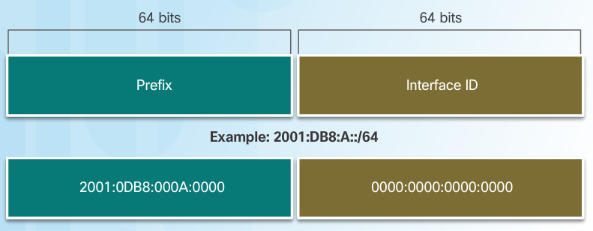
Types of IPv6 Addresses IPv6 Prefix Length
The IPv6 prefix length is used to indicate the network portion of an IPv6 address:
The prefix length can range from 0 to 128.
Typical IPv6 prefix length for most LANs is /64
Notes:
7.2 – IPv6 Network Addresses
7.2.3 – Types of IPv6 Addresses
7.2.3.2 – IPv6 Prefix Length

Slide 11
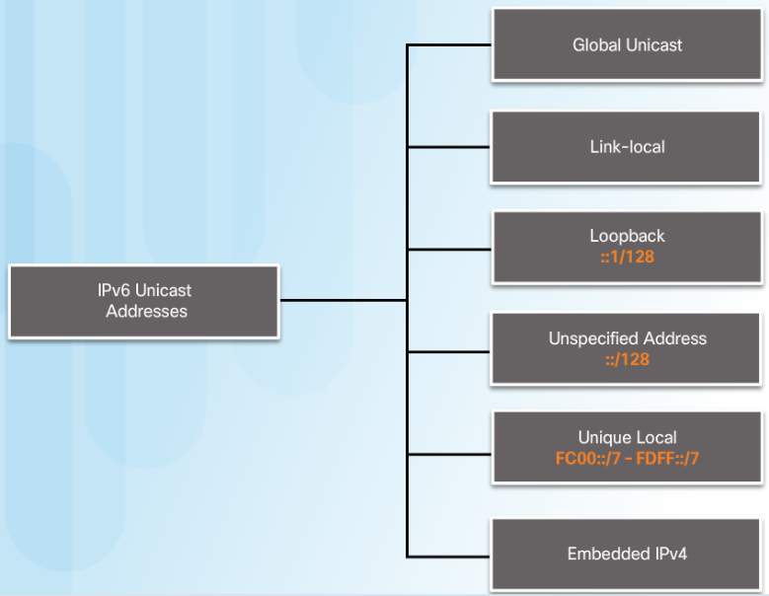
Types of IPv6 Addresses IPv6 Unicast Addresses
Global Unicast - These are globally unique, Internet routable addresses.
Link-local - used to communicate with other devices on the same local link. Confined to a single link.
Unique Local - used for local addressing within a site or between a limited number of sites.
Notes:
7.2 – IPv6 Network Addresses
7.2.3 – Types of IPv6 Addresses
7.2.3.3 – IPv6 Unicast Addresses

Slide 12
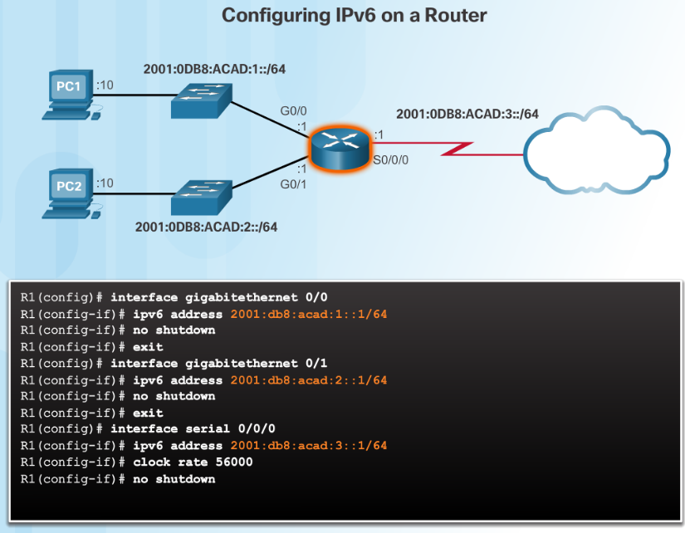
IPv6 Unicast Addresses Static Configuration of a Global Unicast Address
Router Configuration:
Similar commands to IPv4, replace IPv4 with IPv6
Command to configure andIPv6 global unicast on an interface is ipv6 address ipv6-address/prefix-length
Notes:
7.2 – IPv6 Network Addresses
7.2.4 – IPv6 Unicast Addresses
7.2.4.2 - Static Configuration of a Global Unicast Address

Slide 13
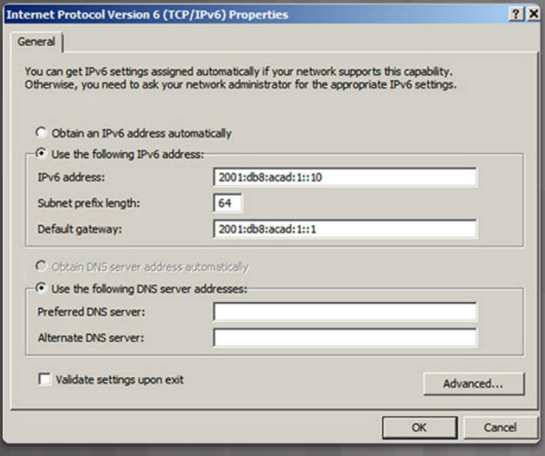
IPv6 Unicast Addresses Static Configuration of a Global Unicast Address (Cont.)
Host Configuration:
Manually configuring the IPv6 address on a host is similar to configuring an IPv4 address
Default gateway address can be configured to match the link-local or global unicast address of the Gigabit Ethernet interface.
Dynamic assignment of IPv6 addresses:
Stateless Address Autoconfiguration (SLAAC)
Stateful DHCPv6
Notes:
7.2 – IPv6 Network Addresses
7.2.4 – IPv6 Unicast Addresses
7.2.4.2 - Static Configuration of a Global Unicast Address (Cont.)

