Slide 1

Advanced Analytics and Machine Learning - Group Project
By
Maadhu K Hiran Kumar Prasad Patole Kedar Sapte Anil Nair

Slide 2
Business Problem:
The Portuguese bank would like to know what actions need to be taken in order to persuade their clients to engage in long term deposits which would invariably help improve the overall revenue. As a result, the marketing team of the Portuguese bank would like to identify existing clients that have higher chance to subscribe for a term deposit and focus marketing effort on such clients.
Analytics Approach:
The objective is to provide classification model(s) to predict which clients are more likely to subscribe for term deposits.
Data Source and Preparation:
The data set is publicly available in the below link:
https://archive.ics.uci.edu/ml/datasets/bank+marketing
It consists of 41,188 observations (customer data on direct marketing campaigns) with 20 predictors of a Portuguese banking institution. The classification goal is to predict if the client will subscribe (yes/no) to a term deposit (variable y).
The dataset is used without any modifications.
All the categorical variables were converted to dummy variables using one-hot encoding and one column was removed randomly to avoid collinearity.
The ‘duration’ variable is dropped as it would have a value only after the call is completed.
For ‘pdays’ column, more that 95% of the rows have a value of 999 and it can affect the model performance. (999 denotes client was not previously contacted). To overcome this, the values were grouped into bins (0-7, 8-15 etc.)

Slide 3
Sampling and Validation:
For Logistic Regression modelling, random seed state was used to generate train and test data. The final model was validated against the test dataset.
For Random Forest, the default bootstrap sampling technique was used.
The Random Forest estimator was implemented using GridsearchCV to identify the best hyperparameters.
Models built and Evaluation Effectiveness:
The models built are Logistic regression followed by a Random forest classifier for better accuracy.
As the business objective was to determine the subscription to the term deposit which is a binary outcome (Yes/No), we implemented the above two models.
The effectiveness of the two models were evaluated using Scikit learn’s Accuracy Score and the AUC generated using the ROC curve.

Slide 4
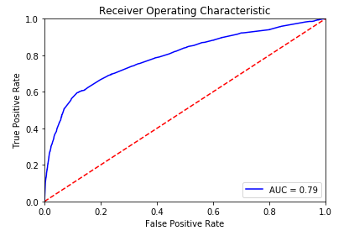
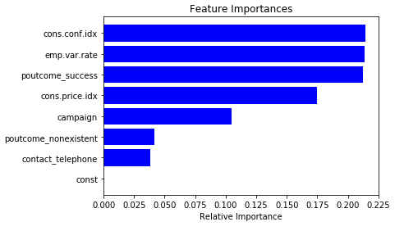
Visualizations:
Following Visualization diagrams are illustrated in the attached html file :
Visual representation using histograms for all the categorical variables
ROC curve and Confusion matrix for the Logistic Regression Model
ROC curve for the Random Forest classifier
Important features from the Random Forest Classifier’s best estimator
ROC curve and Feature Importance Histogram from the Random Forest

Slide 5


