Slide 1
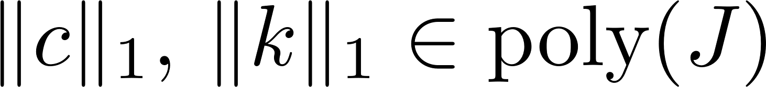
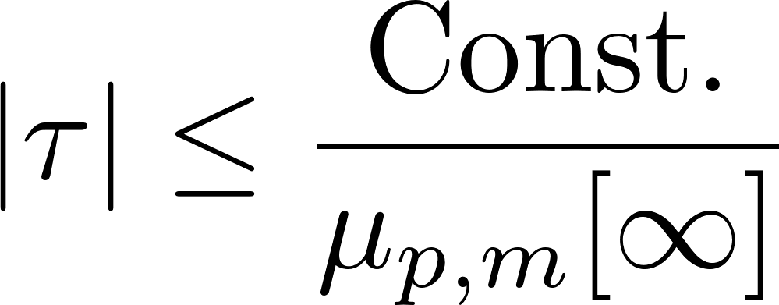
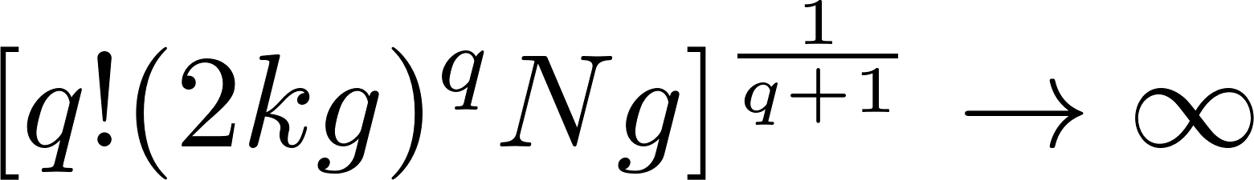
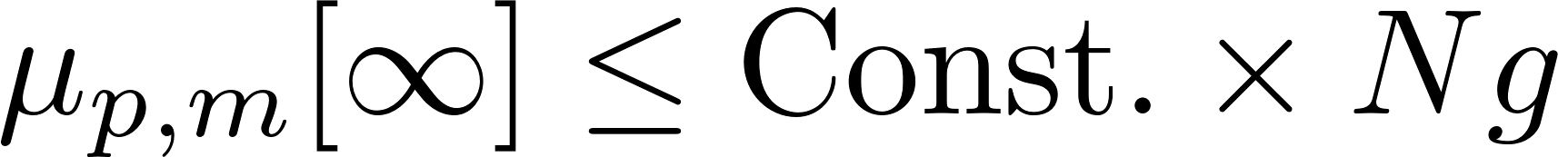
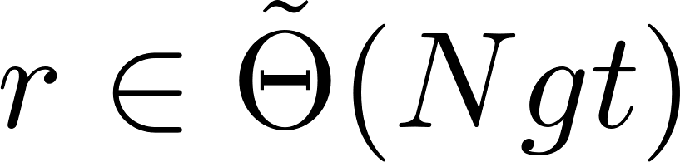
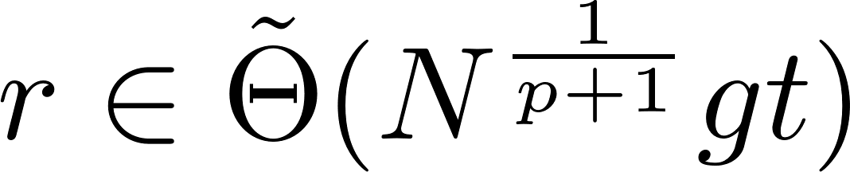
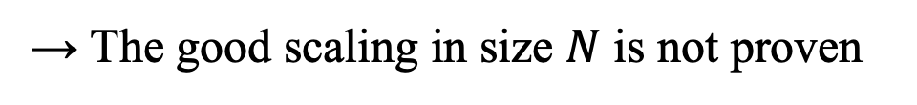
5. Comparison with previous results
[Low-Kliuchnikov-Wiebe 2019]
G. H. Low, V. Kliuchnikov, and N. Wiebe, arXiv:1907.11679 (2019)
・ Prove the good scaling in $t$ & $ε$ by the well-conditioned solution
・Prove that the error is given by commutators but NOT provide its explicit form
→ The good scaling in size $N$ is not proven
[Aftab-An-Trivisa 2024]
J. Aftab, D. An, and K. Trivisa, arXiv:2403.08922 (2024)
・Prove an explicit error bound of the MPF composed of nested commutators
(Simplified version)
if
・However, it involves $q$-fold nested commutators $α_{com,q}$ with arbitrarily large $q$
→ Locality gives no meaningful upper bound on
due to
We can only confirm
in general
→ The cost results in
for generic local Hamiltonians
(1-norm scaling)
Our contribution
Our result with commutator scaling:
Prove the MPF error composed of a finite number of nested commutators
& Complete the proof of the efficiency in $N,t,ε$ for generic local Hamiltonians !

